Slide 1
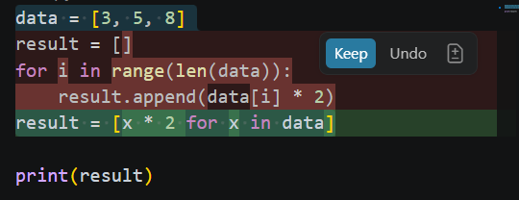
Provide inefficient code:
data = [3, 5, 8]
result = []
for i in range(len(data)):
result.append(data[i] * 2)
print(result)
Select above and ask:
Refactor this code
Expected result:
result = [x * 2 for x in data]

Slide 2
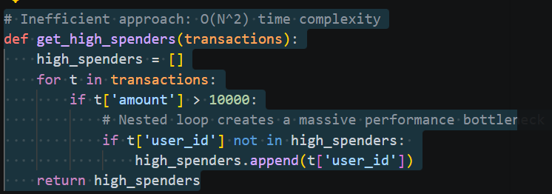
Improve Performance
Ask:
Optimize this to handle millions of rows

Slide 3
