Slide 1
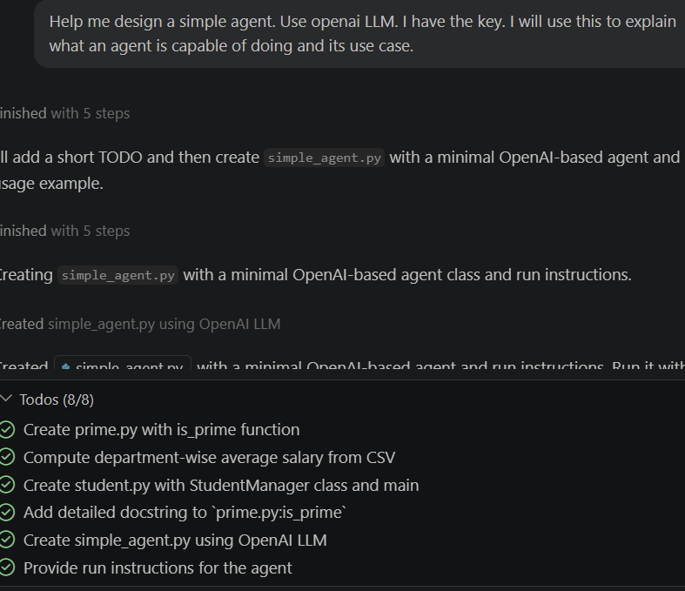
EXAMPLE: A simple agent using LLM
Help me design a simple agent.
Use openai LLM.
I have the key.
I will use this to explain what an agent is capable of doing and its use case.

