Slide 1
Connect to google drive

Slide 2
Configure your project in the Google Cloud Console by
Creating a new project
Enabling the Google Drive API
Create a service account and Create/download a key
Give your folder in google drive permission for service account
Install python packages and run python code

Slide 3
Creating a new project

Slide 4
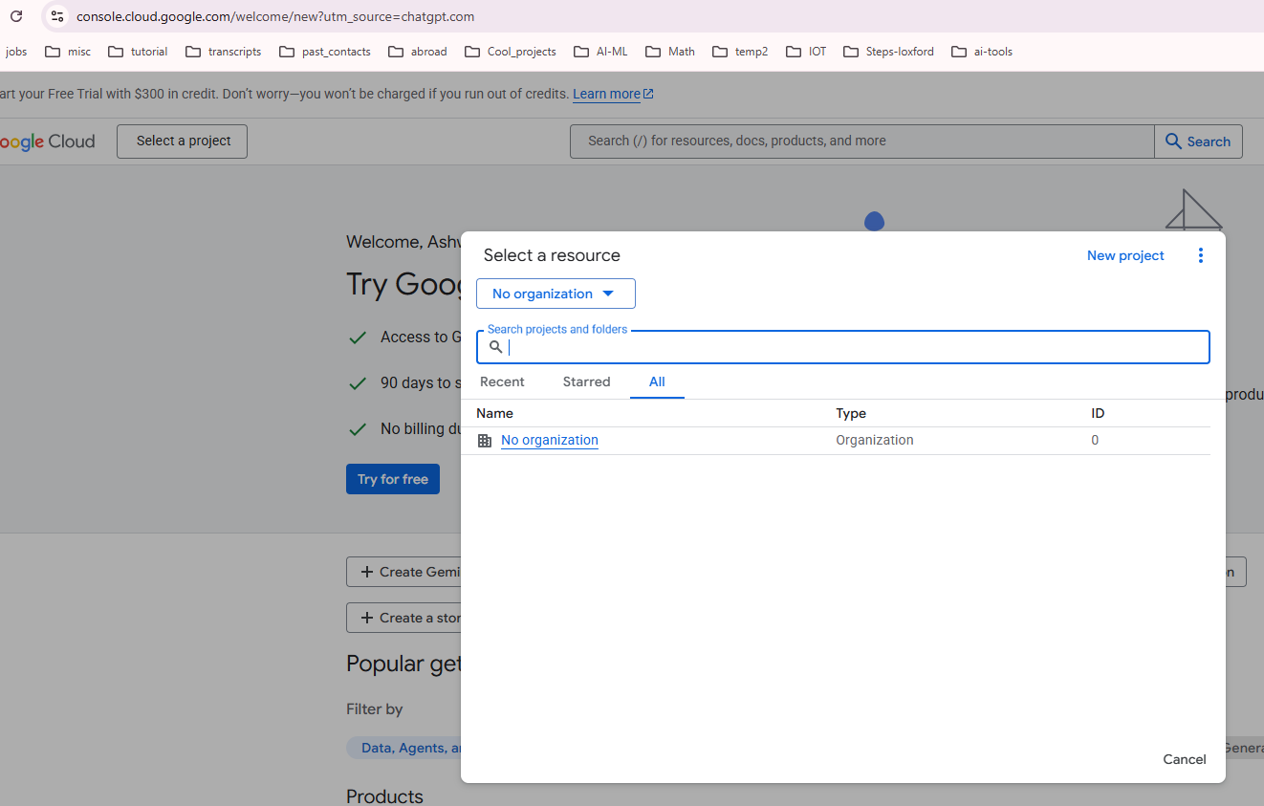
Creating a new project
Open Google Cloud Console: https://console.cloud.google.com/welcome/new
Create a new project (for example, DriveAPIProject).

Slide 5
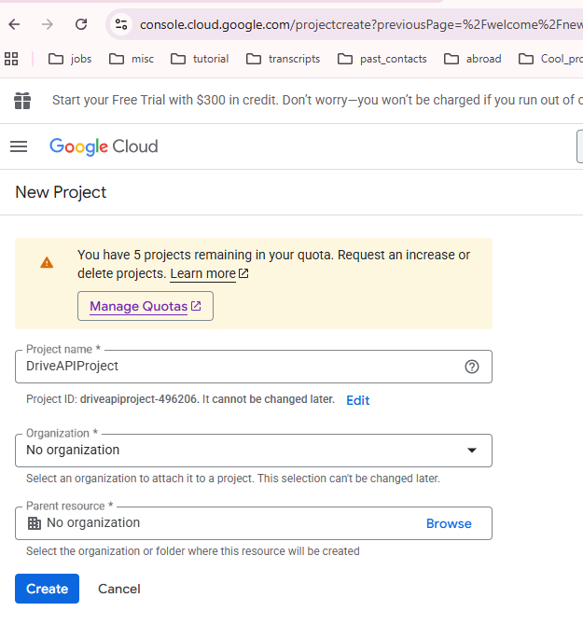
Creating a new project
Open Google Cloud Console: https://console.cloud.google.com/welcome/new
Create a new project (for example, DriveAPIProject).

Slide 6
Enabling the Google Drive API

Slide 7
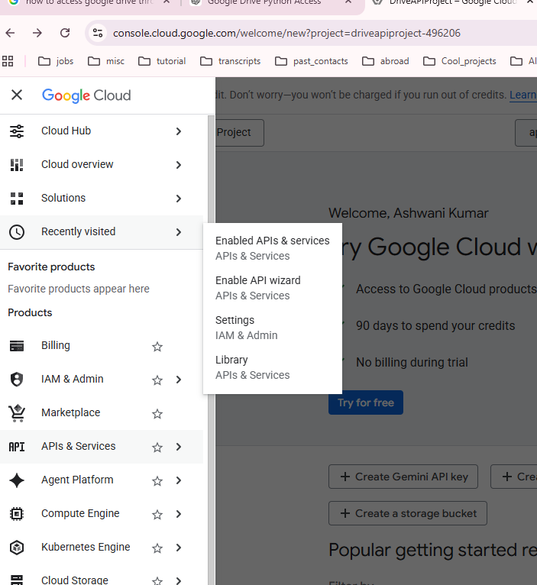
Enabling the Google Drive API
In the left menu, go to APIs & Services → Library.
Search for Google Drive API and enable it.

Slide 8
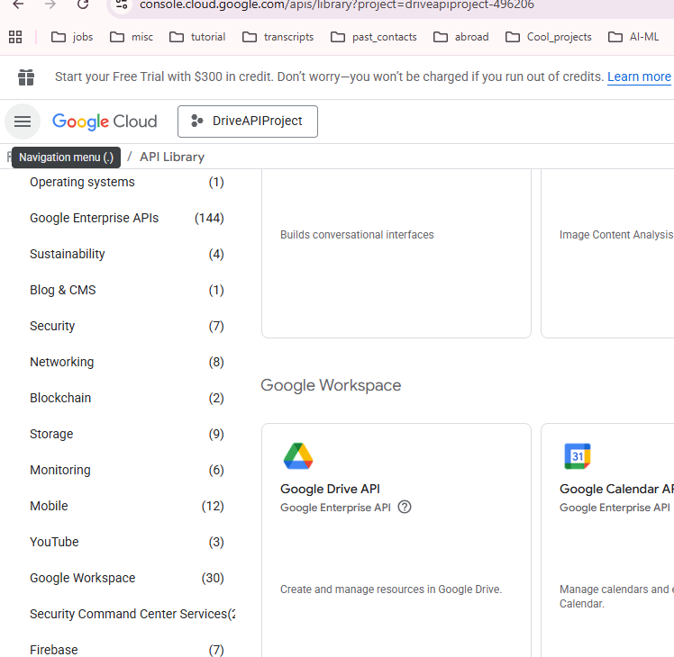
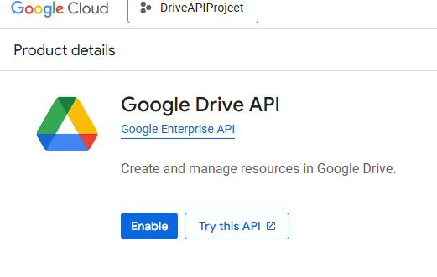

Enabling the Google Drive API
In the left menu, go to APIs & Services → Library.
Search for Google Drive API and enable it.

Slide 9
Create a service account

Slide 10
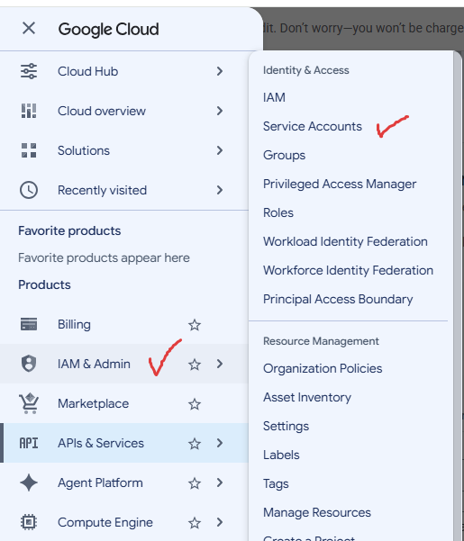
Go to IAM & Admin → Service Accounts.
Click Create Service Account.
Give it a name, such as:
drive-agent
Finish creating it.

Slide 11
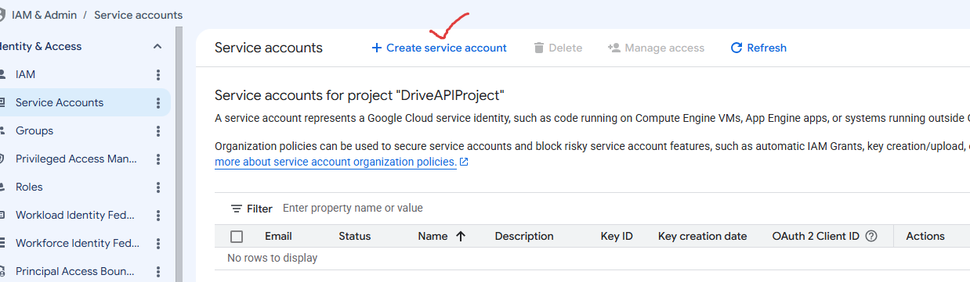
Go to IAM & Admin → Service Accounts.
Click Create Service Account.
Give it a name, such as:
drive-agent
Finish creating it.

Slide 12
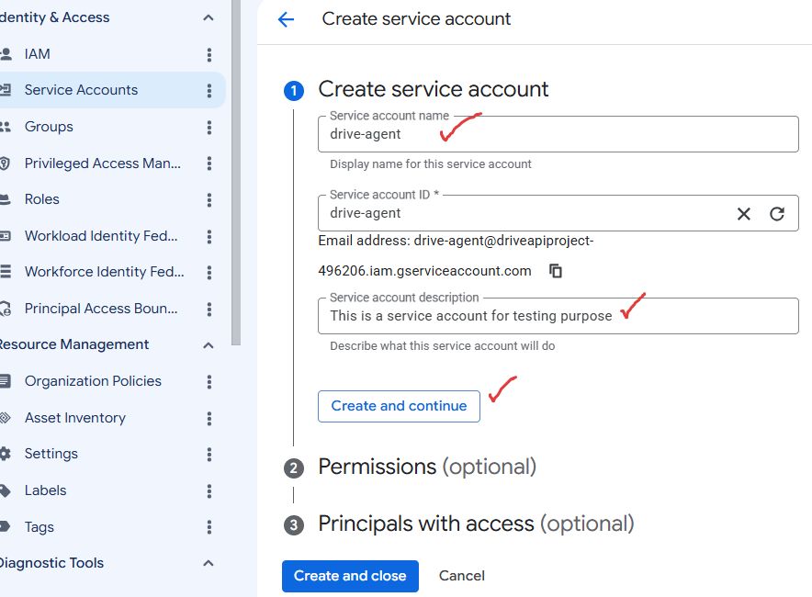
Go to IAM & Admin → Service Accounts.
Click Create Service Account.
Give it a name, such as:
drive-agent
Finish creating it.
Leave everything
default

Slide 13
Create a Key

Slide 14
Create a Key
1) Inside the service account:
Keys → Add Key → Create New Key
2) Choose JSON
Download it.
You'll get something like
my-drive-agent-456.json
Save it in your project folder.

Slide 15
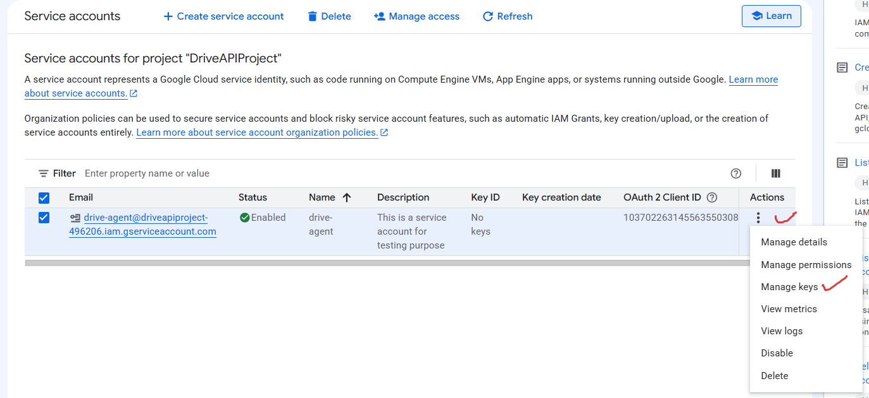

Slide 16
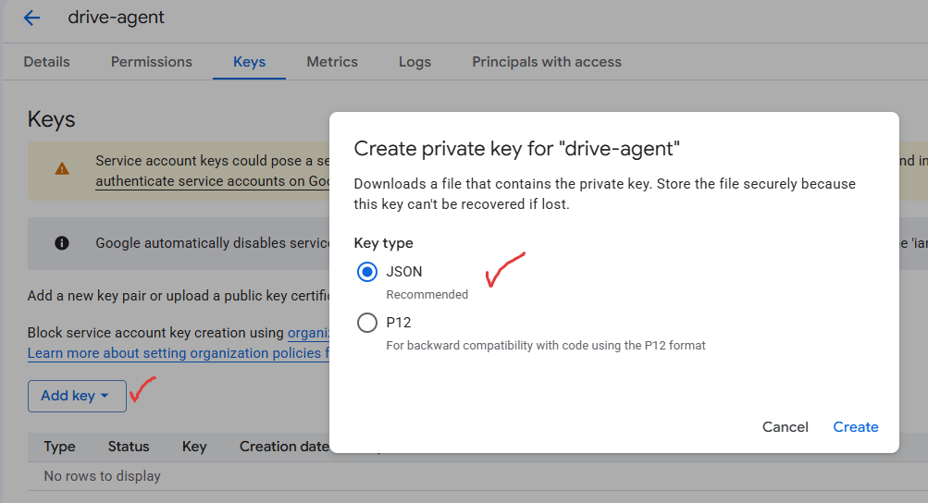

The key is downloaded -> Move the key in the project folder

Slide 17
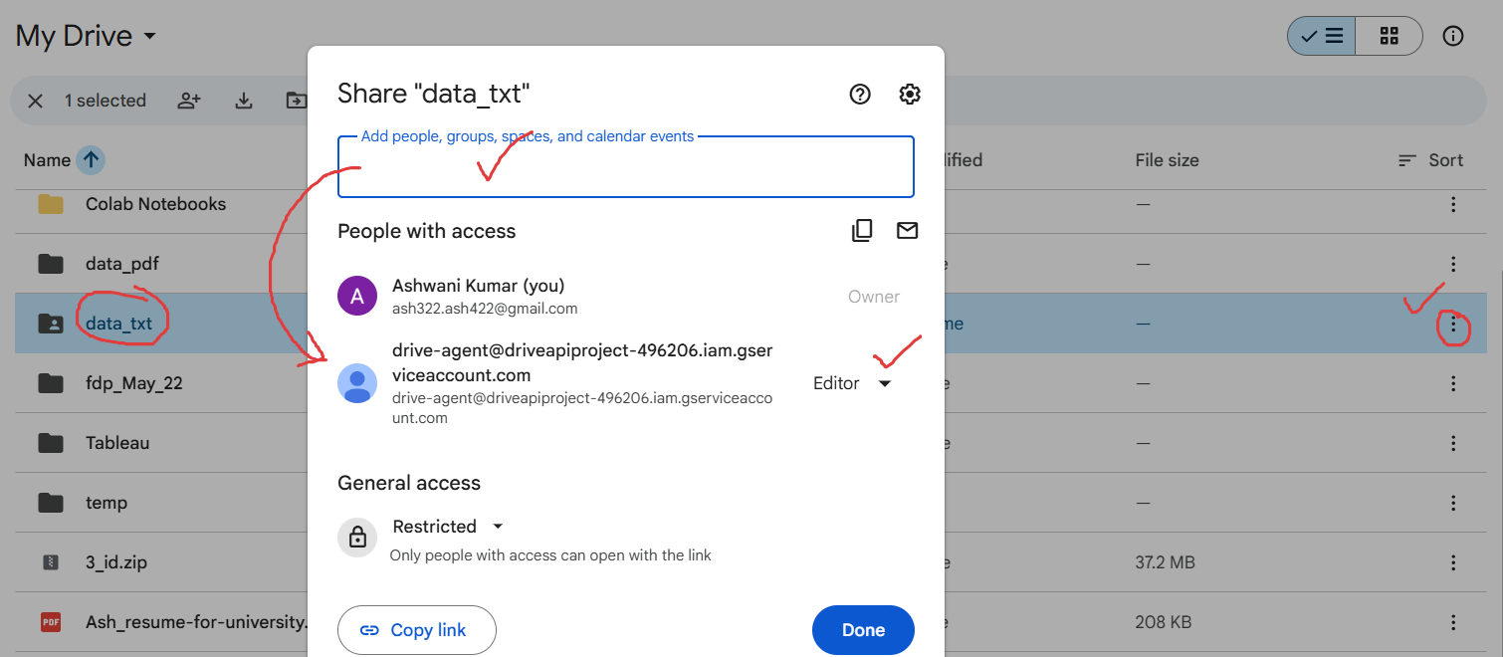

Slide 18
The python script

Slide 19
Look at the python script

