Slide 1
ReAct Agent (zero-shot-react-description)

Slide 2
ReAct stands for Reasoning + Acting.
The model:
Thinks (reasoning)
Takes an action (calls a tool / API)
Observes result
Continues reasoning
Why ReAct is powerful
Combines
LLM reasoning
External tools (search, calculator, query DB, etc.)
This way ReAct also reduces hallucination

Slide 3
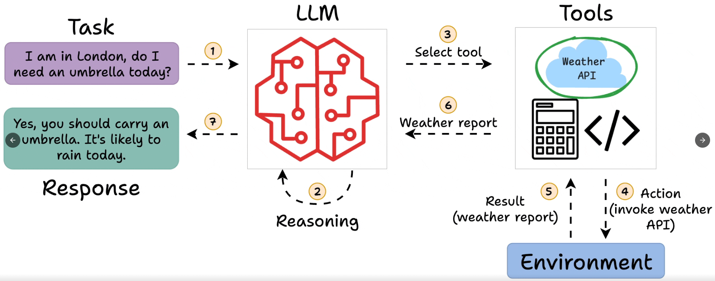
Example: ReAct Agent
Source: https://blog.dailydoseofds.com/p/intro-to-react-reasoning-and-action

Slide 4
🧱 Why ReAct is Powerful
1. Reduces hallucination
Instead of guessing, model fetches real data using tools
2. More “human-like” problem solving
Think → Do → Check → Continue
This allows it to solve complex tasks

Slide 5
Key things to understand about the ReAct architecture:
zero-shot means the agent gets no worked examples — it figures out which tool to use purely from the tool's description string.
This is why writing good tool descriptions is critical.

Slide 7
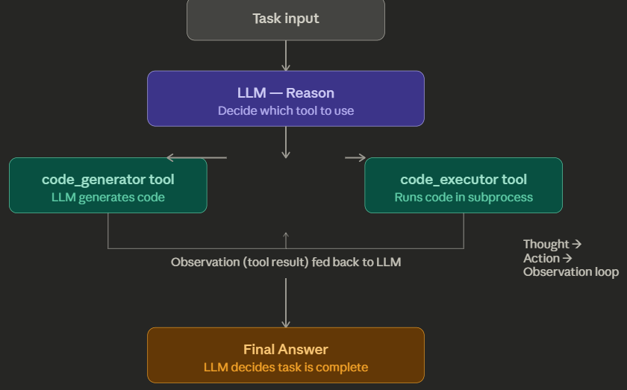
ReAct Agent (zero-shot-react-description)

Slide 8
The agent has no real memory. Each time the LLM is called, the entire conversation history — every Thought, Action, and Observation so far — is concatenated into a single prompt and sent again.
The loop is bounded by max_iterations (default 15 in LangChain). If the agent hasn't reached a Final Answer by then, it stops forcibly. This prevents infinite loops but can also cut off complex tasks.
The two tools in our code have a natural chain:
code_generator → LLM writes code → code_executor → LLM sees output → decides if it's correct.
This is not reflection (no self-critique prompt), but it is multi-step tool chaining, which is a key ReAct strength.

Slide 9
EXTRA
Ffnbksdfd
Fdslj;f
Fl;ds

