Slide 1
Transformers

Slide 2
Playground: https://poloclub.github.io/transformer-explainer/
Source:
https://youtu.be/ZhAz268Hdpw?si=jQXkVM058uJkEWCw
https://youtu.be/zxQyTK8quyY?si=C-flWWBSxwrqWao7
3 parts:
1) https://youtu.be/OxCpWwDCDFQ?si=xo2r5jOoc3YQgji6
2) https://youtu.be/UPtG_38Oq8o?si=fYUN8D7y1fvW2vCw
3) https://youtu.be/qaWMOYf4ri8?si=iA8GmBLLFfcZgCQk
https://www.datacamp.com/tutorial/how-transformers-work

Slide 3
What are Transformers?
Definition: Neural Network that learns the context of sequential data and generates new data out of it.
Origin: “Attention is All You Need” by Vaswani et al. (2017)

Slide 4
Applications: Where are Transformers used ?
NLP
Text classification (BERT)
Text generation (GPT)
Translation (T5, MarianMT)
Question answering (RoBERTa)
Vision
Vision Transformers (ViT)
Object detection, segmentation
Speech
Whisper, wav2vec
Multimodal
CLIP (image + text)
Flamingo, Gemini

Slide 5
Transformers overcame limitations of RNNs and LSTMs
RNN Limitation:
Sequential processing and therefore no parallelism
An RNN reads one word at a time.
The → movie → that → I → watched → last → week → with → my → friends → was → absolutely → amazing
It cannot process "movie" before finishing "The."
Since every step waits for the previous one, GPU cannot process all words together.
->Training becomes slow.

Slide 6
Transformers overcame limitations of RNNs and LSTMs
RNN Limitation:
2) Hard to capture long-term dependencies due to vanishing gradients
Consider sentence:
"The book that I borrowed from the university library shelf after attending yesterday seminar was good read. I think I will buy it.“
The word “it” refers to the “book” and appeared may words later. The RNN model struggles to associate the word “it” to the “book”
Vanishing Gradient -> As you proceed further in sentence, because of multiplication of small derivatives, RNN would forget the previous words

Slide 7
Transformers enabled parallel processing of large text corpora
Led to models like GPT, BERT, T5, ViT

Slide 8
General idea of transformer
Use case 1: It is good for figuring out the context
Sentence: “I drank juice from the bottle. It was cold”
“It” can refer to “juice” or “bottle”
Transformer can figure out that “it” refers to “juice”
Use case 2: It is good for predicting next word
Command: What is LLM in Deep Learning ?
Response: LLM
Response: LLM stands
Response: LLM stands for
Response: LLM stands for Large
Response: LLM stands for Large Language
Response: LLM stands for Large Language Models

Slide 9

Why training a Transformer from scratch is not preferred?
01. Computational Cost
High GPU Demand
Requires massive GPU resources, long runtimes, and extensive hyperparameter tuning.
02. Data Inefficiency
Sparse Labeled Data
Downstream tasks have limited data; training from scratch leads to poor generalization.
The Ideal Solution
Pre-trained Transformers
Fine-tuning leverages existing weights efficiently to achieve comparable or better performance.
huggingface.co
03. Information Loss
Representation Discard
Training anew completely discards rich linguistic or visual features already learned.
04. Constraints
Resource & Time
Fails to leverage existing weights, demanding excessive cost and budget investments.

Slide 10
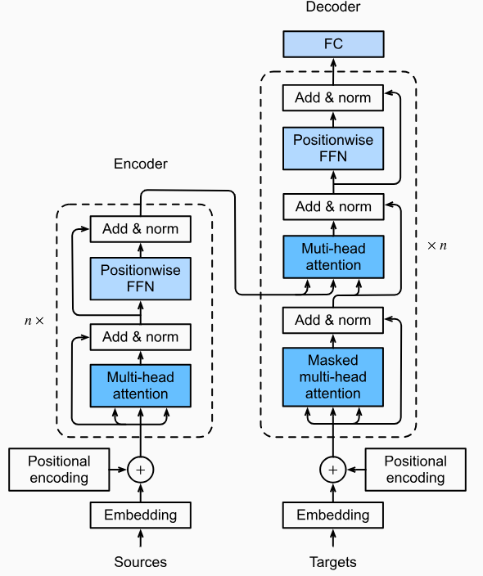
Key Concepts of Transformers
Self-Attention
Parallel Processing
Encoder-Decoder Structure
Positional Encoding
Multi-Head Attention

Slide 11



Core Components of a Transformer
Transformers consist of encoder and decoder stacks. Most models use either:
Encoder-only (e.g., BERT – understanding tasks) – sentiment analysis
Decoder-only (e.g., GPT – generation tasks)
Both (e.g., T5 – translation/summarization)
Encoder
layer
Decoder
layer
Positive
output
Transformer
input
I am feeling awesome ?
Stacking Layers: A typical transformer model stacks 6–96 of these encoder or decoder blocks.

Slide 12



Core Components of a Transformer
Transformers consist of encoder and decoder stacks. Most models use either:
Encoder-only (e.g., BERT – understanding tasks)
Decoder-only (e.g., GPT – generation tasks) – Write a python code
Both (e.g., T5 – translation/summarization)
Encoder
layer
Decoder
layer
CODE
output
Transformer
input
Write python code to read CSV file ?
Stacking Layers: A typical transformer model stacks 6–96 of these encoder or decoder blocks.

Slide 13

Core Components of a Transformer
Transformers consist of encoder and decoder stacks. Most models use either:
Encoder-only (e.g., BERT – understanding tasks)
Decoder-only (e.g., GPT – generation tasks)
Both (e.g., T5 – translation/summarization) – Translate into Spanish
Encoder
layer
Decoder
layer
Como Estas ?
output
Transformer
input
How are you ?
Stacking Layers: A typical transformer model stacks 6–96 of these encoder or decoder blocks.

Slide 14
BERT has only the encoder part
GPT has only the decoder part
Generic

Slide 15
Core Components of a Transformer
(Word) Embedding + Positional Encoding
Words are converted into vectors via embedding layers.
Swim -> [ 1, 0, 0, 0.7, ]
Fishing -> [ 0.9, 0.1, 0.6, 0.03, ]
We use these vectors to find which words are similar.
The values are found through training data
Googles Word2Vec uses 300 dimension
Other word embedding packages are Glove, etc.
4 Dimension
 | Sea | Air | Land | Love
Swim | 1 | 0 | 0 | 0.7
Fly | 0.01 | 0.9 | 0.2 | 0.8
Walk | 0 | 0 | 1
Stand | 0 | 0 | 0.9 | 0
Studying | 0.1 | 0.4 | 0.3 | -0.01
Fishing | 0.9 | 0.1 | 0.6 | 0.03

Slide 16
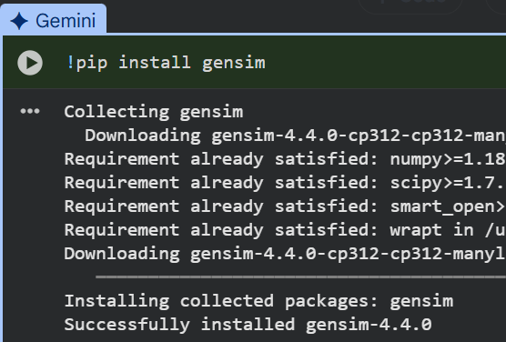
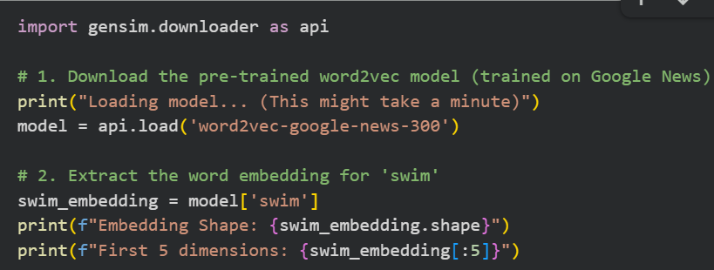
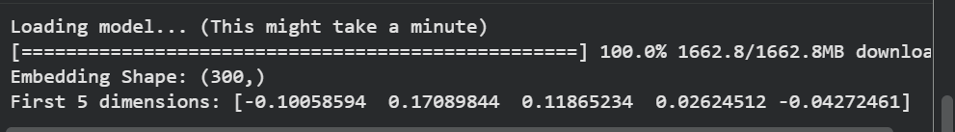

Slide 17
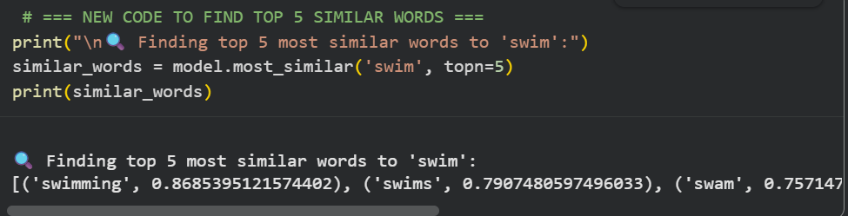
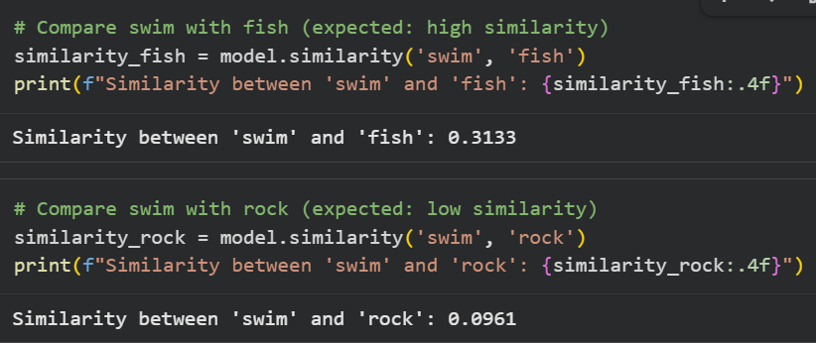

Slide 18
Core Components of a Transformer
Positional embeddings
Sentence: “I went to the bank to deposit money. Later, I sat near the river bank.”
Here we use positional embeddings that would distinguish the 2 banks.
Since the model has no sense of word order (no recurrence), we add positional encoding to preserve sequence information.
Positional Embeddings are learned during training
It treat position like a word
pos 1 (I) → [0.3, 0.2, ...]
pos 2 (went) → [0.4, 0.2, ...]
pos 3 (to) → [-0.3, 0.8, ...]

Slide 19

Final embeddings = Word embedding + positional embeddings
Sentence: “I went to the bank to deposit money. Later, I sat near the river bank.”
0.1
0.3
0.4
…..
0.6
0.9
-0.6
…..
Word
embedding
0.3
0.2
-0.7
…..
0.4
0.2
-0.6
…..
Position
embedding
0.4
0.5
-0.3
…..
1.0
1.1
-1.2
…..
Final
embedding

Slide 20
Core Components of a Transformer
Problem with Word Embedding:
They are static
I went to the bank to deposit money. Later, I sat near the river bank.
If bank is [0, -0.3, 0.2, …], then it cannot represent the word bank in above 2 sentences in a meaningful manner
Solution: Self-Attention Mechanism
Key concept: Every word (token) in a sentence "looks at" all other words to understand their importance in context.
Example
Sentence: "The cat sat on the mat and it was sleeping"
When encoding "cat", attention may also focus on "sat", "mat", etc.
For "it" in “and it was sleeping", attention helps resolve that "it" refers to "cat".

Slide 21








Self-Attention Mechanism
Self-attention calculates the similarity between first word (The) and all the words in a sentence and
It does this for all the words in the sentence
The cat sat on the mat and it was sleeping
The attention mechanism would find the similarity score between it and all words:
it → cat (high importance)
it → mat (low importance)
The cat sat on the mat and it was sleeping
The cat sat on the mat and it was sleeping

Slide 22

Self-Attention Mechanism
For each word there is Attention(Q, K, V)
Each word is converted into 3 vectors:
Query (Q) → “What am I looking for?”
Key (K) → “What do I contain?”
Value (V) → “What information do I give?”
Given token vectors, the model creates: Query (Q) , Key (K), Value (V)
This measures how much attention each word pays to others and helps model know which words are important to focus on.

Slide 23
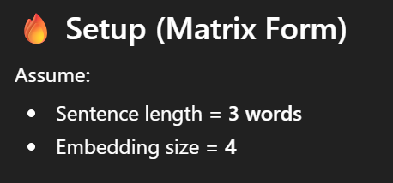
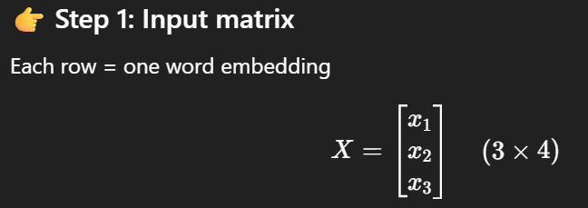
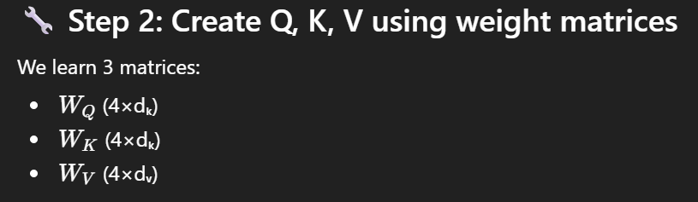

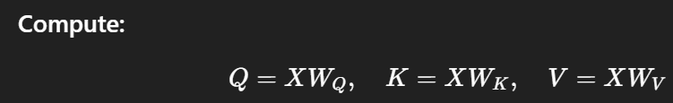
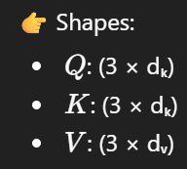
Self-Attention Mechanism: This is math (OPTIONAL)

Slide 24
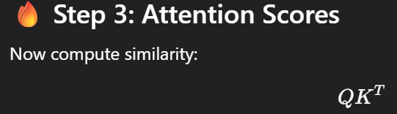
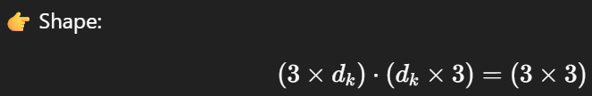
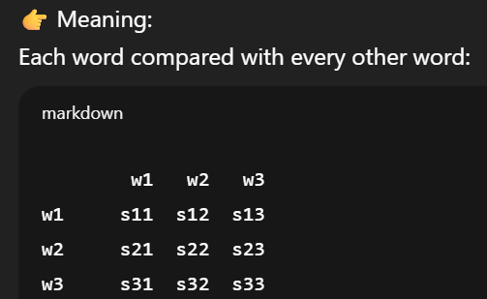
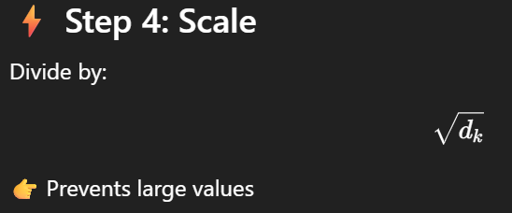
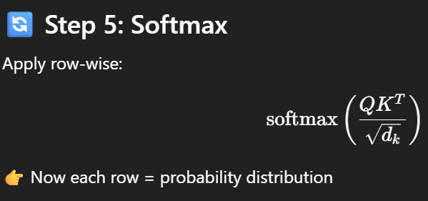

Slide 25
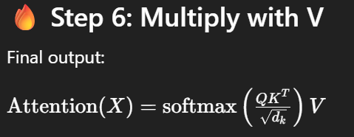
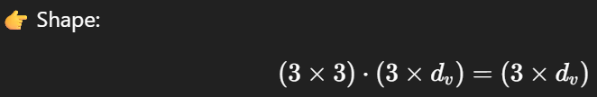
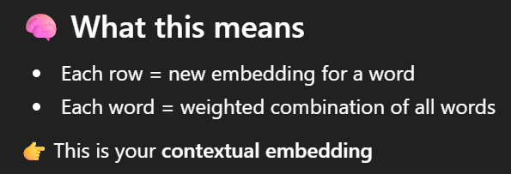
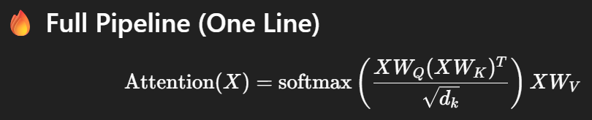

Slide 26
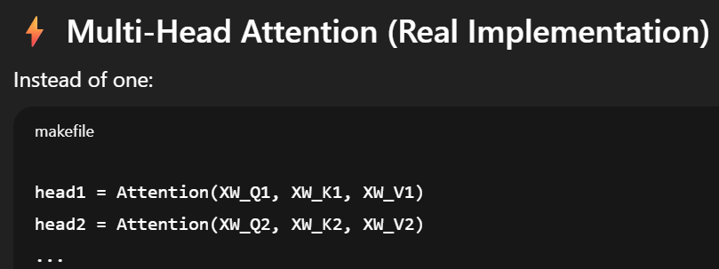

Multi-Head Attention
Instead of one attention layer, we use multiple heads in parallel.
Each head captures different types of relationships (syntax, semantics, etc.).
Then we concatenate and linearly transform the outputs.

Slide 27
Core Components of a Transformer
Output Process
For classification tasks (like BERT), the final token representations are passed to a classifier.
In BERT
Output = contextual embeddings
Used for: classification , NER , QA
For generation tasks (like GPT), the decoder predicts the next word/token step-by-step.
GPT predicts next word

Slide 28
Pros & Cons Of Transformers
Pros
Parallel processing
Better long-range understanding
Cons
Requires large data
Expensive training (GPU/TPU)

Slide 30


Core Components of a Transformer
Add Residual Connections + Layer Normalization
Add Residual connection:
Output of each block is added back to its input (helps gradient flow).
Layer normalization:
Keeps values in good range + Stabilizes training.

Slide 31
Core Components of a Transformer
Feed Forward Network (FFN)
Each word independently passes through a small neural network:

