Slide 1
Some Real-World Application

Slide 2
Role: You are a Senior Python Developer and Data Engineer specializing in writing high-performance, production-grade data pipelines. You write exceptionally clean, memory-efficient code and prioritize robust error handling over quick hacks.
Task: Write an optimized Python function to calculate the variance of a specific column in a CSV file.
The function must meet the following requirements:
1. Input Parameters: Accept `filename`, `delimiter`, and `column_name`.
2. Functionality: Read the CSV file (default delimiter is a semi-colon ';') and compute the mathematical variance of the specified column (e.g., 'age').
3. Optimization: Optimize for memory efficiency and speed, handling potentially large files without loading the entire dataset into memory at once (e.g., using Welford's algorithm for online variance or streaming via the built-in `csv` module).
4. Robust Error Handling: Include try-except blocks to gracefully handle:
- FileNotFoundError
- KeyError (if the column name does not exist)
- ValueError (if the column contains non-numeric data or has fewer than two valid data points)
- Empty files
5. Output: Return the calculated variance as a float.
Include clean code comments and a brief production-ready usage example.

Slide 3
[ROLE & CONTEXT]
You are an expert Executive Research Assistant. Your task is to help a busy CEO quickly digest a long industry report without losing critical data.
[TASK & INPUT]
Analyze the attached 3-page document and summarize its core arguments, key findings, and major data points into a single, cohesive paragraph.
[CONSTRAINTS & FORMAT]
Length: The final summary paragraph must be exactly 6 lines long.
Structure: It must be a single, continuous paragraph (no bullet points).
Quality: Avoid generic filler phrases like "This document discusses..." or "In conclusion...". Start directly with the primary thesis.
[INFORMATION PRIORITY]
Focus heavily on the "what" and the "why." Prioritize concrete metrics, financial figures, or statistical trends over general background information or historical context.
[OUTPUT EXPECTATION]
Deliver a high-density, professional, and easily scannable paragraph that captures the absolute essence of the 3 pages.

Slide 4
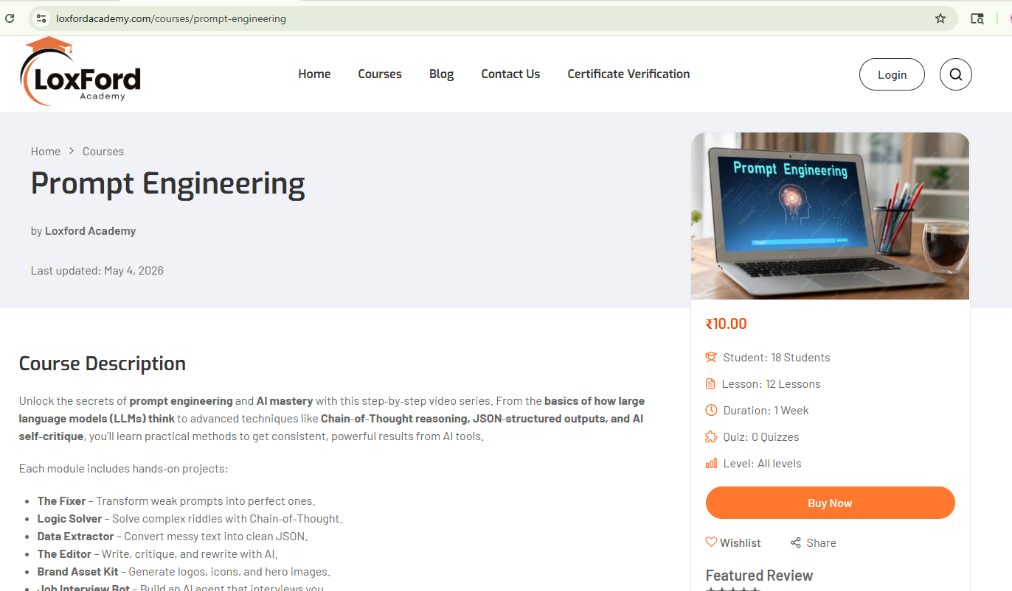
Problem: I want to remove the Student and Quiz part from the RHS menu. I am using wordpress

Slide 5


Slide 6
