Slide 1
Prompt Engineering
Today we will understand how AI actually processes language and how to design better prompts.
Prompt engineering and optimization involve designing, testing, and refining input text (prompts) to guide AI models like LLMs to produce
accurate,
relevant, and
high-quality output

Slide 2
Prompt Engineering
Tokenization – Why AI Sees Numbers, Not Words
AI models do not understand language like humans. They convert text into tokens, which are basically numbers representing pieces of words.
Humans see: I love machine learning
AI sees : [101, 1045, 2293, 3698, 4083, 102]

Slide 3
What is Tokenization?
Tokenization = Breaking text into smaller units (tokens).
Tokens can be:
Words – happy, fish
Parts of words – ungodly (un + godly)
Characters – a
Symbols – smiling emoji
Punctuation – what !

Slide 4
Example
Sentence: Unbelievable performance!
Possible tokens: ["Un", "believ", "able", "performance", "!"]
-> [1012, 45892, 672, 9834, 0] → (5 tokens) these are token ID
Each token id is a vector (say in 4D)
1012 → [0.12, -0.45, 0.88, 0.33] 45892 → [0.91, 0.02, -0.11, 0.76] 672 → [0.55, -0.66, 0.14, 0.99] 9834 → [0.20, 0.77, -0.88, 0.10] 0 → [0.01, 0.02, 0.03, 0.04]
So final input becomes a matrix:
[ [0.12, -0.45, 0.88, 0.33], [0.91, 0.02, -0.11, 0.76], [0.55, -0.66, 0.14, 0.99], [0.20, 0.77, -0.88, 0.10], [0.01, 0.02, 0.03, 0.04] ]
Input Into LLM: Text → tokens → IDs → vectors → N. network
Output from LLM: IDs → tokens → text

Slide 5
Why Tokenization Matters in Prompt Engineering
1) Token Limit
Every AI model has a maximum token capacity.
Example:
GPT models have input + output token limits
If prompt is too long → information gets cut
2) Cost Calculation
Most APIs charge per token used.
More tokens = More cost

Slide 6
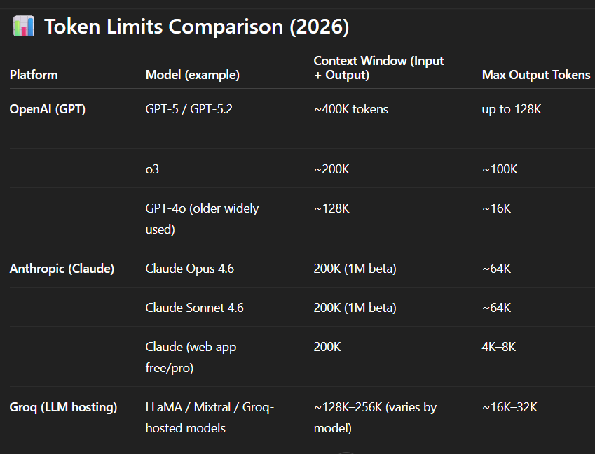

Slide 7
3) Prompt Clarity
Bad tokenization can change meaning.
Example:
Let’s eat grandma
Let’s eat, grandma
Comma changes tokens → meaning changes
In first case : Tokens could be [234, 12, 0, 34]
In second case: Tokens could be [215, 12, 6, 37, 892]

Slide 8
Hallucinations – Why AI Lies & How to Stop It
What is Hallucination?
Real Example
Prompt: Who won FIFA World Cup 2050?
AI may confidently give wrong answer:
The FIFA was won by Argentina
Hallucination happens when AI:
Generates false information
Sounds confident, but information is incorrect or invented

Slide 9
Hallucinations – Why AI Lies & How to Stop It
Why Hallucination Happens
1. Prediction Based Model
AI predicts most probable next word, not truth. It is not verifying.
2. Missing Information
If prompt lacks details → AI guesses.
3. Ambiguous Prompts
Vague instructions lead to creative (but wrong) answers.

Slide 10
Hallucinations – Why AI Lies & How to Stop It
How to Reduce Hallucinations
Provide Context
Bad Prompt:
Explain diabetes.
Better Prompt:
You are a high school biology textbook author.
Explain Type 2 diabetes for class 11 students in exactly 100 words. The students are all majoring in biology.
Constraints to reduce hallucination:
Base your explanation strictly on standard, globally accepted medical guidelines (like the WHO or ADA).
If a specific physiological mechanism is still scientifically debated or unknown, do not speculate; stick only to proven facts.
No Filler: Do not include introductory sentences. Start directly with the definition.

Slide 11
Hallucinations – Why AI Lies & How to Stop It
How to Reduce Hallucinations
2) Ask AI to Admit Uncertainty
Example:
What is the cure for Type 2 diabetes? If unsure, say "I don’t know".
3) Use Source Requirement
Example:
What is the cure for Type 2 diabetes. If unsure, say "I don’t know".
Use following source to answer: <source_text>
Provide answer with references.

Slide 12
Hallucinations – Why AI Lies & How to Stop It
How to Reduce Hallucinations
4) Break Tasks into Steps
Instead of:
Write research paper
Use:
Step1: I will give you a general idea, and you will propose 3 specific, researchable angles.
Step 2: Ask AI to create outline
Step 3: Ask AI to expand sections

Slide 13
Hallucinations – Why AI Lies & How to Stop It
4) Break Tasks into Steps
Instead of:
Write me a python code that analyzes the iris dataset
Use:
Step 1: How should I load a iris data into pandas dataframe df.
Step 2: How do I print the dataframe df
Step 3: How can I identify the datatype
Step 4: How can I visualize the numeric columns
Step 5: How do I remove duplicates

Slide 14
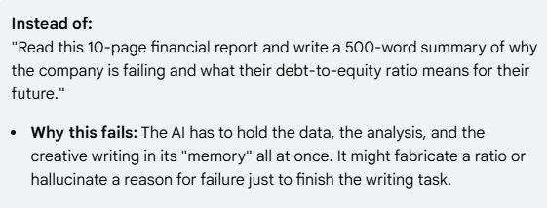
Hallucinations – Why AI Lies & How to Stop It
How to Reduce Hallucinations
Break Tasks into Steps

Slide 15
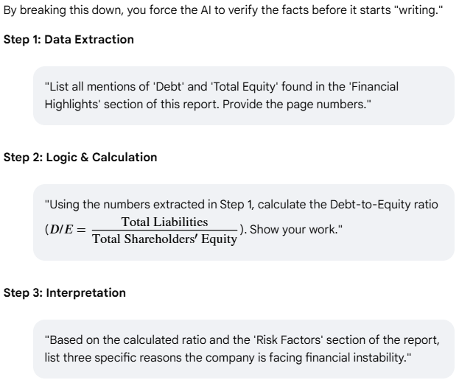
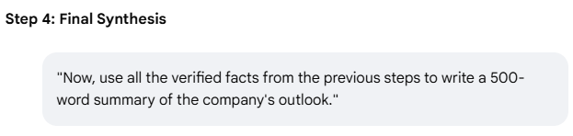
How to Reduce Hallucinations
Break Tasks into Steps

Slide 16
Hallucinations – Why AI Lies & How to Stop It
How to Reduce Hallucinations
Use Role Prompting
1) You are a certified medical professional. I am having a running nose and high fever. I have rash on my head. What should I do ?
2) You are a certified chartered accountant. I am late in filing ITR by 3 months. What should I do ?

Slide 17
Hallucinations – Why AI Lies & How to Stop It
How to Reduce Hallucinations
Use Role Prompting
The "Generic" Prompt (High Hallucination Risk)
Bad Prompt: "What should I do if my heart is racing?“
Risk: The AI might give overly cautious, irrelevant, or dangerously vague advice because it's pulling from its entire training set—which includes forums, blog posts, and fiction.

Slide 18
How to Reduce Hallucinations
Use Role Prompting
The "Role-Prompted" Example (Lower Hallucination Risk)
Better Prompt: "You are a board-certified cardiologist with 20 years of experience.
Based on clinical emergency protocols, what is the step-by-step procedure for a patient experiencing a sudden resting heart rate over 120 BPM? If you are unsure of specific diagnostic criteria, state that you cannot provide medical advice for that detail."
Why this works:
Domain Alignment: By assuming the role, the model weights "medical journal" data more heavily than "internet forum" data.
Tone Shift: It shifts from a conversational buddy to a professional authority, which often suppresses the AI's tendency to "people please" with made-up answers.
Specific Constraints: You’ve combined the role with an "uncertainty" clause, which is proven to reduce hallucinations by up to 30–50%.

Slide 19
The Golden Prompt Formula
Prompt = Context + Task + Constraint + Output Format
1. Context (Background Information)
Gives AI situation or environment.
Without context → AI guesses
The "No Context" Prompt (The Guessing Game)
Bad Prompt: "Write a plan to improve customer retention.“
The Problem: The AI doesn't know if you are a local coffee shop, a billion-dollar SaaS company, or a non-profit.
It will likely give you a "generic list" (loyalty cards, email newsletters) that might be totally irrelevant to your business model.

Slide 20
The Golden Prompt Formula
Prompt = Context + Task + Constraint + Output Format
The "High Context" Example (The Grounded Response)
Better Prompt :
"[Background]: We are a mid-sized B2B software company that sells a project management tool to construction firms. Our subscription is $500/month.
[The Situation]: We’ve noticed that customers usually leave (churn) after the 3rd month because the software feels too complex for their field workers.
[Goal]: Create a 30-day retention plan specifically focused on simplifying the 'onboarding' phase for non-technical users."

Slide 21
The Golden Prompt Formula
Prompt = Context + Task + Constraint + Output Format
2. Task (What AI Should Do)
Clear action instruction.
Example:
Analyze the dataset and find trends in sales from the column monthly_sales.

Slide 22
The Golden Prompt Formula
Prompt = Context + Task + Constraint + Output Format
3. Constraint (Rules & Limitations)
Controls AI output.
Examples:
Word limit
Tone
Audience level
Style
Technology restriction
Example:
Explain in simple language under 150 words the concept of calculus. My audience is high school students with weak math background. Do not use complex math formulas.

Slide 23
The Golden Prompt Formula
Prompt = Context + Task + Constraint + Output Format
4. Output Format (Structure)
This dramatically improves results.
Output format examples:
Table
Bullet points
JSON
Code
Step-by-step guide

Slide 24
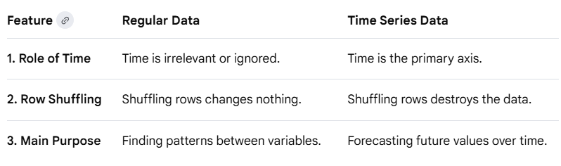
The Golden Prompt Formula
Example:
Tell me the 3 difference between regular data and time series data. Provide output in table format.

Slide 25
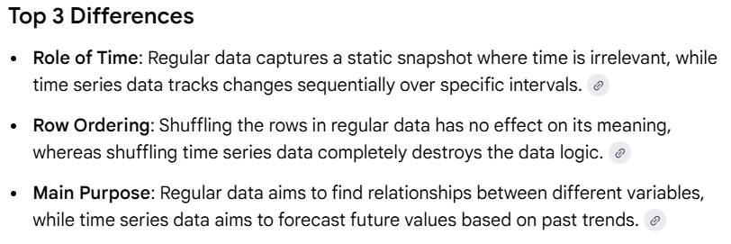
The Golden Prompt Formula
Example:
Tell me the 3 difference between regular data and time series data. Provide output in bullet format.

Slide 26

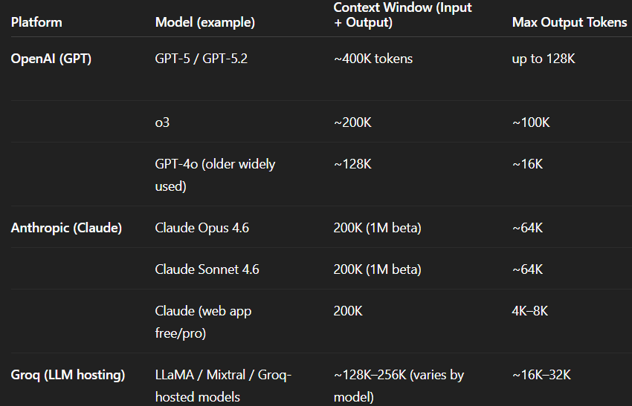
The Golden Prompt Formula

Slide 27
The Golden Prompt Formula
Prompt = Context + Task + Constraint + Output Format
Weak Prompt:
Explain neural networks
Strong Prompt Using Formula
Context: You are teaching beginners in AI.
Task: Explain neural networks.
Constraint: Use simple language and include real-life analogy. Do not use heavy math.
Output Format: Provide explanation in bullet points.

Slide 28
(Add On) Prompt Template
[ROLE]
You are a ___
[TASK]
Your task is to ___
[CONTEXT]
Here is the context: ___
[CONSTRAINTS]
Follow these rules:
- ___
- ___
[OUTPUT FORMAT]
Return answer as: ___

Slide 30
Practical Demo Idea
Ask students:
Count tokens in:
"Machine learning is powerful.“
Then show them using tokenizer tools like:
OpenAI tokenizer
HuggingFace tokenizer

