Slide 1
Prompt Engineering
Techniques
Zero Shot Prompting
One Shot Prompting
Few-Shot Prompting
Chain-of-Thought (CoT) Prompting
Role Prompting

Slide 2
1. Zero-Shot Prompting is a prompting technique where you ask an AI model to perform a task without providing any examples of how to do it.
The model relies entirely on its pre-trained knowledge and the instructions in your prompt.

Slide 3
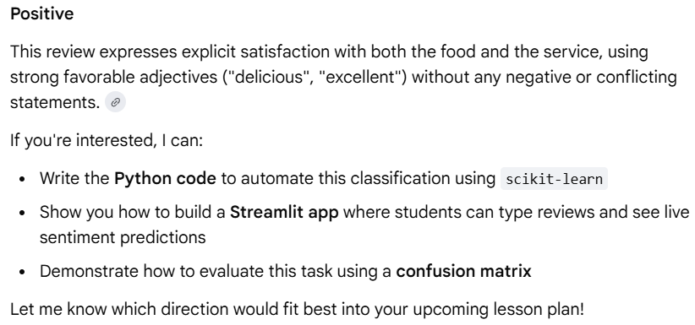
Zero-Shot Prompting
Prompt:
Classify the sentiment of the following review as Positive, Negative, or Neutral.
Review:
"The food was delicious and the service was excellent."

Slide 4
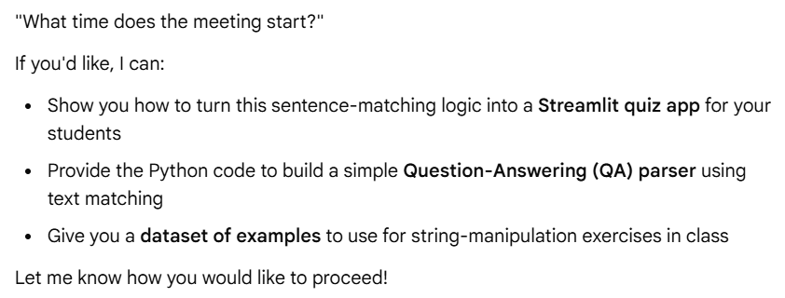
2. One-Shot
One example provided.
Prompt:
Example:
Statement: "John lives in Tokyo."
Question: "Where does John live?"
Statement: "The meeting starts at 10 AM."
Question:

Slide 5
3. Few-Shot Prompting – Giving Examples to Set Patterns
In this technique we provide a few examples to the AI before asking it to perform a task.

Slide 6
How Few-Shot Prompting Works
The prompt usually contains:
Example Inputs
Example Outputs
New Input for AI to solve

Slide 7
Example: Without Few-Shot Prompting
Prompt:
Convert the sentence into a positive sentiment.
"I hate rainy days.“
Output from run1 -> "I enjoy the calm and refreshing atmosphere that rainy days bring”
Output from run2 -> "I love sunny days." (Alternatively: "I love rainy days.")
AI output may vary and may not follow consistent structure.

Slide 8
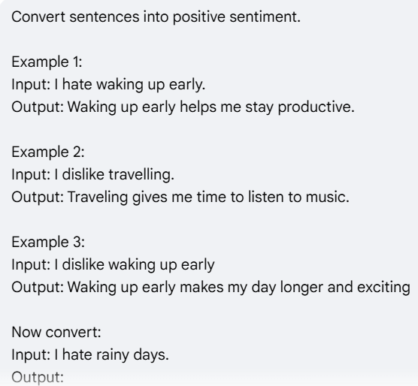
Example: With Few-Shot Prompting
Prompt:
Convert sentences into positive sentiment.
Example 1:
Input: I hate waking up early.
Output: Waking up early helps me stay productive.
Example 2:
Input: I dislike travelling.
Output: Traveling gives me time to listen to music.
Example 3:
Input: I dislike waking up early
Output: Waking up early makes my day longer and exciting
Now convert:
Input: I hate rainy days.
Output:
AI is now more likely to follow the pattern.

Slide 9
Example : With Few-Shot Prompting
Prompt:
Categorize the sentiment of customer reviews based on the examples below.
Review: The interface is confusing and slow.
Sentiment: Negative
Review: I absolutely love the new design, it's so sleek!
Sentiment: Positive
Review: It arrived on time and works as expected.
Sentiment: Neutral
Review: The battery life is terrible.
Sentiment:

Slide 10
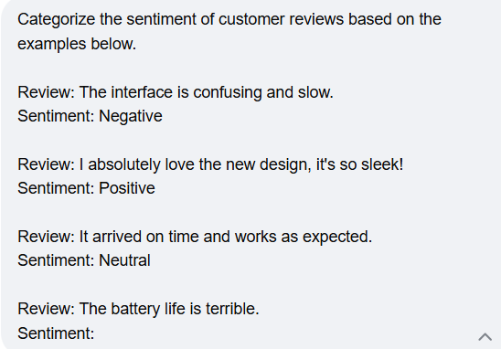

Slide 11
Why Few-Shot Prompting is Important
AI models learn patterns very effectively. When we provide examples:
AI understands formatting better: AI adapts to specific styles or formats or tones
AI produces more accurate responses

Slide 12
2. Chain-of-Thought (CoT) Prompting – Making AI Show Its Reasoning
What is Chain-of-Thought Prompting?
Chain-of-Thought Prompting is a technique where we ask AI to explain its reasoning step-by-step before giving the final answer.

Slide 13
Example Without Chain-of-Thought
Prompt:
If a train travels 60 km in 1 hour, how far will it travel in 3 hours?
AI may directly give the answer:
180 km

Slide 14
Example With Chain-of-Thought
Prompt:
Solve the problem step-by-step.
If a train travels 60 km in 1 hour, how far will it travel in 3 hours?
AI Output:
Step 1: Distance covered in 1 hour = 60 km
Step 2: Total time = 3 hours
Step 3: Total distance = 60 × 3
Final Answer: 180 km

Slide 15
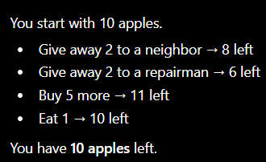
Example With Chain-of-Thought
Without COT Prompt:
"I have 10 apples. I give 2 to a neighbor and 2 to a repairman. Then I buy 5 more and eat 1. How many do I have left?“
Typical AI Response: "You have 11 apples." (Incorrect; often occurs when models skip steps)

Slide 16
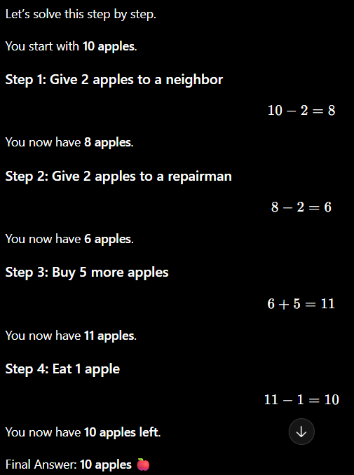
Example With Chain-of-Thought
With COT Prompt:
You are math instructor. Solve following math problem step by step. Show me the reasoning:
I have 10 apples. I give 2 to a neighbor and 2 to a repairman. Then I buy 5 more and eat 1.
How many do I have left?

Slide 17
Powerful CoT Keywords
You can force reasoning by adding phrases such as:
“Explain step-by-step”
“Show your reasoning”
“Break the solution into steps”
“Think through the problem logically”

Slide 18
Why Chain-of-Thought Prompting is Important ?
Normally, AI may jump directly to an answer.
When we ask AI to show steps:
Errors reduce significantly
Reasoning becomes transparent and Output becomes more reliable
Complex tasks become easier
This method improves accuracy, especially in:
Logical problems: Coding
Mathematical calculations
Complex reasoning tasks
Decision making and Data analysis

Slide 19
3. Role Prompting – Assigning AI a Professional Identity
What is Role Prompting?
Role Prompting is a technique where we assign AI a specific role, profession, or expertise level before asking it to perform a task.
Example (Without Role Prompting):
I want to import a csv file into a list.
Write me a code that would do this.
Example (With Role Prompting):
Act as a Python Software Developer. You are cautious and like to handle all types of unforeseen problems.
I want to import a csv file into a list.
Write me a code that would do this

Slide 20
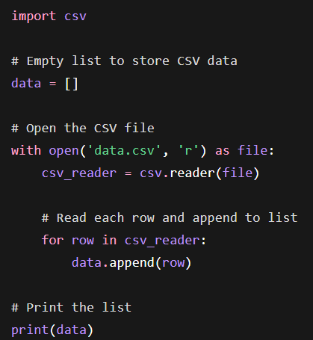


Slide 21
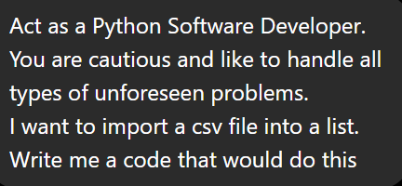
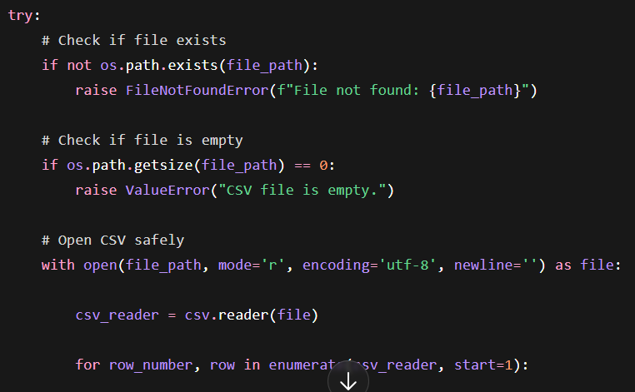
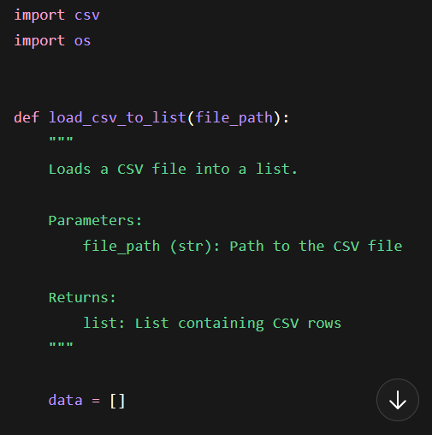

Slide 22
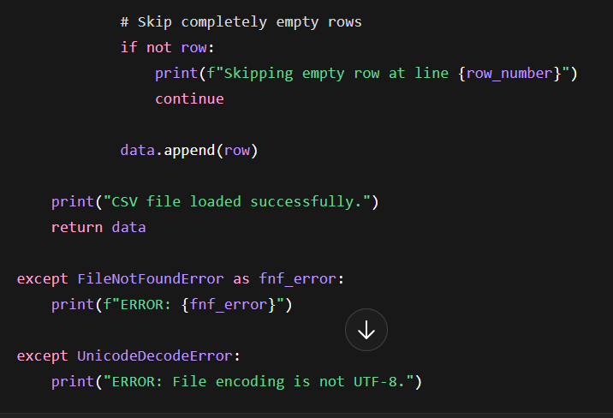
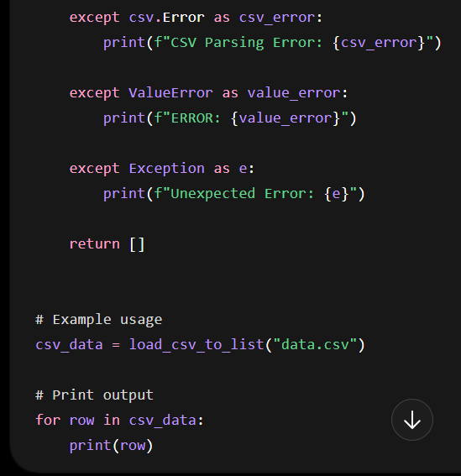

Slide 23
Example Without Role Prompting
Prompt (no role prompting):
Explain API security.
Output may be generic or basic.
Prompt (with role prompting):
Act as a Cybersecurity Expert. Explain API security risks and best practices.
Output will be more professional and detailed.

Slide 24
Common Roles Used in Prompt Engineering
Senior Software Developer
Data Scientist
Medical Professional
Financial Advisor
Teacher or Trainer
Business Consultant
Research Analyst

Slide 25
Combining All Three Techniques:
These techniques can be used together for best results.
Bad Prompt:
A customer buys a laptop for $1,200.
There is a 15% discount, but a 7% sales tax is applied to the final discounted price.
How much is the final total?

Slide 26
Combining All Three Techniques: These techniques can be used together for best results.
Good Prompt:
Role Prompt: Act as a Senior Tax Accountant with 20 years of experience in retail finance.
Few-Shot Examples (Pattern Consistency):
Scenario A: Buy a $100 shirt, 10% discount, 5% tax.
Reasoning: Discount is $100 * 0.10 = $10. Subtotal is $90. Tax is $90 * 0.05 = $4.50. Total is $94.50. 1.2.7
Scenario B: Buy a $50 book, 20% discount, 10% tax.
Reasoning: Discount is $50 * 0.20 = $10. Subtotal is $40. Tax is $40 * 0.10 = $4. Total is $44. 1.1.4
Task: Now, calculate the final total for a customer buying a laptop for $1,200 with a 15% discount and 7% sales tax.
Chain-of-Thought Instruction: Please think step-by-step, breaking down each calculation clearly before stating the final answer.

Slide 27
Combining All Three Techniques: These techniques can be used together for best results.
Example Combined Prompt
Act as a Senior Data Scientist.
Below are examples of sentiment classification:
Example 1:
Text: I love this product.
Sentiment: Positive
Example 2:
Text: This service is terrible.
Sentiment: Negative
Now classify the following text step-by-step:
Text: The experience was okay but could improve.

