Slide 1
AI Agents

Slide 2
Architecture of a single AI agent
AI Agent
Tools:
Web-search,
Calculator, etc.
LLM
Memory

Slide 3

A regular AI model (like a chatbot) takes your input, thinks once, and gives you an answer. That's it — one shot, done.
An AI agent is different.
It can plan, take actions, observe the results, and keep going until a goal is achieved.
The workflow of an agent:
Plan
(Uses LLM)
Take action
(Uses Tools)
Observe the result
(Uses LLM + Memory)
Goal Achieved ?
Yes: Stop
No: Loop

Slide 4
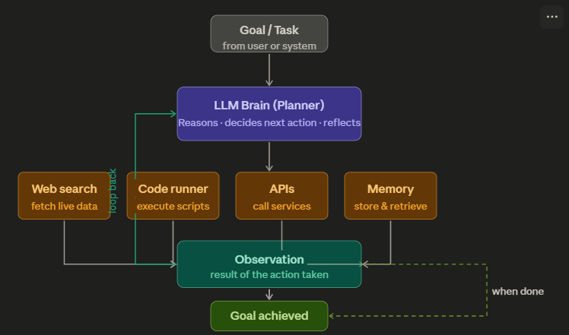





Modern AI Agent
Today’s Agentic AI systems often use:
Large Language Models (LLMs) as the “brain”
Tools (APIs, search, calculators)
Memory (vector DB / RAG)
Planning (multi-step reasoning)
👉 Example: “Book me the cheapest flight”
Agent would
search flights,
compares prices,
decides best option and
books ticket

Slide 5
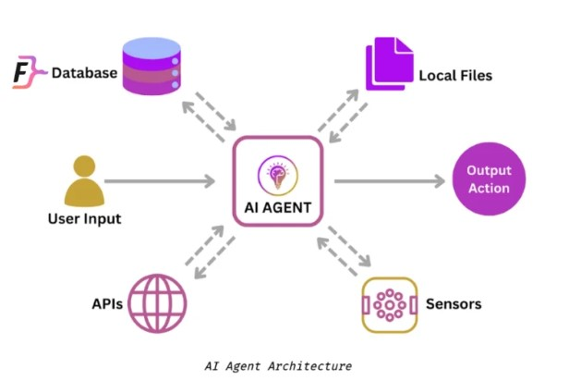
Unlike traditional automation that follows predefined paths, agents can dynamically adapt their approach based on
context and
intermediate results.
AI agent are capable of executing a given task without ongoing direct human intervention.

Slide 6

Agents can collaborate/communicate with other agents to achieve the goal.
Goal
Agent1
Agent2
Agent3
Agent3
Result

Slide 7
Components of an AI Agent
It’s a system of modules working together:
Component | Role
Planner | Decides what steps to take – Needs LLM for this
Memory | Stores past information
Tools | External capabilities (APIs, DBs, calculators)
Executor | Actually, performs the actions by calling tools

Slide 8
🪙 Running Example (FinTech)
🎯 User Query:
“Analyze my spending this month and tell me if I can invest ₹10,000 in stocks.”

Slide 9
1️⃣ Planner (The Strategist)
💡 What it does:
Breaks the problem into steps
Decides how to solve the task
🧠 In our example:
Planner creates a plan like:
Step 1: Fetch user transaction data
Step 2: Calculate total expenses
Step 3: Calculate savings
Step 4: Check if ₹10,000 is affordable
Step 5: Suggest investment decision

Slide 10
2️⃣ Memory (The Context Keeper)
💡 What it does:
Stores:
User history
Preferences
Past interactions
🧠 In our example:
Memory may store:
- User monthly income: ₹50,000
- Previous spending patterns
- Risk appetite: Moderate
- Past investments: Mutual funds
👉 With memory:
Agent becomes personalized advisor

Slide 11
3️⃣ Tools (The Capabilities Layer)
💡 What it does:
Allows agent to interact with the outside world
🔧 Examples in FinTech:
Bank API → fetch transactions
Calculator → compute savings
Stock API → get market data
Risk model → evaluate investment
🧠 In our example:
Agent may use:
Tool 1: get_transactions(user_id)
Tool 2: calculate_total_expense(data)
Tool 3: stock_price_api()

Slide 12
4️⃣ Executor (The Doer)
💡 What it does:
Executes the plan created by Planner
Calls tools
Collects results
Sends back to LLM
🧠 In our example:
Executor workflow:
→ Call get_transactions()
→ Run expense calculation
→ Compute savings
→ Send results back to LLM

Slide 13
Example: booking vacations
Lets illustrate how an agent works within a context like booking a vacation.
Imagine you're trying to book a vacation.
You need to research flights -> find hotels -> check restaurant reviews -> and keep track of your budget.
Traditional workflow automation
A traditional automation system follows a predetermined sequence: it can take inputs such as dates, location, and budget, and make calls to predefined APIs in a fixed order. However, if any unexpected situations arise, such as flights being sold out, or the specified hotels being unavailable, it cannot adapt.
Input
step1
step2
step3
Output

Slide 14
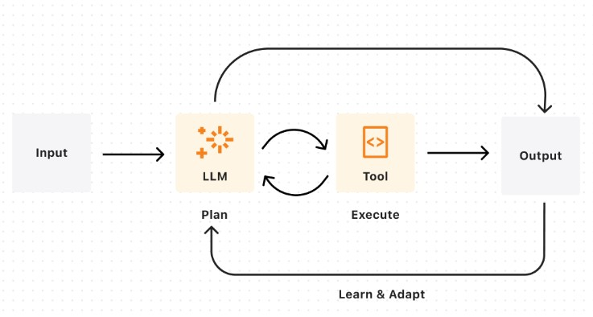
Example: booking vacations
Agent Workflow
An agent combines AI's ability to make judgements and call the relevant tools to execute the task. An agent's output will be nondeterministic given: real-time availability and pricing changes, dynamic prioritization of constraints, ability to recover from failures, and adaptive decision-making based on intermediate results. In other words, if flights or hotels are unavailable, an agent can reassess and suggest a new itinerary with altered dates or locations, and continue executing your travel booking.

Slide 15
An AI agent continuously follows this loop:
Perception (Observe)
Takes input from environment
Example: text, images, sensors, user queries
Decision (Think / Reason)
Uses logic, rules, or ML models
Example: LLM deciding next step
Action (Act)
Performs a task
Example: sending email, calling API, generating response
Learning (Optional)
Improves over time
Example: reinforcement learning, memory updates

Slide 16
Some examples of AI Agent
Simple tasks
A customer says "I was charged twice for my Netflix subscription." An agent checks the transaction history, identifies the duplicate, calls the refund API, sends a confirmation, and logs the case — without human involvement. It escalates to a human only if the situation is genuinely ambiguous or the customer is distressed.
Agent that could help me review my emails and create tasks on a digital to-do list based on the highest priority emails coming in.
Agent that could respond to people reporting bugs and automatically gather missing information and seek clarification on confusing parts of a bug report and then route the bug to the appropriate team to resolve.

Slide 17
Complicated tasks:
Agent also to build a travel planning agent that takes my preferences and needs into account, researches things like destinations and hotels and even activities, and then suggests an itinerary for me and use a collaborating agent to book everything all in one shot.
Agent to find a list of suppliers, email them for quotes, and sort replies according to the best price.
Agent to create a shopping list based on a recipe, purchase the ingredients online, and have them delivered to you.
Agents that monitor patients' vitals, and suggest treatment plans and even support surgical procedures by providing realtime data to surgeons

Slide 18
AI Agents in FinTech Industry
Fraud Detection
A transaction comes in — $85,000 to a new payee at 2am from a device never used before.
A rules-based system might let it through (amount is under limit).
An agent instead:
→ checks device fingerprint
→ looks up IP geolocation
→ compares against the user's last 90 days of behaviour
→ queries if the payee account is newly created
→ calculates a risk score
→ blocks the transaction and sends an OTP challenge
— all in under 200ms.

Slide 19
AI Agents in FinTech Industry
Credit Underwriting
A loan application arrives.
The agent pulls the applicant's credit bureau report,
fetches bank statement PDFs and parses income/expense patterns,
runs a risk model,
checks for negative news about the employer, and
produces a structured recommendation with reasons.
What used to take a human analyst 2–3 days happens in minutes.

Slide 20
AI Agents in FinTech Industry
Algorithmic Trading
An agent watches price feeds,
reads earnings call transcripts,
monitors news sentiment in real time, and
executes trades based on a defined strategy — automatically managing position sizes and stop-losses.
It can also flag unusual market conditions and pause itself, which a static algorithm cannot.

Slide 21
AI Agents in FinTech Industry
One important caveat for fintech
Agents in financial services need human-in-the-loop guardrails for high-stakes decisions.
Fully autonomous agents are fine for low-risk actions (sending a statement, blocking a suspicious transaction).
But for large loan approvals, account closures, or large trades, best practice is to have the agent prepare a recommendation and a human confirm it.
Regulators in most countries — including India's RBI — expect an audit trail and human accountability for consequential financial decisions.

Slide 22
Ffnbksdfd
Fdslj;f
Fl;ds

Slide 23
How Does an AI Agent Work?(p1)
In essence, an AI agent works through the process of assigning, creating, or inferring an objective, which it will then break down into a series of tasks and attempt to complete. This process can be divided into three stages:
Task definition and planning,
Decision-making, and
Feedback and adaptation.
1. Task Definition and Planning
Define and assign an objective: giving an agent a predefined goal you want it to accomplish.
Assign Resources: select the tools and sources of information the agent will be permitted to use to achieve its goal.
Environmental assessment: the agent uses sensors and any other available data sources to collect information about its environment; this helps it understand its given task in greater context, as well as potential obstacles.
Plan generation: taking the tools at its disposal into account, the agent devises strategies for achieving its goal, which typically involves breaking down its tasks into subtasks, and potentially also breaking the goal down into subgoals.

Slide 24
How Does an AI Agent Work?(p2)
2. Decision-Making
Data analysis: analyzing available data – such as environmental sensor readings, past experiences, and the model that powers it, to predict the outcomes of prospective actions it could take.
Action execution: the agent sequentially selects and executes the action it has determined will maximize the likelihood of success.
3. Feedback and Adaptation
Performance Monitoring: the agent monitors the outcome of its actions and evaluates if they brought it closer to accomplishing the given objective.
Feedback loop: The agent uses the feedback to adjust its strategy and potential actions to take. If permitted, i.e., if programmed to do so, it can ask for human intervention if it is stuck on a task.
Adaptation and learning: The agent continuously learns from its experiences. It monitors the results of its actions and updates its knowledge base and decision-making processes based on the new information.

Slide 25
The Components of an AI agent
AI Model: recent advances such as an LLM, VLM (vision-language model), or, more recently, LMM (large multi-modal model) could be used as the core of an AI agent, acting as its decision-making mechanism. The model will process data collected by sensors, make decisions based on said data, and take actions to achieve the agent’s goals.
Sensors: components responsible for collecting data from the agent’s environment so it can “perceive” it accurately and act accordingly. Sensors are an agent’s input devices, enabling it to learn about the world. In software agents, a sensor would be digital interfaces to websites or databases, while in a robotic agent, these include cameras and microphones.
Actuators: these are an agent’s means of output – enabling it to take actions based on its given objective and data collected from its sensors. In software agents, these are components that can control other applications or devices, while for a robotic agent, these could be appendages, i.e., limbs, display screens, or speakers.

Slide 26
EXTRA
Ffnbksdfd
Fdslj;f
Fl;ds

