Slide 1
The need for LangChain

Slide 2
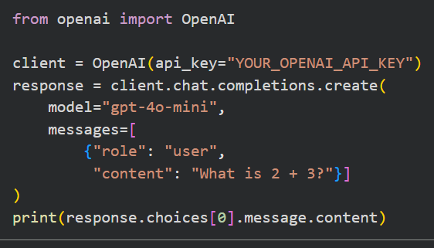
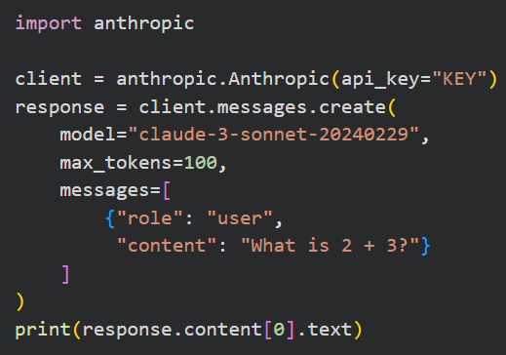

Problem: No Uniformity Across LLM Providers

Slide 3
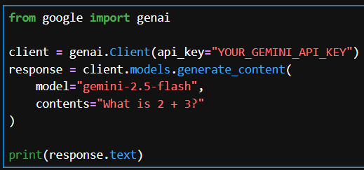

Problem: No Uniformity Across LLM Providers

Slide 4

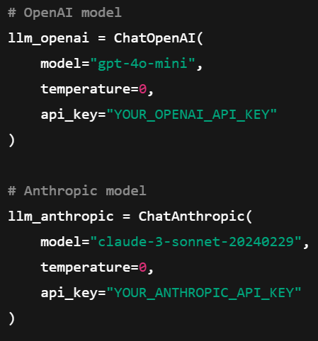
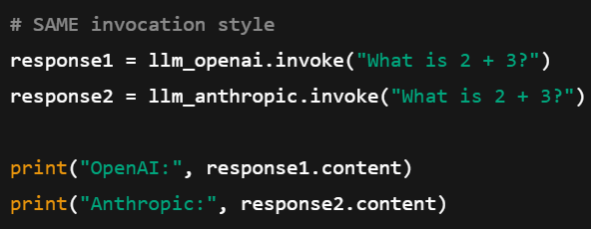
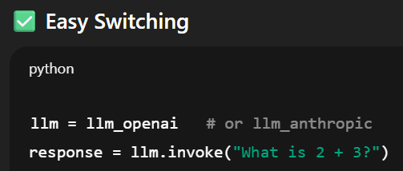
Langchain helps in providing uniformity

Slide 5
Models
(OpenAI, Groq, Anthropic, etc.)
Vector DB
(PineCone, FAISS, ChromaDB)
Communication
Communication
LangChain
Memory Management
(Store conversation)
Chains
(Sequence of steps)
Agents
(Which tools to call)

Slide 6
Ffnbksdfd
Fdslj;f
Fl;ds

