Slide 2
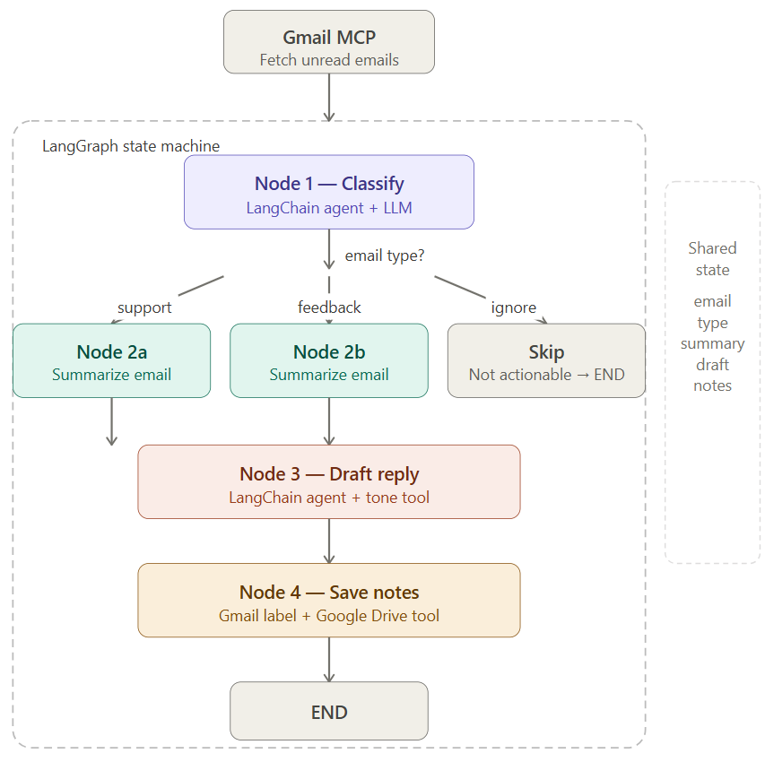

Slide 3
System architecture:
Node 1 (Classify) — LLM reads the email and routes it: `support`, `feedback`, or `ignore`
Node 2 (Summarize)— agent extracts the key issue, sentiment, and urgency
Node 3 (Draft reply) — agent with a tone-control tool writes a professional reply
Node 4 (Save notes) — saves summary + draft to Google Drive via MCP

