Slide 1
Automation
Based on the user's form answers, the workflow
send an email to user and
in Google Sheets, automatically calculates and sets a Lead Priority column (High or Low)

Slide 2
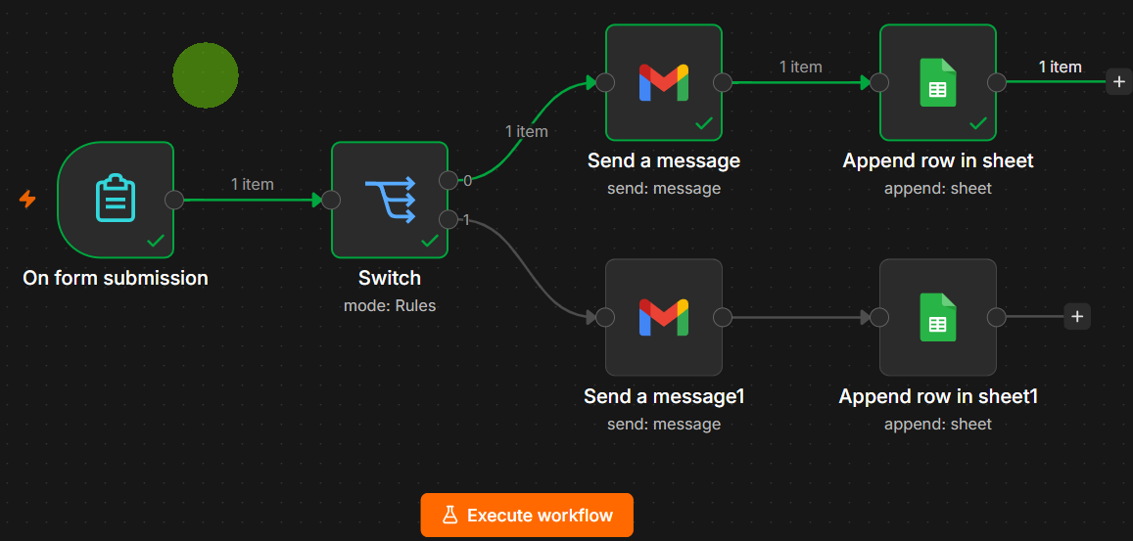

Slide 3
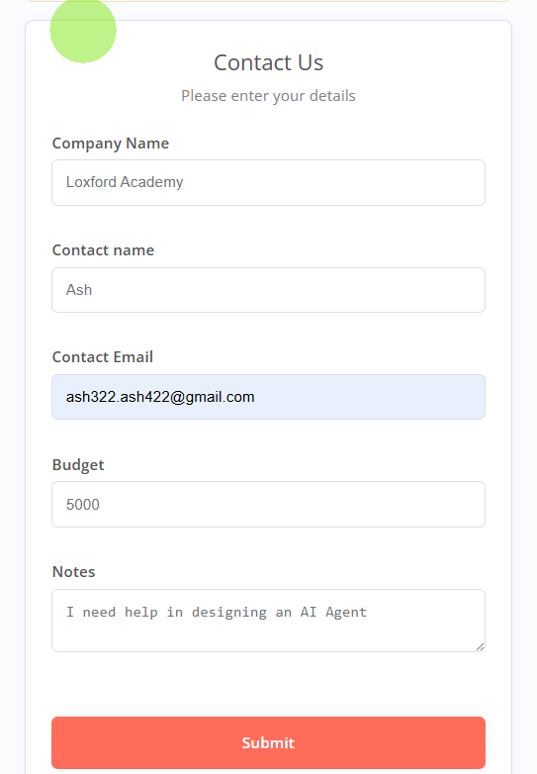
Form would take input:
Company name
Contact name
Contact email
Budget
Notes

Slide 4
The flow logic:
If budget < 3000, then send email to user and lead_priority = Low
Else send email to user and lead_priority = High

