Slide 1
Project Title: AI-Powered RAG System
The Problem: Professors / Researchers spend hours reading abstract papers to see if they are relevant to their syllabus or ongoing research grants.
The Solution:
A system where researcher can chat with the paper

Slide 2
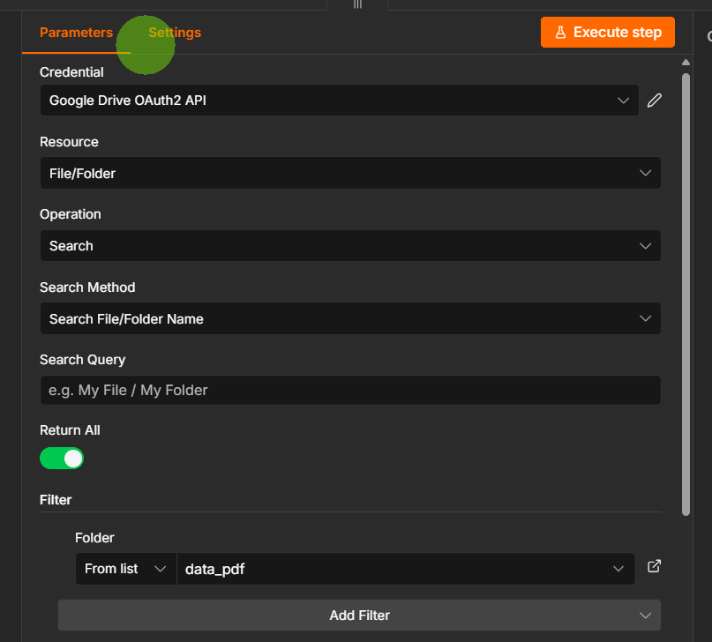





Slide 3
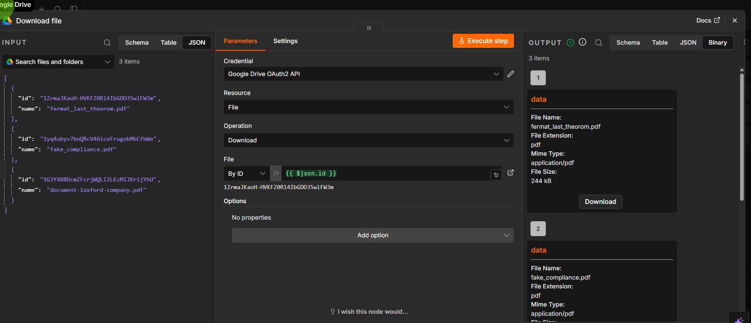











Now we download the file by file_id

Slide 4
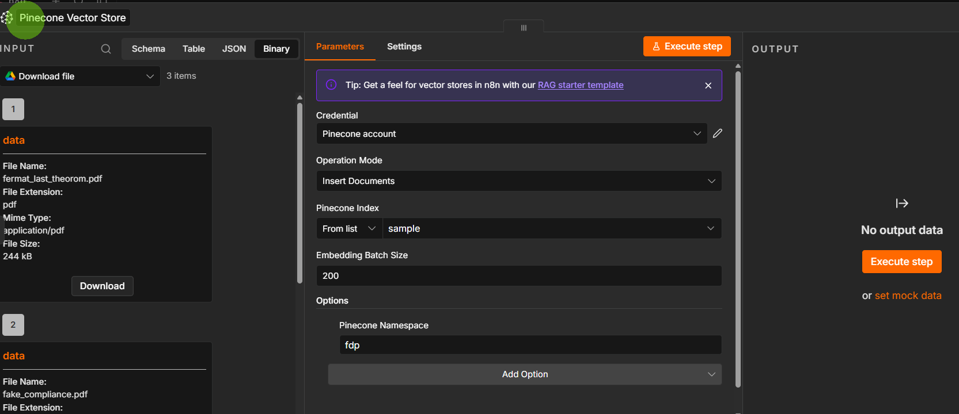





Slide 5
