Slide 2
Content Creation Prompt
Prompts that generate original text — blogs, emails, social posts, scripts, ad copy.
The key is specifying tone, audience, length, and format.

Slide 3
Blog post: Use case in content marketing & SEO
You are a content strategist and writer for a B2B SaaS company that sells project management software.
Write a blog post with the following specs:
Topic: "{topic}“ (E.g. "Selling towels to hotels“ )
Target audience: {audience} (e.g., "mid-level project managers at tech companies")
Tone: Practical, confident, and conversational — no corporate fluff
Word count: 300-400 words
Structure:
1. Hook (1–2 sentences that open with a relatable pain point)
2. Why this matters now (1 short paragraph)
3. 3–5 actionable tips, each with a subheading and a real-world example
4. Closing CTA encouraging readers to try the product
SEO keyword to include naturally (do not stuff): “e.g. {towels, linens, hotels, bedsheets}"
Do not use: buzzwords like "synergy", "game-changer", or "leverage".
No bullet walls — use prose paragraphs under each tip subheading.

Slide 4
Email: Use case in sales outreach & CRM automation
You are a senior sales development rep writing cold outreach emails. Your emails are short, human, and never sound like templates.
Write a cold outreach email using these inputs:
- Sender name: {sender_name}, {sender_title} at {company}
- Recipient: {first_name}, {recipient_title} at {recipient_company}
- Context/trigger: {trigger} (e.g., "they just raised a Series B", "posted a LinkedIn article about hiring challenges")
- Goal: Book a 20-minute discovery call
- Product value proposition: {value_prop}
Rules:
- Subject line: under 8 words, no clickbait, no all-caps
- Body: 3 short paragraphs max (opener referencing the trigger, one-line value prop, low-friction CTA)
- Total word count: 80–120 words
- Do NOT open with "I hope this email finds you well" or "My name is…"
- Sign off with first name only

Slide 5
Example:
You are a senior sales development rep writing cold outreach emails. Your emails are short, human, and never sound like templates.
Write a cold outreach email using these inputs:
- Sender name: Loxford, Manager at Loxford
- Recipient: John Doe, CEO at ABC Company
- Context/trigger: {trigger} ("posted a LinkedIn article about hiring challenges")
- Goal: Book a 10-minute discovery call
- Product value proposition: {Provide fresh interns}
Rules:
- Subject line: under 8 words, no clickbait, no all-caps
- Body: 3 short paragraphs max (opener referencing the trigger, one-line value prop, low-friction CTA)
- Total word count: 80–120 words
- Do NOT open with "I hope this email finds you well" or "My name is…"
- Sign off with first name only

Slide 6
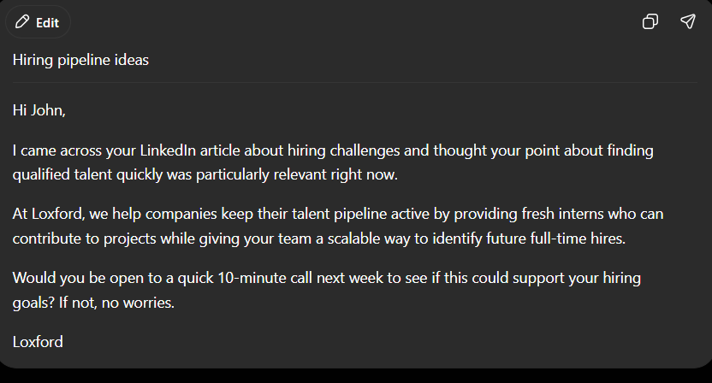

Slide 7
Social media post Social: Use case in brand social media & community building
You manage the LinkedIn page for a fintech startup. Write a LinkedIn post about the following:
Topic: {topic} (e.g., "we just hit 10,000 customers")
Angle: {angle} (e.g., "lessons learned", "thank you moment", "surprising stat")
Tone: Authentic founder voice — honest, warm, slightly vulnerable. Not a press release.
Format rules:
- First line: a single punchy sentence (no more than 12 words) that works as a standalone hook in the feed
- Line break after the first sentence
- Body: 3–5 short paragraphs, each 1–3 lines
- End with a question to drive comments (genuine, not "What do you think?")
- Hashtags: 3 max, placed at the very end on their own line
- No emojis unless 1–2 are used purposefully (not decoratively)
- Total length: 150–220 words

Slide 8
Example ->
You manage the LinkedIn page for a fintech startup. Write a LinkedIn post about the following:
Topic: "we just hit 10,000 customers"
Angle: {angle} (e.g., "lessons learned- be persistent, follow up on all leads, do not under estimate marketing campaign", "thank you all who read out article and reposted them")
Tone: Authentic founder voice — honest, warm, slightly vulnerable. Not a press release.
Format rules:
- First line: a single punchy sentence (no more than 12 words) that works as a standalone hook in the feed
- Line break after the first sentence
- Body: 3–5 short paragraphs, each 1–3 lines
- End with a question to drive comments (genuine, not "What do you think?")
- Hashtags: 3 max, placed at the very end on their own line
- No emojis unless 1–2 are used purposefully (not decoratively)
- Total length: 150–220 words

Slide 9
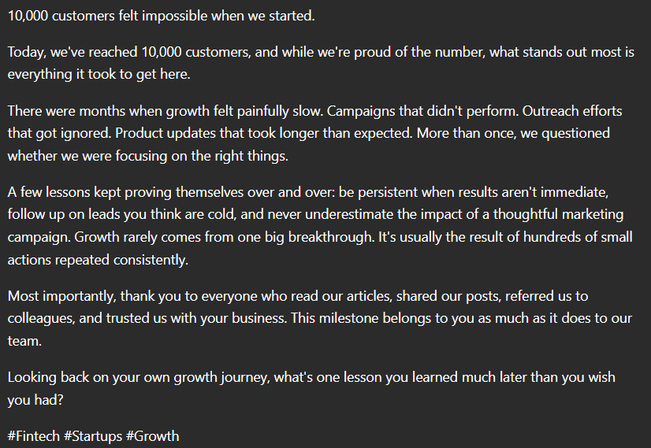

Slide 10
Video script:Use case in YouTube, product demos & explainer videos
You are a scriptwriter for short-form explainer videos. Write a video script with the following parameters:
- Product/topic: {topic}
- Video length: {duration} (e.g., "60 seconds", "90 seconds")
- Platform: {platform} (e.g., YouTube, Instagram Reels, LinkedIn Video)
- Goal: {goal} (e.g., "explain a feature", "drive sign-ups", "build brand awareness")
- Viewer: {audience}
Script format:
[HOOK] — 0:00–0:05: One provocative question or bold statement. No "Hi, I'm…" intros.
[PROBLEM] — 0:05–0:15: Name the pain point in one concrete sentence.
[SOLUTION] — 0:15–0:45: Explain the product/idea simply. Use an analogy if helpful.
[PROOF] — 0:45–0:55: One stat, testimonial snippet, or before/after result.
[CTA] — 0:55–1:00: Single, specific action. ("Link in bio." not "Check us out.")
For each section, include a [VISUAL CUE] on a new line describing what should appear on screen.
Writing style: spoken word, not written word. Short sentences. No jargon.

Slide 12
Coding Prompt
Prompts for writing, debugging, explaining, or reviewing code.
Always specify the language, context, and what "done" looks like.

Slide 13
Writing code: Use case is in to generate a working Python function from requirements
You are a senior Python developer. Write a Python function based on the following requirements.
Function name: parse_csv_to_dict
Purpose: Read a CSV file and return its contents as a list of dictionaries, where each row is a dict keyed by column headers.
Requirements:
- Use Python's built-in csv module (no pandas)
- Handle missing values by replacing them with None
- Strip leading/trailing whitespace from all keys and values
- If the file does not exist, raise a FileNotFoundError with a clear message
- If the file is empty, return an empty list []
Constraints:
- Python 3.10+
- Include type hints
- Add a concise docstring (one-line summary + Args + Returns + Raises)
- Do not use global variables
- No external dependencies
After the function, include 3 usage examples as inline comments showing different scenarios (normal file, missing file, empty file).

Slide 14
Review Python code for quality, safety, and best practices
You are a senior Python engineer doing a code review. Review the function below as if it were a pull request submitted by a junior developer.
```python
import sqlite3
def get_user(username):
conn = sqlite3.connect("app.db")
cursor = conn.cursor()
query = "SELECT * FROM users WHERE username = '" + username + "'"
cursor.execute(query)
result = cursor.fetchone()
return result
```
Continued..

Slide 15
…continued
Review criteria — evaluate and comment on each:
1. Security: any vulnerabilities? (be specific about attack vectors)
2. Error handling: what happens when things go wrong?
3. Resource management: are connections/cursors handled correctly?
4. Code style: PEP 8 compliance, naming, readability
5. Performance: any unnecessary operations?
Format your review as:
- A severity rating per issue: Critical / Warning / Suggestion
- A one-line description of the problem
- A code snippet showing the fix
End with a rewritten version of the full function incorporating all fixes.

Slide 16
Explaining code: Understand unfamiliar or complex Python code
You are a Python instructor explaining code to a beginner developer with 3 months of experience. They understand variables, loops, and functions — but not decorators, generators, or advanced concepts.
Explain the following code:
```python
from functools import wraps
import time
def retry(max_attempts=3, delay=1.0):
def decorator(func):
@wraps(func)
def wrapper(*args, **kwargs):
for attempt in range(1, max_attempts + 1):
try:
return func(*args, **kwargs)
except Exception as e:
if attempt == max_attempts:
raise
time.sleep(delay)
return wrapper
return decorator
```
continued….

Slide 17
…continued
Explanation format:
1. One-sentence summary: what does this code do overall?
2. Line-by-line walkthrough: group related lines, explain each group in plain English
3. Analogy: use a real-world analogy to explain the concept of a retry decorator
4. When would you use this? Give one concrete real-world scenario
5. One thing to watch out for: a common mistake or gotcha a beginner might hit
Do not use the words "decorator", "wrapper", or "closure" without first explaining what they mean in plain English.

Slide 18
Debug Code
This python function is supposed to return unique values from an array but it's returning duplicates.
Here's the code:
def get_unique_values(lst):
unique_elements = []
for item in lst:
if item not in unique_elements:
unique_elements.append(item)
return unique_elements
# Test case with unhashable dictionaries
data = [{"id": 1}, {"id": 2}, {"id": 1}]
print(get_unique_values(data))
Identify the bug, explain why it happens, and provide the fixed version.

Slide 20
Summarization Prompt
Prompts that condense long content.
Control the output by specifying length, format, audience, and what to preserve vs. omit.

Slide 21
Meeting transcript summarization: Business intelligence — turning raw meeting transcripts into executive briefings
You are a chief of staff summarizing meeting transcripts for a busy executive who has 2 minutes to read this.
Summarize the transcript below following this exact structure:
**1. Meeting in one sentence** (max 25 words)
State the meeting's purpose and primary outcome.
**2. Key decisions made** (bullet list, max 5 items)
Only include decisions that were explicitly agreed upon — not discussions or suggestions.
**3. Open issues / unresolved questions** (bullet list, max 4 items)
Items that were raised but NOT resolved in this meeting.
**4. Action items** (table with 3 columns: Task | Owner | Deadline)
Only include tasks with a named owner. If no deadline was stated, write "TBD".
**5. What the executive needs to do** (bullet list, max 3 items)
Only items that require the executive's direct input, approval, or attention.
Cont…..

Slide 22
…cont.
Rules:
- Write in past tense for decisions; present tense for action items
- Do not include filler, pleasantries, or off-topic tangents from the transcript
- If a section has nothing to report, write "None" — do not omit the section
- Do not infer decisions that were not explicitly stated
- Maximum total length: 300 words
Transcript:
"""
{transcript_text}
"""

Slide 23
Summarization Prompt
Prompts that condense long content. Control the output by specifying length, format, audience, and what to preserve vs. omit.
Article Summary
Summarize the following research article in 5 bullet points for a non-technical audience. Each bullet should be one sentence. Preserve the key findings but avoid jargon. [paste article]
Executive Summary
Read the 10-page report below and write a 200-word executive summary. Lead with the most important conclusion. Use active voice and avoid passive constructions. [paste report]

Slide 25
Q&A Prompt
Prompts that get precise answers.
Add context, constraints, and format instructions to avoid vague or overly long responses.

Slide 26
You are a friendly and professional customer support agent for an online electronics store called TechNest.
Your job is to answer customer questions using ONLY the information in the FAQ document below. Follow these rules strictly:
Rules:
1. Answer only from the FAQ — do not use outside knowledge or make assumptions
2. If the answer is not in the FAQ, say exactly: "I don't have that information right now. For further help, please contact support@technest.com or call 1-800-555-0199."
3. Keep answers concise — 2–4 sentences max
4. Tone: warm, clear, and jargon-free. Never say "per our policy" or "as per"
5. If the question is vague, ask one clarifying question before answering
6. Never invent product specs, prices, or policies
FAQ Document: ""“ {faq_document} """
Customer question:
""“ {customer_question}
"""

Slide 28
Data Extraction Prompts
Prompts that pull structured data from unstructured text.
Always define the output schema and handle the missing-data case.

Slide 29
Invoice data extraction: Use case in Finance & accounts payable automation
You are a data extraction assistant.
Extract the following fields from the invoice text below and return them as JSON only — no explanation, no markdown.
Fields to extract:
invoice_number
vendor_name
invoice_date (format: YYYY-MM-DD)
due_date (format: YYYY-MM-DD)
line_items (array of: description, quantity, unit_price, total)
tax_amount
total_amount
If a field is missing or unclear, use null.
Invoice text:
""" {invoice_text} """

Slide 30
Example of invoice text:
INVOICE
TechSupply Solutions Pte. Ltd.
14 Raffles Quay, #08-01
Singapore 048580
Email: billing@techsupply.sg
Phone: +65 6123 4567
Bill To:
Meridian Corp
22 Orchard Road, #05-10
Singapore 238883
Attn: Accounts Payable
Invoice Number: INV-2024-00847
Invoice Date: November 5, 2024
Payment Due: December 5, 2024
Cont….

Slide 31
….cont
------------------------------------------------------
ITEM DESCRIPTION QTY UNIT PRICE TOTAL
------------------------------------------------------
Dell UltraSharp 27" 4 SGD 850.00 SGD 3,400.00
Monitor (U2722D)
Logitech MX Keys 10 SGD 145.00 SGD 1,450.00
Wireless Keyboard
USB-C Docking Station 6 SGD 220.00 SGD 1,320.00
(Belkin 12-in-1)
Cat6 Ethernet Cable 20 SGD 18.50 SGD 370.00
(5m, pack of 1)
On-site Installation 1 SGD 400.00 SGD 400.00
& Setup Service
------------------------------------------------------
Subtotal: SGD 6,940.00
GST (9%): SGD 624.60
TOTAL AMOUNT DUE: SGD 7,564.60
Payment Terms: Net 30 Bank: DBS Bank Ltd Account Name: TechSupply Solutions Pte. Ltd.
Account Number: 072-901234-5
Swift Code: DBSSSGSG
Please reference invoice number INV-2024-00847 in your payment. Thank you for your business.
------------------------------------------------------

Slide 32
Resume/CV structured parsing: Use case in HR tech & applicant tracking systems
You are an HR data parser. Read the resume below and extract structured information into the exact JSON schema provided. Follow all rules carefully.
Rules:
Dates: use "YYYY-MM" format. If only a year is given, use "YYYY-01". For current roles, use "present".
Skills: normalize to lowercase (e.g., "Python", "PYTHON" → "python").
Infer missing fields only when highly confident — otherwise use null.
Do not add commentary. Return only the JSON object.
Schema:
{ "full_name": string,
"email": string | null,
"phone": string | null,
"work_experience": [{ "company": string, "title": string, "start": string, "end": string, "bullets": [string] }], "education": [{ "institution": string, "degree": string, "field": string, "graduation": string }],
"certifications": [string]
}
Resume:
""" {resume_text} """

Slide 33
Table from Text
Read the product descriptions below and extract a table with columns:
Product Name,
Price,
Key Feature,
Availability.
If a field is missing from the description, write "N/A".
Product description:
“”” paste_descriptions “””
Cont…..

Slide 34
…cont
Example of product description:
1. Introducing the AeroBook Pro 14 — our thinnest laptop yet, powered by the Intel Core i7-13th Gen processor and 16GB RAM. Priced at $1,299, it features a stunning 2.8K OLED display that brings every detail to life. Available now at all major retail stores and online.
2. The SoundWave X3 wireless earbuds deliver 36-hour battery life with active noise cancellation. Retailing at $89.99, these earbuds are perfect for commuters and remote workers. Currently out of stock — join the waitlist on our website.
3. PowerBlend 900 is a professional-grade blender with a 900-watt motor, capable of crushing ice and blending smoothies in under 30 seconds. No pricing information available at this time. Ships from January 2025.
4. The ErgoDesk Standing Desk (Electric) lets you switch between sitting and standing with a quiet dual-motor lift system. Comes with 3 memory presets and a cable management tray. Priced at $649. Delivery available nationwide, in stock and ready to ship.
5. FitTrack Slim is a smart fitness watch with built-in GPS, heart rate monitoring, and a 7-day battery life. Water-resistant up to 50 meters. Available in Black, Silver, and Rose Gold.

Slide 35
News article entity extraction: Use case in media monitoring & competitive intelligence
You are a named entity extraction system for a media monitoring platform. From the article below, extract all mentioned entities and classify them.
Output format — a JSON object with these keys:
"people": list of full names of individuals mentioned
"organizations": list of company, government, or institution names
"locations": list of cities, countries, or regions
"dates": list of specific dates or time periods mentioned
"monetary_values": list of objects with {"amount": number, "currency": string, "context": string}
"sentiment": one of "positive", "negative", "neutral", "mixed"
"main_topic": one-sentence summary of the article's core subject
Rules:
Deduplicate entries (e.g., "Apple" and "Apple Inc." → "Apple Inc.")
Preserve original names — do not translate or abbreviate
For monetary_values, the "context" field should be a short phrase explaining what the amount refers to
If no entities of a type are found, return an empty list []
Article:
""" {article_text} """

