Slide 1
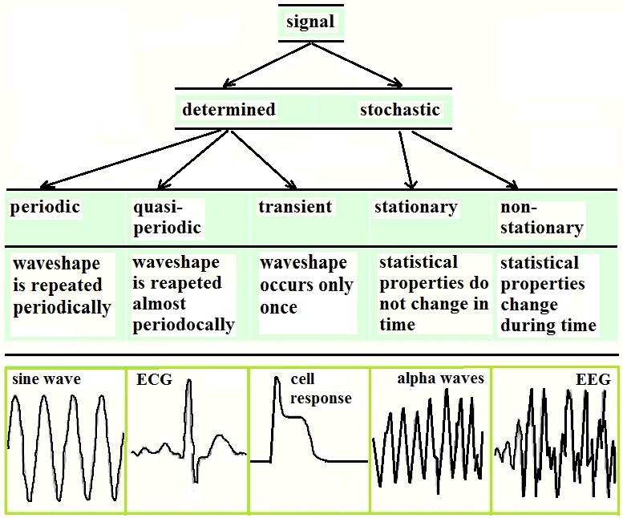
Biomedical signal Classification
Examples of statistical properties:
Mean (First-order moment)
Variance (Second-order moment)
Autocorrelation Function: Measures how the signal correlates with itself at different lags.
Power Spectral Density (PSD): Frequency-domain representation of how power is distributed over frequencies.
Higher-Order Moments (Skewness, Kurtosis): Skewness: Indicates asymmetry of the signal distribution.
Cross-correlation (for multi-lead ECG): Measures correlation between two different signals (e.g., different ECG leads).
Entropy Measures (e.g., Shannon Entropy, Sample Entropy): Quantifies signal complexity or unpredictability.

Slide 2
Classification: by Characteristics
Deterministic: may be accurately described mathematically
Usually predictable (Not in case of chaos)
Periodic s(t) = s(t+nT). E.g. A sine wave in your math class - you can predict exactly what comes next
Almost periodic: Pattern repeat with some irregularity. E.g. Your heartbeat - similar pattern but slight variations each beat
Transient : signal characteristics change with time. E.g. A muscle signal that gets weaker as you get tired
Stochastic: defined by their statistical properties (Distribution)
Stationary: Random signals whose statistical properties of the signal do not change over time. E.g. White noise from a radio - sounds random but statistically consistent
Ergodic : You can learn about the signal's behavior by studying just one long recording. Like judging a person's personality from one long conversation vs. needing multiple short meetings i.e. Statistical properties may be computed along time distributions.

Slide 3
Classification: by Characteristics
All real biosignals may be considered stochastic
ECG are Almost deterministic signals: waveshapes that (almost) repeat themselves -> characterization (often) by detection of certain measures and waves
EEG are “Truly” stochastic: We analyze these by using statistical methods like averages, frequency content, and probability distributions

Slide 4
The Electrocardiogram (ECG)

Slide 5
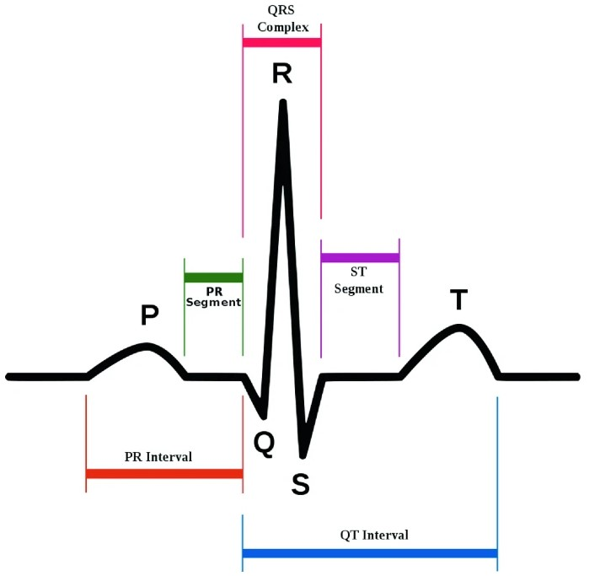
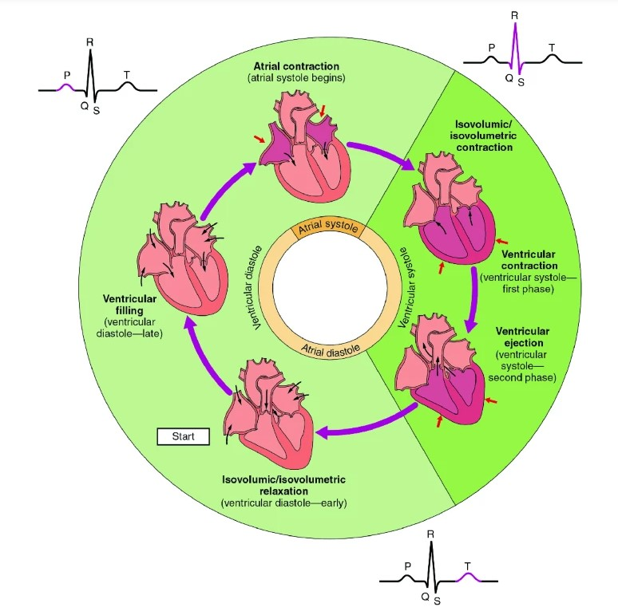
What is ECG(p1) ?
Source: https://link.springer.com/chapter/10.1007/978-3-030-47994-7_17
An ECG can convey a large amount of information about the structure of the heart and the function of its underlying conduction system, including: the rate and rhythm of heartbeats, the size and position of the chambers, and the presence of damage to the myocytes or conduction system.
Good video: https://makeagif.com/i/Ym5CLo

Slide 6
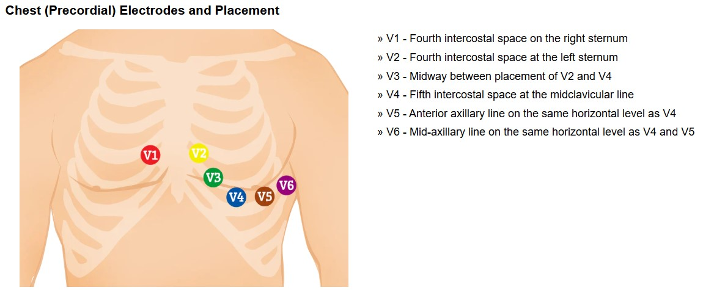
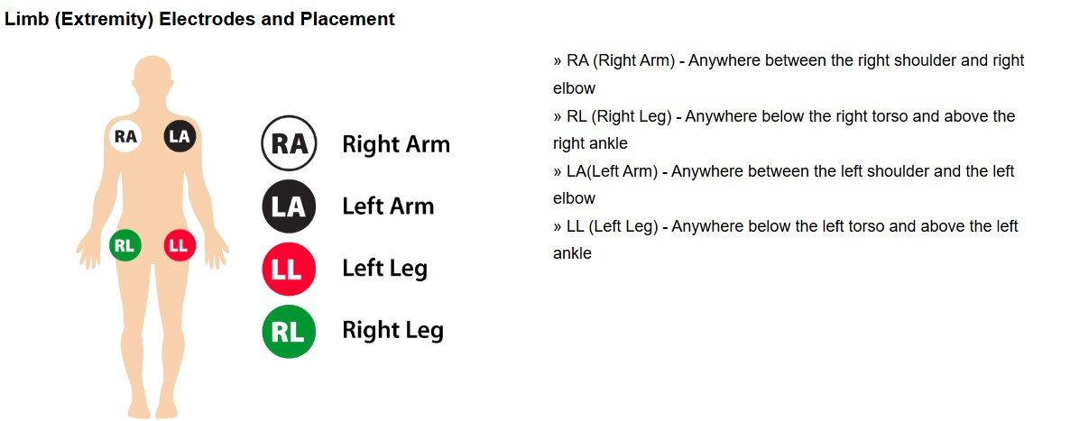
Where to place the leads to measure ECG? There are many ways. Below is 2 of them
During an ECG, sensors (electrodes) that can detect the electrical activity of your heart are attached to your chest and sometimes your limbs. ECG gathers information from generally 12 different areas of the heart. These views are created by electrodes, typically 10, placed on the skin of your chest and sometimes your limbs.
These sensors are usually left on for just a few minutes.
Each beat of your heart is triggered by an electrical impulse normally generated from special cells in the upper right chamber of your heart. An electrocardiogram records the timing and strength of these signals as they travel through your heart.
The electrical activity is recorded as waves on a graph, with different patterns corresponding to each electrical phase of your heartbeat.
https://www.cablesandsensors.com/pages/12-lead-ecg-placement-guide-with-illustrations?srsltid=AfmBOopo7D2tN00u5Nt6wFDn-8Qbxgo1V3cDSu9WhhYHtPdihfduYoxj

Slide 7
The Electrocardiogram (ECG)
ECG is the graphical representation of electrical activity of heart
It is a interpretation of the electrical activity of the heart over time captured and externally recorded by skin electrodes
The device used to produce this non invasive record is called electrocardiograph
ECG is used for the diagnosis of heart disease and may occasionally be the only marker for the presence of heart disease
The graph on which the electrical activity is recorded is called electrocardiogram. The most important is the waves which is represented as ‘PQRST’
In which P wave represents Atrial depolarisation where T wave represents ventricular repolarisation and QRS represents ventricular depolarisation

Slide 8
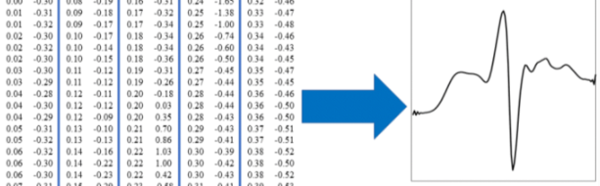
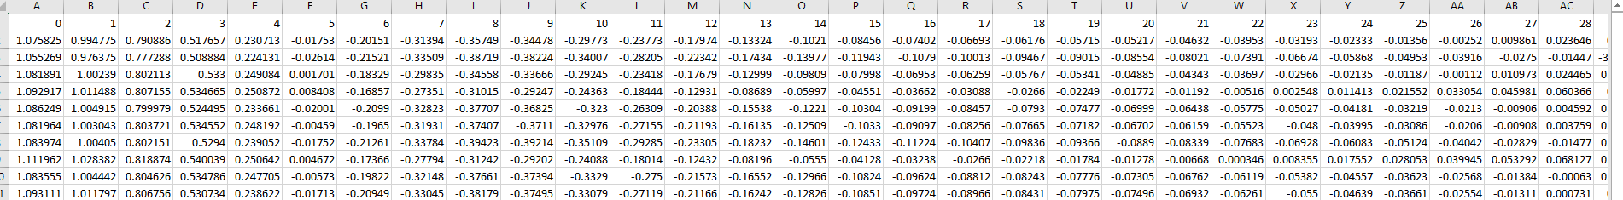
How does ECG data looks like?

Slide 9
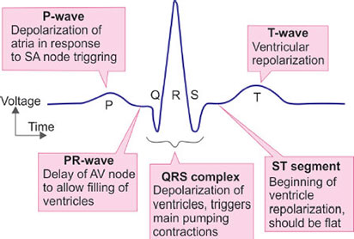
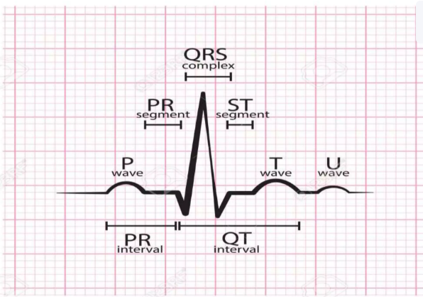
The Electrocardiogram (ECG )

Slide 10
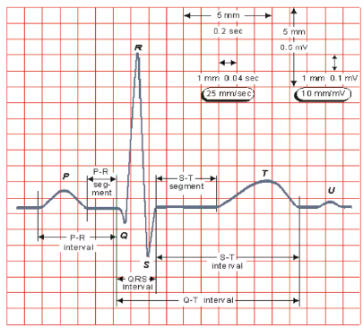
The Electrocardiogram (ECG)
• Amplitude: 1-5 mV
• Bandwidth: 0.05-100 Hz
• Largest measurement error sources:
  – Motion artifacts: Body movements, muscle contractions, or even electrode displacements.
  – 50/60 Hz powerline interference

Slide 11
Uses of The Electrocardiogram (ECG )
Uses of ECG Electrocardiogram is used to detect:
Irregularities in your heart rhythm (arrhythmias)
If blocked or narrowed arteries in your heart (coronary artery disease) are causing chest pain or a heart attack
Structural problems with your heart's chambers
A previous heart attack
How well certain ongoing heart disease treatments, such as a pacemaker, are working
Signs and symptoms which leads for ECG analysis
Heart palpitations
Rapid pulse
Chest pain
Shortness of breath
Dizziness, light-headedness or confusion
Weakness, fatigue or a decline in ability to exercise

Slide 12
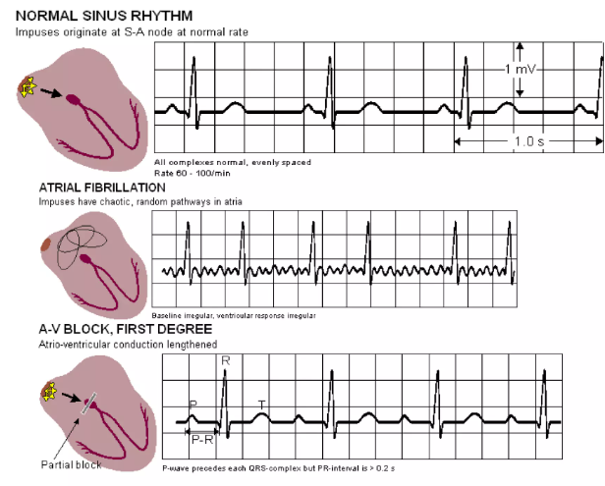
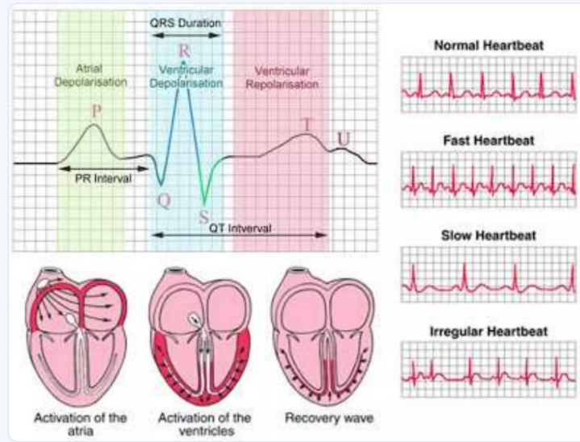
Irregularities in ECG

Slide 13
The Electrocardiogram (ECG )
Advantages
Low cost
Low morbidity
Readily repeatable
Portable
Provides some spatial or localization information
Disadvantages
It provides static picture which may not reflect severe underlying heart issues related to patients.
It uses wires and probes for testing, it restricts body movement.

Slide 14
The ElectroEncephaloGram (EEG)

Slide 15
Fun facts
1. Your Brain Has a Rhythm — Literally!
EEG shows that your brain creates rhythmic electrical patterns, like musical beats, even when you're resting. These rhythms change depending on whether you're sleeping, solving math problems, or even meditating!
2. You Can Control Devices with Your Brain
With Brain-Computer Interfaces (BCIs) based on EEG, people can control video games, prosthetic limbs, drones, or even type with their thoughts — just by thinking!
Fun example: In competitions, students use EEG headsets to race cars with their focus levels!
3. Your Brain Tells If You’re Sleeping — Before You Know It
EEG can detect when you're falling asleep before you're consciously aware of it. Brainwaves shift from fast and small (beta) to slow and large (theta and delta) during the transition into sleep.
4. Everyone’s Brainprint Is Unique
Just like a fingerprint, each person’s EEG pattern is slightly different. Some researchers are exploring EEG-based biometric authentication — unlocking devices with your brain’s signature!

Slide 16
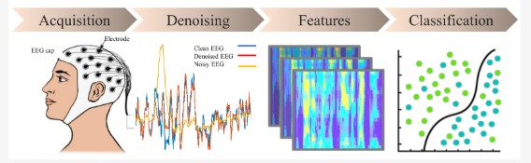
EEG in ML:

Slide 17
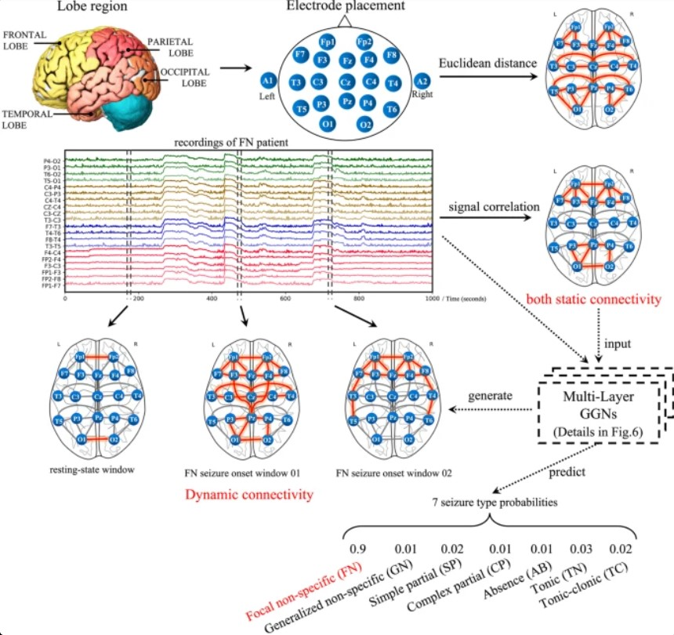
EEG in AI to predict seizures
https://scholarscolab.com/product/depression-detection-using-eeg-by-advanced-graphical-deep-learning/

Slide 18
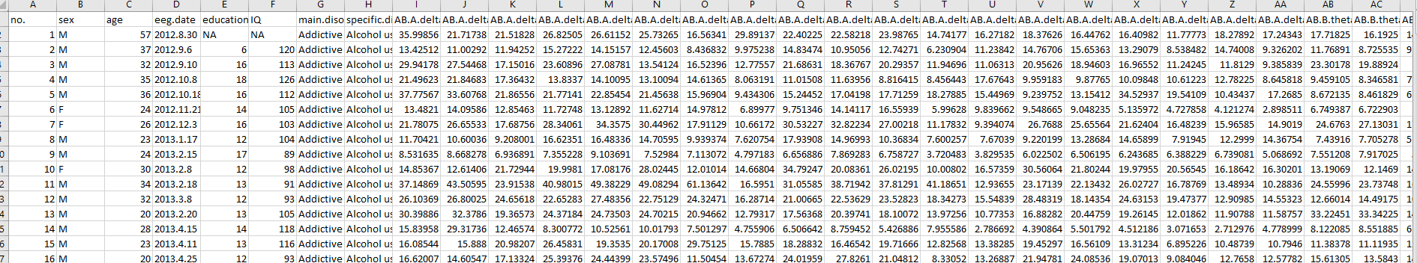
How does EEG data looks like?

Slide 19
The Electroencephalogram (EEG)
• Measures the brain’s electric activity from the scalp
• Measured signal results from the activity of billions of neurons
• Amplitude:0.001-0.01 Mv
• Bandwidth:0.5-40 Hz
• Errors:
  – Thermal RF noise
  – 50/60 Hz power lines

Slide 20
The Electroencephalogram (EEG)
An electroencephalogram (EEG) is a test used to find problems related to electrical activity of the brain.
An EEG tracks and records brain wave patterns. During an EEG test, small electrodes like cups or disc type are placed on the scalp
They pick up the brains electrical signals and send them to machine called Electroencephalogram
It record the signal as wavy lines on to a computer screen or paper in order of microvolt

Slide 21
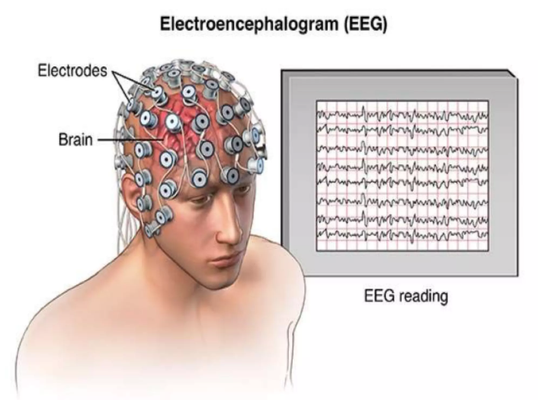
The Electroencephalogram (EEG)

Slide 22
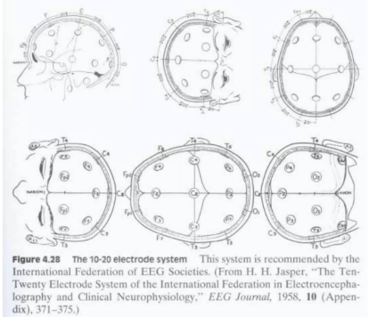
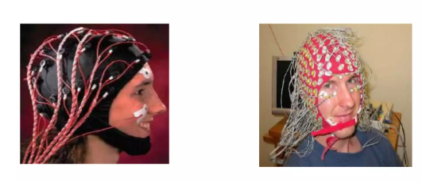
EEG: Electrode Recording System
EEG recording is done using a standard lead system called 10- 20 system

Slide 23
Types of EEG
Routine EEG: Around 20 electrodes are stuck to the scalp using a special paste and EEG signals are recorded
Sleep EEG : the EEG tracing will be recorded along with the heart rate, airflow, respiration, oxygen saturation and limp movement
Ambulatory EEG: it involves recording the brain activity throughout the day and night.

Slide 24
Certain types of mental activity and brain states are associated with strong EEG wave patterns
Wave Type | Frequency (Hz) | Mental Activity / State | Wave Strength
Delta (δ) | 0.5 – 4 Hz | Deep sleep (NREM stages 3 & 4), unconscious state | Very strong during deep sleep
Theta (θ) | 4 – 8 Hz | Drowsiness, light sleep, meditation, daydreaming | Strong during meditative or hypnagogic states
Alpha (α) | 8 – 13 Hz | Relaxed wakefulness, eyes closed, calm focus | Strong when relaxed but awake
Beta (β) | 13 – 30 Hz | Active thinking, problem solving, anxious states | Strong during focused mental tasks
Gamma (γ) | 30 – 100+ Hz | High-level cognition, attention, memory binding | Strong during complex information processing

Slide 25
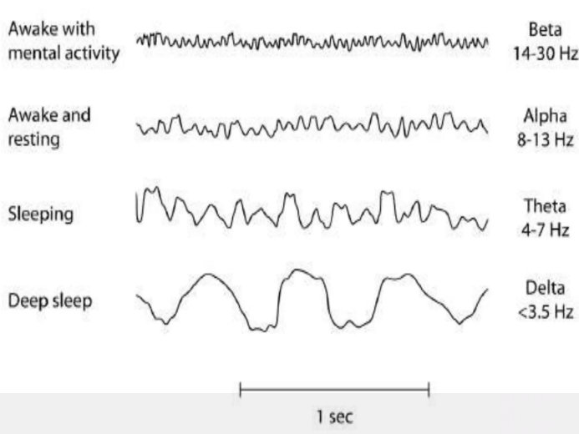
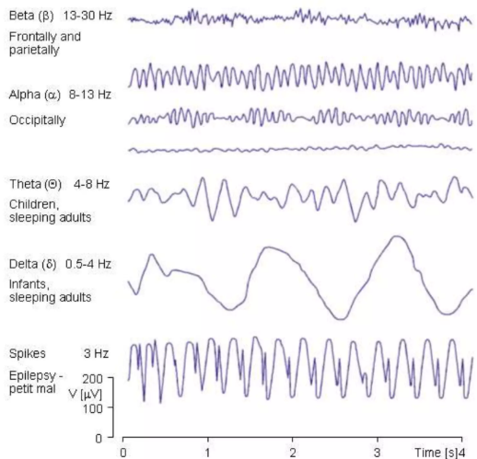
The Electroencephalogram (EEG)

Slide 26
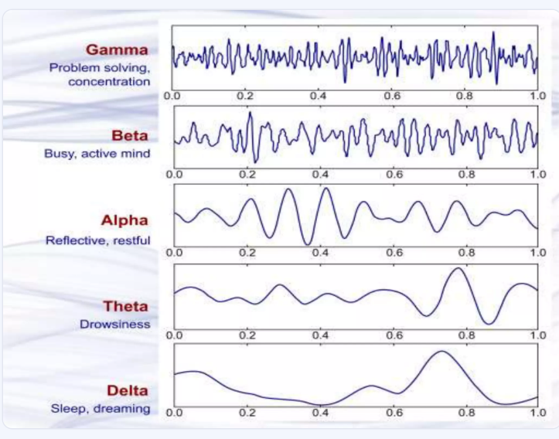
Wave patterns

Slide 27
The Electroencephalogram (EEG)
Advantages
Hardware costs are significantly lower than those of most other techniques
EEG has very high temporal resolution, on the order of milliseconds rather than seconds
Extremely non-invasive
EEG is silent, which allows for better study of the responses to auditory stimuli
EEG does not involve exposure to high intensity magnetic field
Disadvantages
Low spatial resolution
EEG determine neural activity that occurs below the upper layers of the brain poorly
Often takes a long time to connect a subject to EEG
Signal to noise ratio is poor

Slide 28
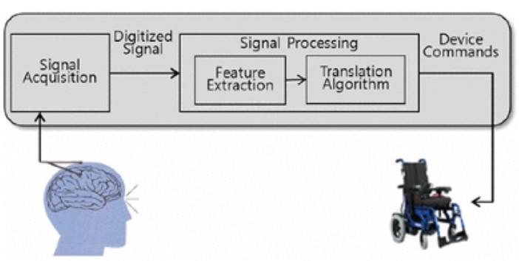
Usage of EEG
Most EEGs are done to diagnose and monitor seizure disorders.
EEGs also can identify causes of other problems, such as sleep disorders.
An EEG can identify the areas of the brain that are not working properly
They're sometimes used to evaluate brain activity after a severe head injury or before a heart transplant or liver transplant
It is also used to determine the level of brain function in people who are in coma
An EEG is used to detect problems in the electrical activity of the brain that may be associated with certain brain disorders. The measurements given by an EEG are used to confirm or rule out various conditions
The test can also be used to monitor activity during brain surgery
Brain-Computer Interfaces (BCI): EEG to control external devices such as wheelchair

