Slide 2
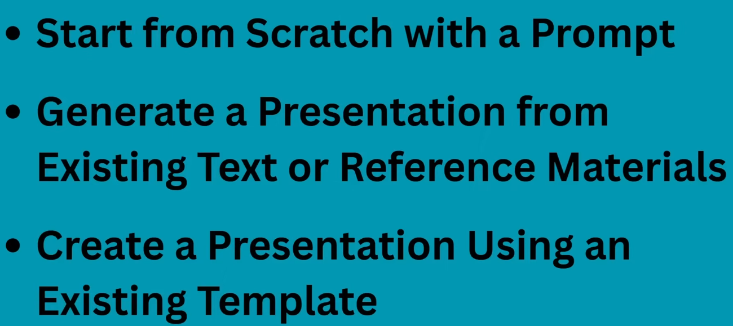

Slide 3
1) Start from scratch from prompt

Slide 4
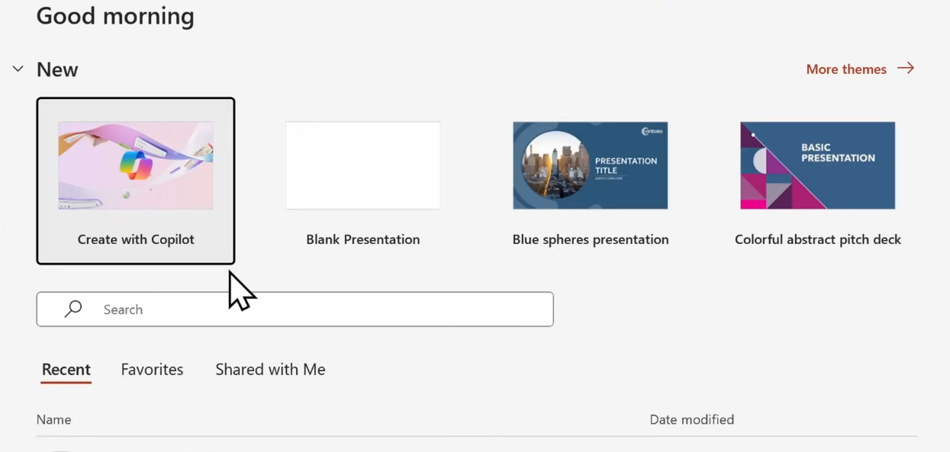

1) Start from scratch from prompt

Slide 5
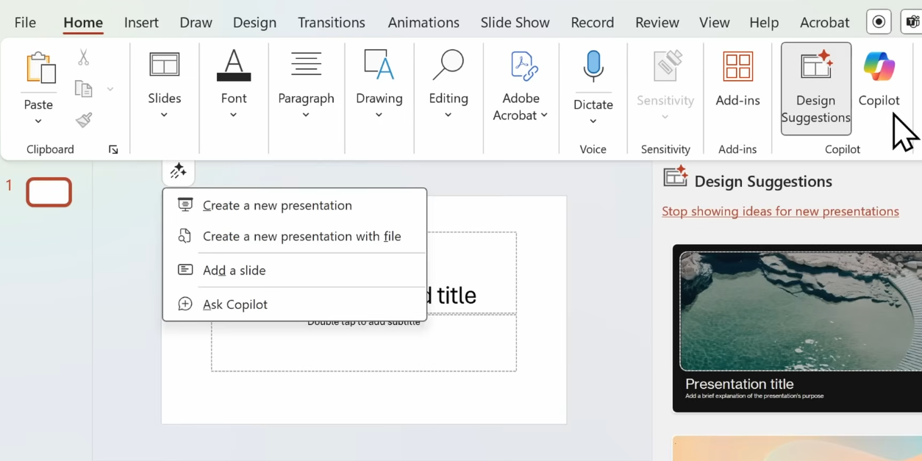

Select: Create a new presentation

Slide 6
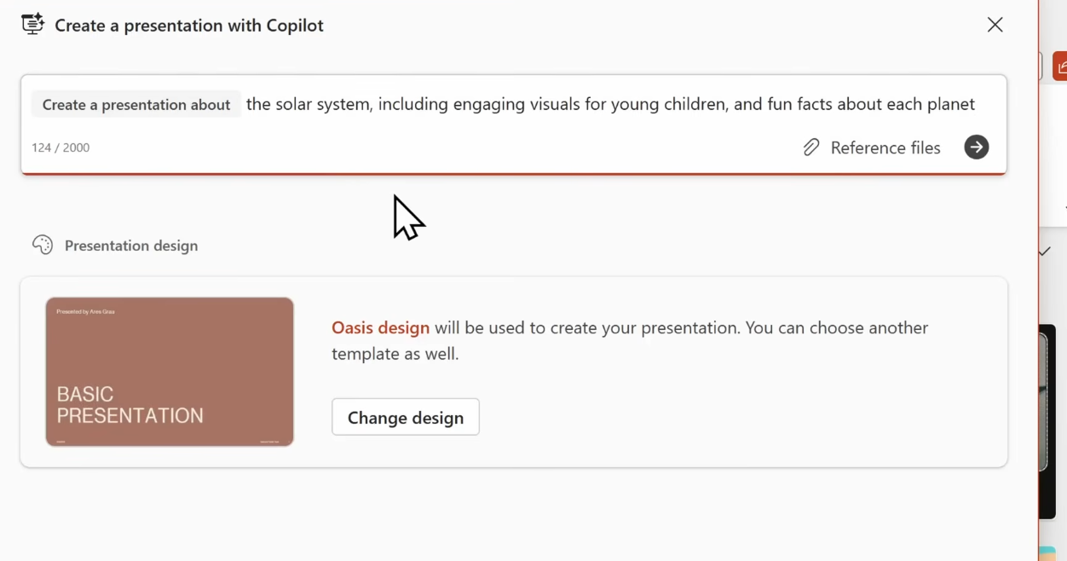

Write following prompt.
This would create a bunch of slides

Slide 7
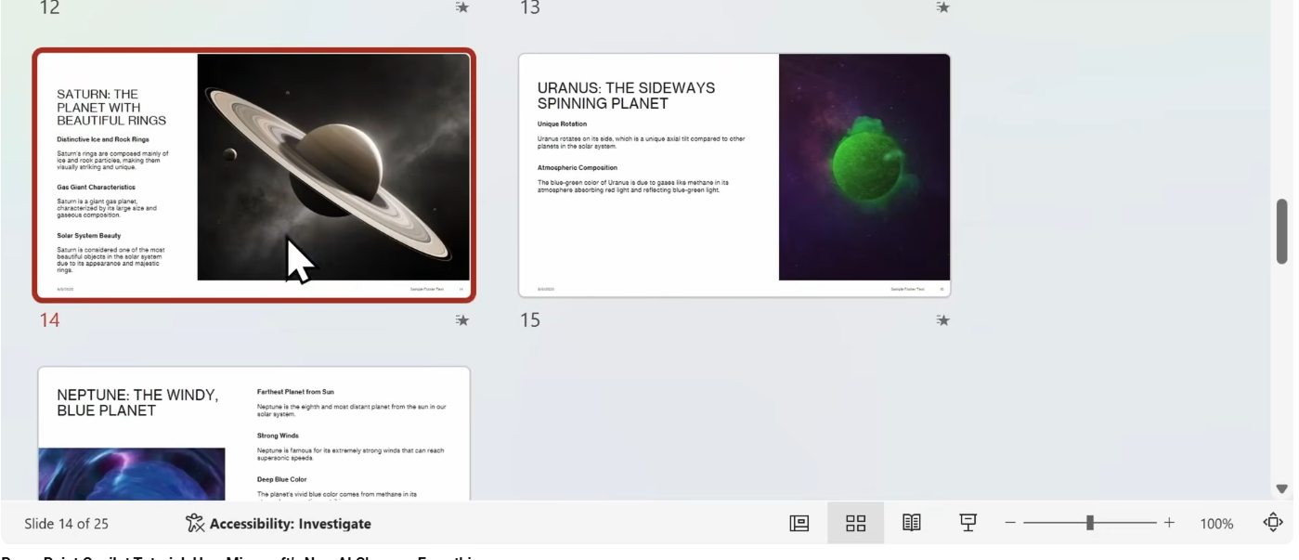

Now we would change content of a slide:
Select any slide and click on bottom Normal

Slide 8
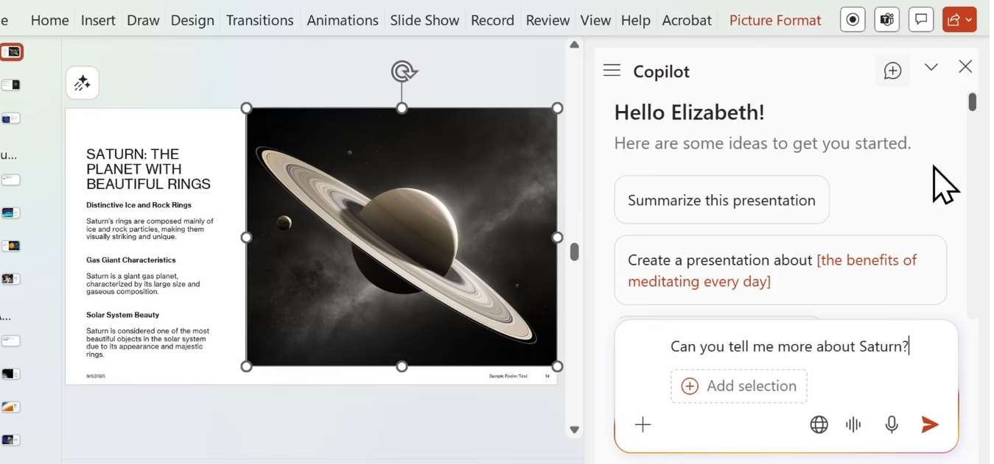
Now I want some additional info about some planet. Open copilot and following prompt

Slide 9
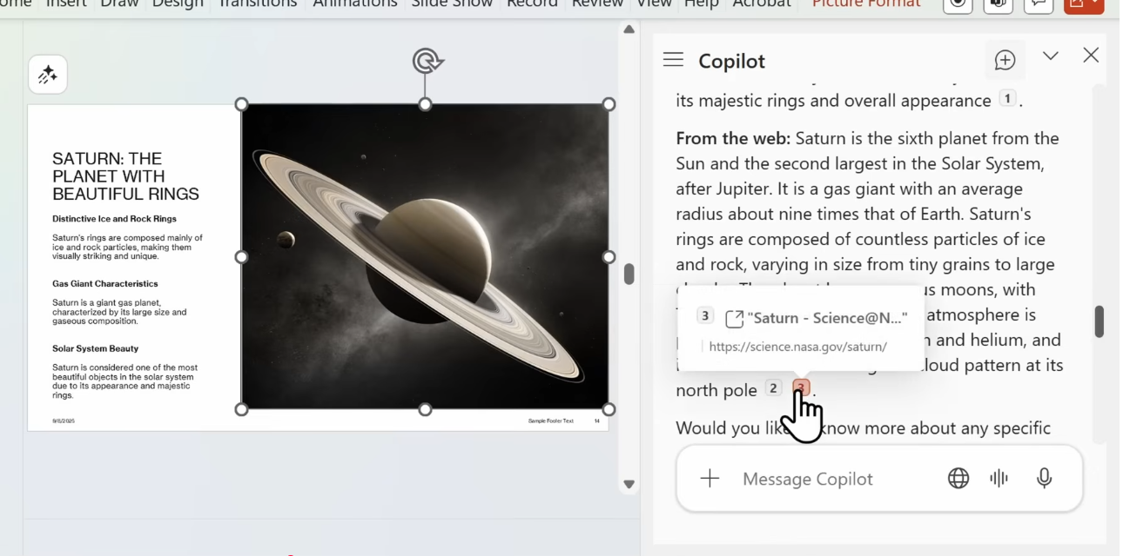
It pulled some info from web and also includes
some citation
Additional prompts

Slide 10
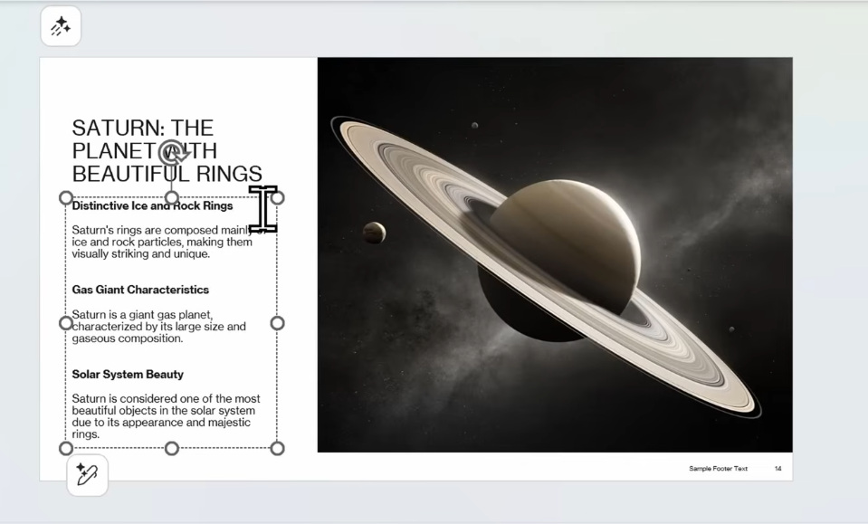
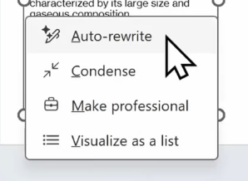
Suppose I want to re write some content on the slides:
Select the content and then click edit button -> Auto-rewrite

Slide 11
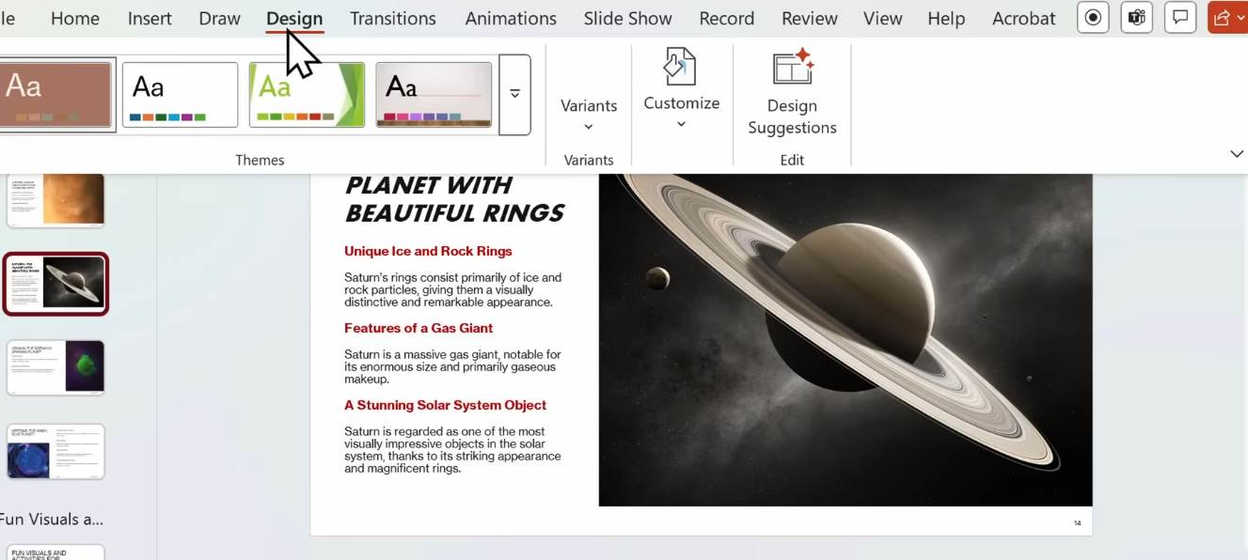
Suppose we want to change the design:
Design -> Design suggestions -> Choose the one that fits your need
You can also customize the background -> choose the options -> Apply to all

Slide 12
2) Create presentation from pre existing document

Slide 13
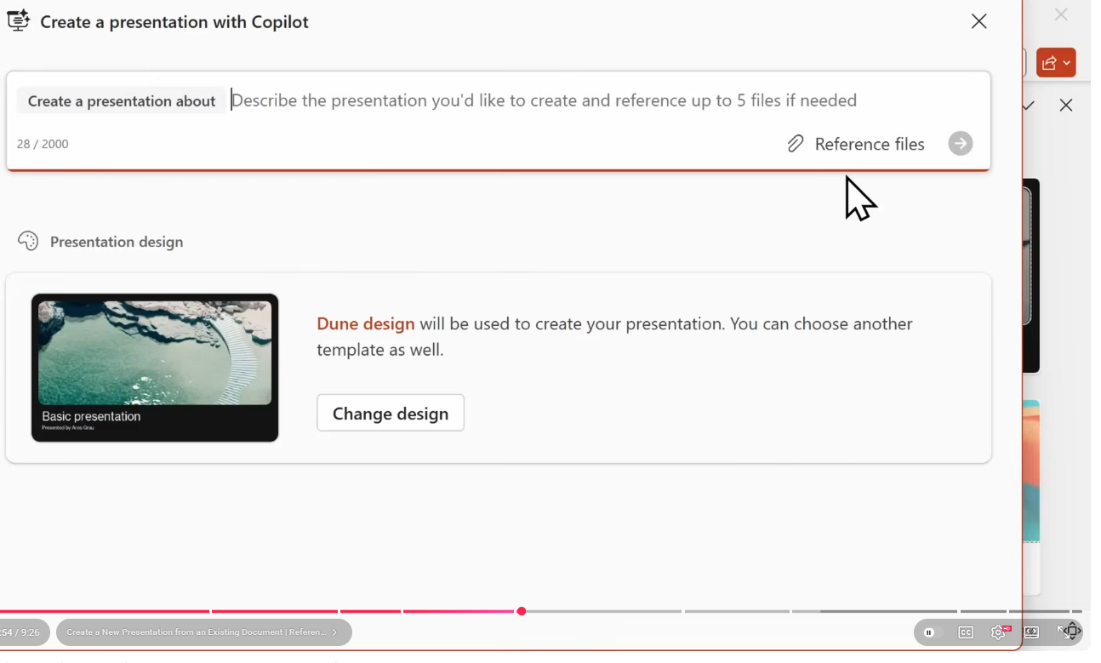
For reference files, use the data_for_planets.docx or use data_for_LSTM_GRU.docx

Slide 14
Generate professional speaker notes for each slides

Slide 15
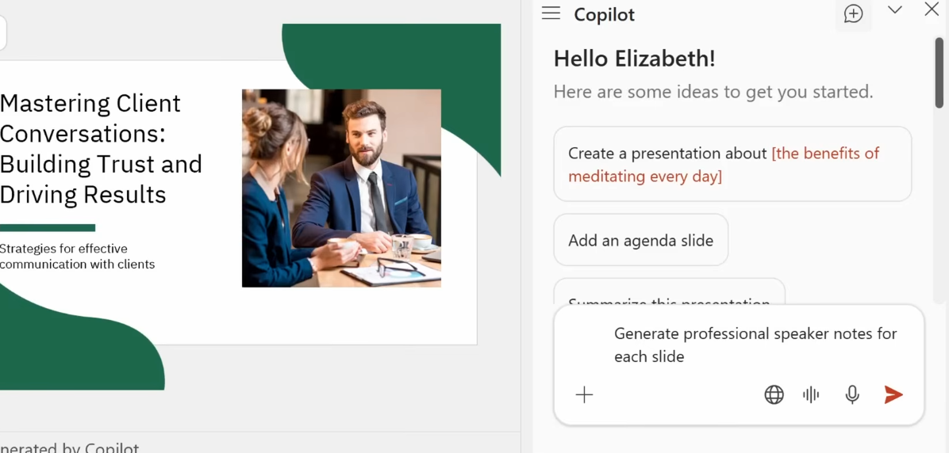
Suppose we want to generate some speaker notes:
Use below prompt
This generates the speaker notes at the bottom for all slides (see next slide)

Slide 16
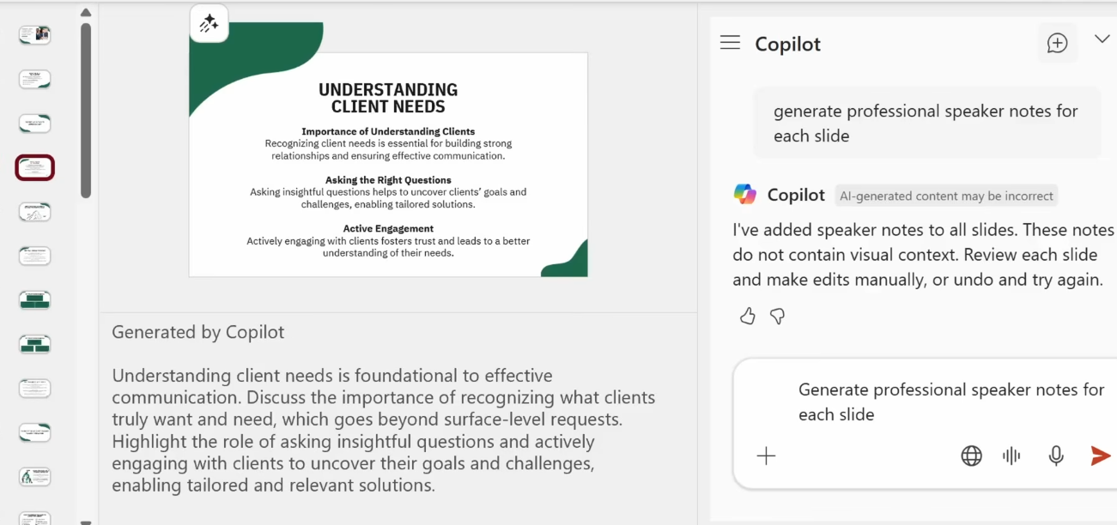

The speaker notes at the bottom for all slides

Slide 17
EXTRA
Ffnbksdfd
Fdslj;f
Fl;ds

