Slide 2
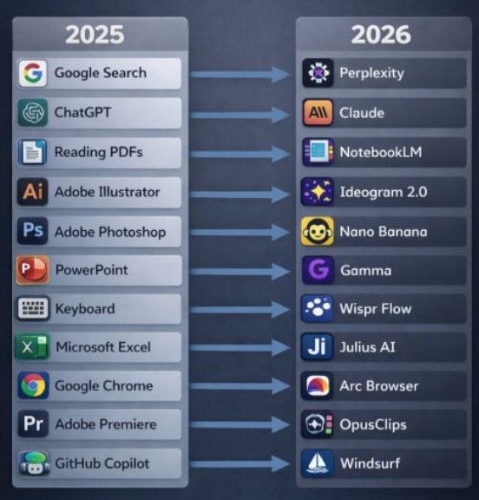
Source : internet

Slide 3
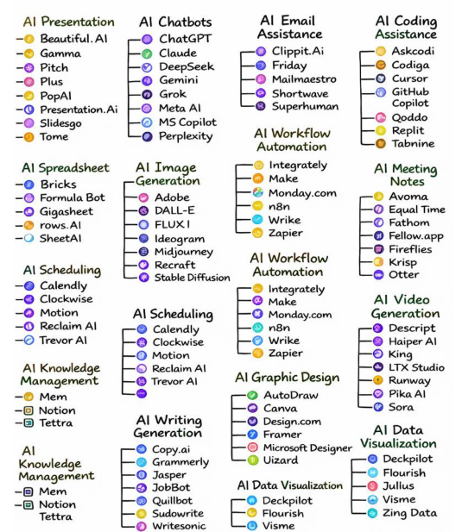
Source : internet

Slide 4
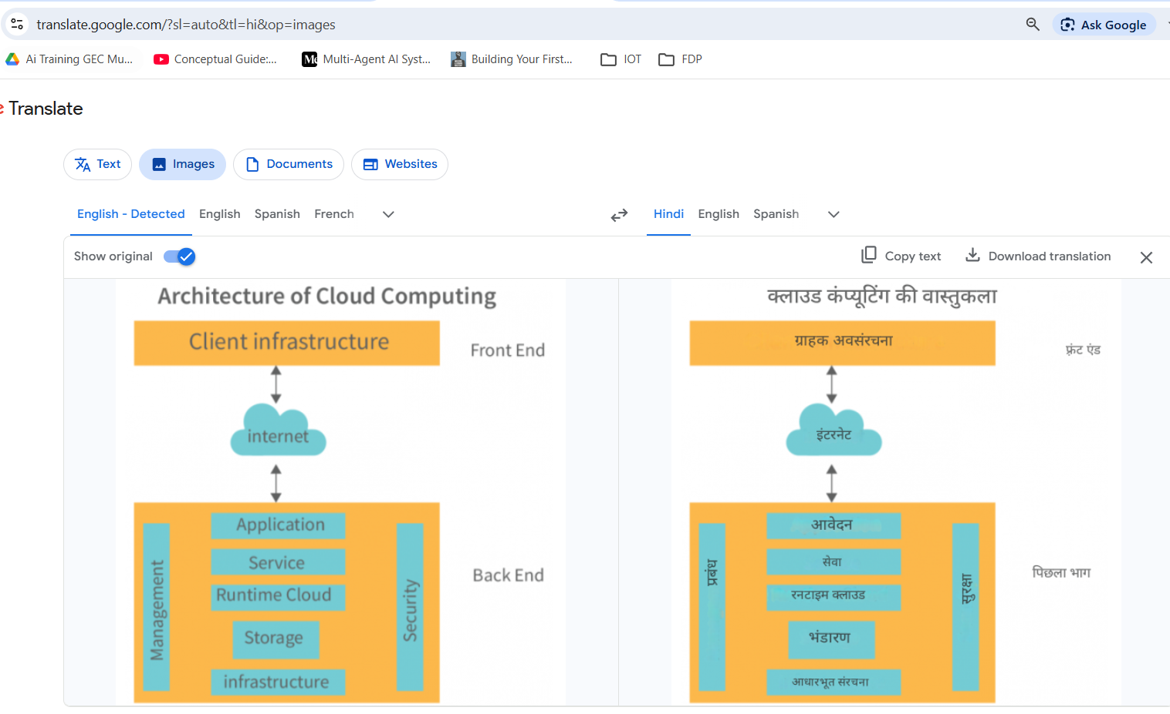
Translate.google.com
Take input an image and convert it to different language
Allows users to point their smartphone camera at text in any foreign language and receive immediate translation overlays.
The system processes text from signs, menus, documents, and even handwritten notes with remarkable accuracy.

Slide 5
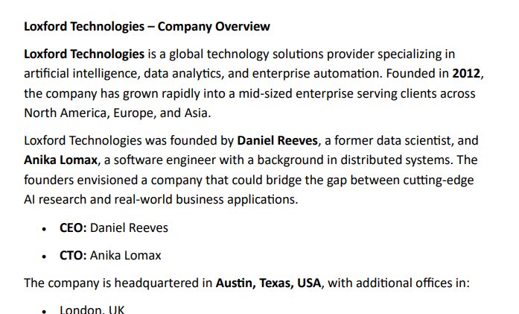
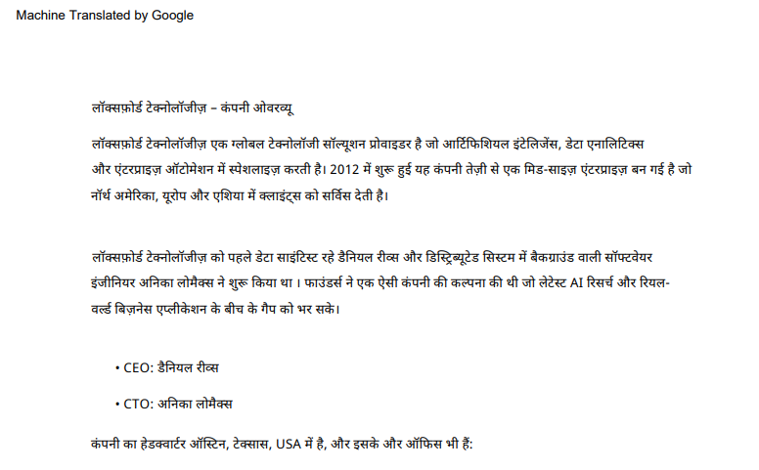
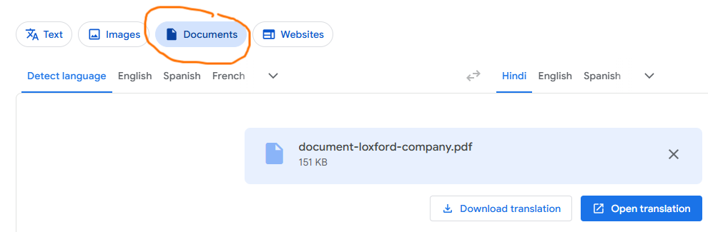
Translate.google.com
Take input a PDF document in English and coverts it into Hindi
Allows users to point their smartphone camera at text document in any foreign language and receive immediate translation overlays.

Slide 6
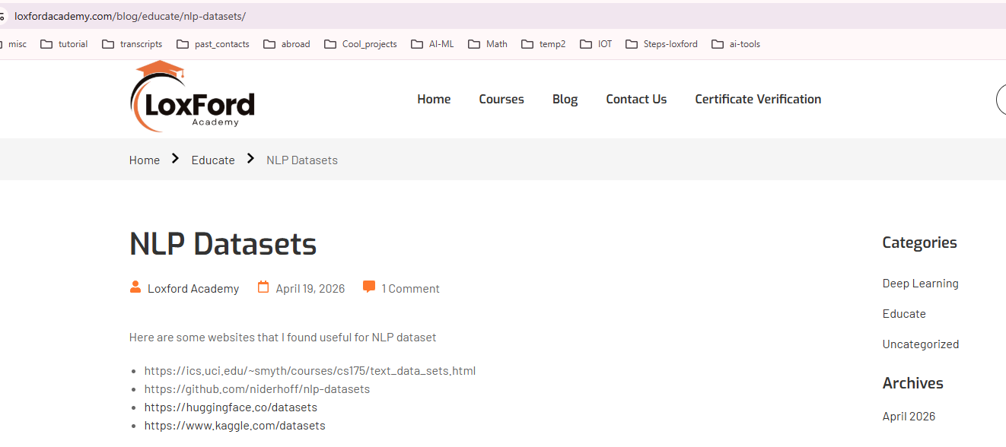
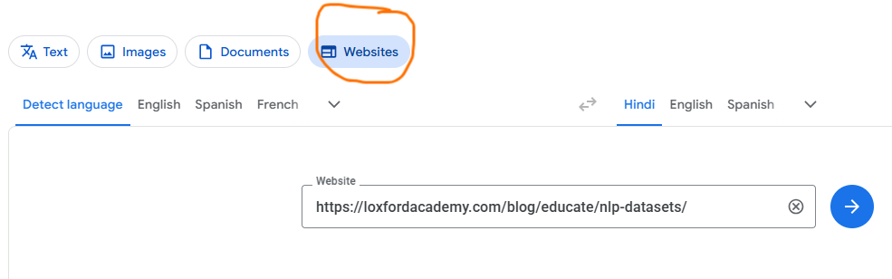
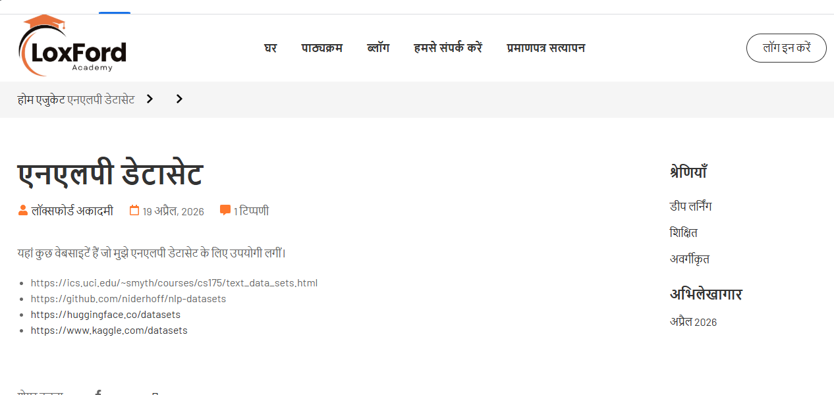
Translate.google.com
Take input a URL of website in English and coverts it into Hindi

Slide 7
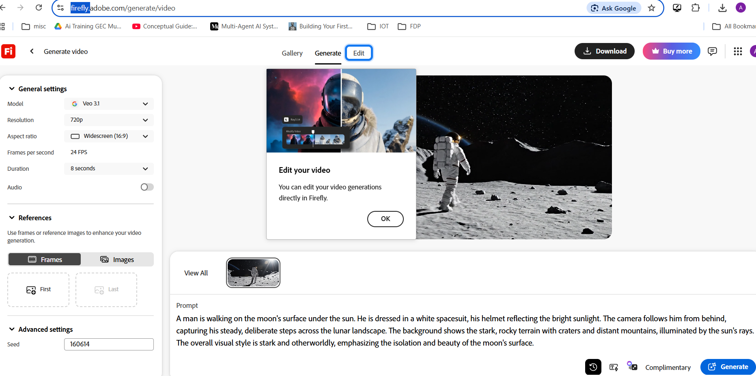

Slide 8
https://firefly.adobe.com/generate/video
Prompt:
A man is walking on the moon's surface under the sun. He is dressed in a white spacesuit, his helmet reflecting the bright sunlight. The camera follows him from behind, capturing his steady, deliberate steps across the lunar landscape. The background shows the stark, rocky terrain with craters and distant mountains, illuminated by the sun's rays. The overall visual style is stark and otherworldly, emphasizing the isolation and beauty of the moon's surface.
Took 30 seconds
Cont….

Slide 9
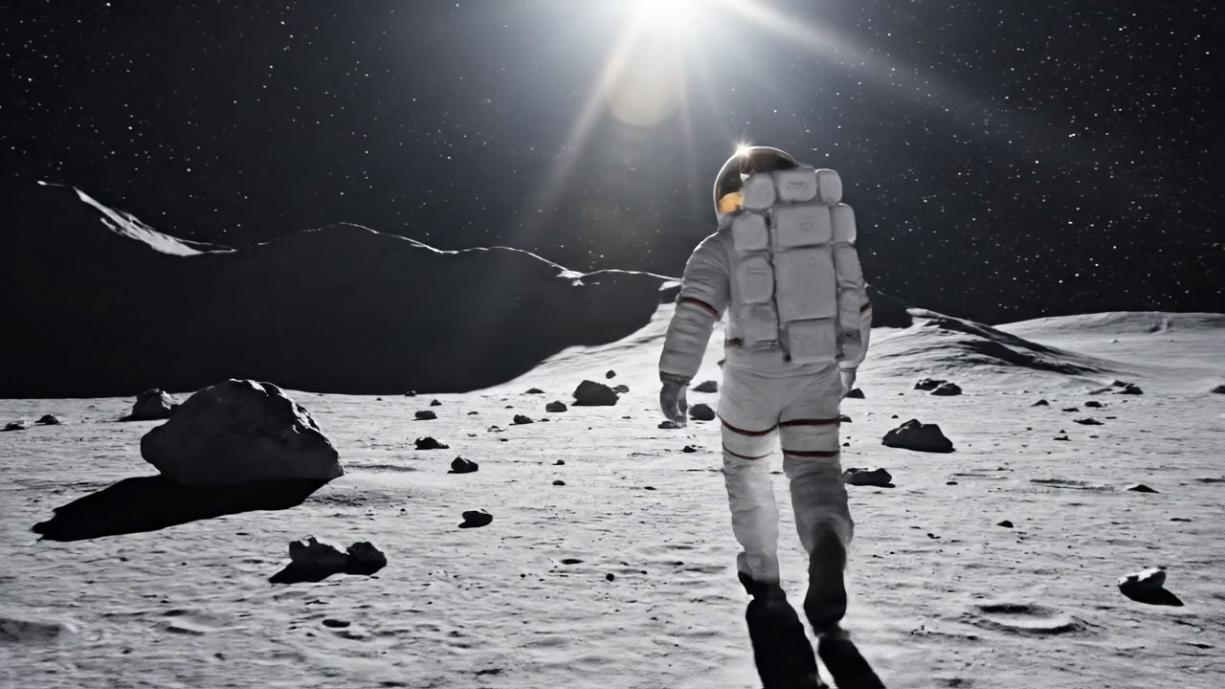

Slide 10
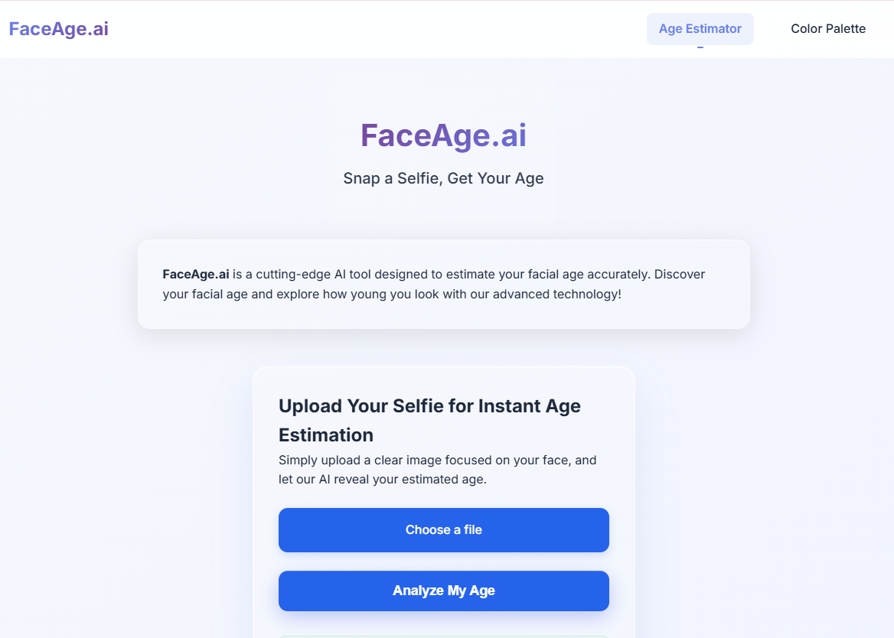
https://faceage.ai/
Face-age ai

Slide 11
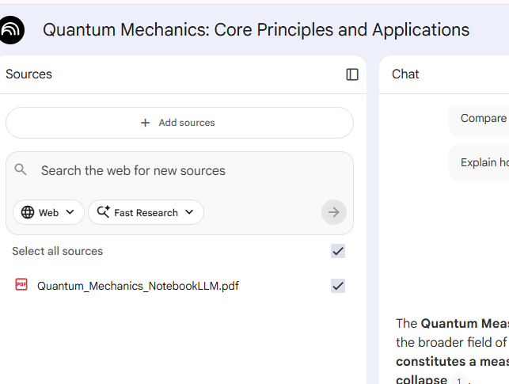
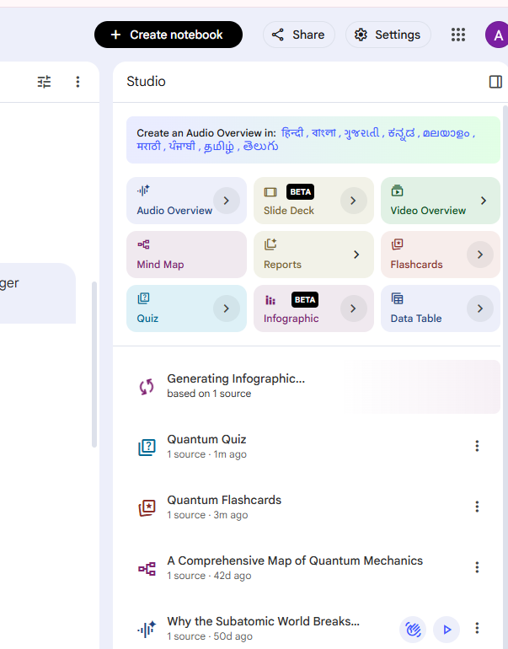



Notebook LM

Slide 12
Create wordpress website with AI:
https://youtu.be/Uta3kgN1Sw0?si=BX76pcPFuEBysjb8

