Slide 1
AWS Bedrock
Converse API
Multi turn conversation
Tool Assistant

Slide 2
Amazon Bedrock is a fully managed cloud service from Amazon Web Services (AWS) that lets you build generative AI applications using top foundation models via a single API.
It offers features like
Knowledge Bases,
Guardrails, and
Agents
without requiring you to manage any servers or infrastructure
Notes:
It is cloud-based service. It helps you build Gen AI application with minimal amount of code. Using API, you can access the top end model.

Slide 3
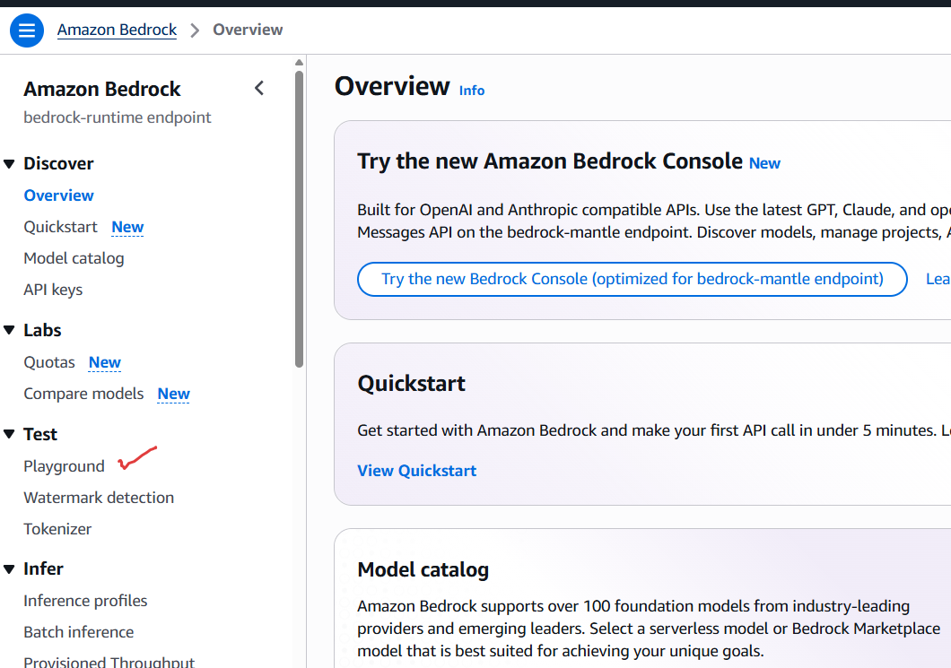
Note: Make sure you are working in Mumbai region

Slide 4
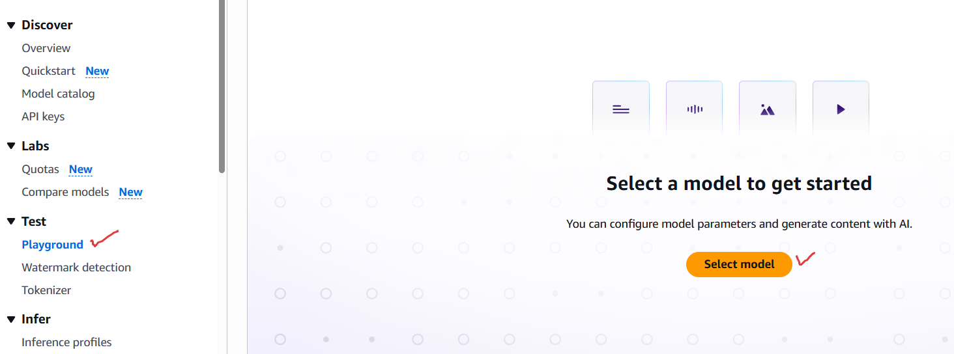

Slide 5
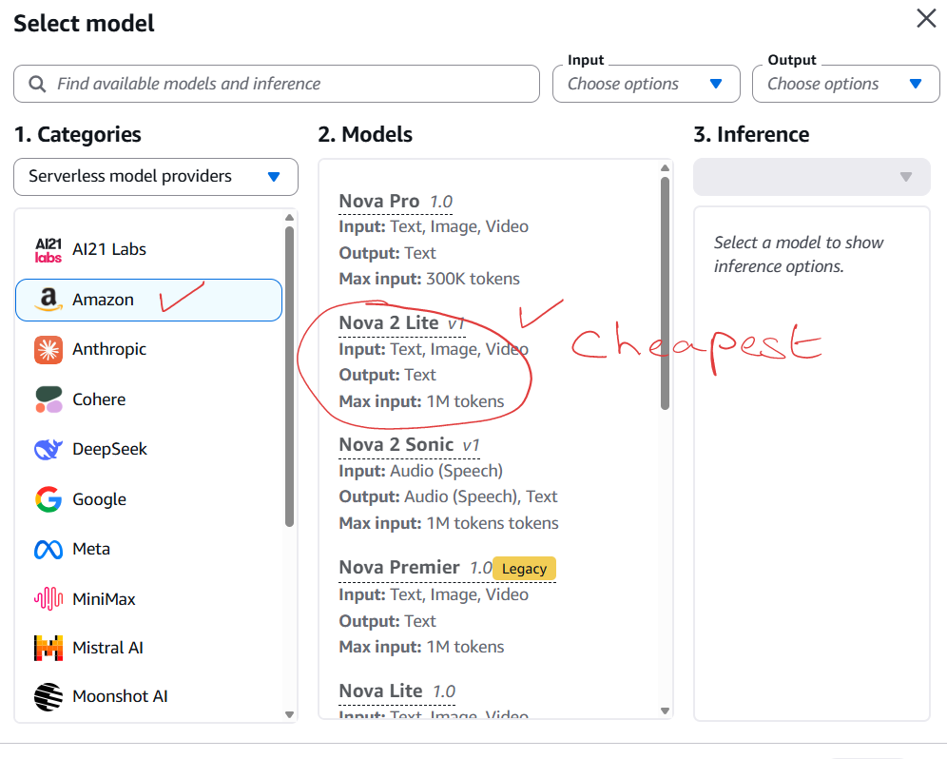

Slide 6
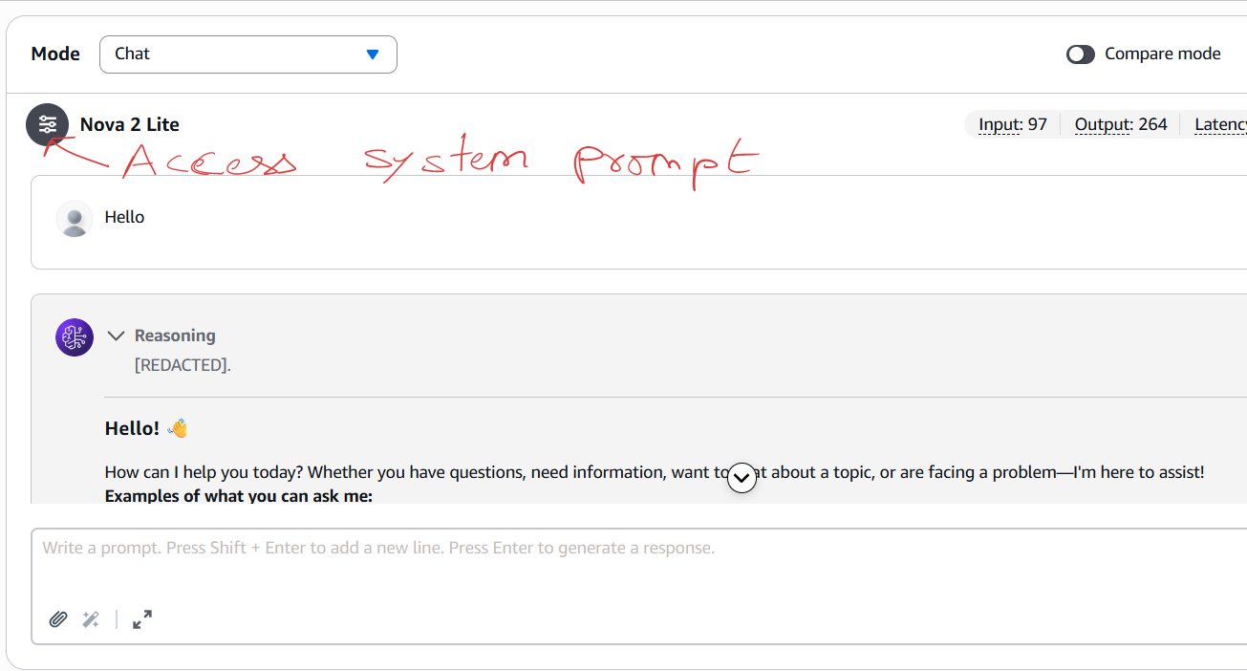

Slide 7
01_converse_api.py

Slide 8
02_multi_turn.py

Slide 9
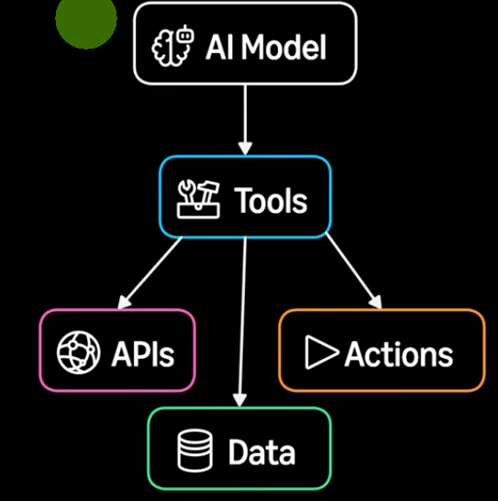
03_tool_using_assistant.py

