Slide 1
RAG – Retrieval Augmented Generation
Amazon Bedrock Knowledge Base
Guard rails
Agents
Notes:
RAG allows you to use LLM to ask question and receive answers related to your personal domain or knowledge base

Slide 2
Step1: Create a S3 bucket
Step2: Create knowledge Base and sync with S3
S3
AWS Bedrock
Knowledge Base

Slide 3
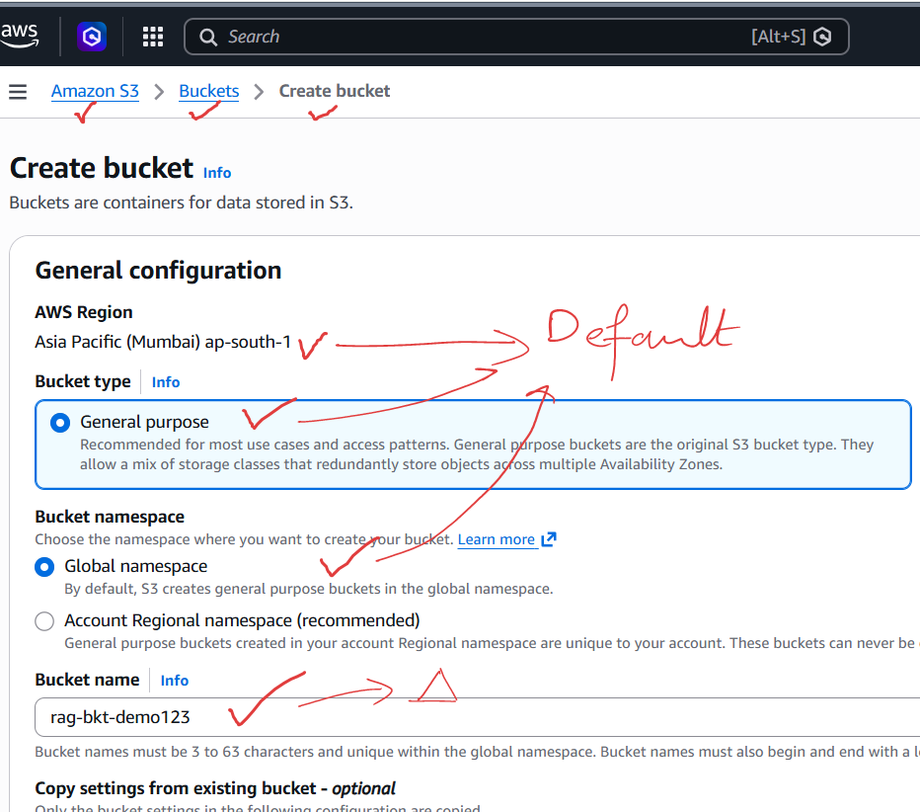
Step1: Create a S3 bucket:
Name of bucket:
rag-bkt-demo123

Slide 4
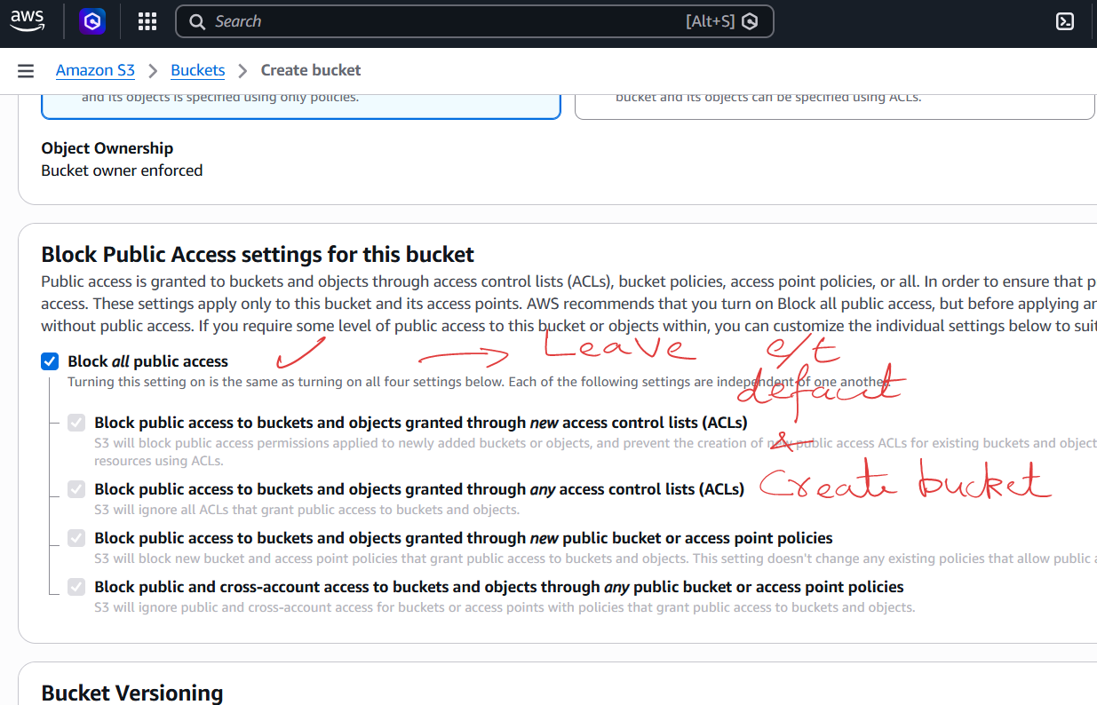

Slide 5
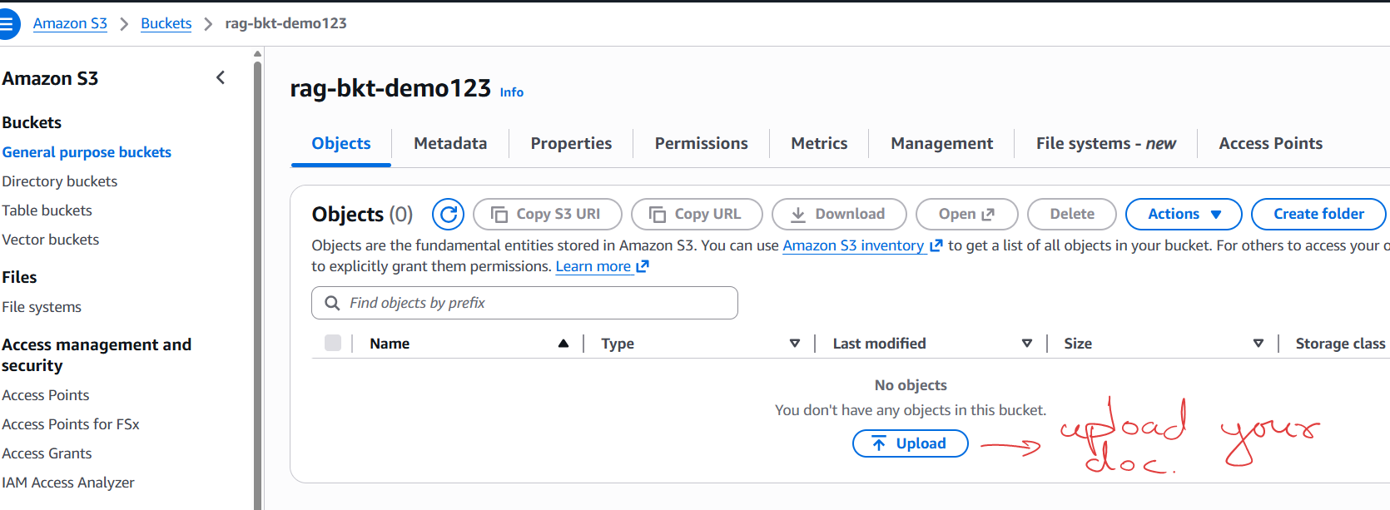

Slide 6
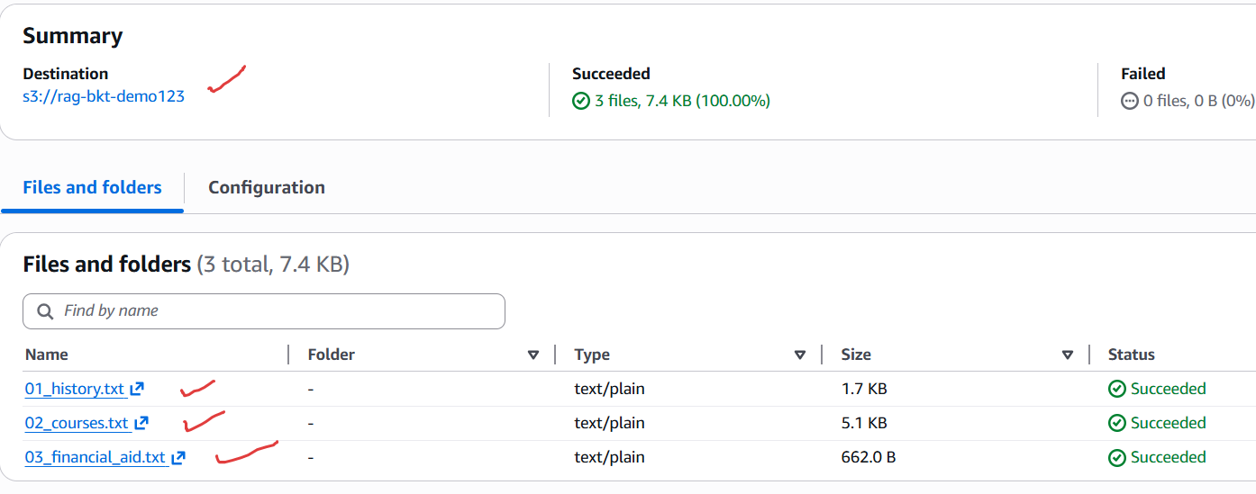

Slide 7
Step2: Now we create Managed Knowledge Base Using AWS Bedrock and sync with S3

Slide 8
Then create Knowledge Base …takes few minutes
Then sync the KB with our data source
Then copy knowledge Base ID which would be needed in python code:
04_RAG_managed_knowledge_base_query.py

Slide 9
Guardrails

Slide 10
Filter Type | Description
Content Filters | Detects harmful content
Denied Topics | Blocks entire topics
Word Filters | Blocks exact words/phrases
Sensitive Information Filters | Detects/blocks PII
Contextual Grounding Checks | Reduces hallucinations in RAG

Slide 11
Agents

Slide 12
Agent
Tool
lookup_course()
LLM
Tool
search_managed_knowledge_base()
Notes:
Agents consist of LLM and tools. LLM is used to decide which tool to select based on user input. It then executes that tool.

