Slide 1
Chunking

Slide 2
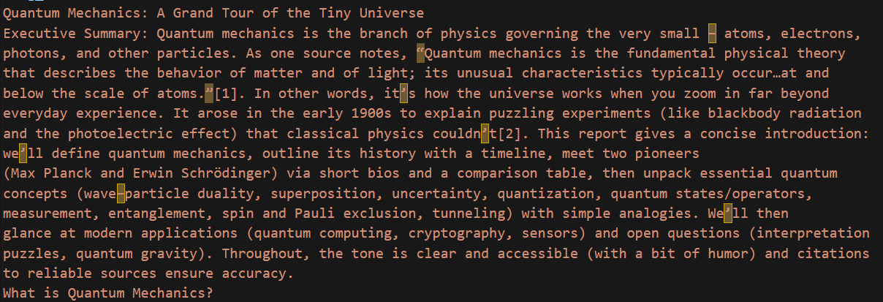
Chunking
It refers to splitting large text into smaller pieces and then storing these small chunks into vector DB

Slide 3
Types of chunking
Fixed size
Overlapping
Semantic chunking (split by meaning)
Paragraph-based splitting
Heading-based splitting

Slide 4
Fixed size
Each chunk is of fixed size: Say 100 words

Slide 5


Overlapping

Slide 6









Semantic chunking (split by meaning)
Artificial Intelligence is transforming industries. It is widely used in healthcare.
Doctors use AI to diagnose diseases.
Football is a popular sport. Millions of people watch it worldwide.
Teams compete in international tournaments. Latin countries love football, also known as soccer.
Data engineering involves building pipelines. It helps process large datasets. Huge data centers are opening up to keep up with large boom in data.

Slide 7



Paragraph-based splitting:
Split text using natural paragraph boundaries
Paragraph = block of text separated by \n or blank line
Chemical reactions are the fundamental processes where substances transform into entirely new forms. By breaking and forming atomic bonds, elements rearrange themselves to create everything from the water we drink to the complex proteins in our bodies. These changes are often accompanied by energy shifts, such as the release of heat or the emission of light.
The periodic table serves as the primary map for understanding these interactions. It organizes elements by their atomic number and electron configurations, allowing chemists to predict how a specific element will behave when it encounters another. For instance, the highly reactive alkali metals in the first column are always seeking to shed an electron to achieve stability.
Laboratory safety remains the most critical aspect of practicing chemistry. Because many reactions can be volatile or produce toxic fumes, scientists must use specialized equipment like fume hoods, safety goggles, and lab coats. Proper handling of reagents ensures that experiments remain controlled and that the resulting data is both accurate and safe to analyze.

Slide 8








Heading-based splitting
AI in Healthcare
AI helps doctors diagnose diseases. Dr. are using
AI to treat patients better.
AI in Finance
AI detects fraud and manages risk. Banks like Loxford
are using ML model to provide better customer service
AI In Education
AI is assisting teachers in preparing better curriculum.

Slide 9
EXTRA
Ffnbksdfd
Fdslj;f
Fl;ds

