Slide 1
Graph DB

Slide 2
A Graph Database (Graph DB) is a type of database designed to store and manage data based on relationships rather than tables.
Instead of rows and columns (like in SQL), it uses a structure similar to a network or graph.

Slide 3
Need for GraphDB:
Vector databases fail when an AI needs to understand multi-hop relationships, exact logic, or structural hierarchies, because vectors only measure superficial semantic similarity (how close words are in meaning), not actual connections.
A prime example where a Vector DB fails
Social Networking:
“Find posts liked by people Ash follows ?”
2) Corporate Supply Chain Risk Management & Compliance.
"Are we sourcing components from any supplier owned by or connected to Company X, which was recently blacklisted?"

Slide 4
Core Idea (Intuition)
Think of social media:
You → follow → your friend
Your friend → likes → a post
That post → belongs to → a topic
This is naturally a graph, not a table.
Follows
Likes
Belongs to
You
Fredo
(Friend)
Post
Stocks

Slide 5
2. Basic Components of a Graph DB

Slide 6
Nodes (Entities)
Represent objects - Example: Person, Product, City
👉 Example:
Node: Ash
Node: Course
Node: Delhi
Ash
Python Course
Delhi

Slide 7
2. Relationships (Edges)
Define how nodes are connected
They are first-class citizens (very important!)
👉 Example:
Ash → TEACHES → Python Course
Ash → LIVES_IN → Delhi
Ash
TEACHES
Python Course
Delhi
LIVES_IN

Slide 8
3. Properties
Additional information about nodes/relationships
👉 Example:
Node (Ash): {age: 30, role: Trainer}
Relationship: { since: 2022 }
Ash
{age: 30,
role: Trainer}
TEACHES
{since: 2022}
Python Course
{Cost: 300 }
Delhi
LIVES_IN
{since: 1998}

Slide 9
Query example:
Social Network + Content Graph
Nodes:
Person: Ash, Ravi, Neha
Post: Post1, Post2
City: Delhi, Tokyo
Topic: AI, Travel
Relationships:
(Ash) ---FOLLOWS---> (Ravi)
(Ash) ---FOLLOWS---> (Neha)
(Ravi) ---FOLLOWS---> (Neha)
(Ash) ---CREATED---> (Post1)
(Ravi) ---CREATED---> (Post2)
(Post1) ---ABOUT---> (AI)
(Post2) ---ABOUT---> (Travel)
(Neha) ---LIKES---> (Post1)
(Ash) ---LIKES---> (Post2)
(Ash) ---LIVES_IN---> (Delhi)
(Ravi) ---LIVES_IN---> (Tokyo)
Suppose you want to answer following:
Find topics liked by people Ash follows ?

Slide 10
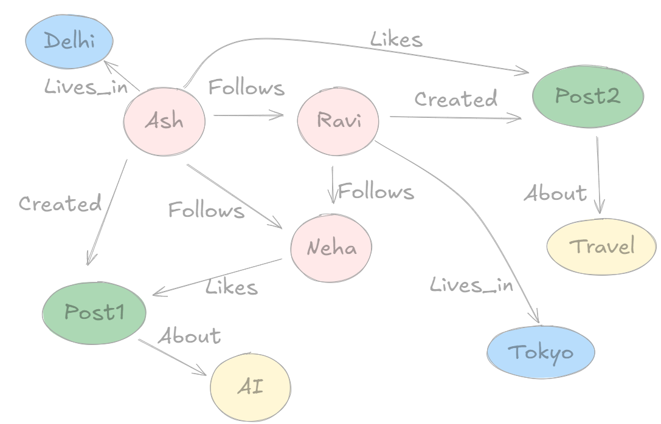
// 1. Create the People (Pink Nodes)
CREATE (ash:Person {name: 'Ash'})
CREATE (ravi:Person {name: 'Ravi'})
CREATE (neha:Person {name: 'Neha'})
// 2. Create the Cities (Blue Nodes)
CREATE (delhi:City {name: 'Delhi'})
CREATE (tokyo:City {name: 'Tokyo'})
// 3. Create the Posts (Green Nodes)
CREATE (post1:Post {name: 'Post1'})
CREATE (post2:Post {name: 'Post2'})
// 4. Create the Topics (Yellow Nodes)
CREATE (ai:Topic {name: 'AI'})
CREATE (travel:Topic {name: 'Travel'})
STEP1: Create Nodes

Slide 11
// 5. Connect the Relationships
CREATE (ash)-[:Lives_in]->(delhi)
CREATE (ash)-[:Follows]->(ravi)
CREATE (ash)-[:Follows]->(neha)
CREATE (ash)-[:Created]->(post1)
CREATE (ash)-[:Likes]->(post2)
CREATE (ravi)-[:Follows]->(neha)
CREATE (ravi)-[:Created]->(post2)
CREATE (ravi)-[:Lives_in]->(tokyo)
CREATE (neha)-[:Likes]->(post1)
CREATE (post1)-[:About]->(ai)
CREATE (post2)-[:About]->(travel)
STEP2: Create relationships

Slide 12
Q: Find topics liked by people Ash follows ?
Answer (Visually): AI

Slide 13
4. Query Example
In graph databases like Neo4j, you use Cypher query language:
Q: Find out where Ash lives.
MATCH (p:Person {name: 'Ash'})-[:Lives_in]->(c:City)
RETURN c.name AS City
Answer: Delhi

Slide 14
4. Query Example
In graph databases like Neo4j, you use Cypher query language:
Q: Find all the people Ash follows ?
MATCH (p:Person {name: 'Ash'})-[:Follows]->(p:Person)
RETURN p.name AS FollowedPerson
Answer: Ravi and Neha

Slide 15
4. Query Example
In graph databases like Neo4j, you use Cypher query language:
Q: what kind of post Ash likes ?
MATCH (p:Person {name: 'Ash'})-[:Likes]->(post:Post)-[:About]->(t:Topic)
RETURN t.name AS Topic
Answer: Travel

Slide 16
4. Query Example
In graph databases like Neo4j, you use Cypher query language:
Q: Find topics liked by people Ash follows ?
MATCH (p:Person {name: 'Ash'})-[:Follows]->(f:Person)-[:Likes]->(post:Post)-[:About]->(t:Topic)
RETURN DISTINCT t.name AS Topic
Answer: AI

Slide 17
Comparison: Graph Databases vs Relation DB
Feature | Graph DB | Relational DB
Structure | Nodes & Edges | Tables
Relationships | Direct & fast | Via JOINs
Performance | Fast for connections | Slow for complex joins
Use Case | Networks, recommendations | Structured data

Slide 18
6. Why Graph Databases Are Powerful
a. Relationship-heavy data
Social networks
Fraud detection
Recommendation systems
b. Faster queries for connections
No expensive JOINs

Slide 19
7. Real-World Use Cases
Social Media
Facebook uses graph-like structures for connections
When Should You Use Graph DB?
Use it when:
Data is highly connected
You need fast relationship queries
You are building:
  Recommendation engines
  Chatbots (RAG + knowledge graph 🔥)
  Network analysis systems

Slide 20
8. Popular Graph Databases
Neo4j (most popular)
Amazon Neptune

Slide 22
EXTRA
Ffnbksdfd
Fdslj;f
Fl;ds

