Slide 2
“Every year, financial fraud costs the world over $5 trillion. Why are humans losing — and why is AI winning?”
Here we answer this question
Topics we will cover:
Types of financial fraud
Why rule-based systems fail
Fraud as a needle-in-a-haystack problem
What "good" detection looks like

Slide 3
🗺️
Types of financial fraud
Credit card fraud
Identity theft
Account takeover
Insider fraud
Money laundering
— real examples with real dollar losses.

Slide 4
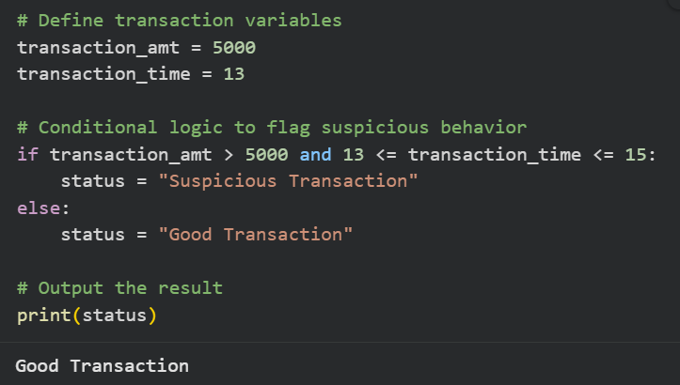
⚡Why rule-based systems fail
Traditional "if amount > $5000, flag it" logic — why fraudsters adapt faster than rule writers.
Fraudsters would use $4,999 to bypass this logic
Here fraudster can use
transaction_amt = 4999 and
transaction_time = 12
This would bypass the rule-based detection

Slide 5
📊 Fraud as a needle-in-a-haystack problem
Introducing class imbalance: fraud is ~0.1% of transactions.
Why this makes analytics hard and interesting.

Slide 6

Why is Imbalanced Data Dangerous?
Suppose:
1000 transactions
990 normal
10 fraud
Fraud = Only 1%
If model predicts “Every sample is Normal”, then
accuracy = 990 / 1000 = 99%
Looks great, but model is useless because it never detects fraud.
Accuracy is misleading in imbalanced datasets.

Slide 7
🎯 What "good" detection looks like
Precision vs. recall trade-off explained simply:
false positives annoy customers,
false negatives cost money.

Slide 8
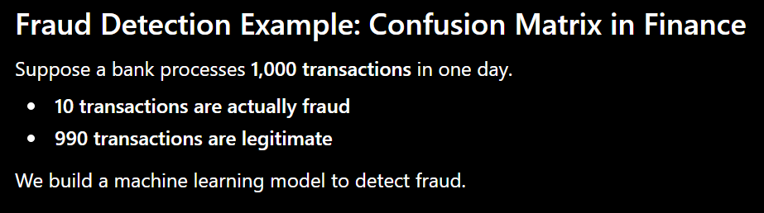

Slide 9
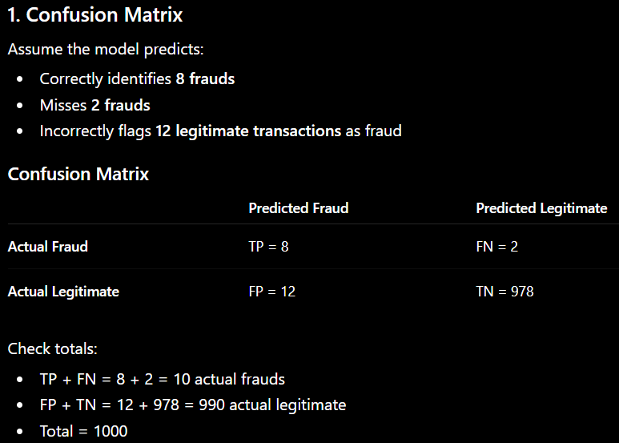

Slide 10
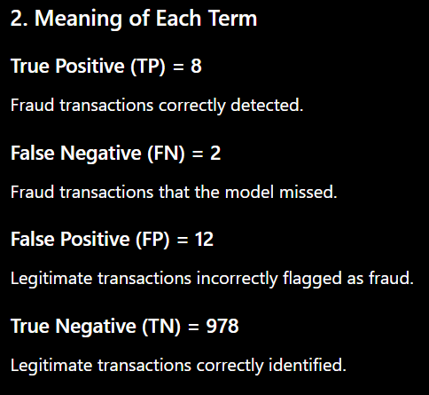

Slide 11
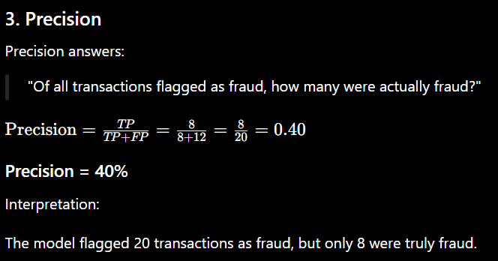
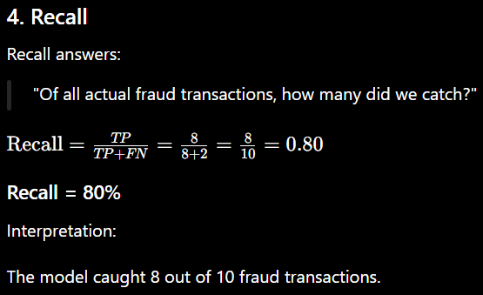

Slide 12
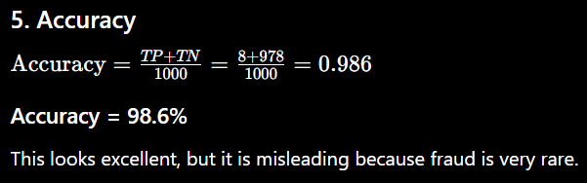
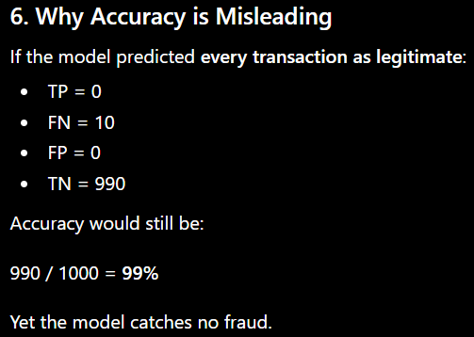

Slide 13


Slide 14

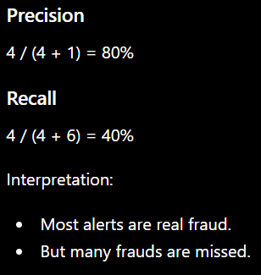
Metric | Value
TP | 4
FP | 1
FN | 6

Slide 15

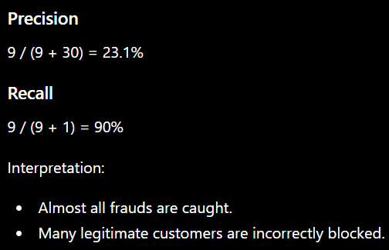
Metric | Value
TP | 9
FP | 30
FN | 1

Slide 16
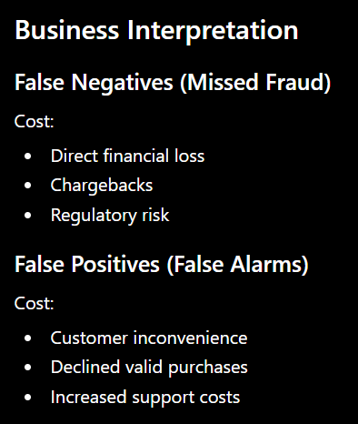
Which Metric Matters More?
In fraud detection, Recall is usually more important because missing fraud can be very expensive.
However, extremely low precision is also problematic because too many good customers are disrupted.
Banks often optimize for:
High Recall
Reasonable Precision

