Slide 2
"Fraudsters are invisible people doing very visible things. The data always tells a story.“
Topics covered:
Feature engineering for fraud
Graph features — following the money

Slide 3
🧱
Feature engineering for fraud
Velocity features (3 transactions in 5 minutes)
location anomalies (distance between 2 transaction is large -> anomaly)
device fingerprinting ()
behavioural baselines.

Slide 4
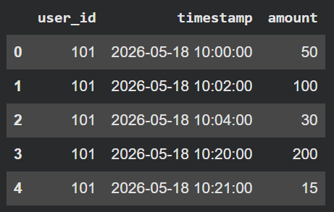
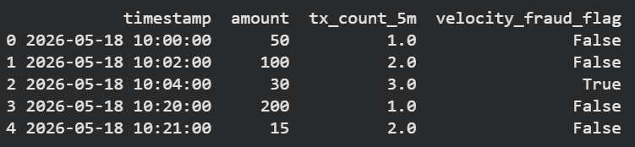
Velocity features (3 transactions in 5 minutes)

Slide 5
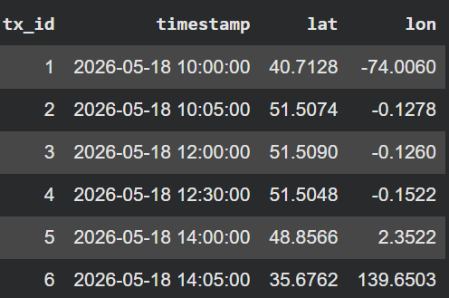
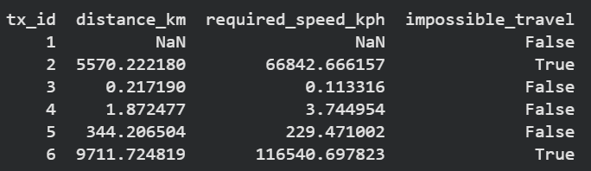
Location Anomaly

Slide 6
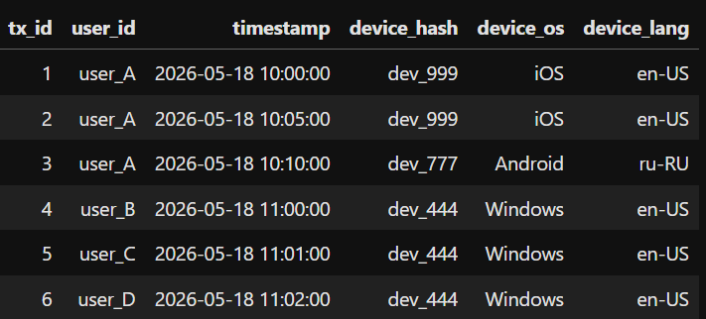
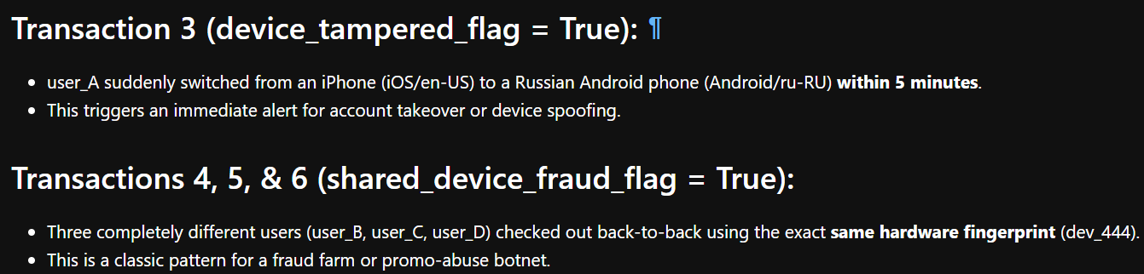
Device fingerprinting (See jupyter notebook for complete code)

Slide 7
Behavioural baseline
Example:
App Inactivity & In-App Navigation Speed
The Baseline: When regular users log into their banking app, they take their time. They might check their balance, scroll through transactions for 30 seconds, and look at a statement. They have a predictable pattern of taps and pauses.
The Anomaly: A user logs in after six months of zero account activity. Within exactly 1.5 seconds of logging in, they navigate straight to the "Add New Wire Transfer Recipient" page and type out an external routing number perfectly without making typos. This rapid, laser-focused navigation screams automated bot script or an experienced fraudster using a compromised account.

Slide 8
🕸️
Graph features — following the money
How shared phone numbers, addresses, and devices connect fraudsters. A visual intro to network/graph analysis.

