Slide 1




1. What is a Time Series?
A time series is a sequence of data points recorded in order over time, at regular intervals.
The key word is order — unlike regular data, you cannot shuffle rows.
The sequence matters.
Name | Age | Income
Loxford | 23 | 34,000
Jerry | 39 | 83,000
Bob | 65 | 129,000
Nancy | 53 | 132,000
Name | Age | Income
Jerry | 39 | 83,000
Loxford | 23 | 34,000
Bob | 65 | 129,000
Nancy | 53 | 132,000
Date | Price
2026-01-01 | 23
2026-01-02 | 27
2026-01-03 | 29
Date | Price
2026-01-02 | 27
2026-01-01 | 23
2026-01-03 | 29

Slide 2
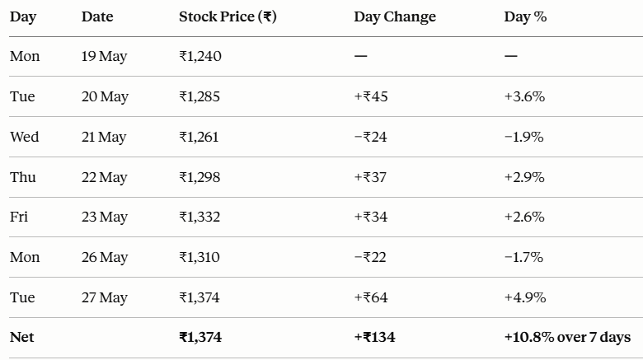
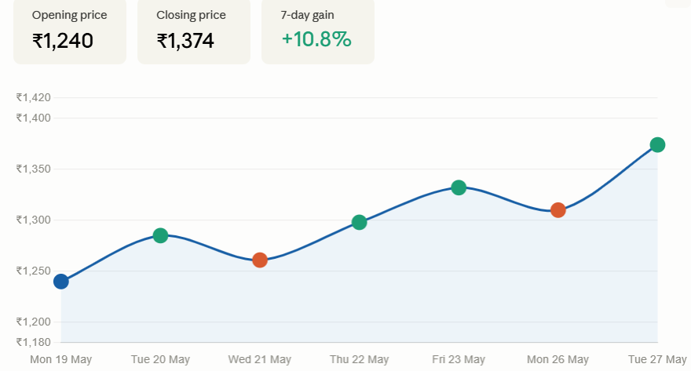
Examples:
Domain | Time Series Example
Finance | Daily stock prices, monthly loan defaults

Slide 3
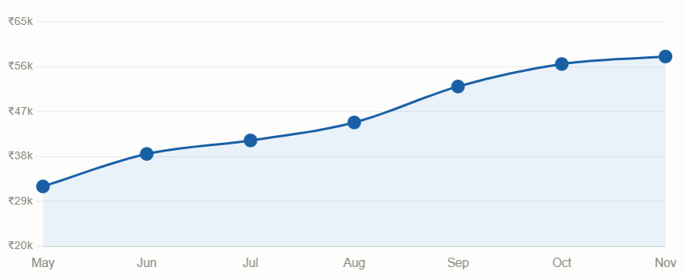
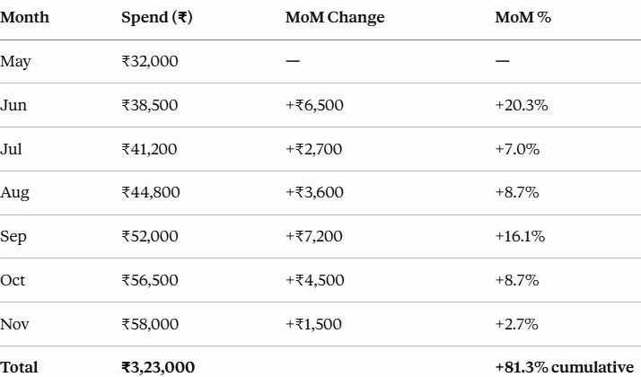
Examples:
Domain | Time Series Example
Banking | Credit card spends per month

Slide 4
More Examples:
Domain | Time Series Example
Finance | Daily stock prices, monthly loan defaults
Banking | Credit card spends per month
Economics | Quarterly GDP, monthly inflation
Retail | Daily sales of a product
Healthcare | Weekly hospital admissions

Slide 5
What makes it different from regular data?
Regular Data | Time Series Data
Rows are independent | Each row depends on the past
Can shuffle rows freely | Order is sacred
Standard ML works directly | Needs special treatment
Name | Age | Income
Loxford | 23 | 34,000
Jerry | 39 | 83,000
Bob | 65 | 129,000
Nancy | 53 | 132,000
Date | Price
2026-01-01 | 23
2026-01-02 | 27
2026-01-03 | 29

