Slide 1
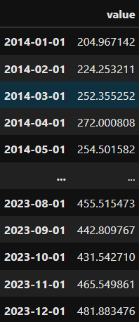
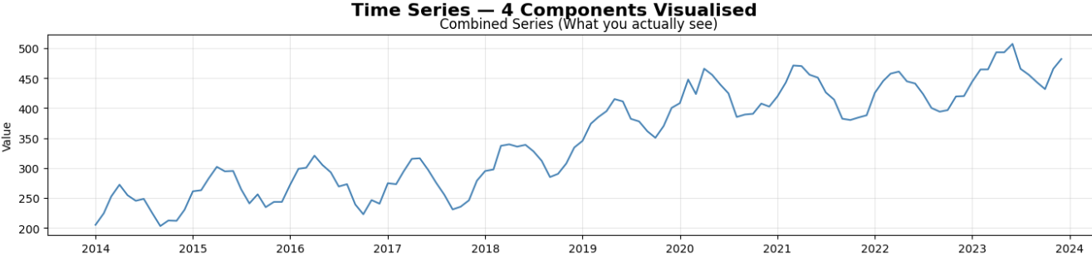
Components of Time Series
Every time series is made up of 4 building blocks.
Your job as an analyst is to decompose the series and understand each part.

Slide 2
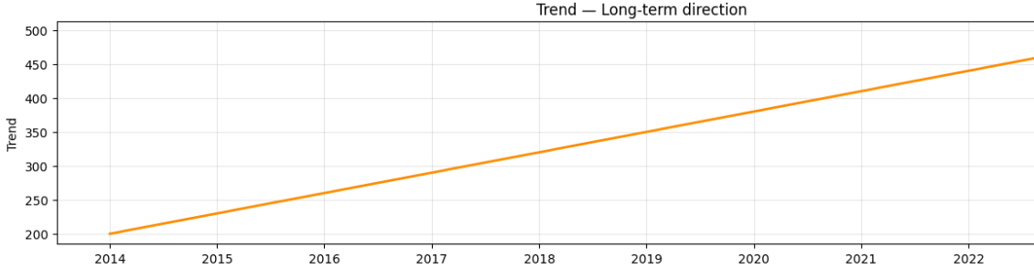
Component 1 — Trend 📈
The long-term direction of the series — rising, falling, or flat.
Ignores short-term fluctuations.
Rising trend → loan disbursements growing year on year
Falling trend → cheque usage declining over a decade
Flat trend → stable utility consumption

Slide 3
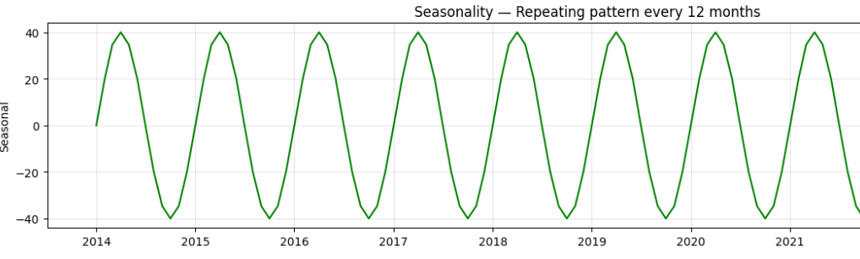
Component 2 — Seasonality 🔄
Regular, repeating patterns tied to a fixed calendar period — daily, weekly, monthly, yearly.
Retail sales spike every December
Credit card spends peak on weekends
Tax payments spike every March in India
Key point: Seasonality is predictable and fixed in period. You know it will repeat.

Slide 4
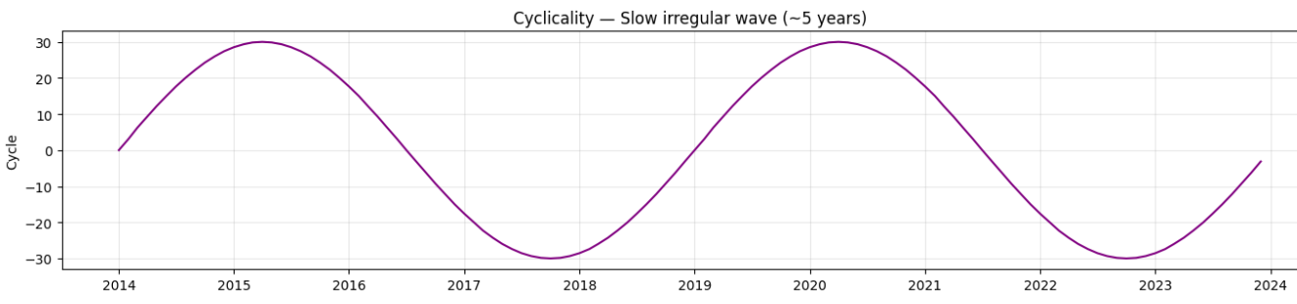
Component 3 — Cyclicality 🌊
Long-term waves that rise and fall but are not fixed in period. Driven by economic or business cycles.
Credit defaults rise during recessions, fall during booms
Real estate prices over 10–15 year cycles
Key difference from seasonality:
Cycles are irregular in timing and length — you can't say "it repeats every 12 months."

Slide 5
 | Seasonality | Cyclicality
Period | Fixed (monthly, yearly) | Irregular
Predictability | High | Low
Example | December sales spike | Recession-driven defaults

Slide 6
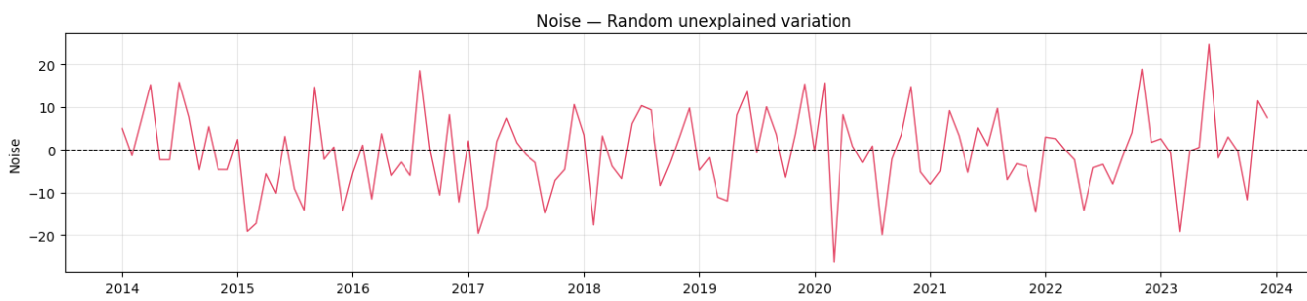
Component 4 — Noise (Residual) ⚡
The random, unexplained variation left after removing trend, seasonality, and cycles.
A sudden spike in defaults due to a flood
One-off festival sales spike not captured by seasonality
Data errors
You cannot model noise — it is random. A good model captures trend + seasonality and leaves only noise as residual.

Slide 7
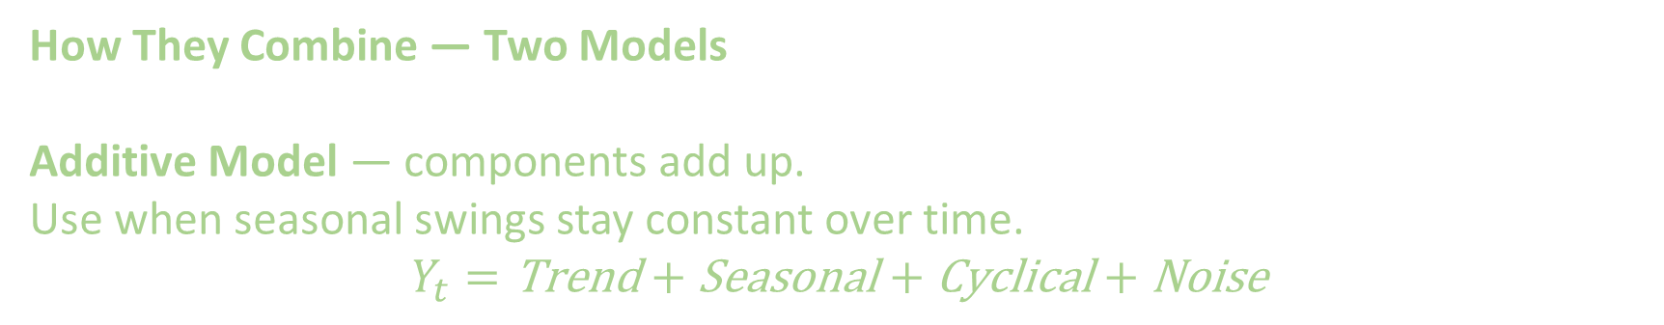
How They Combine — Two Models
Additive Model — components add up.
Use when seasonal swings stay constant over time.
$$Y_{t}=\text{Trend}+\text{Seasonal}+\text{Cyclical}+\text{Noise}$$

Slide 8
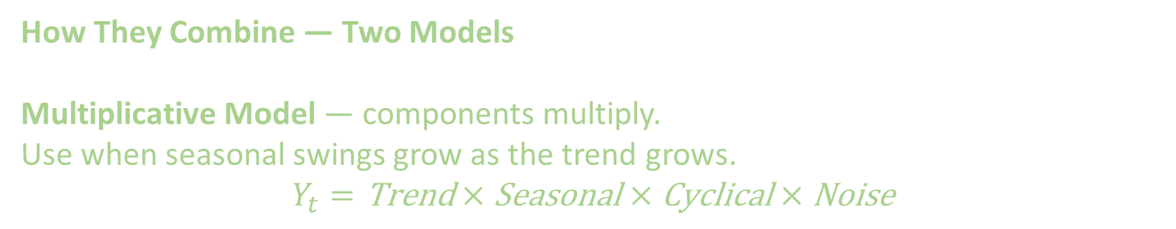
How They Combine — Two Models
Multiplicative Model — components multiply.
Use when seasonal swings grow as the trend grows.
$$Y_{t}=\text{Trend}×\text{Seasonal}×\text{Cyclical}×\text{Noise}$$
Simple rule: If the seasonal peaks get taller as the series grows → use multiplicative.

