Slide 1
Feature | Stock Price 📈 | Stock Return 🔄
What is it? | The exact dollar amount of the asset. | The percentage change in value.
Example | Apple is trading at $180.00. | Apple went up +2.0% today.
Data Nature | Non-stationary (can trend upward or downward over time). | More stationary (typically fluctuates around zero).
Predictability | Very hard to forecast directly. | Easier to model statistically.
Typical Values | 150, 180, 220, etc. | -0.03, 0.01, 0.05, etc.
Used For | Tracking the market value of the stock. | Risk analysis, forecasting, and financial modeling.
Preferred in Finance Models? | No | Yes

Slide 2
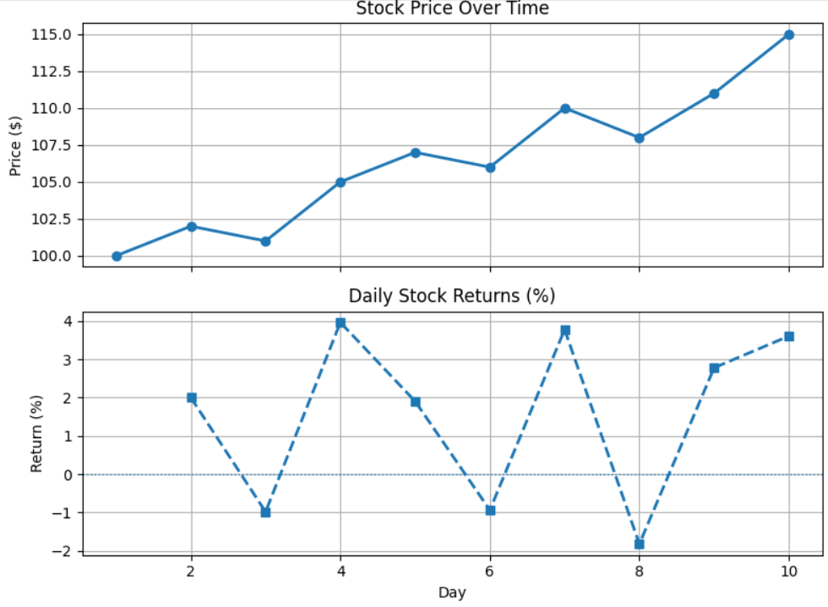
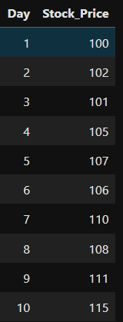
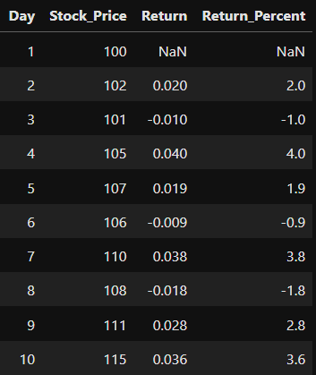
Example:
Given

Slide 3
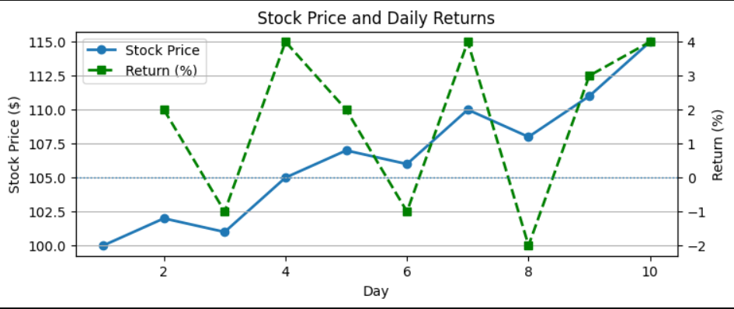
Example:
Given

