Slide 1
Tensorflow

Slide 2
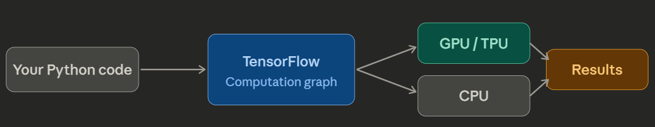
What is TensorFlow?
TensorFlow is an open-source machine learning framework by Google.
Official site: www.tensorflow.org
It lets you define mathematical computations as a graph, then run them efficiently on CPUs, GPUs, or TPUs.
It is used for implementing ML and deep learning applications.
The key idea: you describe what to compute, TensorFlow figures out how to run it fast.

Slide 3
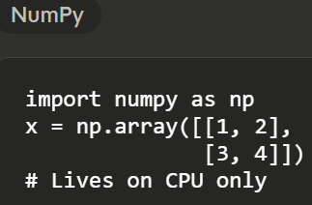
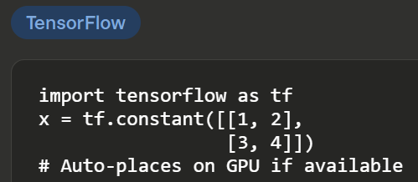
Tensors: the data structure
A tensor is just a multi-dimensional array — like NumPy, but it lives on the GPU.

Slide 4
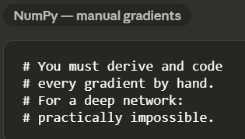
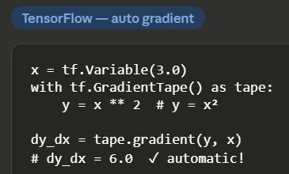
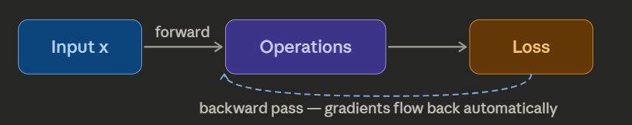
Automatic differentiation (Gradients)
TensorFlow records every operation and can compute gradients automatically — essential for training neural networks.
NumPy cannot do automatic differentiation.

Slide 5
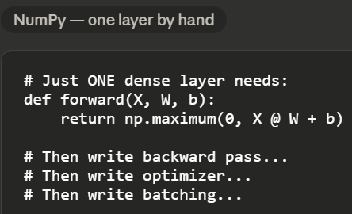
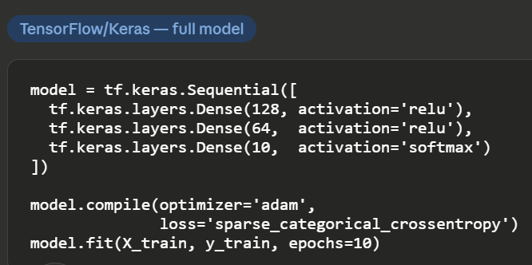
Building a neural network
TensorFlow includes Keras — a high-level API for assembling neural networks from ready-made layers.
NumPy would require you to implement every layer from scratch.

Slide 6
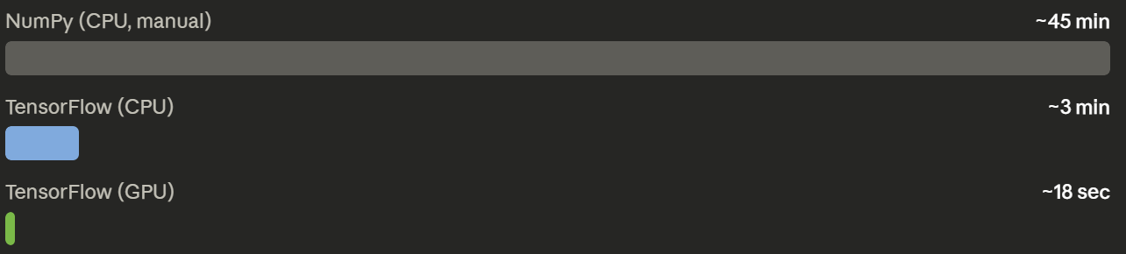
GPU acceleration in action
Training speed is why TensorFlow exists.
Here is a real-world comparison for training a simple image classifier for 10 epochs on MNIST.

Slide 7
Flexibility:
TensorFlow caters to diverse ML tasks, encompassing image recognition, natural language processing (NLP), and recommender systems.
Scalability:
Seamlessly handle large datasets and complex models on various hardware platforms, from single machines to powerful TPUs (Tensor Processing Units) in the cloud.
Other features
TensorFlow is well-documented and includes plenty of machine learning libraries*

Slide 8
TensorBoard Visualization:
TensorBoard, a built-in visualization suite, aids in monitoring model training progress, analyzing performance metrics, and debugging issues.
TensorFlow offers two primary interfaces for building ML models:
Keras: A high-level API ideal for beginners and rapid prototyping. Keras abstracts away complexities, enabling you to focus on model design and experimentation.
TensorFlow Core API: A low-level, more granular approach offering finer control over model architecture and computations. This is preferred for experienced developers or situations requiring extensive customization.

Slide 9
EXTRA
Xxxxxxxxxxx
xxxxxxxxxxxx

