Slide 1
Artificial Neural Network
ANN

Slide 2
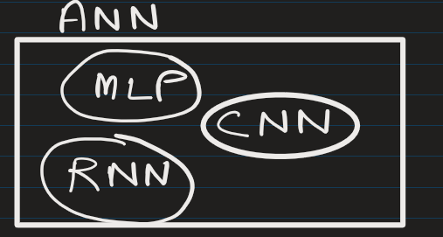
ANN can include many different architectures such as:
Single Layer Perceptron
Multilayer Perceptron (MLP)
Convolutional Neural Networks (CNN)
Recurrent Neural Networks (RNN)
Transformers
Some interesting site to learn ANN:
https://playground.tensorflow.org/

Slide 3
Single Layer Perceptron – show ppt.

Slide 4
Multilayer Perceptron (MLP) – show ppt.

Slide 5
Difference between ANN and MLP:
Feature | ANN | MLP
Meaning | General term | Specific architecture
Layers | Any structure | Input + Hidden + Output
Connectivity | Various | Fully connected
Examples | CNN, RNN, MLP | Only feedforward networks

Slide 6
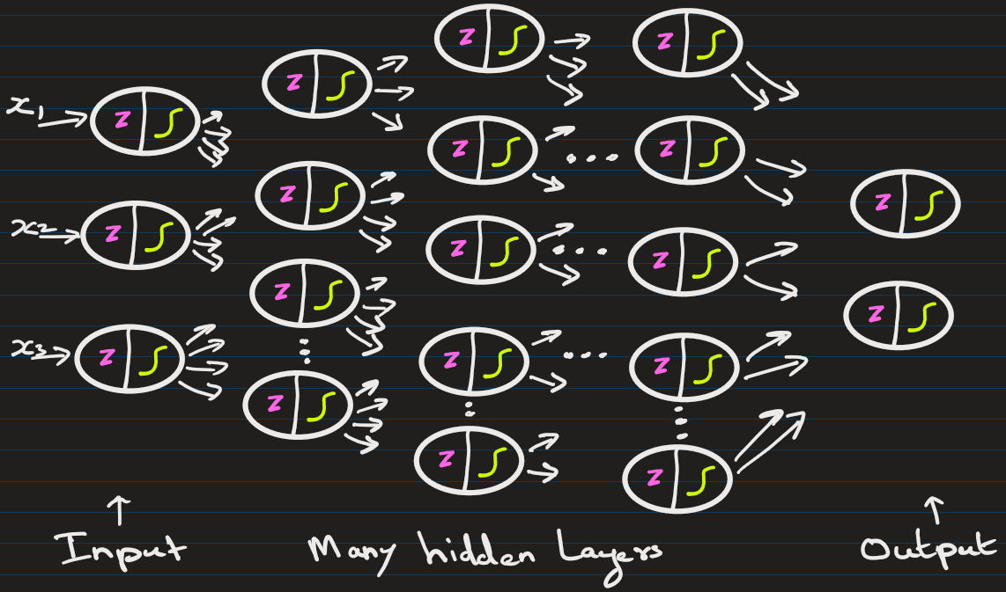
Deep Neural Network has many hidden layers

Slide 7
EXTRA
Xxxxxxxxxxx
xxxxxxxxxxxx

