Slide 1
Activation Function

Slide 2
Logistic (Sigmoid)
ReLU (Rectified Linear Unit)
Hyperbolic Tangent (tanh)
Linear
SoftMax

Slide 3
Some interesting site to learn ANN:
https://playground.tensorflow.org/

Slide 4
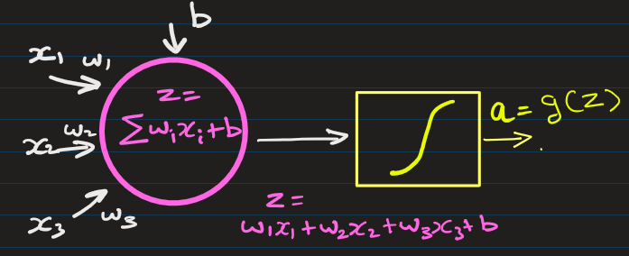
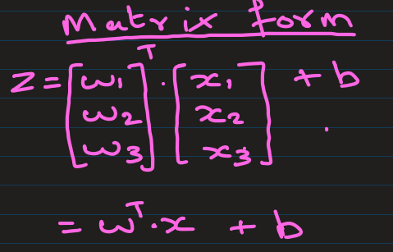
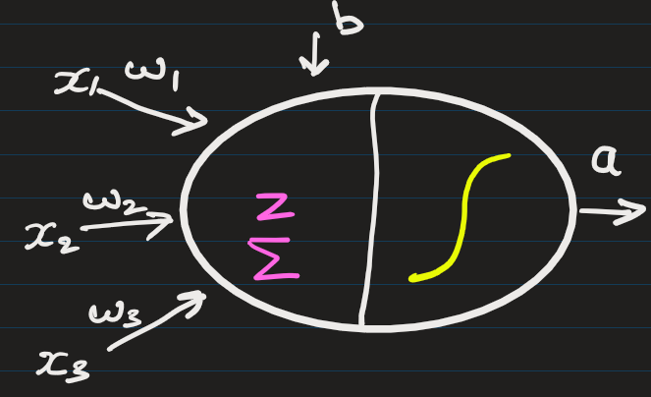
Key Components
Neurons (Nodes): Each layer contains multiple neurons that perform computations.
1 Neuron ->
OR ->

Slide 5
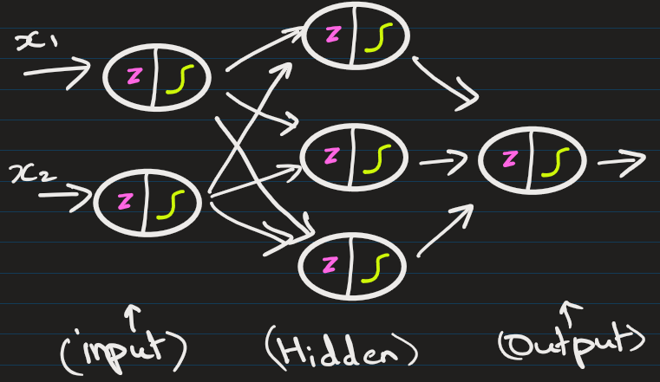
Activation Functions
Activation functions decide whether a neuron should be activated (fire) or not

Slide 6
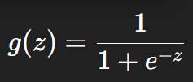
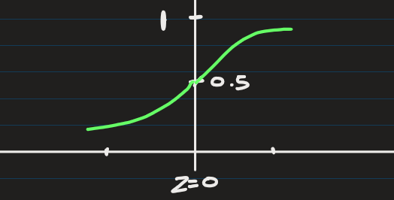
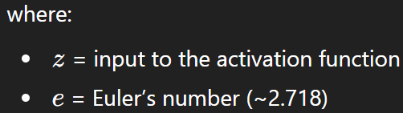
Logistic (Sigmoid) Activation Function
The output is always between 0 and 1. Because of this, it is often interpreted as a probability.
Used in Binary classification output layer

Slide 7
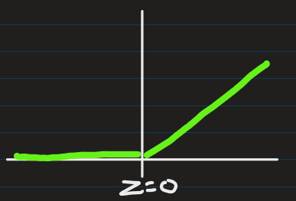


ReLU (Rectified Linear Unit) Activation Function
Most widely used activation functions in modern deep neural networks because it is simple and computationally efficient.
The output is always between 0 and infinity.
Used by hidden layers, etc.

Slide 8
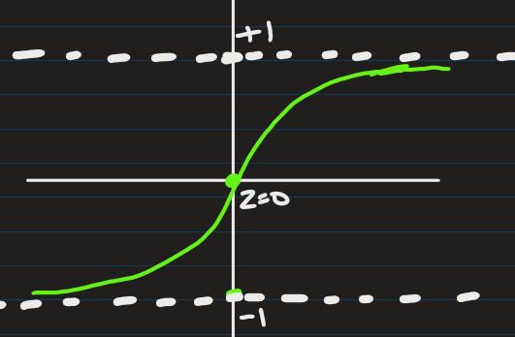



Hyperbolic Tangent (tanh) Activation Function
It is similar to the logistic (sigmoid) function but is zero-centered, which often helps neural networks train better.
tanh outputs both negative and positive values
Used in Hidden layers in neural networks and Recurrent Neural Networks (RNNs)

Slide 9
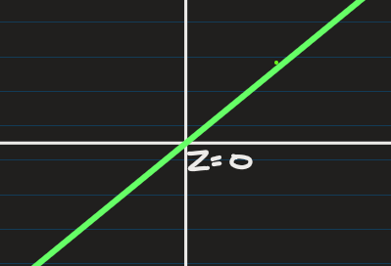


Linear Activation Function
Also called the identity function, simply returns the input value without applying any transformation.
The output can take any real value.
Generally used in the output layer for regression problems.
Examples:
House price prediction
Stock price prediction
Temperature forecasting

Slide 10
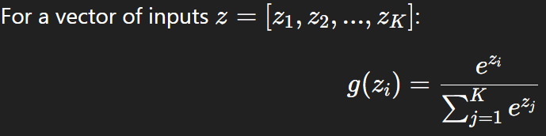

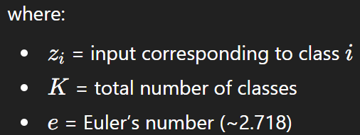
SoftMax Activation Function
It is used when a neural network needs to choose one class out of multiple classes.
It converts raw outputs (logits) into probabilities that sum to 1.

Slide 11
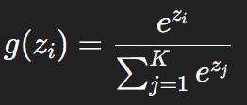

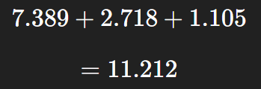
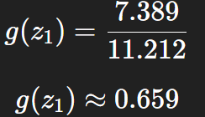
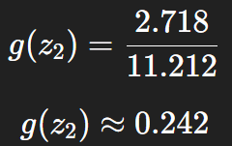
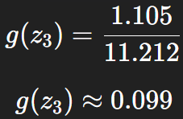

SoftMax operates on an entire vector of inputs, not just a single value.
Example input: z = [2, 1, 0.1]
SoftMax converts this into probabilities.
Predicted class = 1 (high probability)

Slide 12
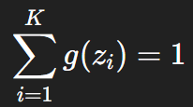
SoftMax Probabilities Sum to 1
Common Use Cases
Output layer of multi-class classification networks
Image classification
Natural language processing (word prediction)
Digit recognition

Slide 13
EXTRA

Slide 14
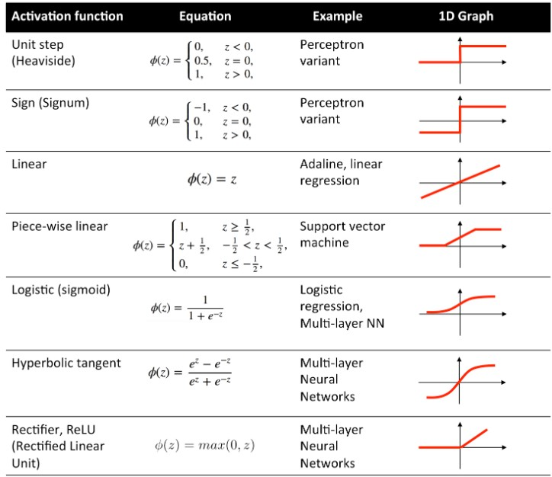

Slide 18
EXTRA
Xxxxxxxxxxx
xxxxxxxxxxxx

