Slide 1
Tensorflow

Slide 2
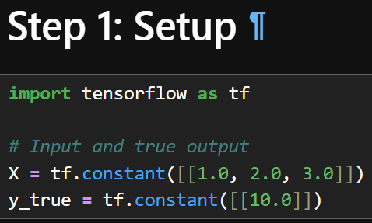
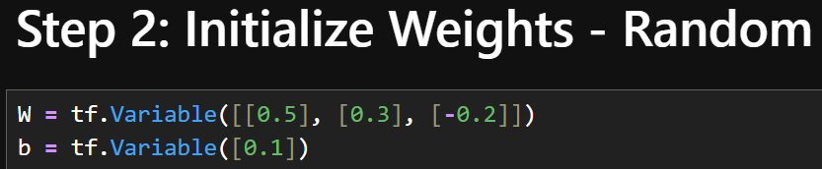

Step-by-Step Implementation
Example: Single Neuron Training

Slide 3
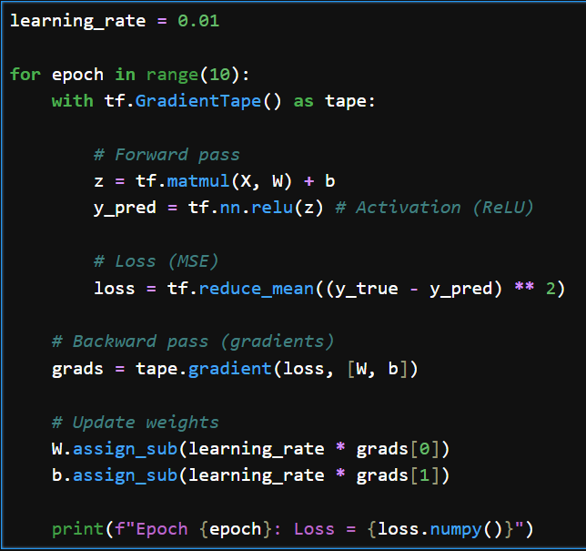


Slide 4
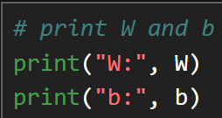
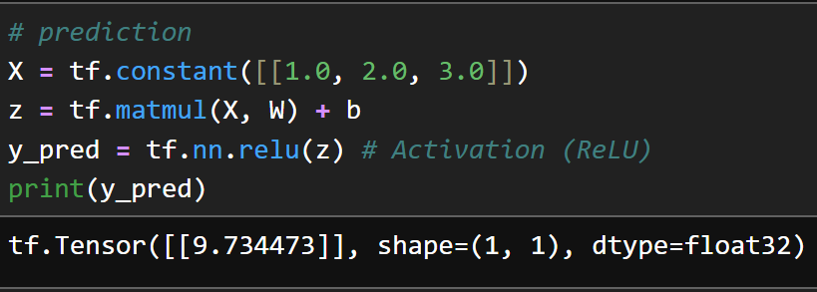

W -> [[1.1089648], [1.5179299], [1.6268946]]
b -> [0.7089649]
Close to actual value 10

Slide 6












2-Layer Neural Network (From Scratch with Training)
Architecture
Input (3 features)
↓
Hidden Layer (4 neurons, ReLU)
↓
Output Layer (1 neuron)

Slide 7
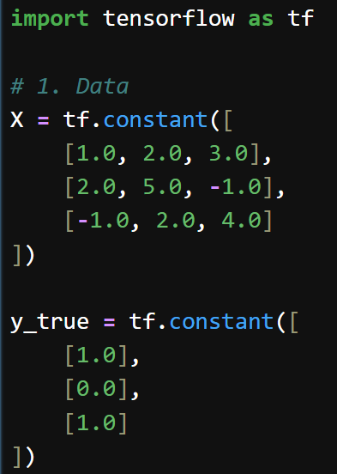













Slide 8
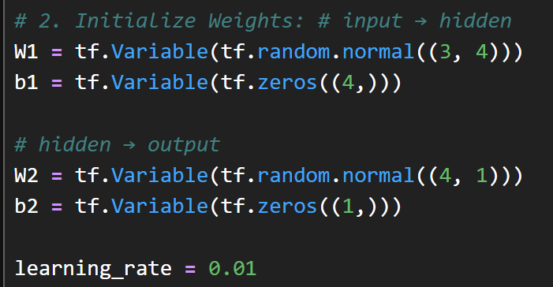

Slide 9
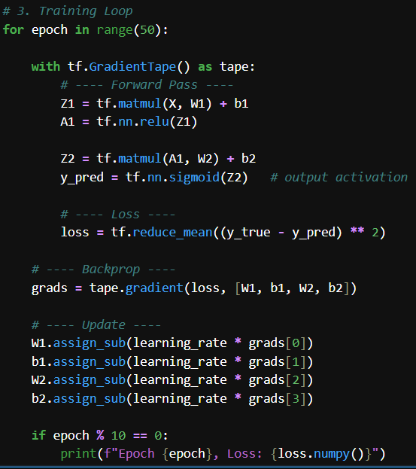
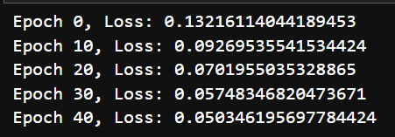

Slide 10
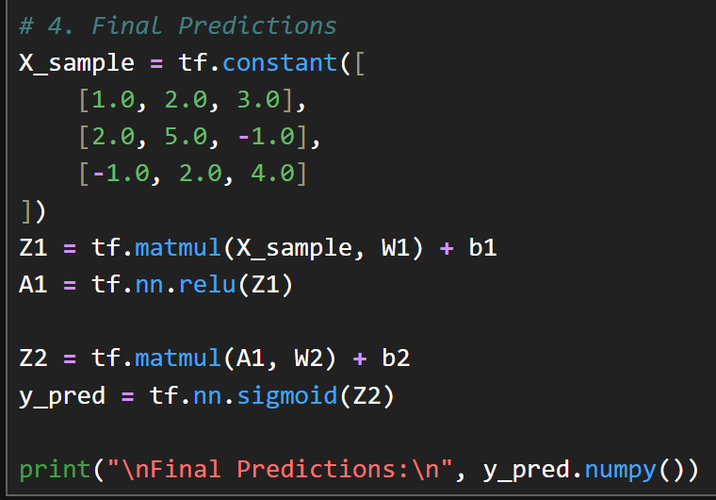
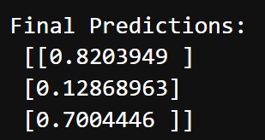

Slide 11
REDO the same thing using Kera – 5 lines of code

Slide 12
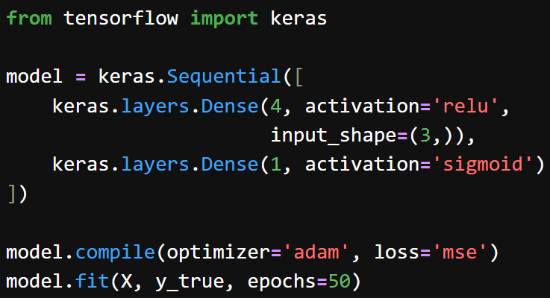
REDO the same thing using Kera – 5 lines of code

Slide 13
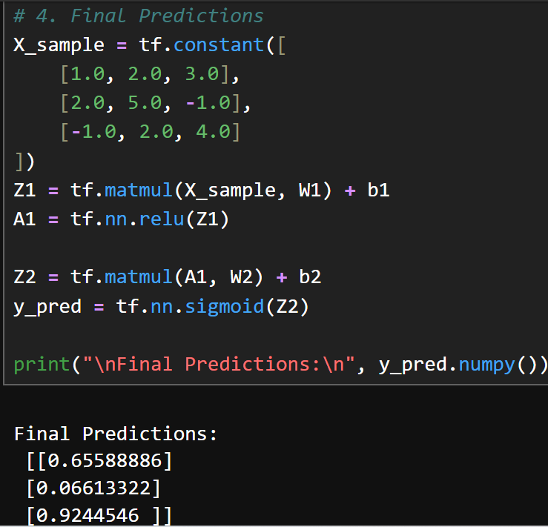
REDO the same thing using Kera – 5 lines of code
Pretty close to actual value

Slide 14
EXTRA
Xxxxxxxxxxx
xxxxxxxxxxxx

