Slide 1
Parameters

Slide 2
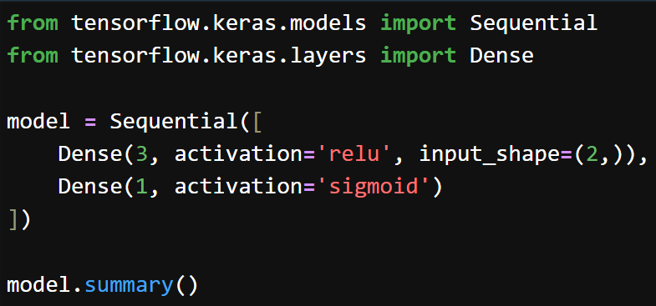
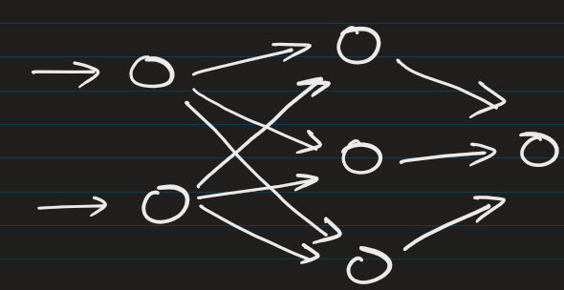
Number of parameters in any dense layer = (inputs × neurons) + neurons
Layer type | Output shape | Param #
Dense (Dense) | (None, 3) | 9
Dense_1 (Dense) | (None, 1) | 4

Slide 3
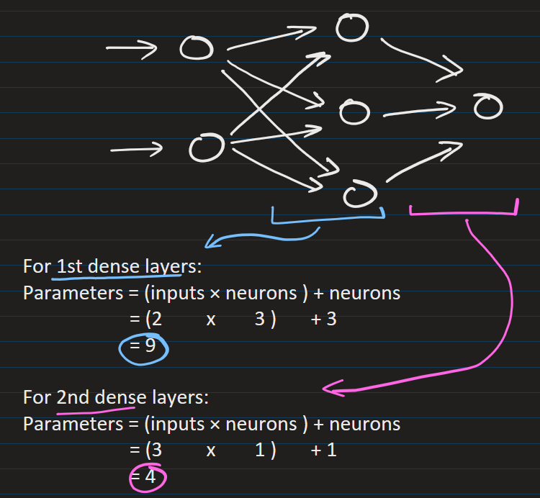
Number of parameters in any dense layer = (inputs × neurons) + neurons
Layer type | Output shape | Param #
Dense (Dense) | (None, 3) | 9
Dense_1 (Dense) | (None, 1) | 4

Slide 4
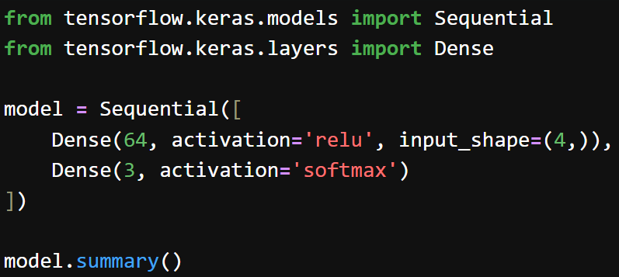
Number of parameters in any dense layer = (inputs × neurons) + neurons
Layer type | Output shape | Param #
Dense (Dense) | (None, 64) | 320
Dense_1 (Dense) | (None, 3) | 195

Slide 5
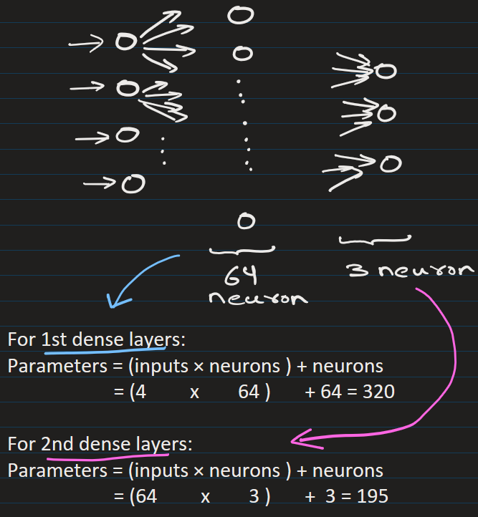
Number of parameters in any dense layer = (inputs × neurons) + neurons
Layer type | Output shape | Param #
Dense (Dense) | (None, 64) | 320
Dense_1 (Dense) | (None, 3) | 195

Slide 6
Number of parameters in any dense layer = (inputs × neurons) + neurons

Slide 7
EXTRA
Xxxxxxxxxxx
xxxxxxxxxxxx

