Slide 1
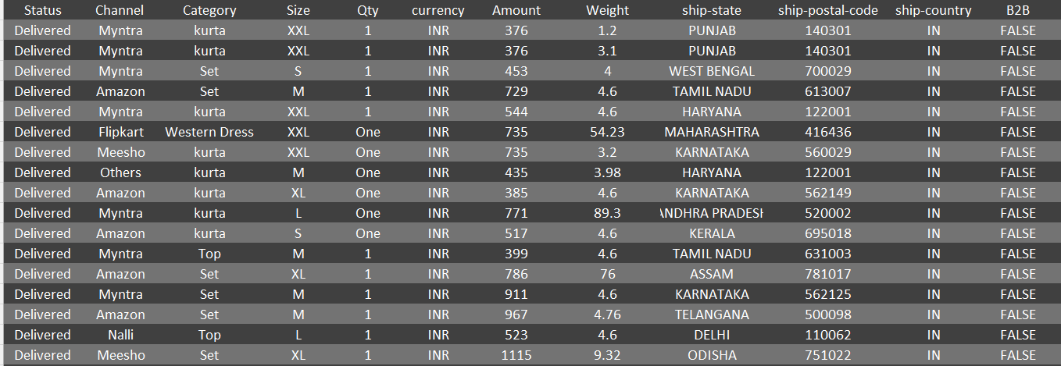
Types of Data
Problem: Can you identify which data types are present in following table ?
Numerical - Continuous
Numerical - Discrete
Categorical - Ordinal
Categorical – Nominal
All Of The Above

Slide 2
Types of Data: Theory
Data types
Numerical: Are numbers
- Age
- Weight
- Blood Pressure
- Number of cars
Categorical: Are classes. Generally, are non-numeric in nature.
- Colors
- Gender
- Country
- Ethnicity
Continuous: Values are any number between a range: that is, generally infinite possibilities
- Weight (2.3Kg, 3.45Kg, etc.)
- Height(1.73 m, 1.56 m, etc.)
Discrete: Values are integers
- Age in years(3, 5, 34, etc.)
- Numbers of cars (3, 5, etc.)
- Game Score (+2, -3, -5, etc.)
Ordinal: Hierarchy in classes
- Type of BP (low BP < medium BP < High BP)
- Size of shirt (S < M < L < XL)
Nominal: No Hierarchy
- Color (Red, Green, etc.)
- Gender (M, F)
- Country (USA, India, etc.)

Slide 3
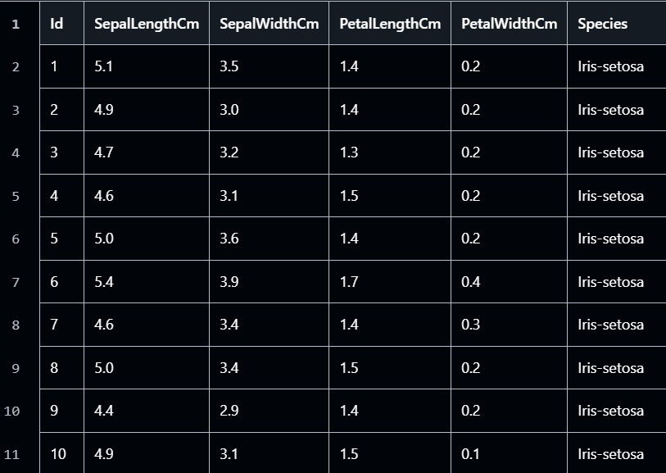























Types of Data: Examples

Slide 4
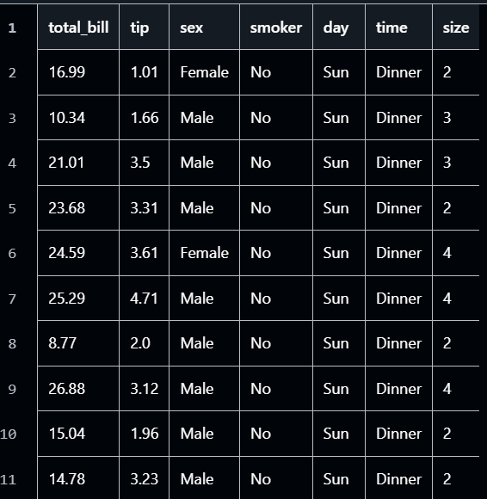




































Types of Data: Examples

Slide 5



























Types of Data: Examples

Slide 6












Types of Data: Examples

Slide 7
STOP
ZZZZZZZZZZZZZZZ
ZZZZZZZZZZZZZZZZZ

