Slide 1
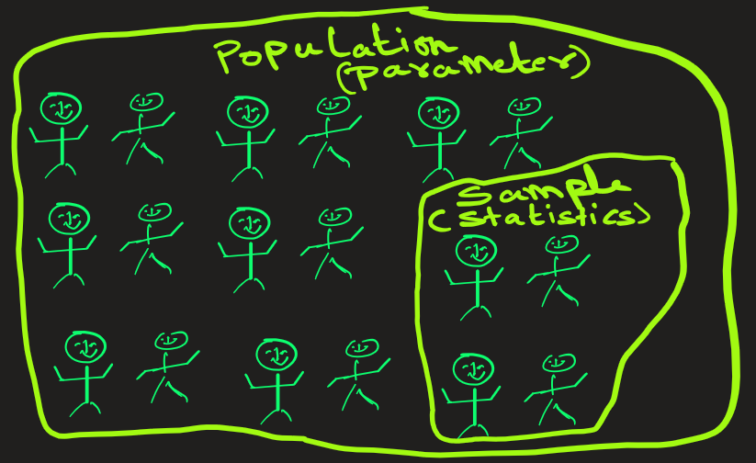
Population versus Sample
Concept | Definition | Example
Population | The entire group you want to study. | All the students in your university.
Sample | A subset of the population, selected for actual observation and analysis. Used when studying the entire population is impractical. | 200 students chosen randomly from your university.

Slide 2
Concept | Definition | Symbol | Example
Parameter | A numerical value that describes a characteristic of a population. It is usually unknown and fixed. | Greek letters (μ, σ, p, etc.) | Population mean (μ) = average height of all students in the university.
Statistic | A numerical value that describes a characteristic of a sample. It is computed from sample data and used to estimate the population parameter. | Latin letters (x̄, s, p̂, etc.) | Sample mean (x̄) = average height of the 200 students sampled.

Slide 3
stop

