Slide 1
1. Structured Data
Structured data is data that is organized in a fixed format, usually in rows and columns, making it easy for computers to store, search, and analyze.
It follows a predefined schema (structure).
Example
A table in a database or spreadsheet.
Student_ID | Name | Age | Marks
101 | Rahul | 20 | 85
102 | Priya | 21 | 90
103 | Aman | 19 | 78

Slide 2
Characteristics
Organized in rows and columns
Easy to store in relational databases
Easy to query using SQL
Examples of Structured Data
Bank transactions
Customer databases
Excel spreadsheets
Sales records
Inventory data
Common Storage Systems
MySQL
PostgreSQL
Oracle Database
Microsoft Excel

Slide 3
2. Unstructured Data
Unstructured data is data that does not have a predefined format or table structure.
It is harder for computers to analyze directly.

Slide 4

Examples of Unstructured Data
Emails

Slide 5

Examples
Websites

Slide 6

Examples of Unstructured Data
Social media posts, Chat messages

Slide 7
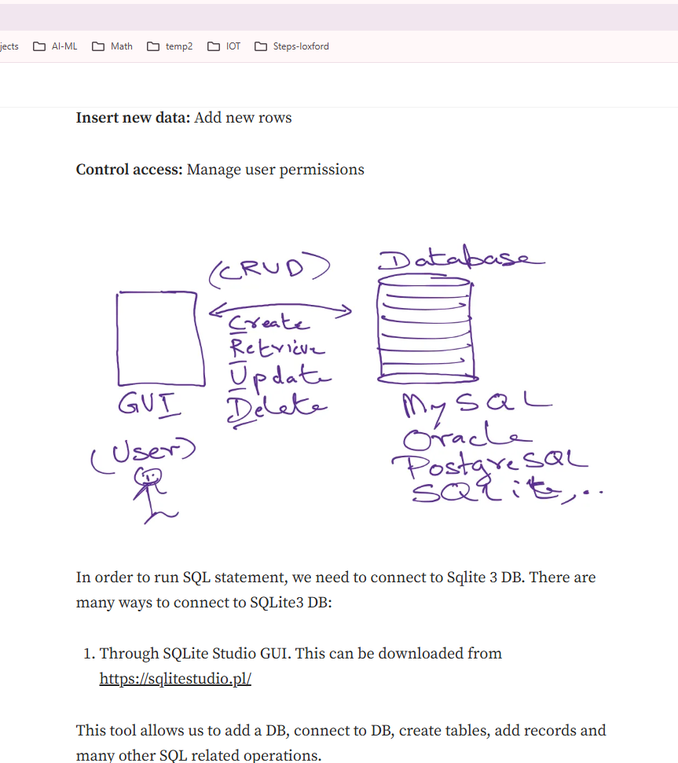
Examples of Unstructured Data
Social media posts, Chat messages

Slide 8
Examples of Unstructured Data
Images, Audio recordings
Videos: YouTube videos
PDFs: Doctor’s handwritten notes

Slide 9
Characteristics of Unstructured Data
No fixed schema
Difficult to store in tables
Requires AI/ML/NLP/computer vision to analyze
Very large portion of real-world data
Majority ( 80–90%) of the world's data is unstructured, which is why fields like
Natural Language Processing
Computer Vision
Generative AI
are growing so fast.

