Slide 1
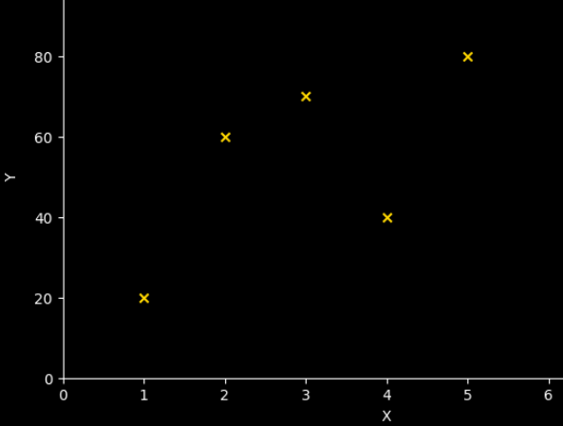
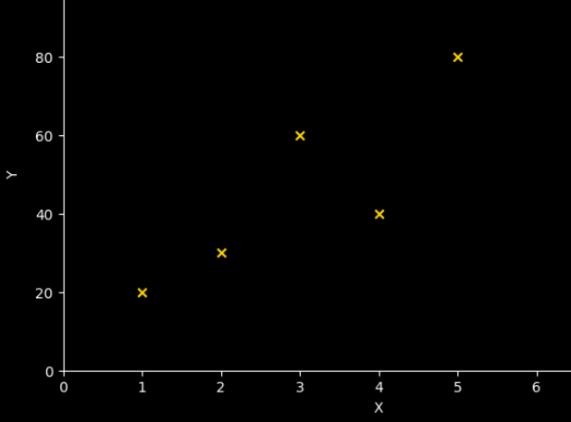
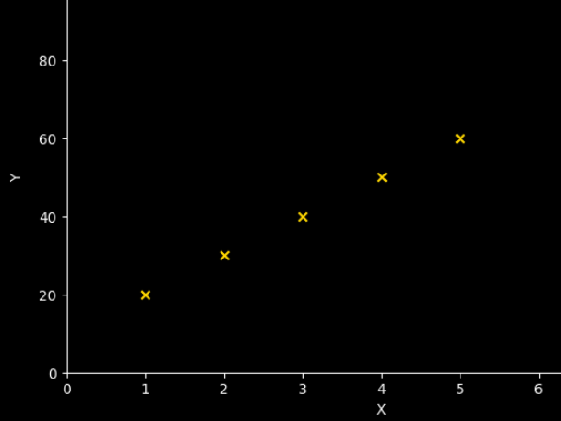
Covariance and Correlation
Problem: What type of relationship is between X and Y ? How would you measure it mathematically?
X | Y
1 | 20
2 | 60
3 | 70
4 | 40
5 | 80
X | Y
1 | 20
2 | 30
3 | 60
4 | 40
5 | 80
X | Y
1 | 20
2 | 30
3 | 40
4 | 50
5 | 60

Slide 2
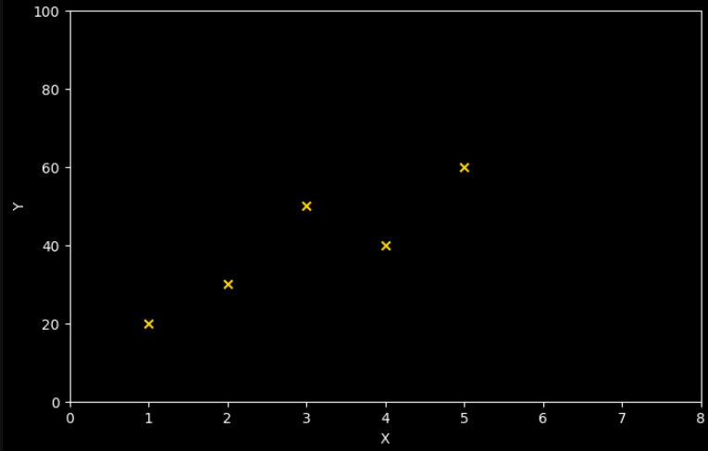
Covariance
Suppose you have following data(e.g. study hours and score):
X | Y
1 | 20
2 | 30
3 | 50
4 | 40
5 | 60
We see that as X increases, Y increases too.
Here X and Y are said to be positively correlated.

Slide 3
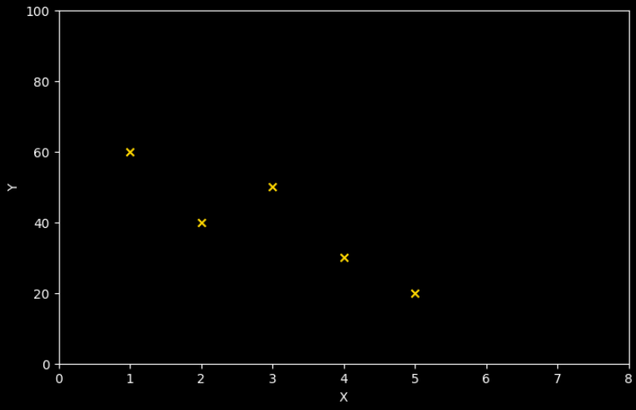
Covariance
Suppose you have following data (game-hours and score):
X | Y
1 | 60
2 | 40
3 | 50
4 | 30
5 | 20
We see that as X increases, Y decreases.
Here X and Y are said to be negatively correlated.

Slide 4
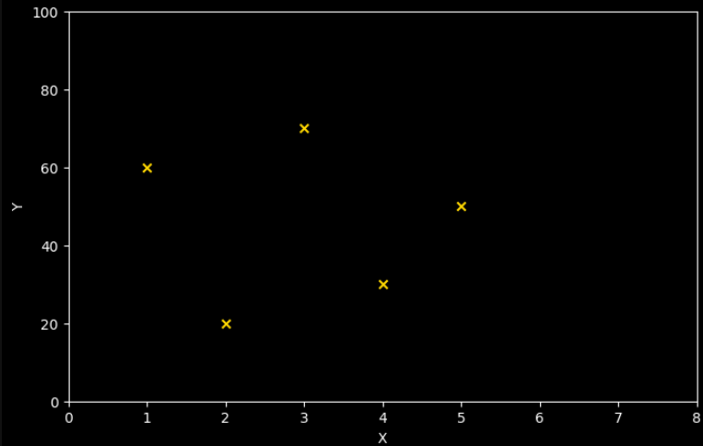
Covariance
Suppose you have following data:
X | Y
1 | 60
2 | 20
3 | 70
4 | 30
5 | 50
Here as X increases, Y has no pattern.
X and Y are said to be not correlated.

Slide 5
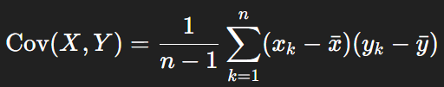
Covariance
We use covariance to determine the direction of relation between X and Y:
Cov (X,Y) > 0: X and Y move in same direction
Cov (X,Y) < 0: X and Y move in opposite direction
Cov (X,Y) = 0: X and Y are independent
Side Note: Above is the covariance of samples, not population. For population, n-1 → n

Slide 6
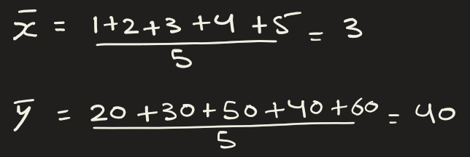
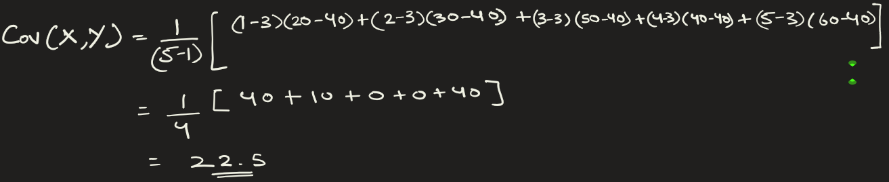
Covariance
Example1: Find covariance between X and Y
X | Y
1 | 20
2 | 30
3 | 50
4 | 40
5 | 60

Slide 7
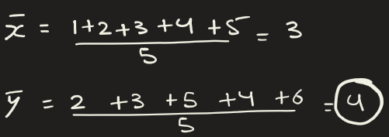
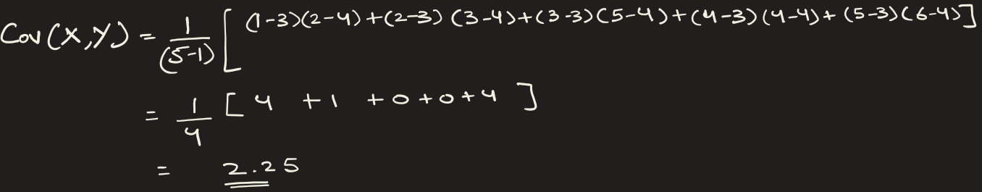
Covariance
Example2: If I take same data as previous and divide Y by 10, scale it down, then COV(X,Y) = 2.25 (smaller by factor of 10)
X | Y
1 | 2
2 | 3
3 | 5
4 | 4
5 | 6

Slide 8
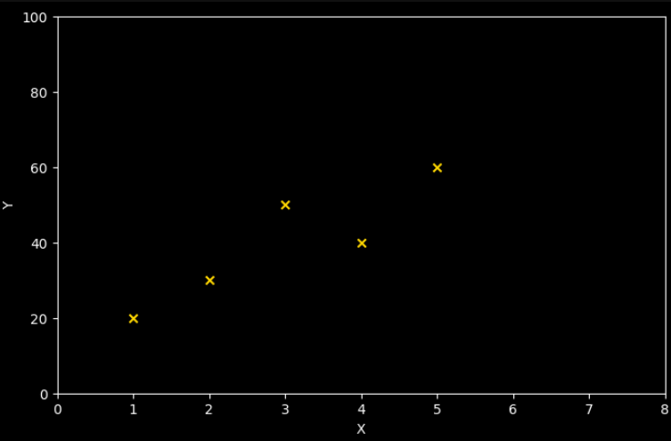
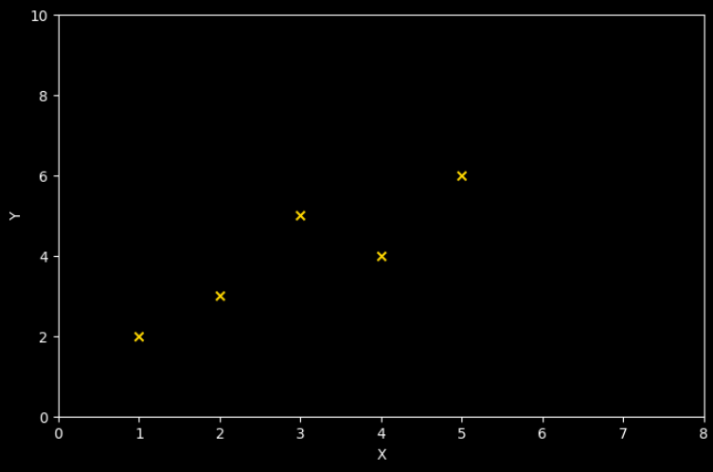
Covariance
Now let’s plot both these separately. Suppose in 1st figure, X is in meters and Y is in Kg, then covariance = 22.5 m-kg.
In 2nd figure, X is in hours and Y is in score, and covariance = 2.25 hours-score. Numerically they are different because of different units, but visually they look identical.
X (m) | Y (Kg)
1 | 20
2 | 30
3 | 50
4 | 40
5 | 60
X(hr) | Y (score)
1 | 2
2 | 3
3 | 5
4 | 4
5 | 6

Slide 9



Correlation
If we divide Cov(X,Y) by standard deviation (X) and standard deviation (Y), then we get correlation.
Correlation measures the strength of linear relationship between 2 variables.
Side Note: Above is for sample. For population, n-1 → n
We use correlation over covariance because it's a standardized measure that is easy to interpret and compare across different datasets: Dataset1 could be between X in kg and Y in meter, in the Dataset2, X could be in hours and Y in score. We can still compare the datasets

Slide 10
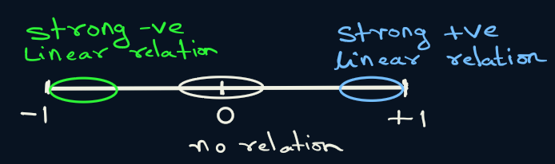
Correlation
Key properties of correlation
It is unitless
Ranges from -1 to 1
If the values of X and/or Y are converted to a different scale, the value of r will be unchanged. (Shown in next 2 examples)

Slide 11
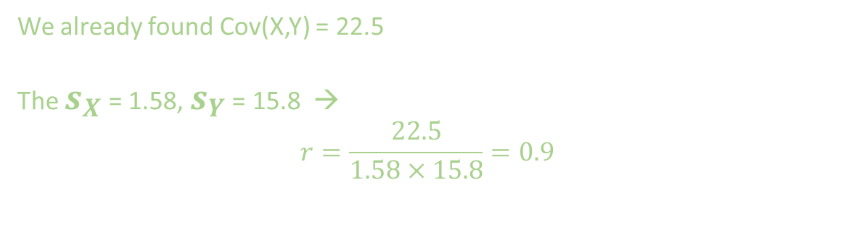
Correlation
Example: Find correlation.
X | Y
1 | 20
2 | 30
3 | 50
4 | 40
5 | 60
We already found Cov(X,Y) = 22.5
The $s_{X}$ = 1.58, $s_{Y}$ = 15.8 →
$$r=\frac{22.5}{1.58×15.8}=0.9$$

Slide 12
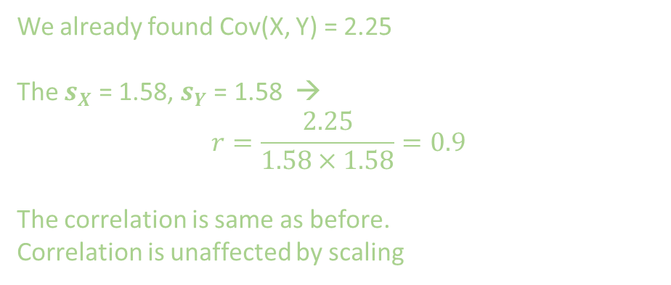
Correlation
Example(Same data as before with Y scaled down by factor of 10): Find correlation.
X | Y
1 | 2
2 | 3
3 | 5
4 | 4
5 | 6
We already found Cov(X, Y) = 2.25
The $s_{X}$ = 1.58, $s_{Y}$ = 1.58 →
$$r=\frac{2.25}{1.58×1.58}=0.9$$
The correlation is same as before.
Correlation is unaffected by scaling

Slide 13
Now let’s plot both these separately. The covariance is different: +22.5 -vs- +2.25.
The correlation is same: 0.9
X | Y
1 | 20
2 | 30
3 | 50
4 | 40
5 | 60
X | Y
1 | 2
2 | 3
3 | 5
4 | 4
5 | 6

Slide 14
Problem: Which of the following has strong linear relationship between X and Y ? How would you measure it?
Ans: Find correlation and that would tell you how strong the linear relation is between the 2 variables.
Correlation is maximum for figure with r = +1
X | Y
1 | 20
2 | 60
3 | 70
4 | 40
5 | 80
X | Y
1 | 20
2 | 30
3 | 60
4 | 40
5 | 80
X | Y
1 | 20
2 | 30
3 | 40
4 | 50
5 | 60
r = + 0.65
r = + 0.85
r = + 1

Slide 15
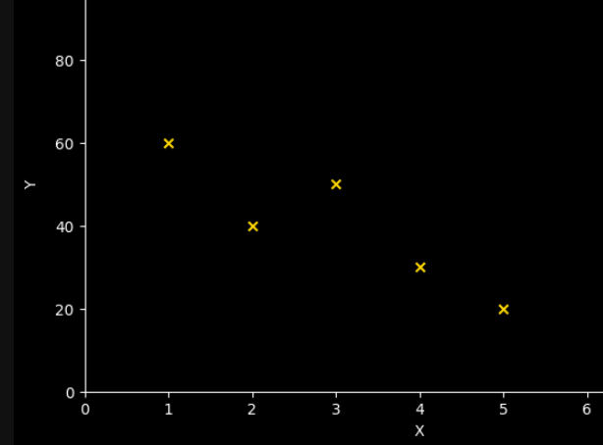
Example: X and Y have a strong negative correlation.
X | Y
1 | 60
2 | 40
3 | 50
4 | 30
5 | 20
r = - 0.9

Slide 16
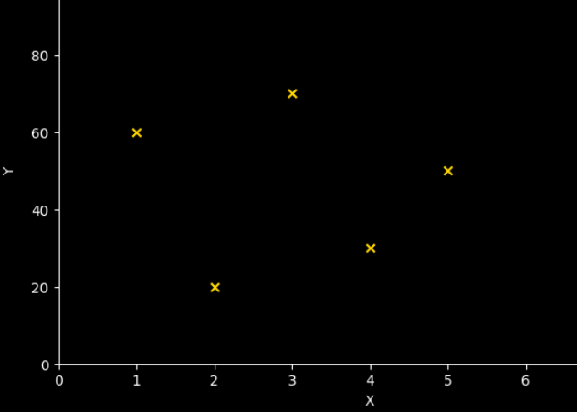
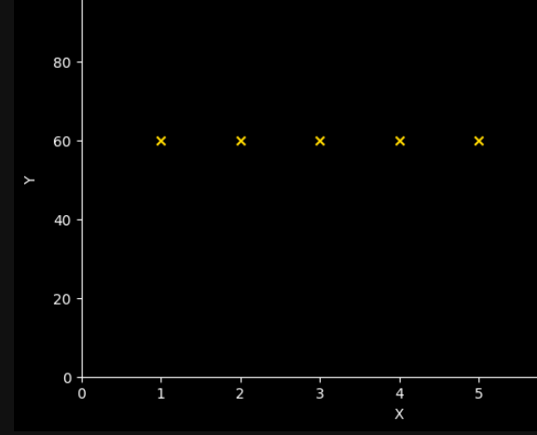
Example: X and Y have almost 0 correlation
X | Y
1 | 60
2 | 20
3 | 70
4 | 30
5 | 50
r = - 0.07

Slide 17
Recap
Cov (X,Y) > 0: X and Y move in same direction
Cov (X,Y) < 0: X and Y move in opposite direction
Cov (X,Y) = 0: X and Y are independent
Major flaw of covariance:
It does not tell you the strength of linear relationship between X and Y.
So, we need correlation.
Correlation ranges from -1 to 1:

Slide 18
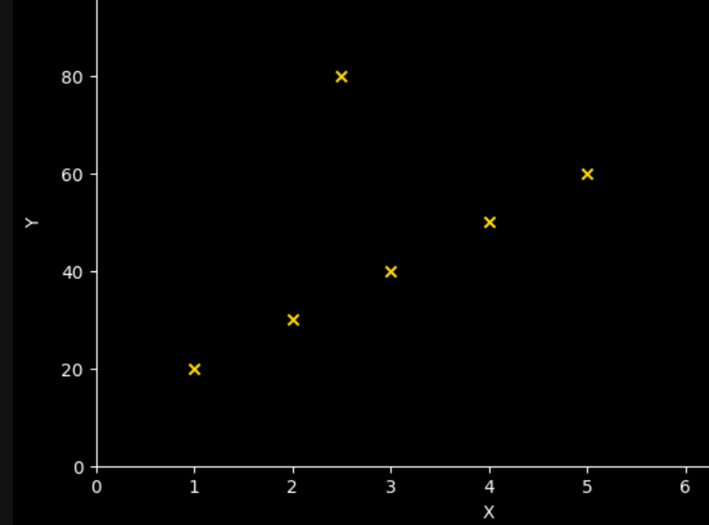
Outliers
The value of r is sensitive to outliers and can change dramatically if they are present in the data.
X | Y
1 | 20
2 | 30
3 | 40
4 | 50
5 | 60
X | Y
1 | 20
2 | 30
2.5 | 80
3 | 100
4 | 50
5 | 60
r = + 1
r = + 0.53

Slide 19
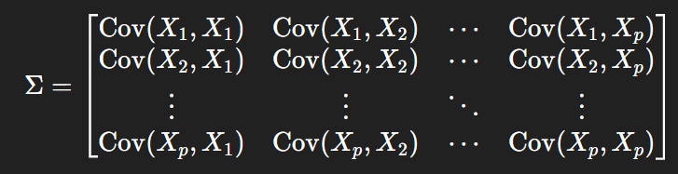
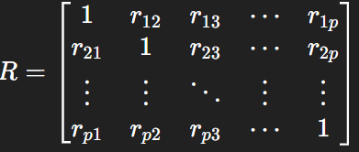

Covariance and Correlation Matrix

Slide 20
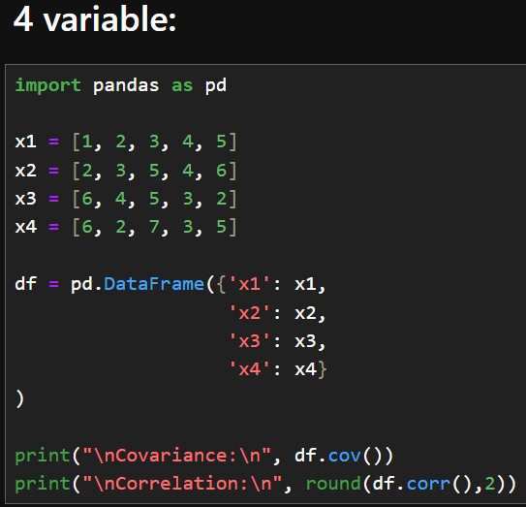
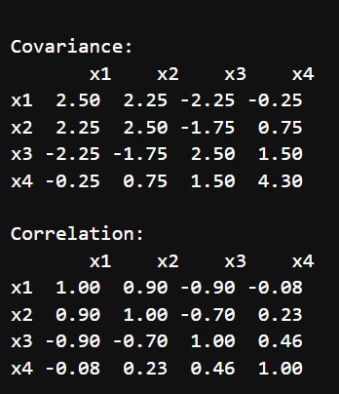
Covariance and Correlation Matrix
Printing covariance and correlation between columns x1, x2, x3 and x4 using pandas.

Slide 21
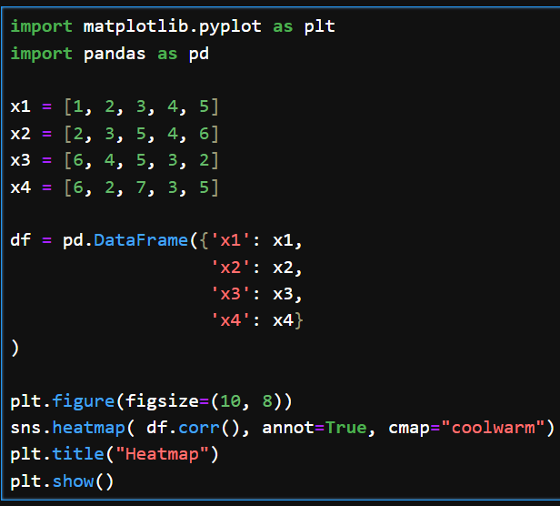
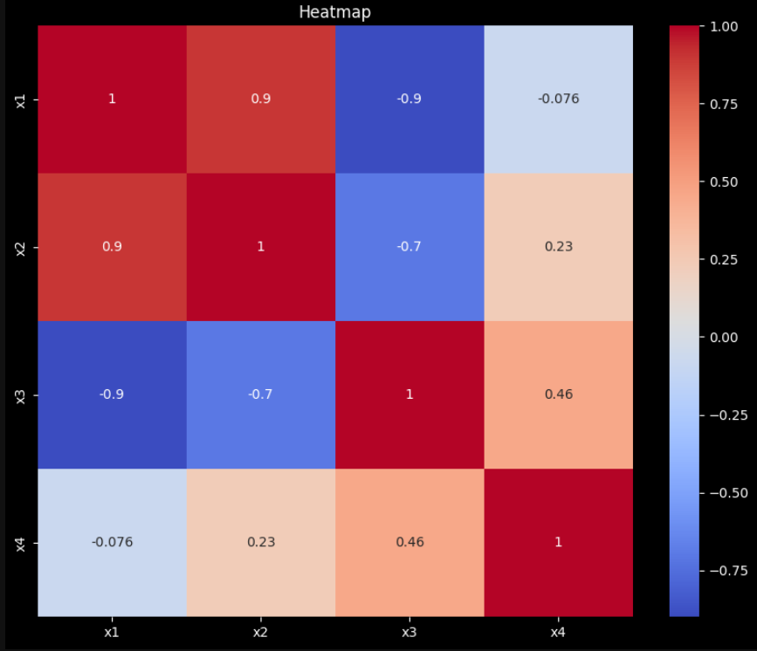
Printing covariance and correlation between columns x1, x2, x3 and x4 using pandas.

Slide 22
EXTRA

Slide 23
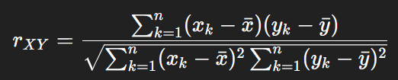
Covariance-correlation
Suppose that you have samples of 2 data: X and Y. Then formula for Covariance and correlation is

Slide 24
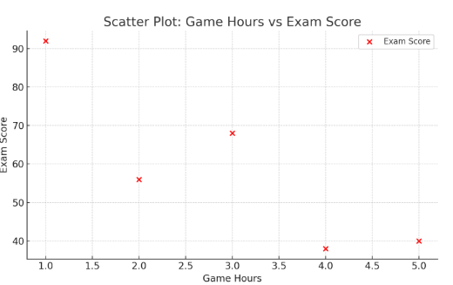
Practice: Following is sample taken from a population. What is correlation coefficient between gamehours and ExamScore ?
Student | GameHrs (X) | ExamScore (Y)
A | 1 | 92
B | 2 | 56
C | 3 | 68
D | 4 | 38
E | 5 | 40
Performing the same calculation as above, we that the mean of each is 3 and 58.8,
Cov (X,Y) = -24.4
Correlation coefficient = -0.868

Slide 25
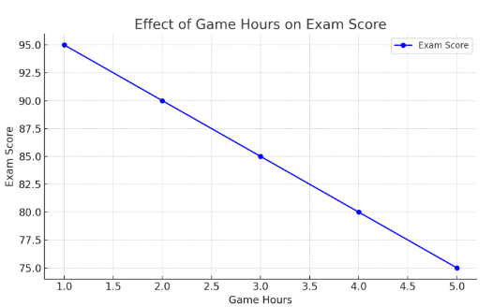
If we plot Gamehours versus Scores, we see following perfect linear plot. This is typical of features that have correlation coeff = 1

Slide 26
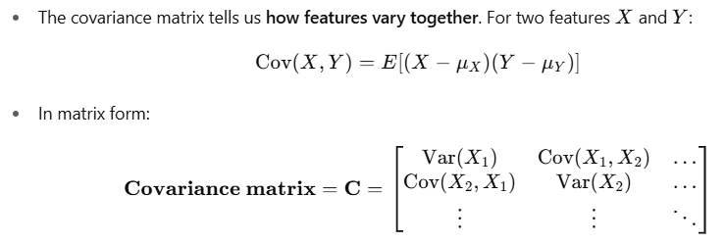
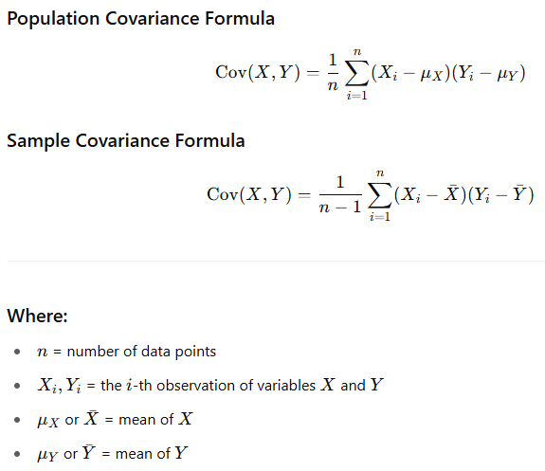
Covariance + correlation (p1)
Covariance measures how two variables change together—whether they increase or decrease in tandem
What does this matrix represent?
The diagonal elements = variances of individual features → how much that feature spreads out.
The off-diagonal elements = covariances → how two features change together:
Negative covariance: when one increases, the other decreases….X1 = age and X2 = number of pushups
Zero covariance: no linear relationship…..X1 = your age and X2 = neighbors income
Positive covariance: they increase together…. X1 = your age, X2 = income
For example X1 could be age, X2 could income and we may see that Cov(X1,X2) be +ve: as age goes up, income goes up to.
You will also see following formula in literature:

Slide 27
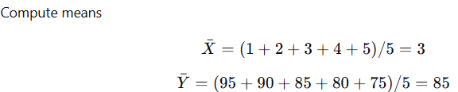
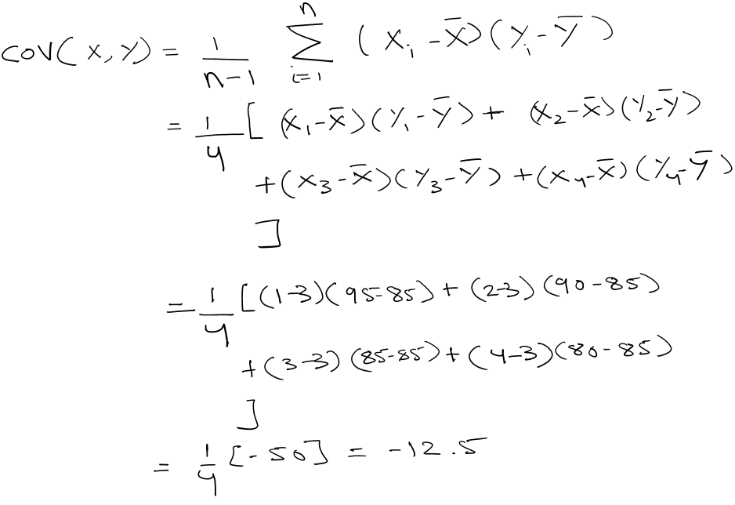
Covariance + correlation EXAMPLE (jupyter n/b)
Example: Suppose we’re looking at:
GameHrs: The number of hours a student plays video games per day
ExamScore: The student’s exam score out of 100.
Below is a sample taken from a population. Find covariance and correlation coeff. between the 2 features.
Student | GameHrs (X) | ExamScore (Y)
A | 1 | 95
B | 2 | 90
C | 3 | 85
D | 4 | 80
E | 5 | 75
We expect that as GameHours (video games) increase, ExamScore decreases → negative covariance. Let’s see if can deduce this mathematically.
Here we would use sample covariance formula.
GameHrs(X) | ExamScore(Y) | (X - 3) | (Y - 85) | Product
1 | 95 | -2 | 10 | -20
2 | 90 | -1 | 5 | -5
3 | 85 | 0 | 0 | 0
4 | 80 | 1 | -5 | -5
5 | 75 | 2 | -10 | -20
So the cova. is -12.5 hours - score point
Cont….

Slide 28
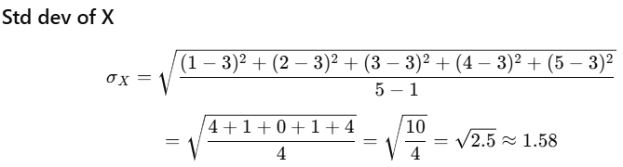
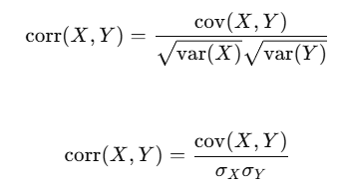
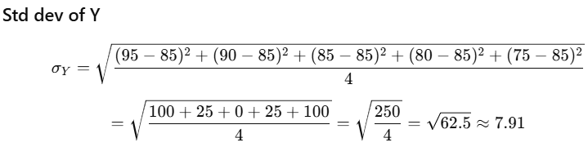


Covariance + correlation EXAMPLE (jupyter n/b)
…cont
Why do we need correlation coefficient (r) ρ?
Covariance has units:
Example: if X = meters, Y = seconds → cov(X,Y) is in meter·second
This makes it hard to compare across different datasets that may have different units
The formula for correlation coefficient is
Continuing with previous example,
Key point on r:
It is dimensionless ( no units ) and ∈ [ -1, 1 ]
+1 → perfect positive linear relationship
0 → no linear relationship
-1 → perfect negative linear relationship

