Slide 1
Skewness
What is skewness ?
What are some examples of skewness ?
How do we measure skewness ?
Why do we care about skewness ?

Slide 2
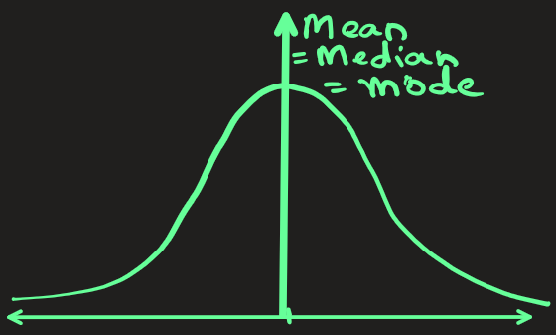
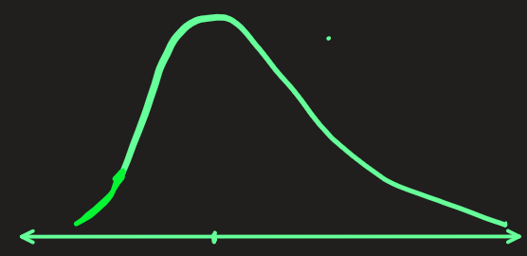
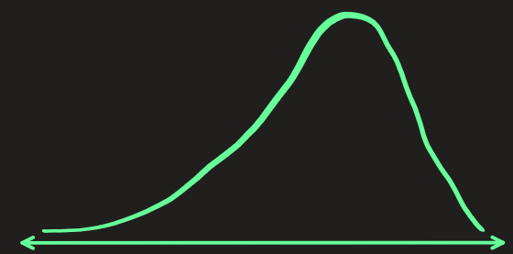
Skewness: Definition
A data with symmetrical distribution has mean = mode= median.
Another name for this is normal distribution.
But sometimes the data is not symmetrical as shown in figure:
The curve can be skewed – either to the right or to the left.
A skewness measures how much the data is far from being symmetrical

Slide 3
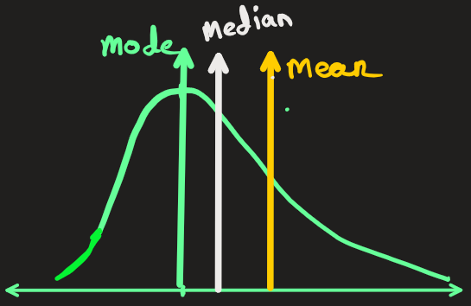
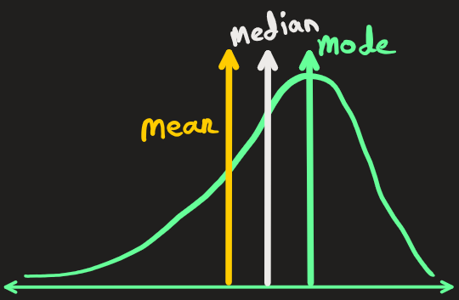
Skewness: Definition
A skewness of zero suggests a symmetrical distribution.
Here mean = median = mode
A positive skewness (right skew) indicates that the tail of the distribution extends further to the right, with more data points clustered on the left side. It also indicates presence of outliers towards right side
Here mean > median > mode
A negative skewness (left skew) indicates that the tail extends further to the left, with more data points clustered on the right side. It also indicates presence of outliers towards left side
Here mean < median < mode

Slide 4
Skewness: Examples
Example of 0 skewedness:
The height distribution in a most countries follows symmetrical distribution.
Examples of right skewedness :
1) Income Distribution: A large portion of the population earns moderate incomes, while a smaller number of individuals earn extremely high incomes, creating a right-skewed distribution.
2) Test Scores: In education, most students might score around the average, but a few exceptional students may achieve very high scores, resulting in a right-skewed distribution of test scores.
Examples of left skewedness :
1) Death from natural cause: Most of death from natural causes (heart disease, cancer, etc.) happen at older ages, with fewer cases happening at younger ages.
2) Scores on an easy test: If students take test that is easy, then most will score high marks, with very few scoring low marks.

Slide 5


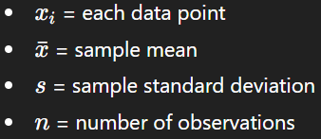
How Do We Measure Skewness?
There are multiple formulas, but one common approach is Pearson’s Moment Coefficient of Skewness:

Slide 6
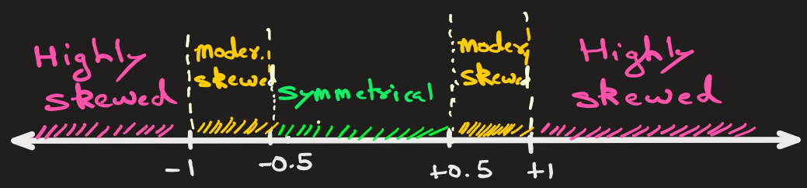
Skewness meaning:
While there isn't a single universally agreed-upon scale, here's a general guideline:
-0.5 to 0.5: The distribution is considered approximately symmetrical.
-1 to -0.5 or 0.5 to 1: The distribution is moderately skewed.
Values beyond -1 and 1: The distribution is considered highly skewed.

Slide 7
Why Skewness matters
1. Helps Detect Non-Normality
Many algorithms (like Linear Regression, Logistic Regression, PCA) assume the data—or residuals—are normally distributed.
If data is highly skewed, this assumption is violated, leading to biased model parameters and hence poor predictions
2. Impacts Feature Scaling
Skewed features can distort mean and standard deviation, which are used in StandardScaler or Z-score normalization.
Solution: Apply log, square-root, or Box–Cox transformations to reduce skewness.
3. Improves Model Performance
Models like tree-based ones (Decision Tree, Random Forest, XGBoost) are less sensitive, but linear or distance-based models (KNN, SVM) can perform better after skewness correction.

Slide 8
STOP

Slide 9
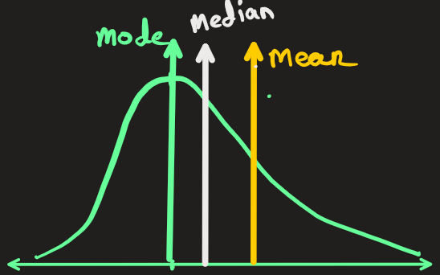

Problem Statement: Predicting House Prices — When the Model Gets “Fooled” by Skewness
You are building a machine learning model to predict house prices in a city. Your dataset has 10,000 houses with various features — area, number of rooms, location, etc. The target variable is the price of the house.
Before modeling, you plot the prices and notice something interesting:
Most houses are between ₹30–₹80 lakhs
A few luxury villas cost ₹5–₹10 crores
The average price is ₹1.2 crore — but that’s not what most houses cost.
The Problem
You train a Linear Regression model directly on the raw price data. The result you obtain is
Training error: ✅ Low
Validation error: ❌ Very high
The model severely overestimates the prices of mid-range homes and underestimates luxury homes.
You check the residuals (errors) and see they are not symmetric — they have a long right tail. In other words, the target variable is positively skewed.
Solution Using Skewness
To fix this, you apply a log transformation to the target variable: y′=log(y)
Then you retrain the model and the result is:
Residuals become more symmetric (skewness ≈ 0)
Model predictions improve dramatically
Validation RMSE drops by 30–40%
After prediction, you simply reverse the transformation using:

Slide 10
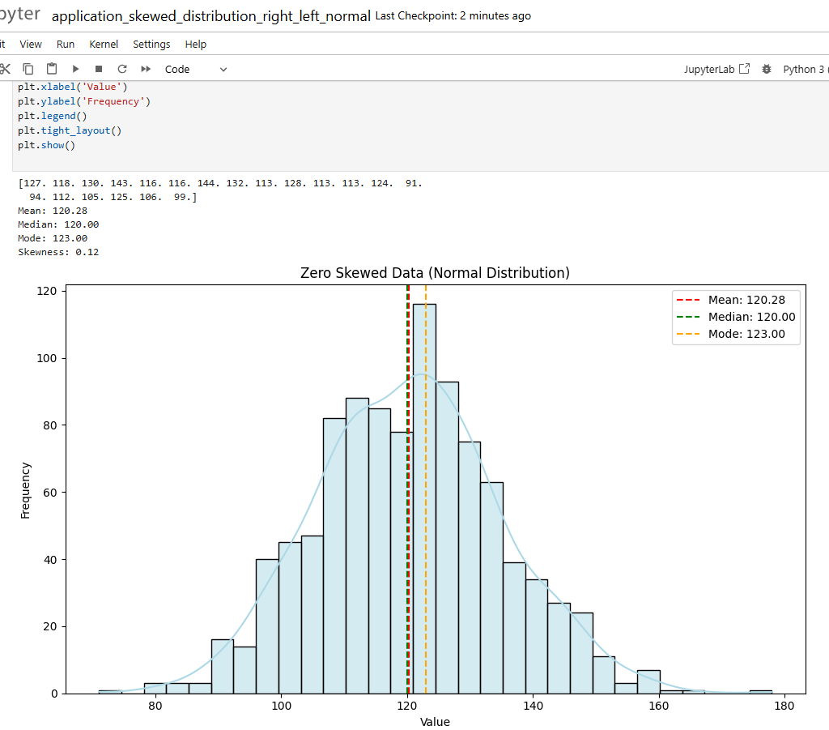
Example of 0 skewed data (see jupyter n/b):

Slide 11
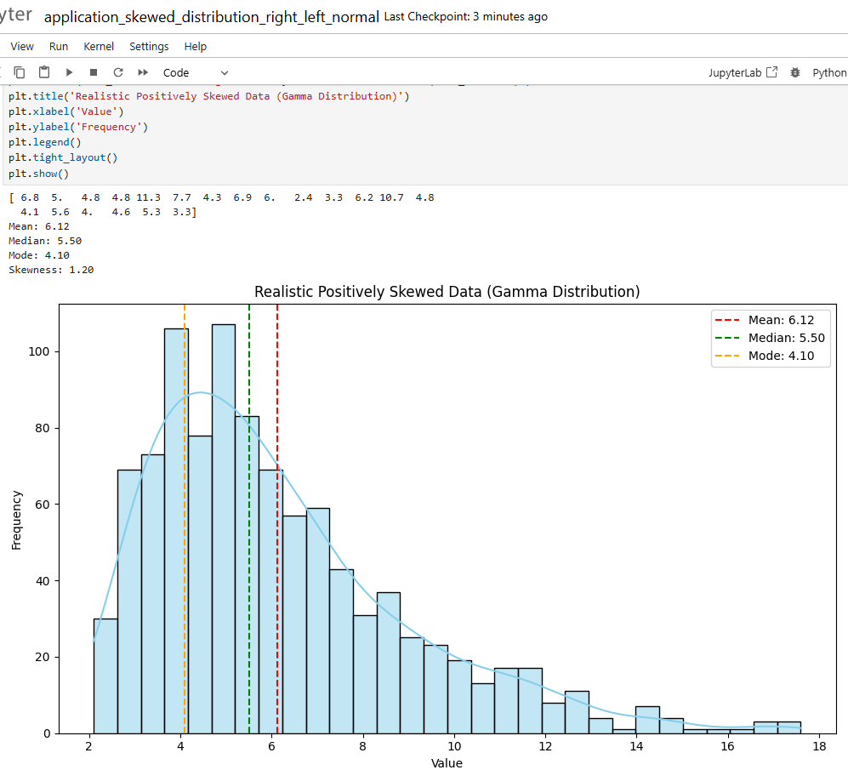
Example of right skewed data (see jupyter n/b):

Slide 12
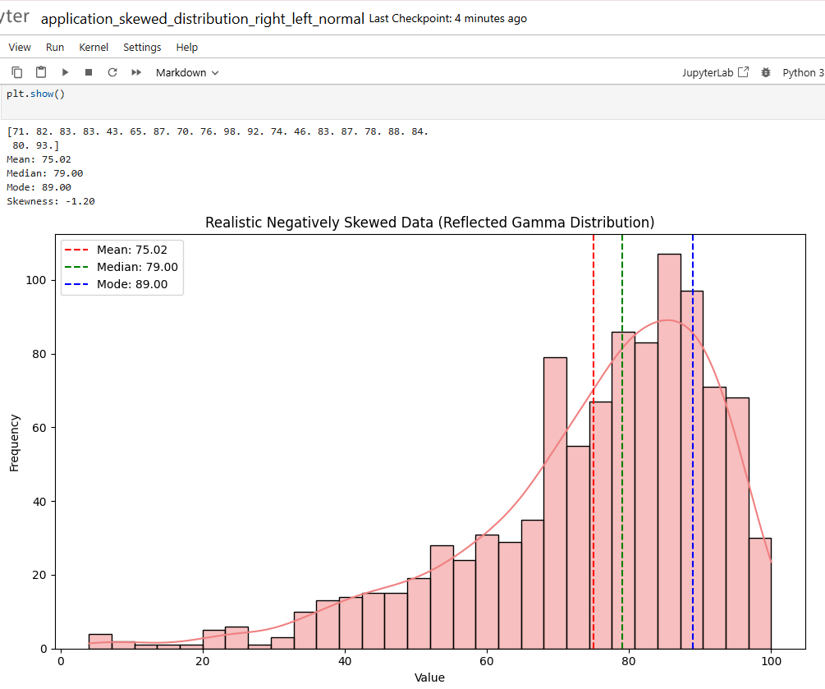
Example of left skewed data (see jupyter n/b):

