Slide 1


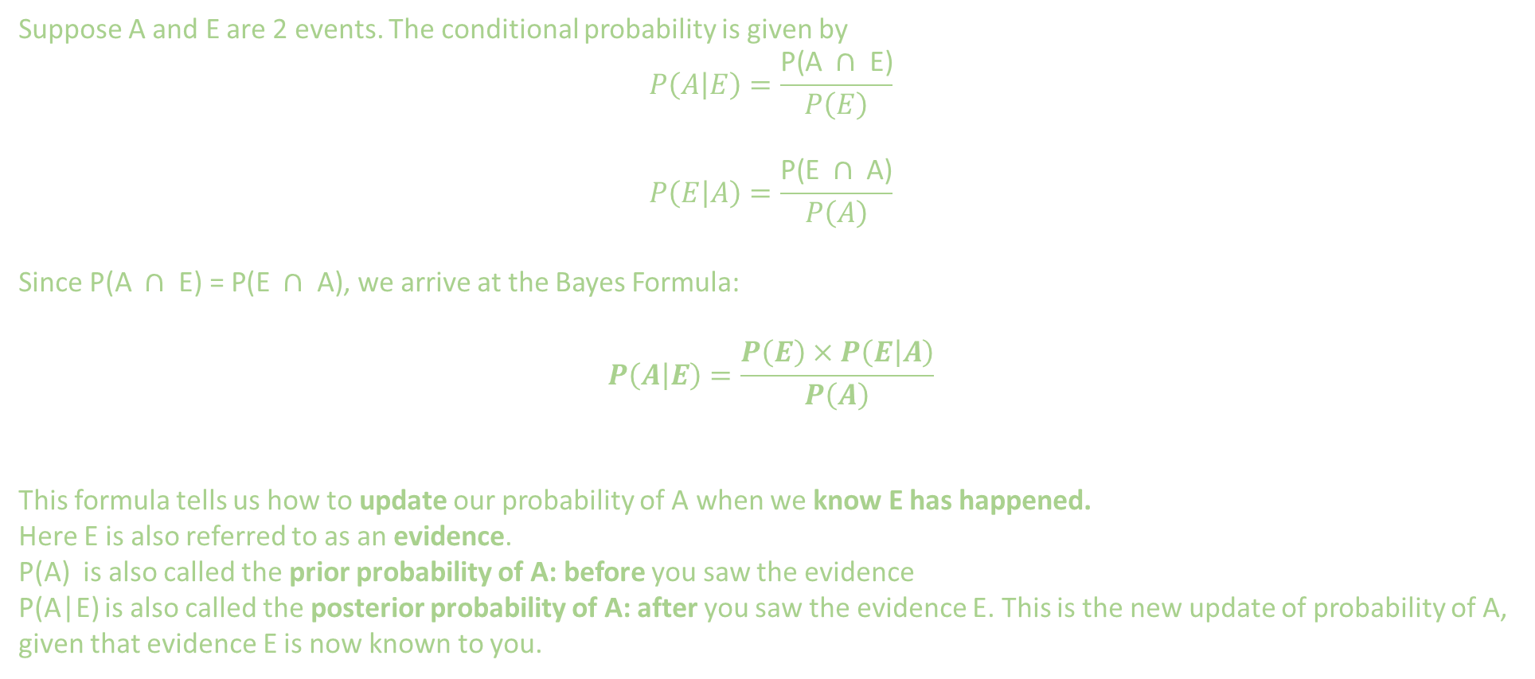
Bayes Theorem
$$P\left(\left.A\right|E\right)=\frac{P\left(A\right)×P\left(\left.E\right|A\right)}{P\left(E\right)}$$
Suppose A and E are 2 events. The conditional probability is given by
$$P\left(\left.A\right|E\right)=\frac{\text{P}\text{(}\text{A} ∩ \text{E}\text{)}}{P\left(E\right)}$$
$$P\left(\left.E\right|A\right)=\frac{\text{P}\text{(}\text{E} ∩ \text{A}\text{)}}{P\left(A\right)}$$
Since $\text{P}\text{(}\text{A} ∩ \text{E}\text{) = }\text{P}\text{(}\text{E} ∩ \text{A}\text{)}$, we arrive at the Bayes Formula:
$$P\left(\left.A\right|E\right)=\frac{P\left(E\right)×P\left(\left.E\right|A\right)}{P\left(A\right)}$$
This formula tells us how to update our probability of A when we know E has happened.
Here E is also referred to as an evidence.
P(A) is also called the prior probability of A: before you saw the evidence
P(A|E) is also called the posterior probability of A: after you saw the evidence E. This is the new update of probability of A, given that evidence E is now known to you.​

Slide 2
Bayes Theorem
$$P\left(\left.A\right|E\right)=\frac{P\left(A\right)×P\left(\left.E\right|A\right)}{P\left(E\right)}$$
Bayes’ theorem is important because it allows updating beliefs based on new evidence. It’s the foundation of Bayesian statistics, widely used in:
Machine learning (e.g., Naïve Bayes classifier)
Medical diagnosis
Spam filtering
Risk assessment
Decision making under uncertainty
Essentially, it helps us revise probabilities when new data becomes available.

Slide 3
EXTRA
$$P\left(\left.A\right|E\right)=\frac{P\left(A\right)×P\left(\left.E\right|A\right)}{P\left(E\right)}$$
Extra problems

