Slide 1
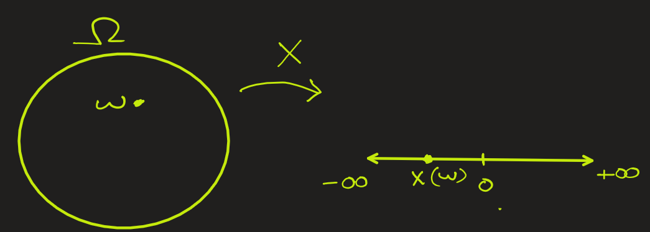


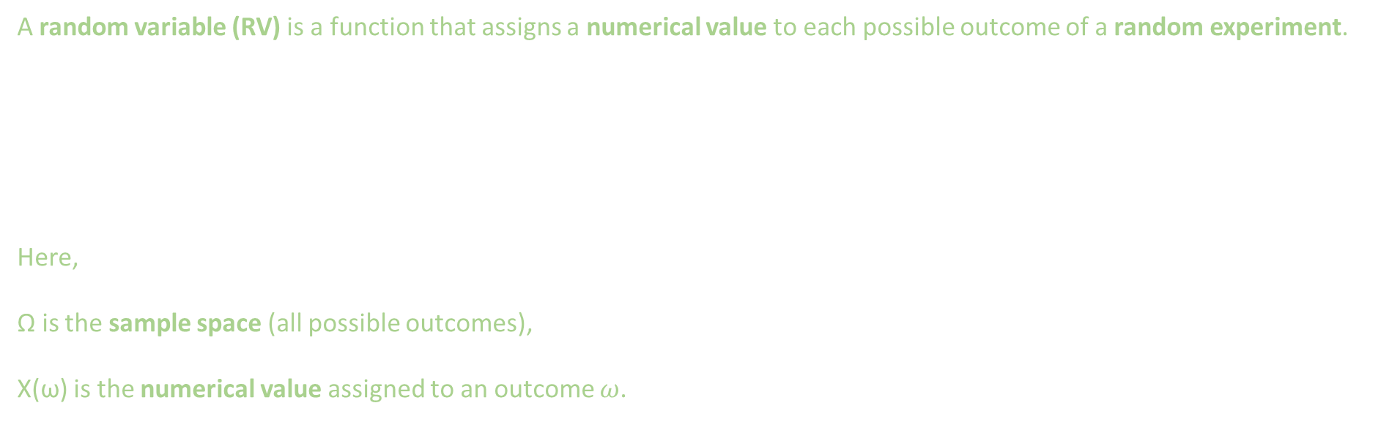
Random Variables: Formal Definition
A random variable (RV) is a function that assigns a numerical value to each possible outcome of a random experiment.
Here,
Ω is the sample space (all possible outcomes),
X(ω) is the numerical value assigned to an outcome $ω$.

Slide 2
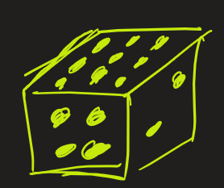

Random Variables: Plain English
Random variable is a numeric variable that represents the outcome of a random experiment — its value is not fixed but depends on chance.
These variable values may change randomly from one experiment to another.
They are often represented by a capital letter like X
For example,
You roll a die, the outcome X could be 1, 2, 3, 4, 5, or 6
You count number of cars passing through a toll in 1 minute, the outcome X could be 0, 1,2,3, …
Measure the temperature of a room: Here outcome X could 10.3, 4, 5.34, etc.

Slide 3
2 types of random variables
Discrete RV
Continuous RV

Slide 4
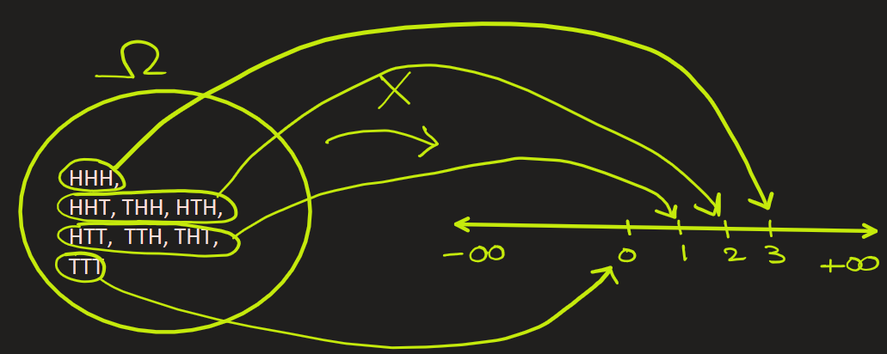
Discrete Random Variables
Definition:
A variable that can only take on a finite or countably infinite number of specific values: {…, -3, -2, -1, 0, 1, 2, 3, 4, 5, …)}.
Example of finite values: The number of heads when you flip a coin three times.
Here outcomes are Ω = { HHH, HHT, HTT, HTH, THH, TTH, THT, TTT } .
Number of heads can be represented as X whose possible values are 0 head, 1 head, 2 head, or 3 head.
So, X = { 0, 1, 2, 3 }

Slide 5
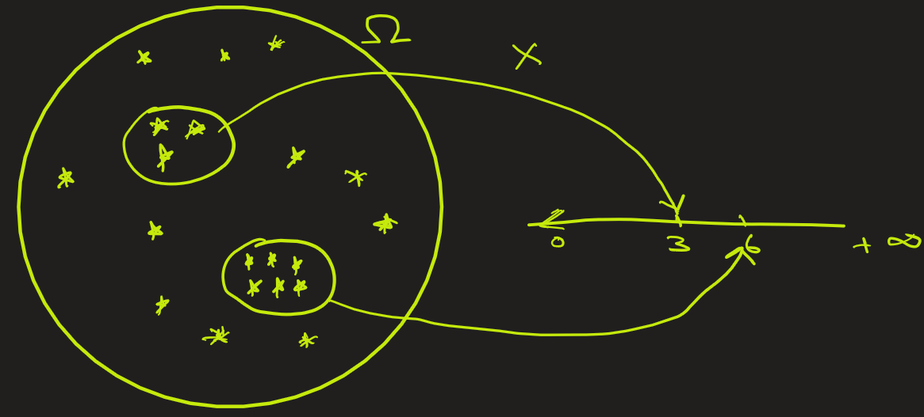
Discrete Random Variables
Example of infinite discrete values: Counting stars in a region of sky
Here outcomes are possible numbers of stars in a region, Ω = { 0, 1, 2, 3, … } .
X can be represented as number of observed stars in a selected region. Its values can 0 star, 1 star, 2 star, 3 star, ….
So, X = { 0, 1, 2, 3, ….. }
Here X = Ω

Slide 6

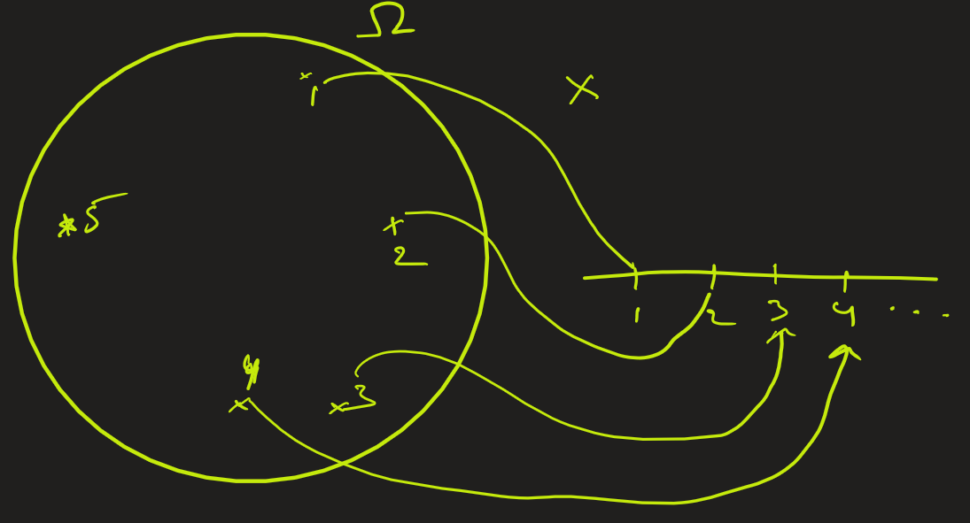
Discrete Random Variables
Example of infinite discrete values: Number of coin tosses until the first head appears
Each outcome represents the trial number on which the first head occurs: So, the sample space Ω = {1, 2, 3, 4, 5, …}
Let X = “the number of tosses needed to get the first head.”
Then X can take any positive integer value: X = {1, 2, 3, 4, 5, …}

Slide 7
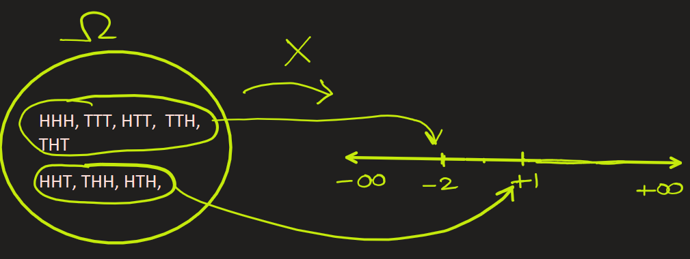
Discrete Random Variables
Example of negative random values: Gamble on coin toss
You flip a coin three times. if you get 2 heads you get $1 else you lose $2
Here outcomes are Ω = { HHH, HHT, HTT, HTH, THH, TTH, THT, TTT } .
X can be represented as win amount: +1 or -2
So, X = { -2, 1}

Slide 8
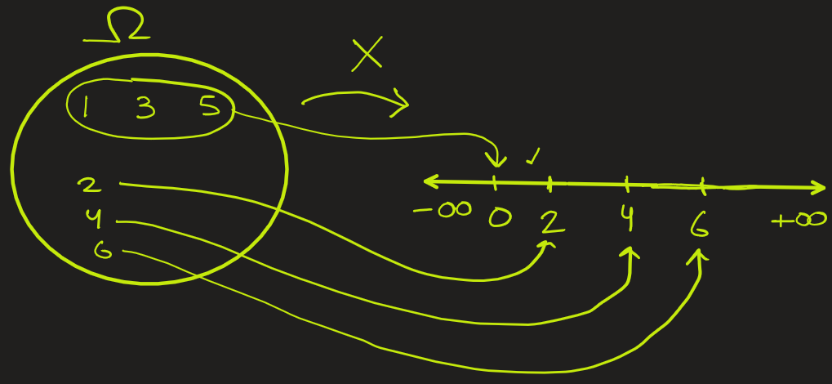
Discrete Random Variables
Example: Rolling a fair die once.
The sample space of all possible outcomes is Ω = {1, 2, 3, 4, 5, 6}. If we define the random variable X as "the number shown on the die when it is even else 0" then the possible values of X are {0, 2, 4, 6}.
X = { 0, 2, 4, 6 }

Slide 9
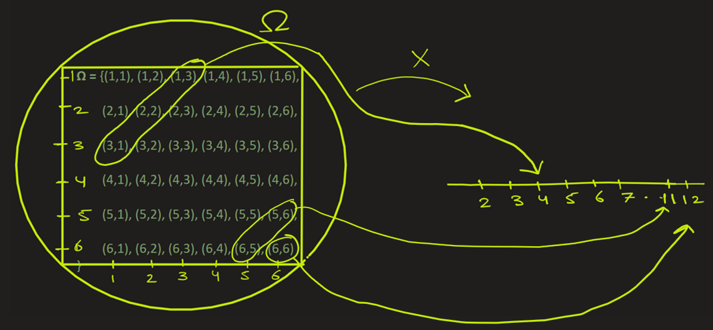
Discrete Random Variables
Example: Rolling 2 dice and adding the numbers on the pair of dice,
Here sample space of all possible outcomes is Ω =
{(1,1), (1,2), (1,3), (1,4), (1,5), (1,6),
(2,1), (2,2), (2,3), (2,4), (2,5), (2,6),
(3,1), (3,2), (3,3), (3,4), (3,5), (3,6),
(4,1), (4,2), (4,3), (4,4), (4,5), (4,6),
(5,1), (5,2), (5,3), (5,4), (5,5), (5,6),
(6,1), (6,2), (6,3), (6,4), (6,5), (6,6) }
If X is the sum of the numbers on
the pair of dice, then
X = { 2, 3, 4, .., 12 }
Mapping here would be
(1,1) -> 2
(1,2) , (2,1) -> 3
(1,3), (2,2), (3,1) -> 4
And so on…

Slide 10

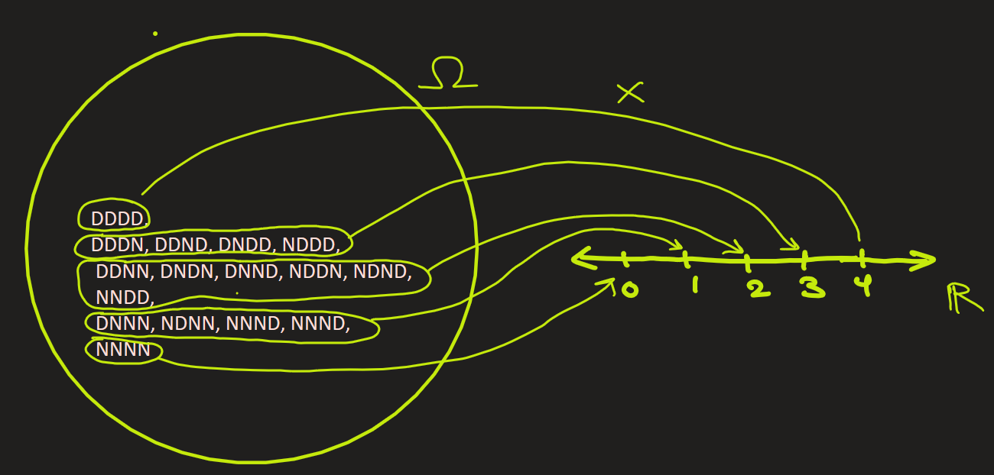
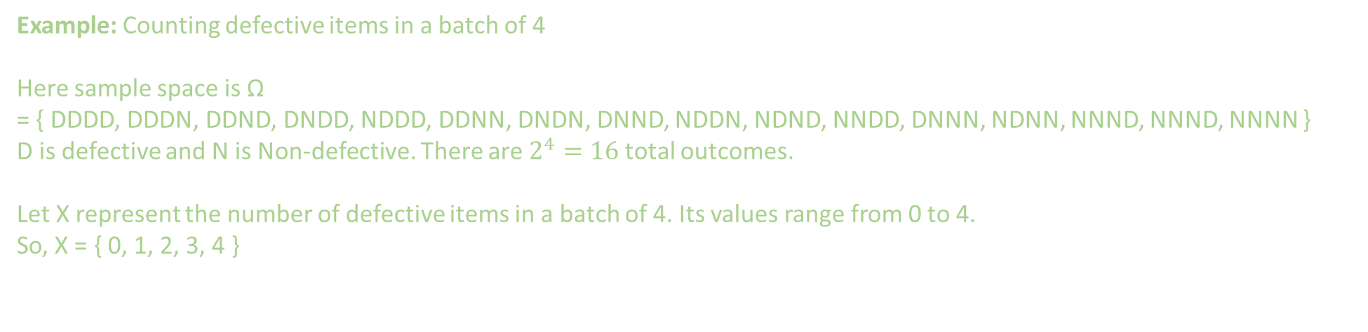
Discrete Random Variables
Example: Counting defective items in a batch of 4
Here sample space is Ω
= { DDDD, DDDN, DDND, DNDD, NDDD, DDNN, DNDN, DNND, NDDN, NDND, NNDD, DNNN, NDNN, NNND, NNND, NNNN }
D is defective and N is Non-defective. There are $2^{4}=16$total outcomes.
Let X represent the number of defective items in a batch of 4. Its values range from 0 to 4.
So, X = { 0, 1, 2, 3, 4 }

Slide 11
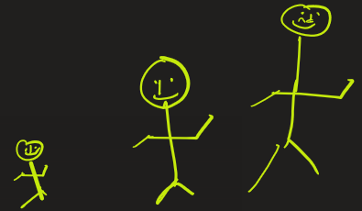
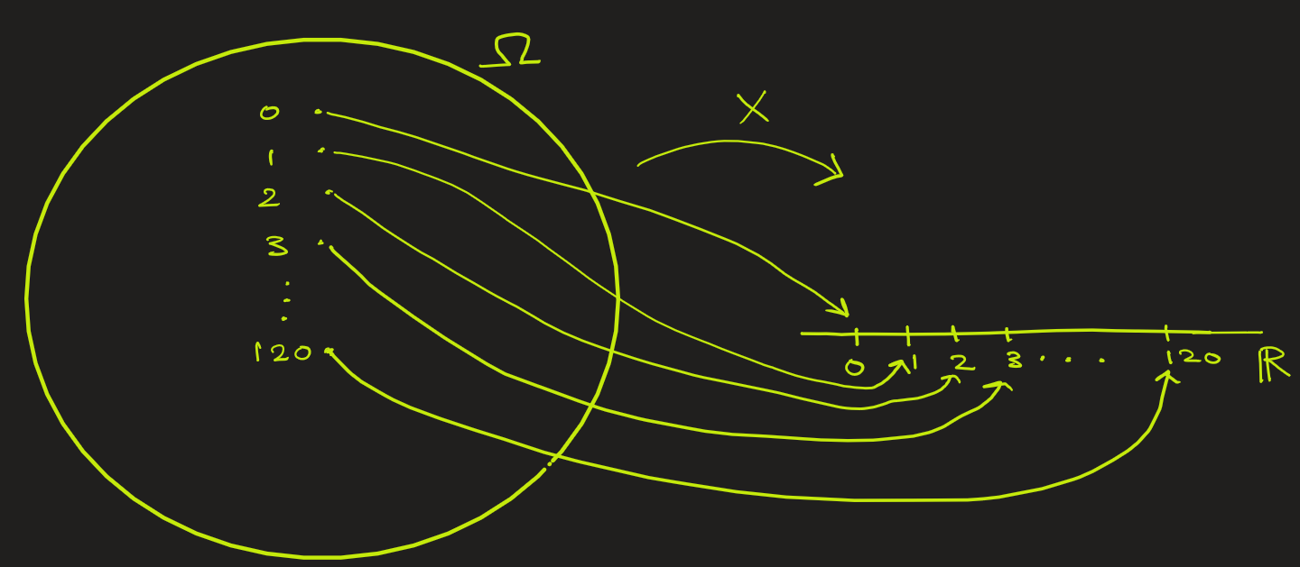
Discrete Random Variables
Example: Picking a person’s age expressed in years.
In everyday use we generally count age in years as whole number. 0 year could be a 2-month-old baby.
Here sample space is Ω = { 0, 1, 2 , 3,…, 120}
Representing X as age, we see it could be any discrete number between 0 years to 120 years.
X = { 0, 1 ,2, 3, …., 120 }
Here X = Ω

Slide 12
CONTINUOUS R.V.

Slide 13

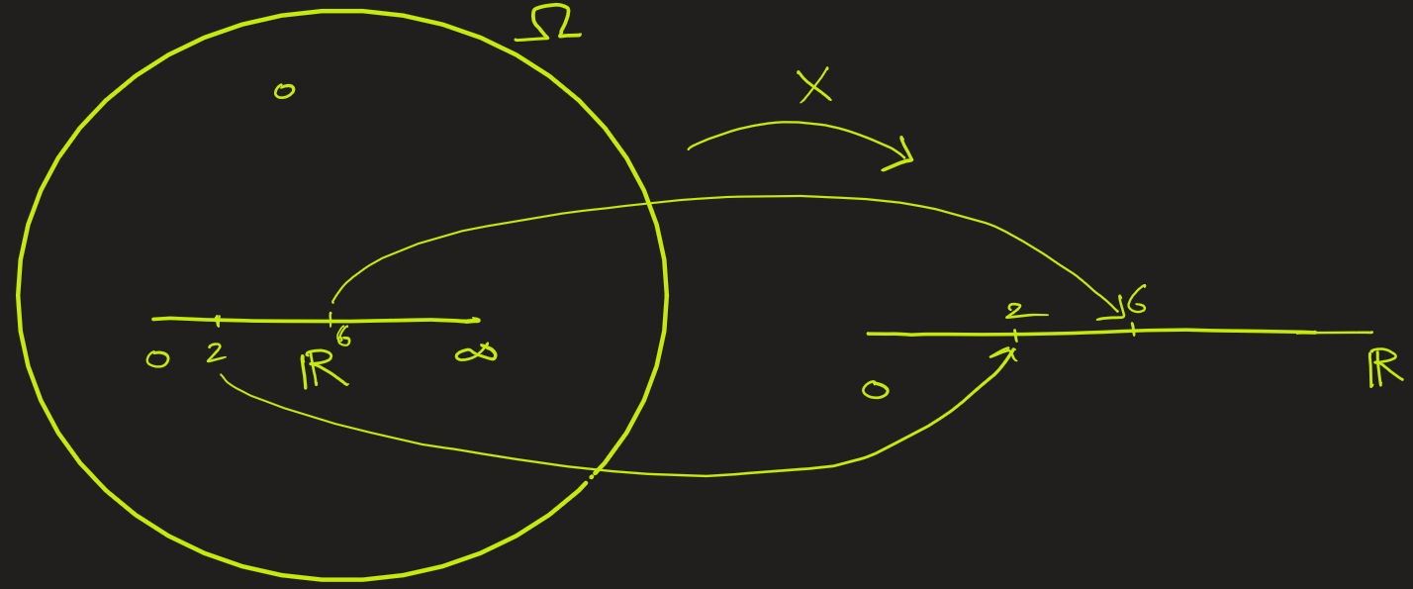
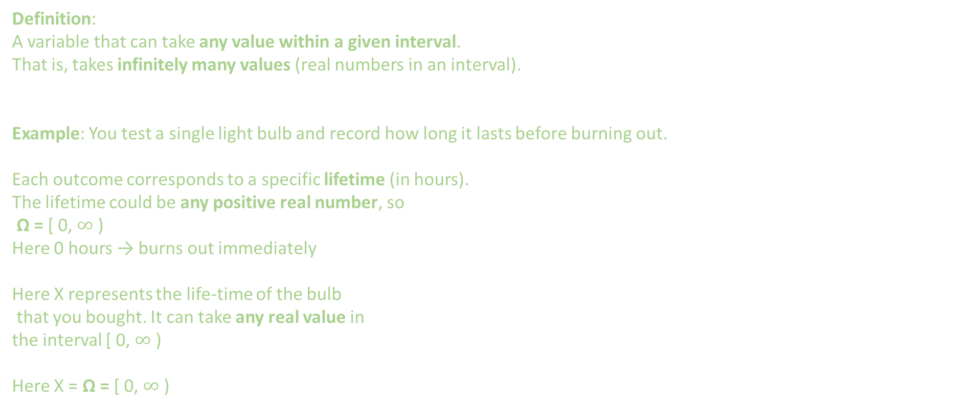
Continuous Random Variables
Definition:
A variable that can take any value within a given interval.
That is, takes infinitely many values (real numbers in an interval).
Example: You test a single light bulb and record how long it lasts before burning out.
Each outcome corresponds to a specific lifetime (in hours). The lifetime could be any positive real number, so
Ω = [ 0, $∞$ )
Here 0 hours → burns out immediately
Here X represents the life-time of the bulb
that you bought. It can take any real value in
the interval [ 0, $∞$ )
Here X = Ω = [ 0, $∞$ )

Slide 14
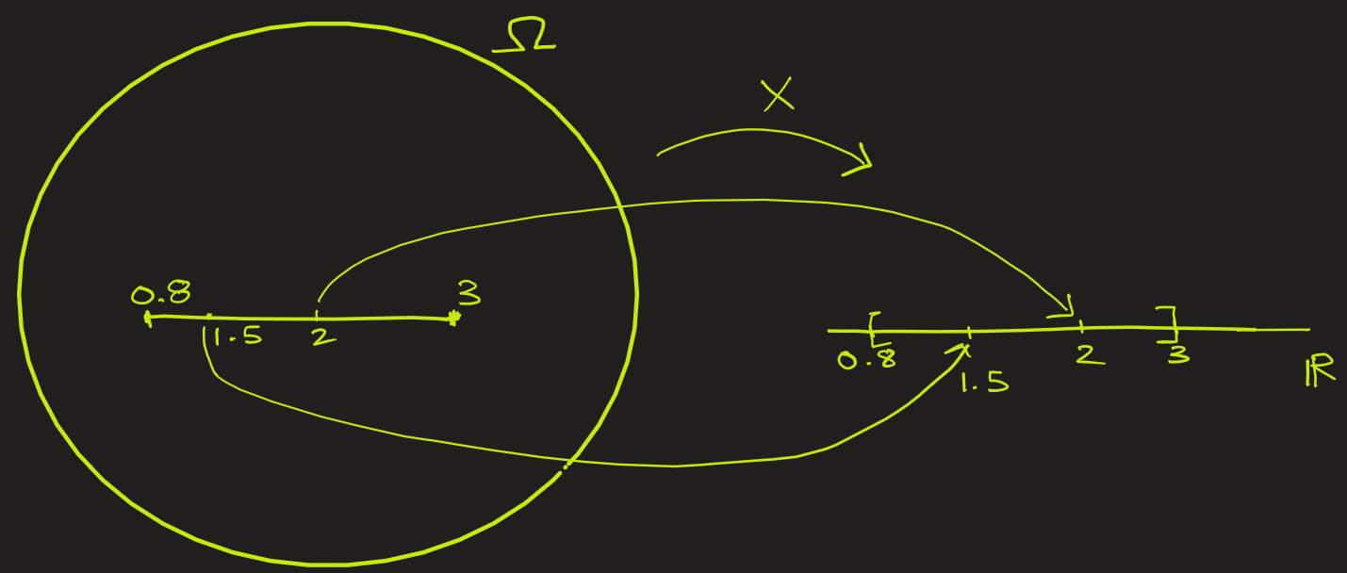
Continuous Random Variables
Simple Example: The height of a person in a crowd.
Here sample space (Ω) is the set of all possible outcomes — i.e., all possible heights that could occur in this experiment. We know from experience that height of any person is between 0.8 to 3 meters, i.e. such as 1.75 meters or 1.755 meters or 1.32 meters, etc.
So, Ω = [0.8, 3] . Here Ω is 1-dimensional.
Let X represent the height of person you selected. It can take any value between [0.8, 3]
Here, X = Ω = [0.8, 3]

Slide 15

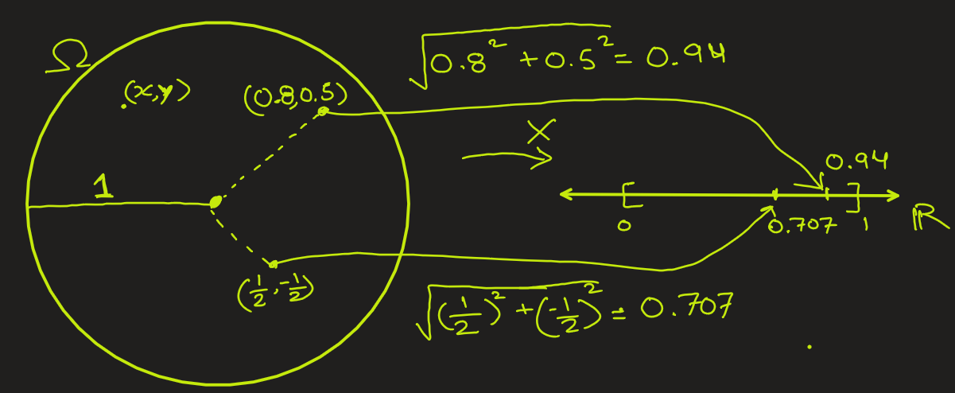
Continuous Random Variables
Example: Tossing a Dart at a Circular Board of radius 1 meter
You throw a dart at a circular dartboard, and record where it lands. Each outcome is a point (x, y) on the circular board.
Here sample space (Ω) is a 2-dimensional — all the points within and on the circle.
Let X be the distance from the center
of the board to the point on which
the dart lands.
Here X can range from 0 (center)
to 1 (edge of the board):
X = [0, 1]

Slide 16
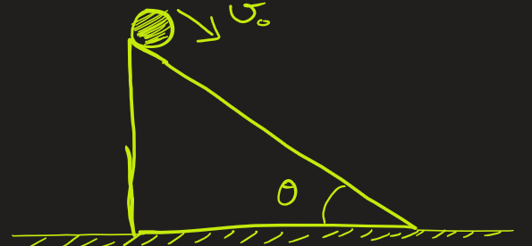

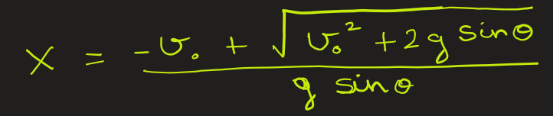
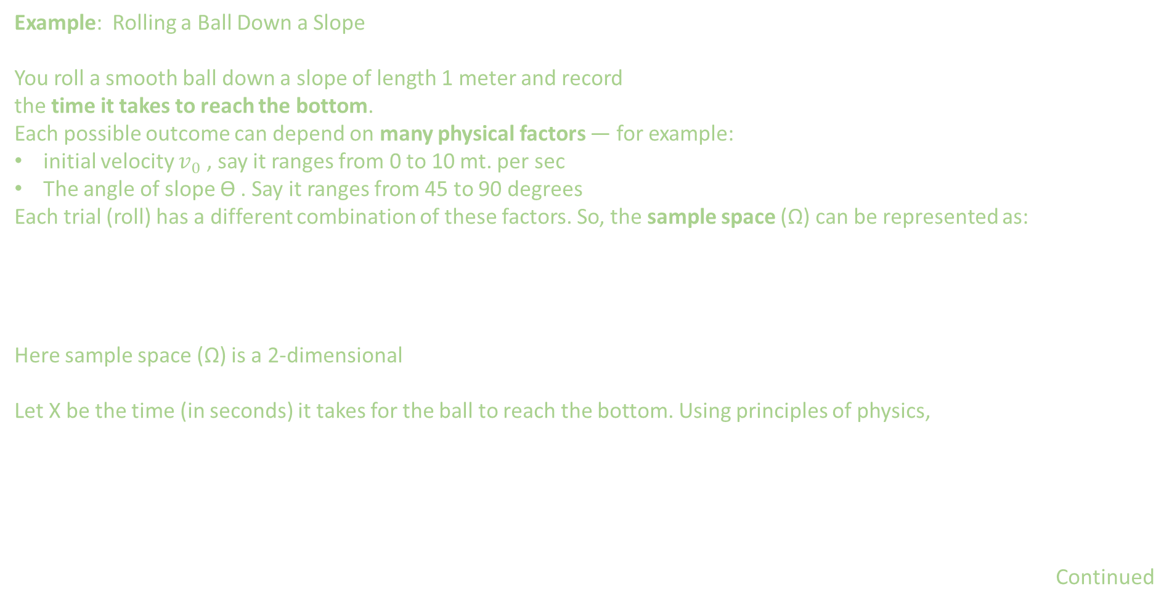
Continuous Random Variables
Example: Rolling a Ball Down a Slope
You roll a smooth ball down a slope of length 1 meter and record
the time it takes to reach the bottom.
Each possible outcome can depend on many physical factors — for example:
initial velocity $v_{0}$ , say it ranges from 0 to 10 mt. per sec
The angle of slope ϴ . Say it ranges from 45 to 90 degrees
Each trial (roll) has a different combination of these factors. So, the sample space (Ω) can be represented as:
Here sample space (Ω) is a 2-dimensional
Let X be the time (in seconds) it takes for the ball to reach the bottom. Using principles of physics,
Continued

Slide 17
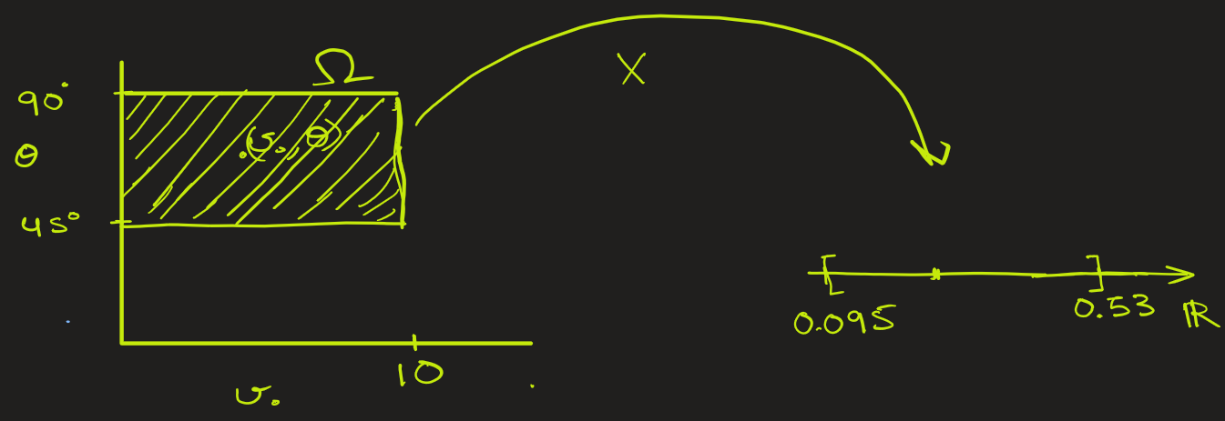
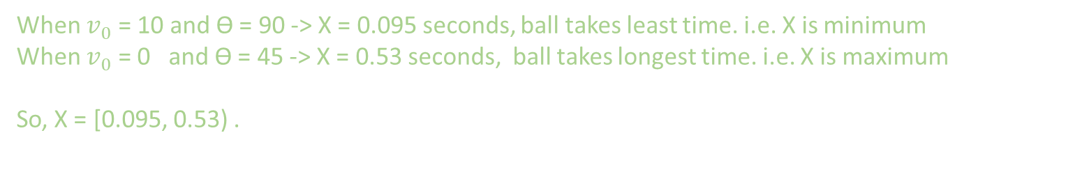
When $v_{0}$ = 10 and ϴ = 90 -> X = 0.095 seconds, ball takes least time. i.e. X is minimum
When $v_{0}$ = 0 and ϴ = 45 -> X = 0.53 seconds, ball takes longest time. i.e. X is maximum
So, X = [0.095, 0.53) .

Slide 18


Random Variables: Formal Definition
A random variable (RV) is a function that assigns a numerical value to each possible outcome of a random experiment.
Here,
Ω is the sample space (all possible outcomes),
X(ω) is the numerical value assigned to an outcome $ω$.

Slide 19
EXTRA-TODO

Slide 20
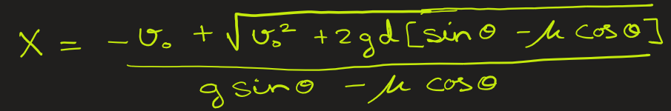
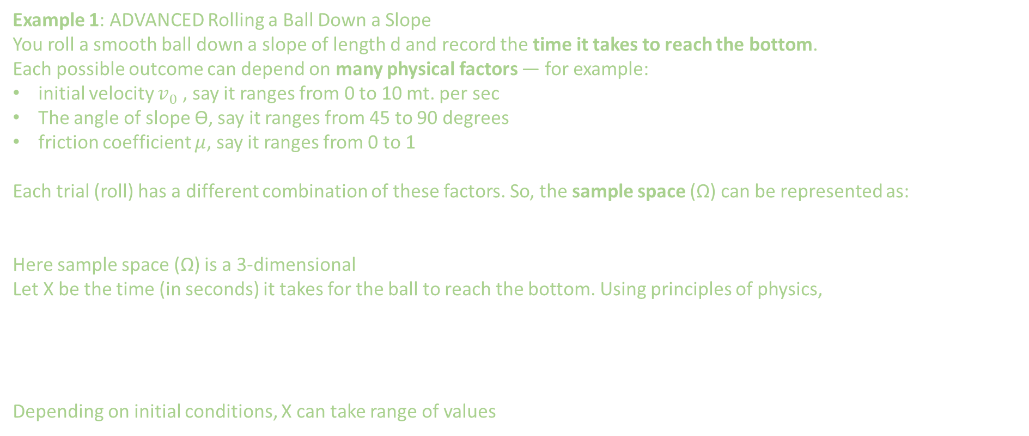
Continuous Random Variables
Example 1: ADVANCED Rolling a Ball Down a Slope
You roll a smooth ball down a slope of length d and record the time it takes to reach the bottom.
Each possible outcome can depend on many physical factors — for example:
initial velocity $v_{0}$ , say it ranges from 0 to 10 mt. per sec
The angle of slope ϴ, say it ranges from 45 to 90 degrees
friction coefficient $μ$, say it ranges from 0 to 1
Each trial (roll) has a different combination of these factors. So, the sample space (Ω) can be represented as:
Here sample space (Ω) is a 3-dimensional
Let X be the time (in seconds) it takes for the ball to reach the bottom. Using principles of physics,
Depending on initial conditions, X can take range of values

Slide 21
Continuous Random Variables
Example: You spin a wheel labeled from 0 to 1 — imagine a continuous circular scale starting at 0 and ending at 1.
When the wheel stops, the pointer lands at some value between 0 and 1 (like 0.37, 0.852, etc.).
Here sample space is Ω = { all numbers between 0 and 1 } = [0, 1]
Here X is the position where wheel stops. So, X = [0, 1]
In this case Ω = X
Example: Person’s age in precise form
A person's exact age could be 25 years, 6 months, 3 days, 12 hours, and 5 minutes, which could be measured with even greater precision if needed. Therefore, age ,X, could be any continuous number between 0 years to 120 years.
So, X = [0,120]

