Slide 1
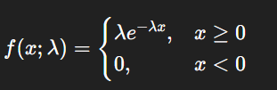

Exponential Distribution
Problem: Let’s say the average lifetime of a bulb from a manufacturer is 5 years. If you buy the bulb from this manufacturer what is the probability that the
bulb lasts between 6 to 9 years
bulb lasts exactly 5 years.

Slide 2
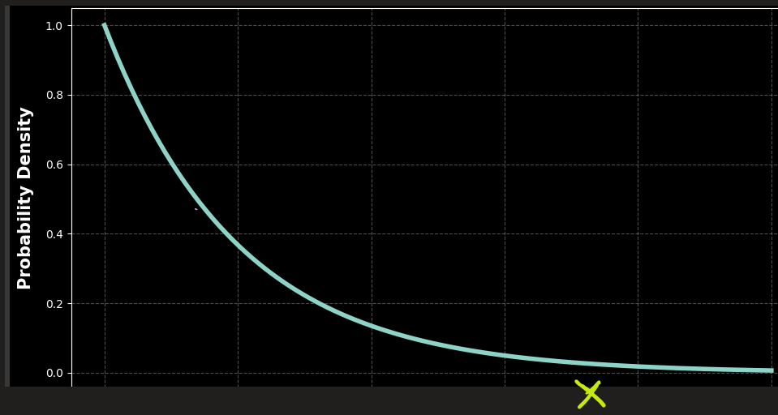

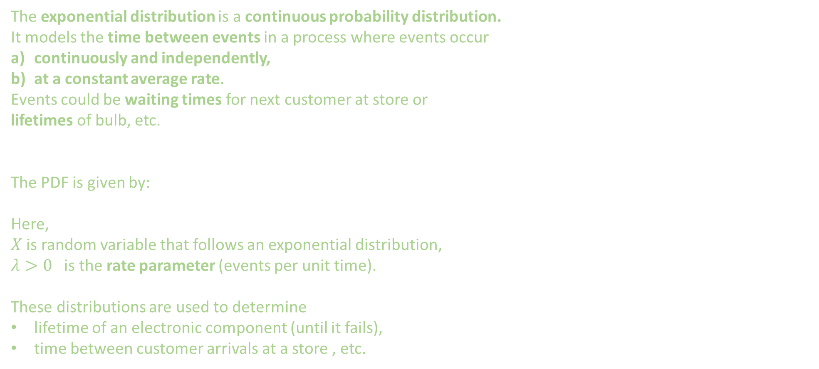
Exponential Distribution: Theory
The exponential distribution is a continuous probability distribution.
It models the time between events in a process where events occur
continuously and independently,
at a constant average rate.
Events could be waiting times for next customer at store or
lifetimes of bulb, etc.
The PDF is given by:
Here,
$X$ is random variable that follows an exponential distribution,
$λ>0$ is the rate parameter (events per unit time).
These distributions are used to determine
lifetime of an electronic component (until it fails),
time between customer arrivals at a store , etc.

Slide 3
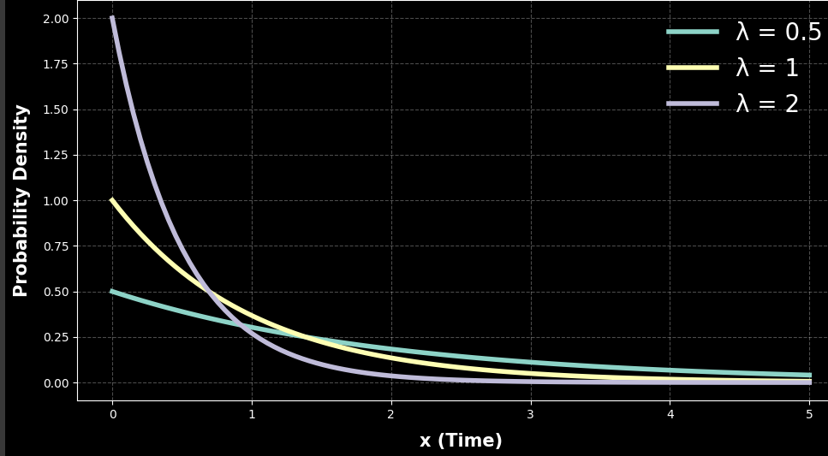
Exponential Distribution: Plots
The exponential distribution curve for different values of $λ>0$

Slide 4

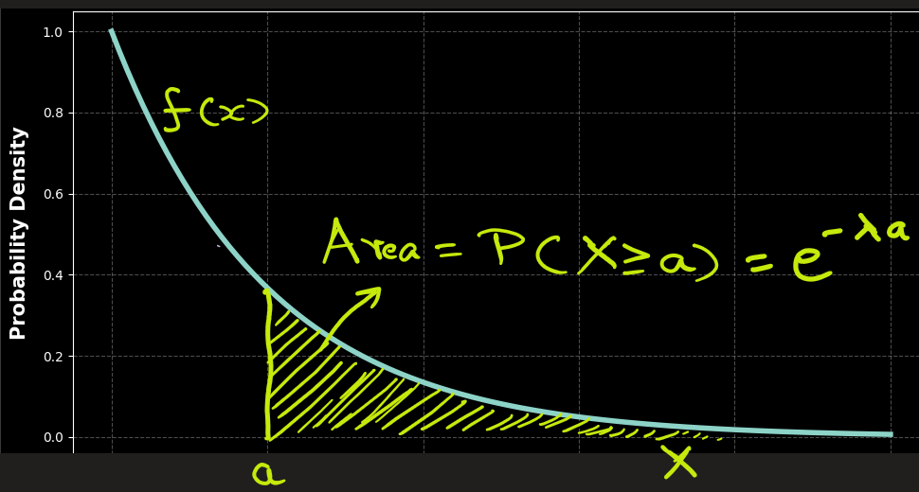




Exponential Distribution: Probability
The probability that random variable X > a, is given by area under the curve:
Substituting,
After integrating we get,
Note:
P(X=a) = 0
P(X > 0) = 1, i.e. the total area under the curve is 1.
This means,

Slide 5
Exponential Distribution: Applications
Problem: Suppose customers arrive at a store on average every 5 minutes. Find the probability that
a) the next customer arrives after 3 minutes.
b) the next customer arrives within 3 minutes.
Ans:
That means the rate λ = 1/5​ = 0.2 customers per minute.
a) P (next customer arrives after 3 minutes)
=
b) P (next customer arrives within 3 minutes)
= 1 - P (next customer arrives after 3 minutes)
= 1 – 0.5488 = 0.4512

Slide 6

Exponential Distribution: Applications
Problem: Let’s say the average lifetime of a bulb is 5 years. Find the probability
a) the bulb lasts more than 8 years,
b) the bulb lasts less than 8 years
c) the bulb lasts between 6 to 9 years
d) the bulb lasts exactly 5 years
Ans: Here$λ=\frac{1}{5}=0.2$
P(bulb lasts more than 8 years)
= Area to under the curve to the right of X = 8
=
b) P(bulb lasts less than 8 years)
= Area to the left of X = 8
= P( X < 8 )
= 1 – P( X > 8 )
= 1 – 0.2019 = 0.7981 = 79.81%

Slide 7
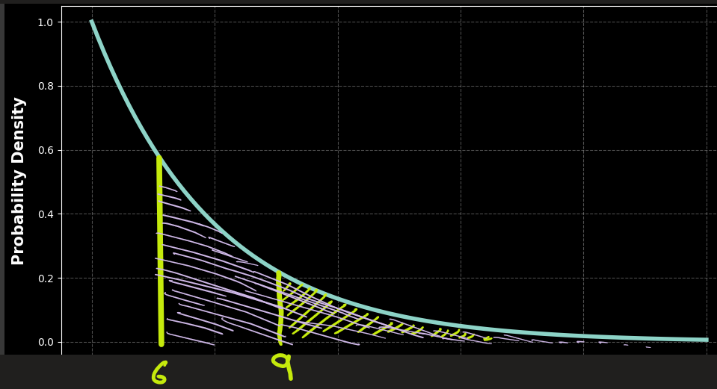
Exponential Distribution: Applications
P(bulb lasts between 6 to 9 years)
= Area between X = 6 and X = 9
= P(X > 6) - P(X > 9)
= 0.3010 − 0.1653
= 0.1357 = 13.57 %
d) P(bulb lasts exactly 5 years)
= Area under X = 5
= 0

Slide 8
EXTRA

Slide 9
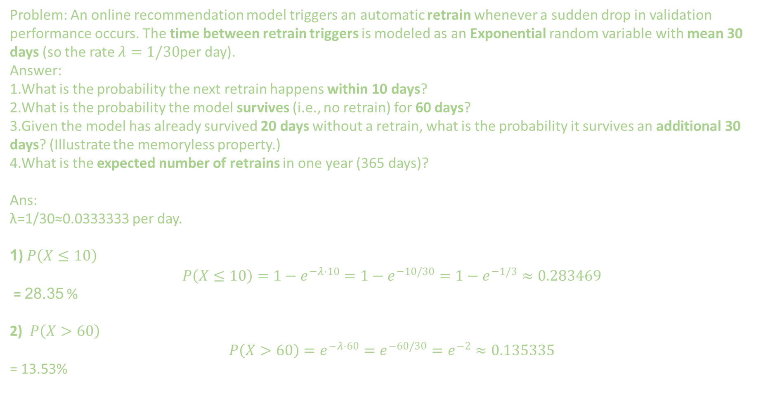
Problem: An online recommendation model triggers an automatic retrain whenever a sudden drop in validation performance occurs. The time between retrain triggers is modeled as an Exponential random variable with mean 30 days (so the rate $λ=1/30$per day).
Answer:
What is the probability the next retrain happens within 10 days?
What is the probability the model survives (i.e., no retrain) for 60 days?
Given the model has already survived 20 days without a retrain, what is the probability it survives an additional 30 days? (Illustrate the memoryless property.)
What is the expected number of retrains in one year (365 days)?
Ans:
λ=1/30≈0.0333333 per day.
1)$P\left(X≤10\right)$
$$P\left(X≤10\right)=1−e^{−λ⋅10}=1−e^{−10/30}=1−e^{−1/3}≈0.283469$$
= 28.35 %
2) $P\left(X>60\right)$
$$P\left(X>60\right)=e^{−λ⋅60}=e^{−60/30}=e^{−2}≈0.135335$$
= 13.53%

Slide 10
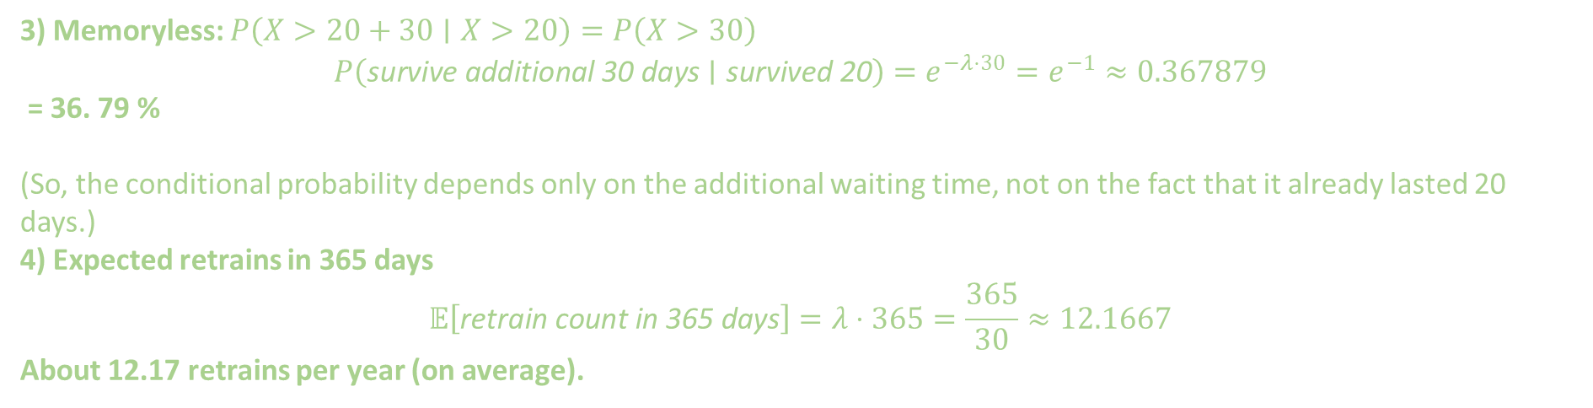
3) Memoryless: $P\left(X>20+30∣X>20\right)=P\left(X>30\right)$
$$P\left(\text{survive} \text{additional} \text{30 }\text{days}∣\text{survived} \text{20}\right)=e^{−λ⋅30}=e^{−1}≈0.367879$$
= 36. 79 %
(So, the conditional probability depends only on the additional waiting time, not on the fact that it already lasted 20 days.)
4) Expected retrains in 365 days
$$𝔼\left[\text{retrain} \text{count} \text{in} \text{365 }\text{days}\right]=λ⋅365=\frac{365}{30}≈12.1667$$
About 12.17 retrains per year (on average).

Slide 11
Exponential Distribution
The exponential distribution is commonly used for:
Modeling waiting times:
Time between customer arrivals at a store.
Time between phone calls at a call center.
Reliability and lifetime modeling:
Lifetime of an electronic component (until it fails).
Queueing systems:
Time between arrivals in a queue (Poisson process).
Essentially, when events occur randomly but at a constant rate, the exponential distribution fits perfectly.

Slide 12


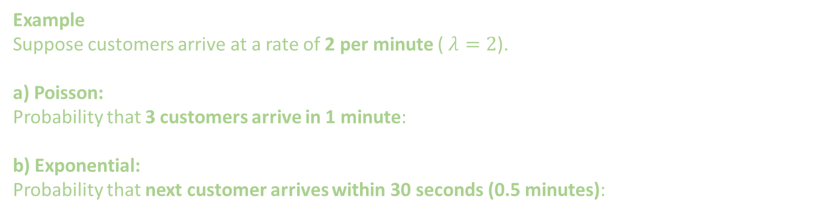
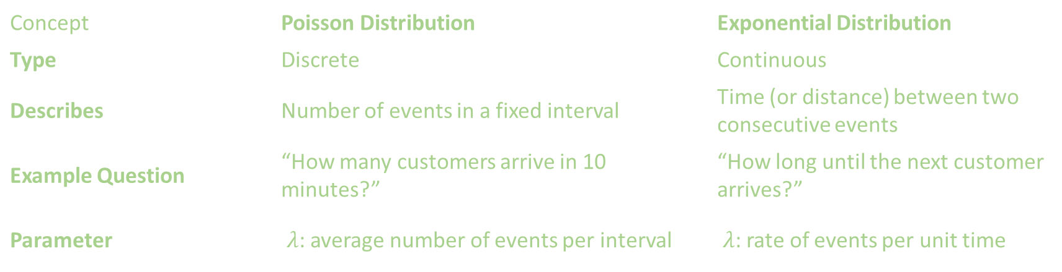
Exponential Distribution vs Poisson Distribution
Concept | Poisson Distribution | Exponential Distribution
Type | Discrete | Continuous
Describes | Number of events in a fixed interval | Time (or distance) between two consecutive events
Example Question | “How many customers arrive in 10 minutes?” | “How long until the next customer arrives?”
Parameter | $λ$: average number of events per interval | $λ$: rate of events per unit time
Example
Suppose customers arrive at a rate of 2 per minute ( $λ=2$).
a) Poisson:
Probability that 3 customers arrive in 1 minute:
b) Exponential:
Probability that next customer arrives within 30 seconds (0.5 minutes):

Slide 13
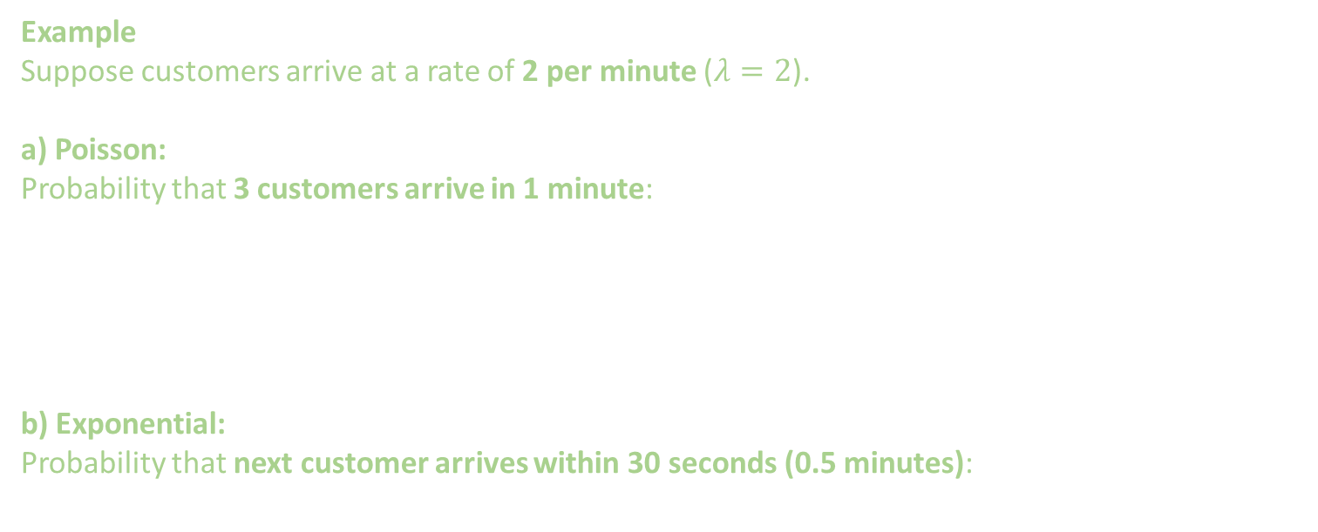
Exponential Distribution vs Poisson Distribution
Example
Suppose customers arrive at a rate of 2 per minute ($λ=2$).
a) Poisson:
Probability that 3 customers arrive in 1 minute:
b) Exponential:
Probability that next customer arrives within 30 seconds (0.5 minutes):

Slide 14
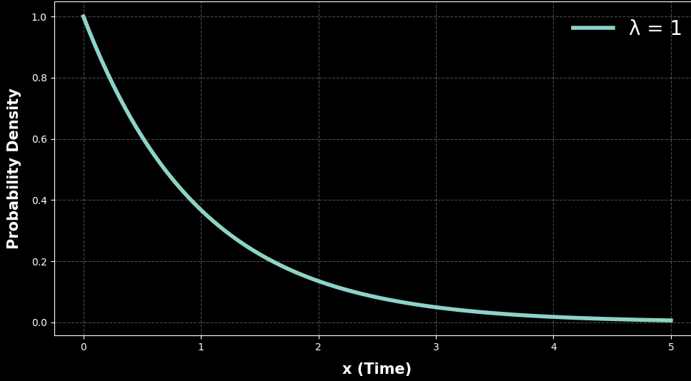
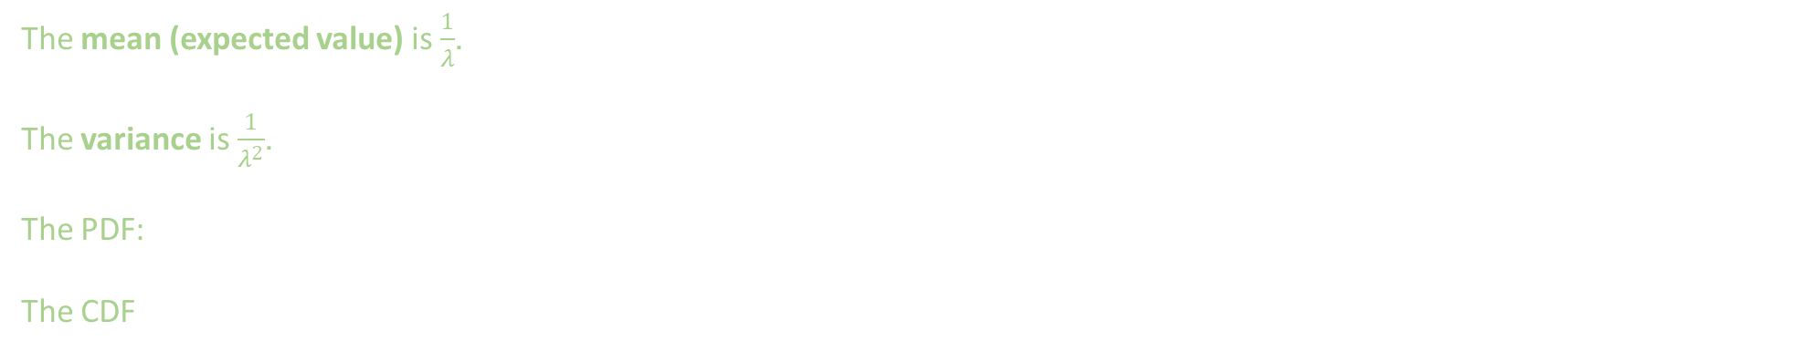
Extra
The mean (expected value) is $\frac{1}{λ}$.
The variance is $\frac{1}{λ^{2}}$.
The PDF:
The CDF

