Slide 1

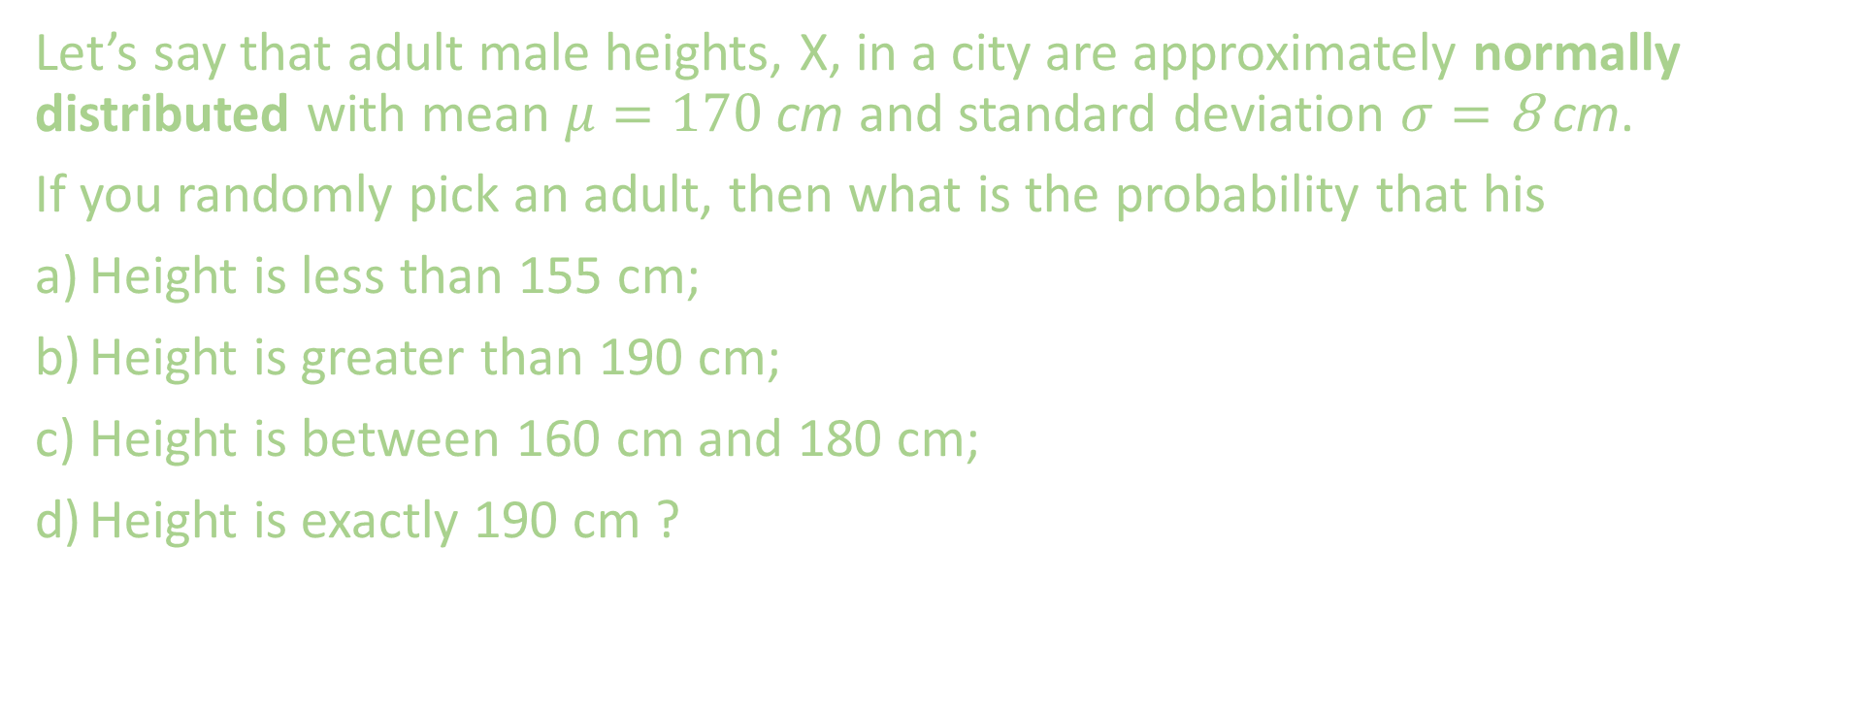
Problem Statement
Let’s say that adult male heights, X, in a city are approximately normally distributed with mean $μ=170 \text{cm}$and standard deviation $σ=\text{8} \text{cm}$.
If you randomly pick an adult, then what is the probability that his
Height is less than 155 cm;
Height is greater than 190 cm;
Height is between 160 cm and 180 cm;
Height is exactly 190 cm ?

Slide 2
Theory

Slide 3
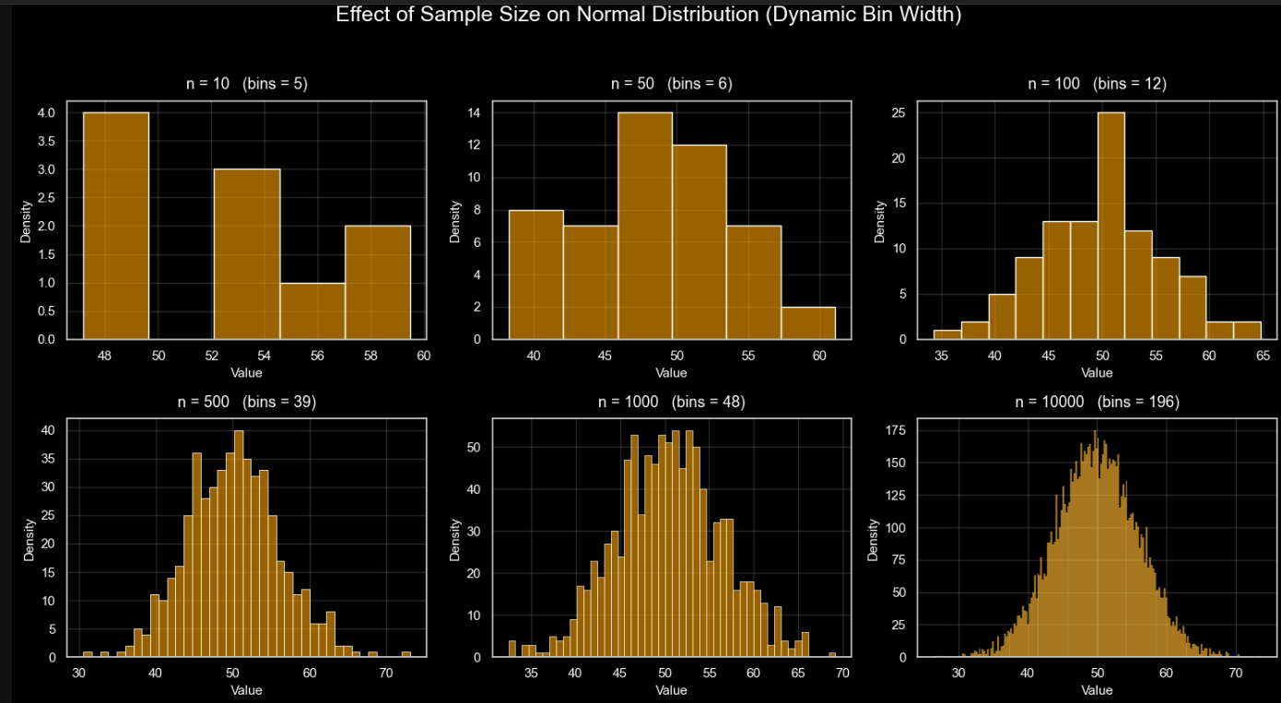
If you selects random sample of 10 people, measures their weight, and constructs a histogram, the graph will look like as shown. Now, if you increase the sample size and increase the bins, the histograms will look like the bell shape curve. The histogram would approach what is called a normal distribution curve AKA a bell curve or a Gaussian distribution curve. This curve show ups in heights of adult, blood pressure, IQ score, etc.

Slide 4
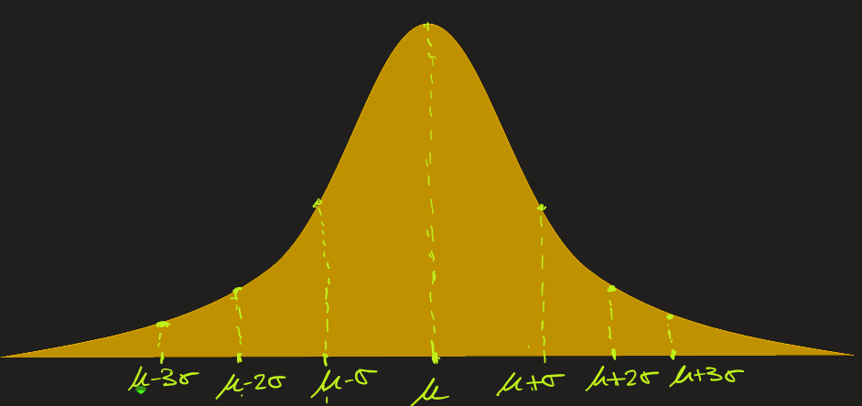
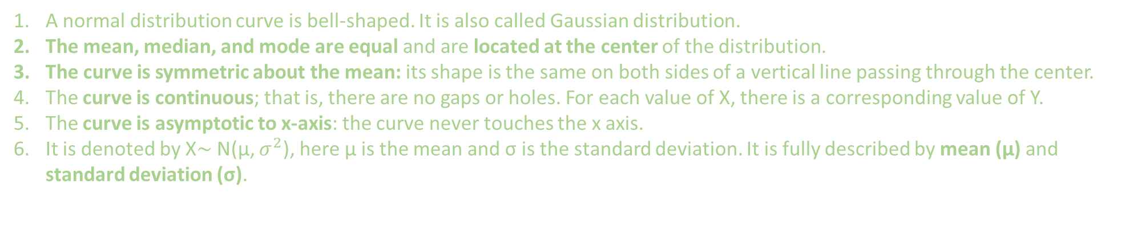
Normal Distribution: Definition
A normal distribution curve is bell-shaped. It is also called Gaussian distribution.
The mean, median, and mode are equal and are located at the center of the distribution.
The curve is symmetric about the mean: its shape is the same on both sides of a vertical line passing through the center.
The curve is continuous; that is, there are no gaps or holes. For each value of X, there is a corresponding value of Y.
The curve is asymptotic to x-axis: the curve never touches the x axis.
It is denoted by X∼ N(μ, $σ^{2}$), here μ is the mean and σ is the standard deviation. It is fully described by mean (μ) and standard deviation (σ).

Slide 5
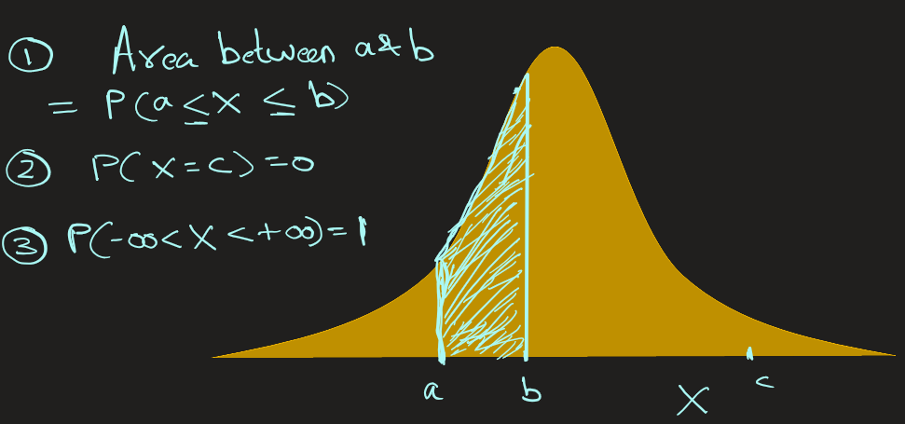

Normal Distribution: Definition
1. The area above an interval represents the probability of finding X value in that interval
2. The probability of finding an exact X value is 0.
3. The total area under a normal distribution curve is equal to 1.00, or 100%.

Slide 6
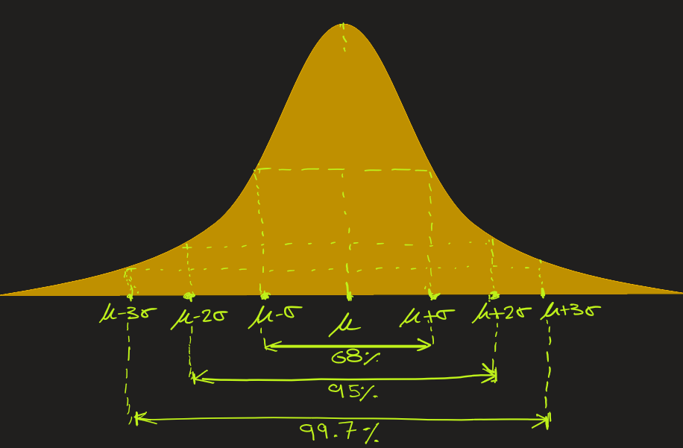
Normal Distribution: Empirical Rule 68-95-99.7
About 68% of data lies within 1 standard deviation (σ) of the mean (μ) → Between μ − σ and μ + σ.
About 95% of data lies within 2 standard deviations (σ) of the mean (μ) → Between μ − 2σ and μ + 2σ.
About 99.7% of data lies within 3 standard deviations (σ) of the mean (μ) → Between μ − 3σ and μ + 3σ.
The above Empirical rule helps to
quickly estimating probabilities without doing integration, (e.g.: P (μ−σ < x < μ+σ) = 0.68)
identify outliers (anything beyond ±3σ is rare), and
check if your dataset is roughly normal (i.e. If dataset satisfies Empirical rule, then it is normal.)

Slide 7

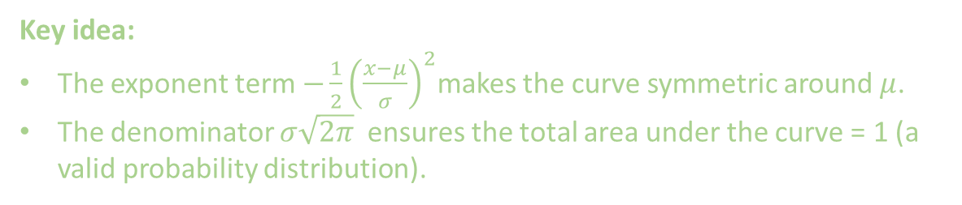
Normal Distribution: The Mathematical Function
The curve can be defined as
f(x) is Probability Density Function
μ is the mean (center of distribution)
σ is the standard deviation (spread)
e is the Euler’s number (~2.71828)
Π is Pi (~3.14159)
Key idea:
The exponent term $−\frac{1}{2}{\left(\frac{x−μ}{σ}\right)}^{2}$makes the curve symmetric around $μ$.
The denominator $σ\sqrt{2π}$ ensures the total area under the curve = 1 (a valid probability distribution).

Slide 8
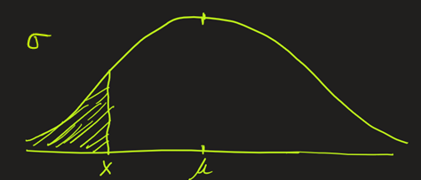

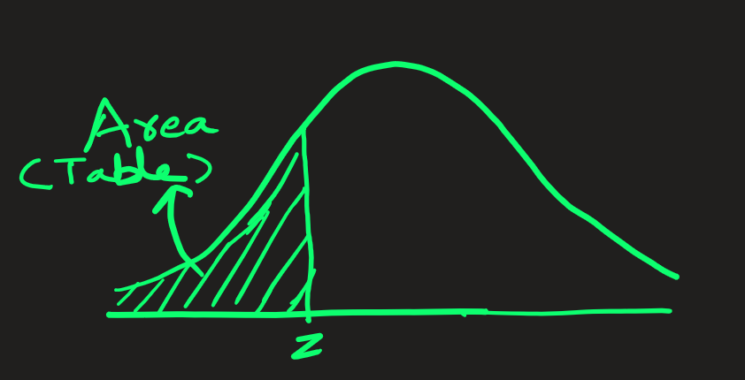


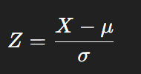

Normal Distribution: Standard Normal Distribution
Standard normal distribution is a special case of normal distribution where the mean = 0, standard deviation = 1.
The variable X from normal distribution is generally mapped, AKA standardization or normalization, to variable Z in Standard normal distribution.
X
The area under Standard normal distribution can be read from the z-table.

Slide 9


Normal Distribution: Standard Normal Distribution
Why the conversion from Normal to Standard?
Because it
simplifies calculation: we read values of areas from z-table
allows us to compare scores from different normal distributions on the same scale. Example: Comparing exam scores with
different means and SDs.

Slide 10
Applications
Normal Distribution

Slide 11
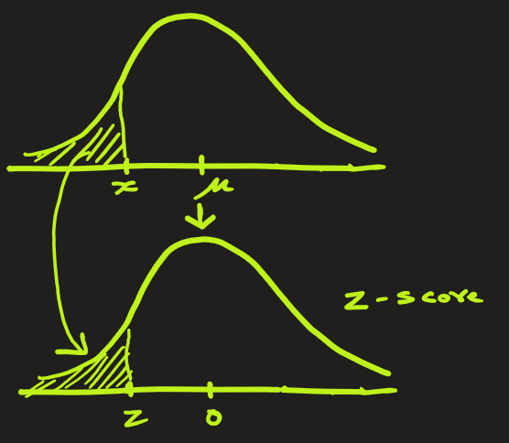
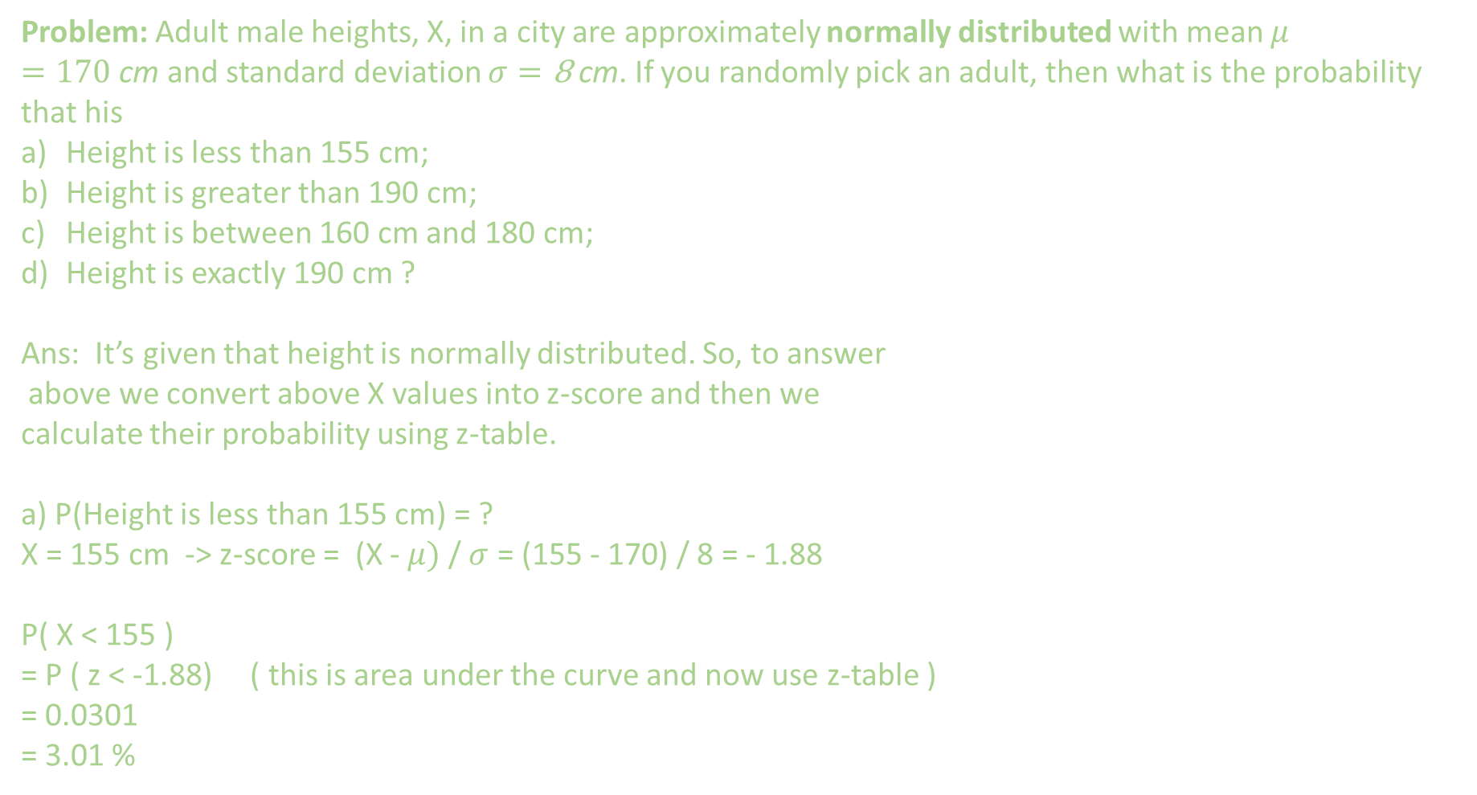
Normal Distribution: Problem
Problem: Adult male heights, X, in a city are approximately normally distributed with mean $μ=170 \text{cm}$and standard deviation $σ=\text{8} \text{cm}$. If you randomly pick an adult, then what is the probability that his
Height is less than 155 cm;
Height is greater than 190 cm;
Height is between 160 cm and 180 cm;
Height is exactly 190 cm ?
Ans: It’s given that height is normally distributed. So, to answer
above we convert above X values into z-score and then we
calculate their probability using z-table.
a) P(Height is less than 155 cm) = ?
X = 155 cm -> z-score = (X - $μ)$ / $σ$ = (155 - 170) / 8 = - 1.88
P( X < 155 )
= P ( z < -1.88) ( this is area under the curve and now use z-table )
= 0.0301
= 3.01 %

Slide 12
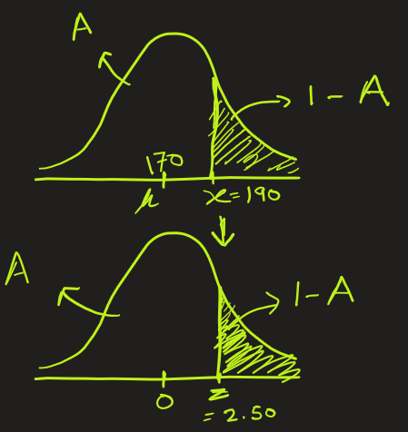
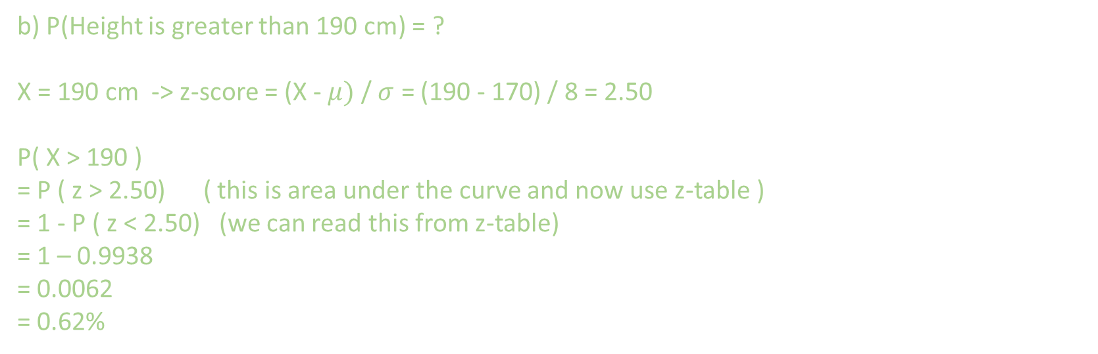
Normal Distribution: Problem
b) P(Height is greater than 190 cm) = ?
X = 190 cm -> z-score = (X - $μ)$ / $σ$ = (190 - 170) / 8 = 2.50
P( X > 190 )
= P ( z > 2.50) ( this is area under the curve and now use z-table )
= 1 - P ( z < 2.50) (we can read this from z-table)
= 1 – 0.9938
= 0.0062
= 0.62%

Slide 13
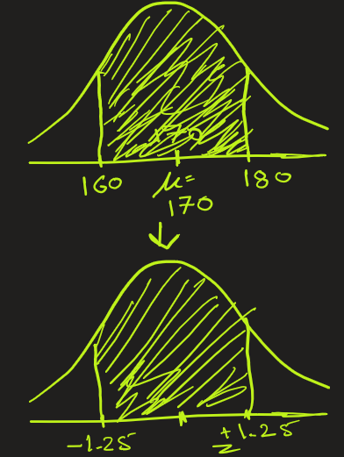
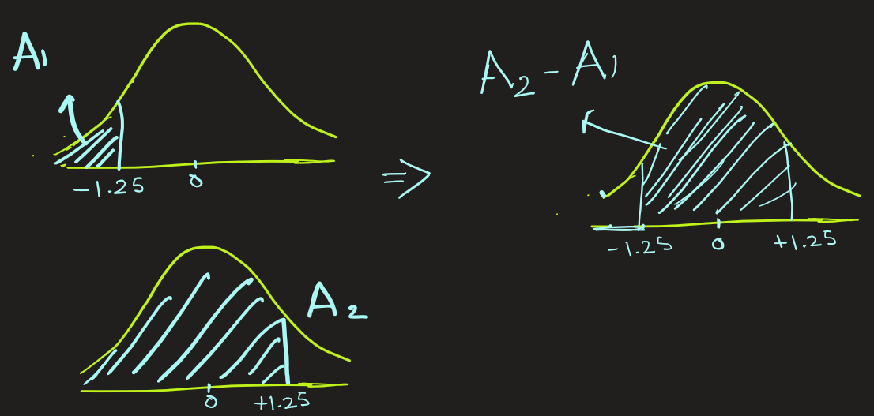

Normal Distribution: Problem
c) P(Height is between 160 cm and 180 cm) = ?
X = 160 cm -> z-score = (X - $μ)$ / $σ$ = (160 - 170) / 8 = - 1.25
X = 180 cm -> z-score = (X - $μ)$ / $σ$ = (180 - 170) / 8 = +1.25
P (160 < X < 180)
= P (-1.25 < z < +1.25) ( this is area under the curve and now use z-table )
= P( z < +1.25) – P ( z < -1.25)
= 0.8944 - 0.1057
= 0.7887
= 78.87 %

Slide 14
Normal Distribution: Problem
d) P( X = 190 cm) = ?
We do not need to convert this into z-score because P(X = 190 cm) = 0

Slide 15
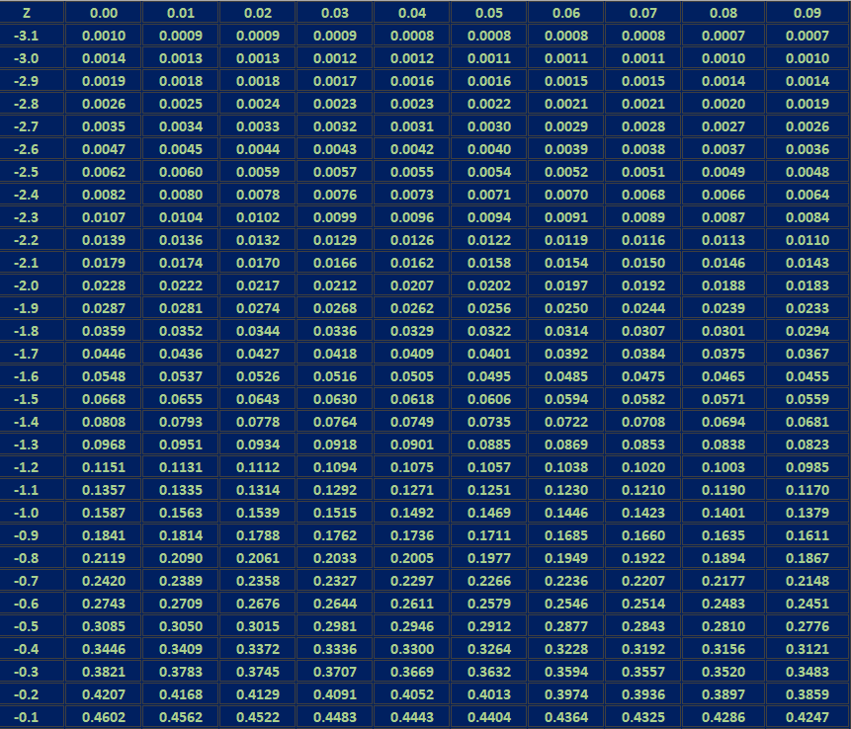
Standard Normal Distribution: Table values represent AREA to the LEFT of the z-score
This table shows z-values from -3.1 to -0.1

Slide 16
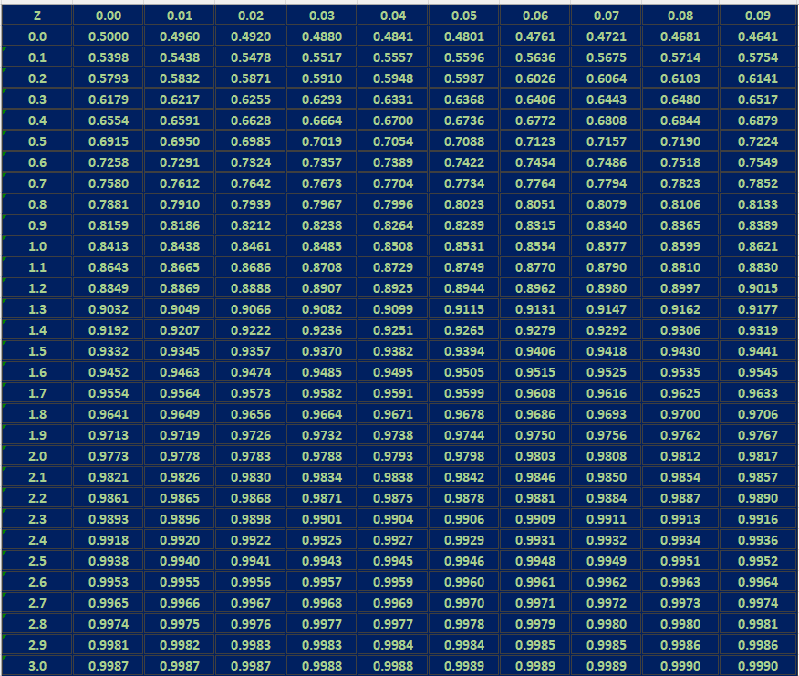
Standard Normal Distribution: Table values represent AREA to the LEFT of the z-score
This table shows z-values from 0.0 to +3.0

Slide 17
STOP

Slide 18
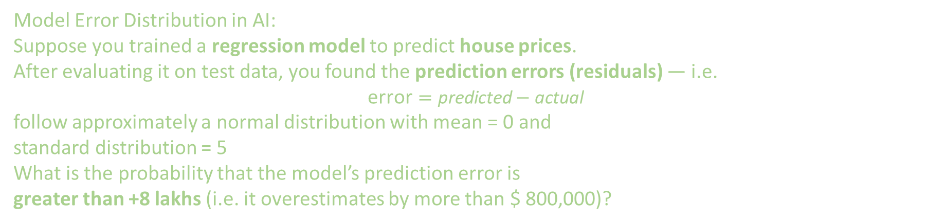
Normal Distribution: Problem
Model Error Distribution in AI:
Suppose you trained a regression model to predict house prices. After evaluating it on test data, you found the prediction errors (residuals) — i.e.
$$\text{error}=\text{predicted}−\text{actual}$$
follow approximately a normal distribution with mean = 0 and
standard distribution = 5
What is the probability that the model’s prediction error is
greater than +8 lakhs (i.e. it overestimates by more than $ 800,000)?

Slide 19
Normal Distribution Function: Uses
Category | Examples | Why It’s Normal
Human Characteristics | - Height - Weight - Blood pressure - IQ scores | These traits result from many small genetic and environmental influences.
Measurement & Experimental Data | - Instrument errors - Sensor noise - Temperature variations | Measurement noise arises from many tiny, random fluctuations.
Finance & Economics | - Daily stock returns (approximately) - Market demand fluctuations | Many independent market factors influence outcomes.
Manufacturing / Quality Control | - Length of produced parts - Material thickness | Random variation in machines and materials combine to form a bell curve.
AI / Machine Learning Context | - Model residuals (errors) in linear regression - Feature distributions after normalization - Weights initialization in neural networks (e.g. Gaussian init) | Model errors often spread symmetrically around zero; Gaussian noise is often assumed for stability and analysis.

Slide 20
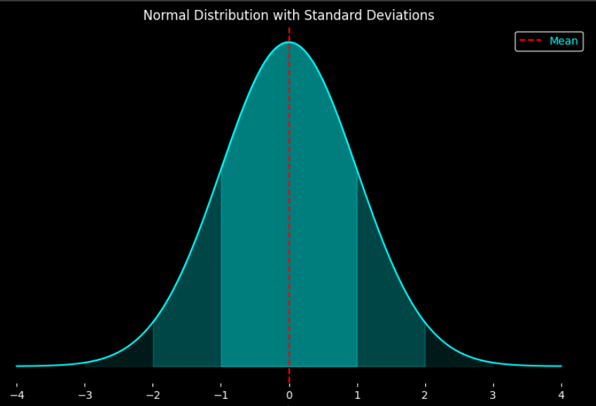
Normal Distribution Functions

Slide 21
Normal Distribution Functions

