Slide 1
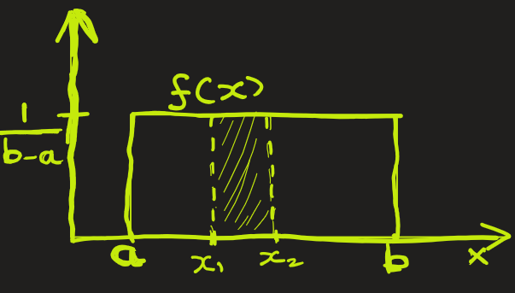
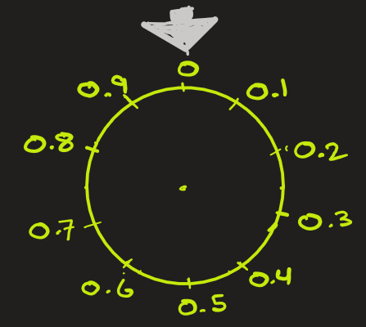

Uniform Distribution
Problem1: If you spin a fair wheel that can stop anywhere between 0 and 1 then what is the probability that it stops exactly at 0.5 ?
Problem2: You arrive at a bus stop where buses come every 10 minutes. What’s the probability that you’ll wait exactly 5 minutes for the next bus?

Slide 2
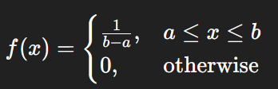

Uniform Distribution: Theory
It generally refers to continuous distribution.
Uniform Distribution is a probability distribution in which all outcomes are equally likely within a given range.
In other words, all intervals of equal length within [a, b] are equally likely.
1) The total area under curve = 1 (True for all PDF)
2) The PDF is given by,
3) The probability of x1 < X < x2 is the area between curve and x1 and x2:

Slide 3

Uniform Distribution: Theory
A common notation that is used for a random variable $X$ that follows a uniform distribution between two values $a$ and $b$, is
$X∼$U (a, b)
$X∼$ Uniform(a, b)

Slide 4
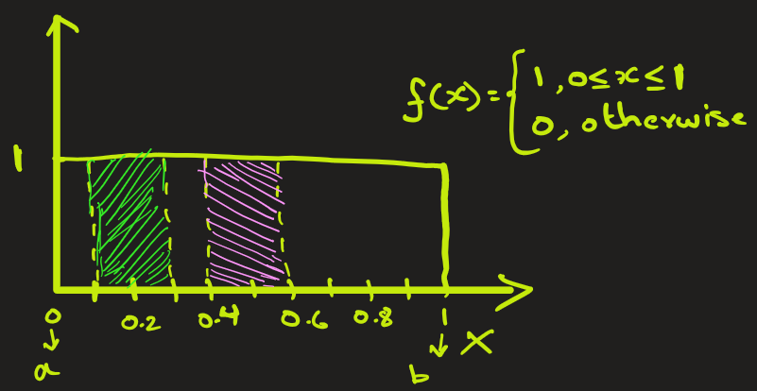
Uniform Distribution: Applications
Problem: If you spin a fair wheel that can stop anywhere between 0 and 1 with uniform
probability distribution Uniform(0, 1), then what is the probability that it stops
Between 0.1 and 0.3
Between 0.4 and 0.6
Exactly at 0.5
Ans: First we find PDF f(x). That’s derived easily using formula.
P( 0.1 < X < 0.3 )
= Area between x = 0.1 and 0.3 under the PDF curve
= (0.3 – 0.1) x (1)
= 0.20 = 20 %
b) P( 0.4 < X < 0.6 )
= Area between x = 0.4 and 0.6 under the PDF curve
= (0.6 – 0.4) x (1)
= 0.20 = 20 % (same as above)
c) P( X = 0.5 )
= Area between x = 0.5 and 0.5 under the PDF curve
= (0.5 – 0.5) x (1) = 0

Slide 5
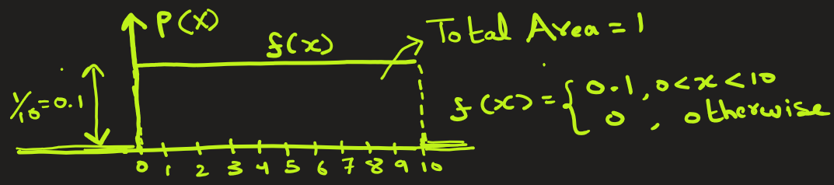
Uniform Distribution: Applications
Problem: Imagine a bus that runs every 10 minutes, and you arrive randomly at the bus stop. Your waiting time X follows a Uniform(0, 10) distribution, i.e. you could wait anywhere between 0 and 10 minutes with equal probability. After arriving at bus stop, what is the probability that you wait
Less than 2 minutes
More than 4 minutes
Between 7 and 9 minutes
Between 5 and 12 minutes
Between 11 and 12 minutes
Exactly 5 minutes
Ans: First we find PDF f(x).
a) P(0 < X < 2) = Area between 0 and 2 = 0.1 x 2 = 0.2
b) P(4 < X < 10) = Area between 4 and 10 = 0.1 x 6 = 0.6
c) P(7 < X < 9) = Area between 7 and 9 = 0.1 x 2 = 0.2
d) P(5 < X < 12) = Area between 5 and 12 = 0.1 x 5 = 0.5
c) P(11 < X < 12) = Area between 11 and 12 = 0 x 1 = 0
d) P(X = 5 ) = Area between 5 and 5 = 0.1 x 0 = 0

Slide 6
EXTRA

Slide 7

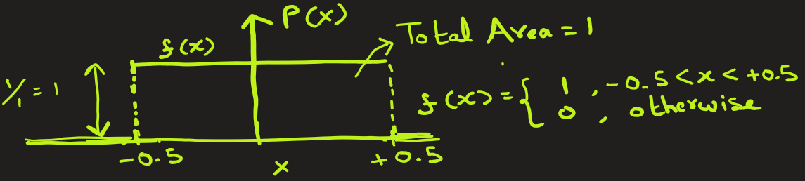
Uniform Distribution: Applications
Problem: A voltage sensor reads values with random noise, X, that can vary between –0.5 V and +0.5 V. There is no bias — every noise value within this range is equally likely.
What is the probability that a reading has noise
That is below -0.25 V
That is above + 0.3 V
That is between –0.2 V and + 0.2 V
That is exactly 0.4 V
Ans: First we find PDF f(x).
Since every noise value within the range
is equally likely, so the noise is uniformly
distributed.
P( -0.5 < X < -0.25) = Area between -0.50 and -0.25 = 1 x 0.25 = 0.25
b) P(0.3 < X < 0.5) = Area between 0.3 and 0.5 = 1 x 0.20 = 0.20
c) P(-0.2 < X < +0.2) = Area between -0.2 and +0.2 = 1 x 0.40 = 0.40
d) P(X = 0.4 ) = Area between 0.4 and 0.4 = 1 x 0 = 0

Slide 8
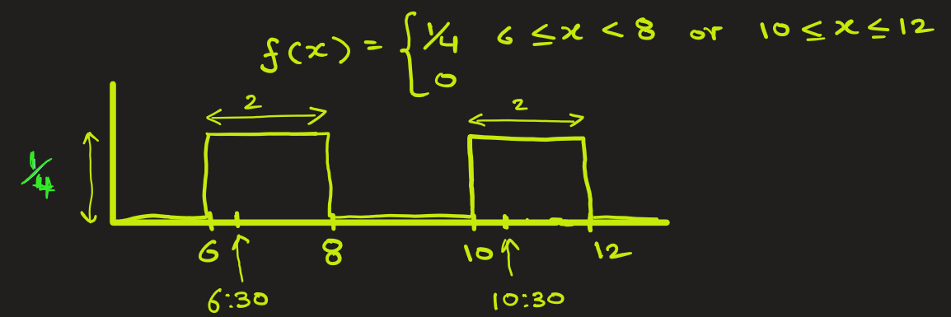
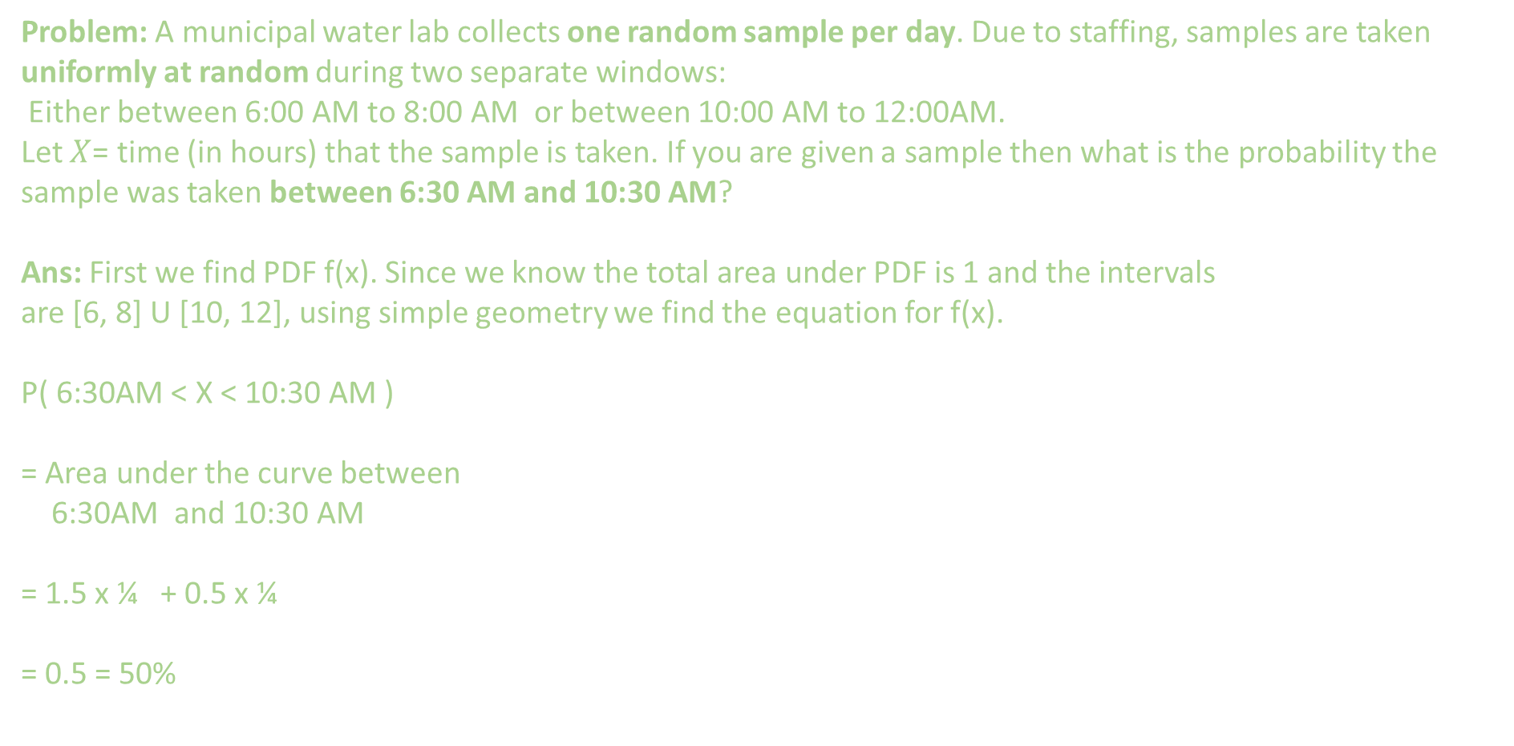
Uniform Distribution: Applications
Problem: A municipal water lab collects one random sample per day. Due to staffing, samples are taken uniformly at random during two separate windows:
Either between 6:00 AM to 8:00 AM or between 10:00 AM to 12:00AM.
Let $X$= time (in hours) that the sample is taken. If you are given a sample then what is the probability the sample was taken between 6:30 AM and 10:30 AM?
Ans: First we find PDF f(x). Since we know the total area under PDF is 1 and the intervals
are [6, 8] U [10, 12], using simple geometry we find the equation for f(x).
P( 6:30AM < X < 10:30 AM )
= Area under the curve between
6:30AM and 10:30 AM
= 1.5 x ¼ + 0.5 x ¼
= 0.5 = 50%

Slide 9
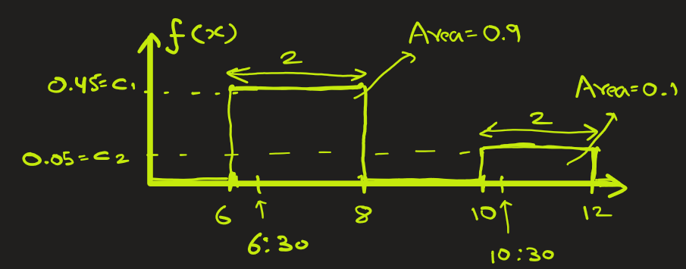
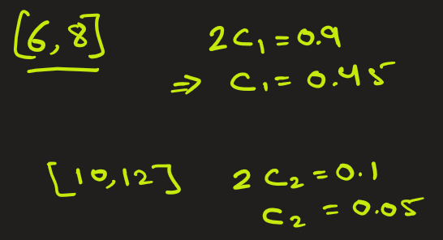
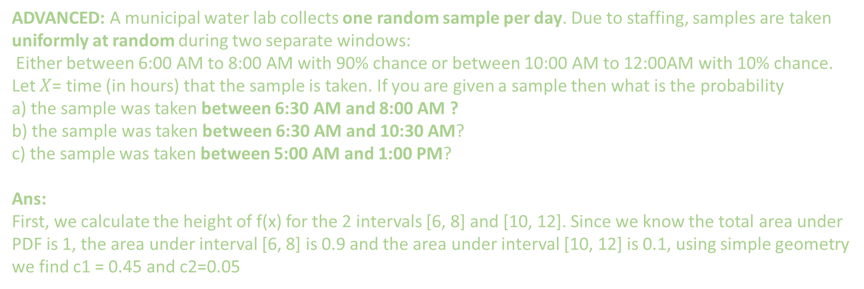
Uniform Distribution: Applications
ADVANCED: A municipal water lab collects one random sample per day. Due to staffing, samples are taken uniformly at random during two separate windows:
Either between 6:00 AM to 8:00 AM with 90% chance or between 10:00 AM to 12:00AM with 10% chance.
Let $X$= time (in hours) that the sample is taken. If you are given a sample then what is the probability
a) the sample was taken between 6:30 AM and 8:00 AM ?
b) the sample was taken between 6:30 AM and 10:30 AM?
c) the sample was taken between 5:00 AM and 1:00 PM?
Ans:
First, we calculate the height of f(x) for the 2 intervals [6, 8] and [10, 12]. Since we know the total area under PDF is 1, the area under interval [6, 8] is 0.9 and the area under interval [10, 12] is 0.1, using simple geometry we find c1 = 0.45 and c2=0.05

Slide 10
Uniform Distribution: Applications
Continued…..
P( 6:30AM < X < 8:00 AM )
= Area under the curve between 6:30 AM and 8:00 AM
= 1.5 x 0.45
= 0.675 = 67.5 %
b) P( 6:30AM < X < 10:30 AM )
= Area under the curve between 6:30 and 8:00 AM
+ Area under the curve between 10:00 and 10:30 AM
= 1.5 x 0.45 + 0.5 x 0.05
= 0.7 = 70%
c) P(5:00 AM < X < 1:00 PM )
= Area under the curve between 5:00 AM and 1:00 PM
= (2 x 0.45) + (2 x 0.05)
= 1.00 = 100 %

Slide 11
Use case:
Uniform Distribution
Simulation and Random Sampling
Many random number generators produce numbers using a Uniform(0,1) distribution.
Used as a base to generate other distributions (like normal, exponential, etc.).
Modeling Equal-Likelihood Scenarios
When every value within a range is equally possible. Example:
Randomly picking a number between 1 and 10.
A bus that can arrive anytime within a 10-minute window.
Monte Carlo Methods
Uniformly distributed random numbers are used in simulations and numerical integrations.
Quality Control
If a machine produces items uniformly within tolerance limits, the thickness or weight may be modeled by a uniform distribution.

