Slide 1

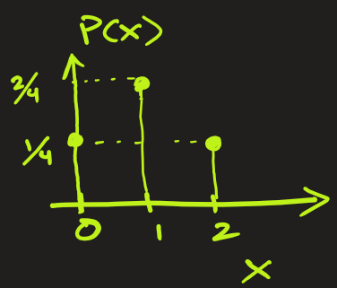
2 Types of Probability Distribution Functions: Discrete and Continuous
1. Discrete Probability Distribution
Example2: Let’s take an experiment of tossing a coin twice and the random variable X being the number of heads.
What is the PDF of X ?
Ans: The sample space is {HH, HT, TH, TT}. So, X = { 0, 1, 2}. We see that
P(X=0) = 1 / 4 , i.e. probability of no heads
P(X=1) = 2 / 4 , i.e. probability of 1 head
P(X=2) = 1 / 4 , i.e. probability of 2 heads

