Slide 1
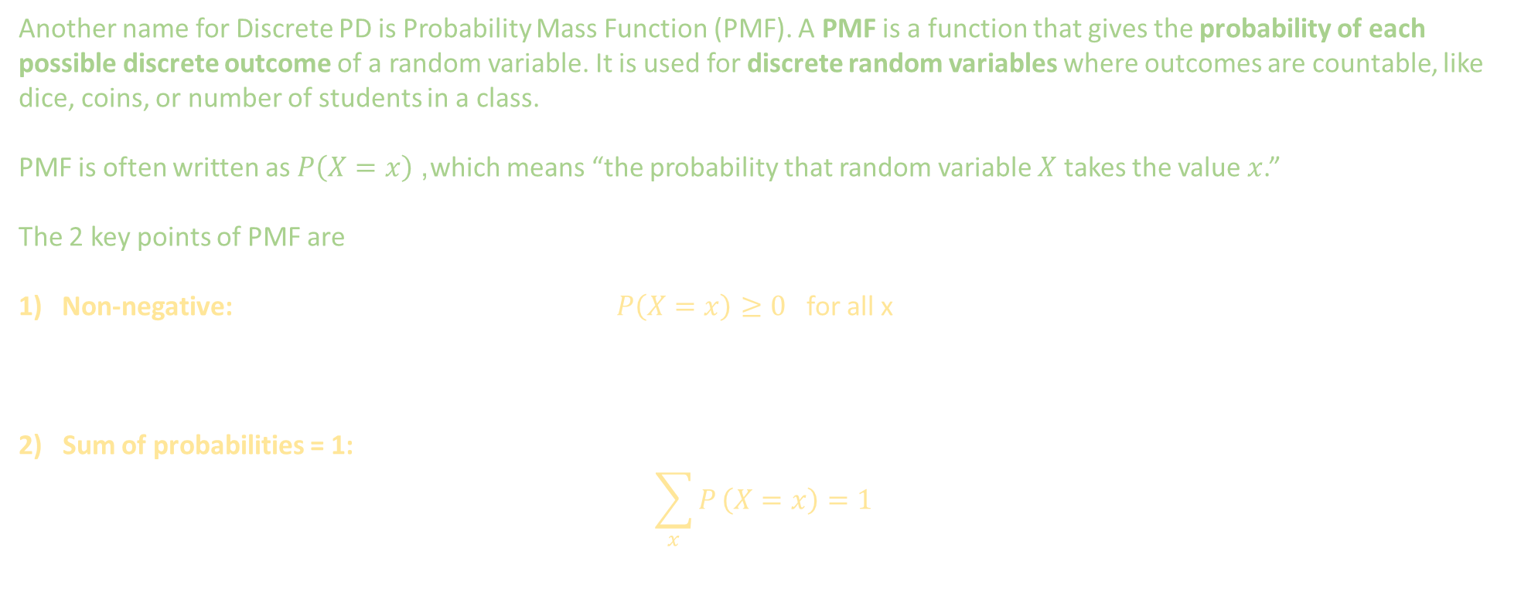
2 Types of Probability Distribution Functions: Discrete and Continuous
1. Discrete Probability Distribution
Another name for Discrete PD is Probability Mass Function (PMF). A PMF is a function that gives the probability of each possible discrete outcome of a random variable. It is used for discrete random variables where outcomes are countable, like dice, coins, or number of students in a class.
PMF is often written as $P\left(X=x\right)$, which means “the probability that random variable $X$ takes the value $x$.”
The 2 key points of PMF are
Non-negative: $P\left(X=x\right)≥0$ for all x
2) Sum of probabilities = 1:
$$\sum_{x}{P}\left(X=x\right)=1$$

Slide 2
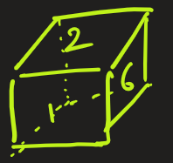

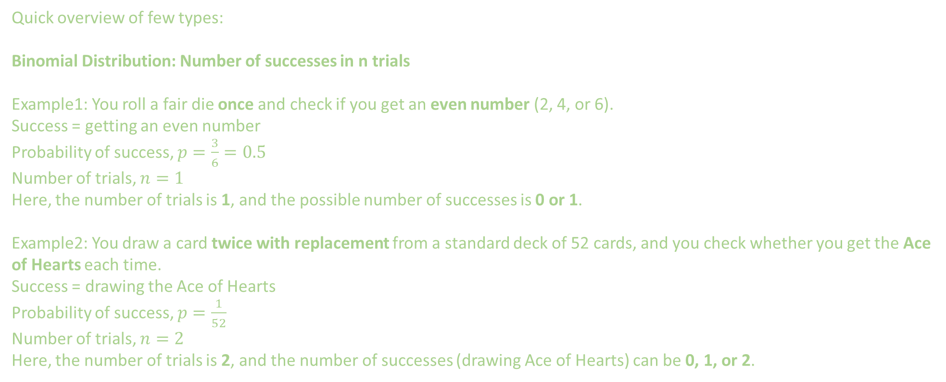
2 Types of Probability Distribution Functions: Discrete and Continuous
1. Discrete Probability Distribution
Quick overview of few types:
Binomial Distribution: Number of successes in n trials
Example1: You roll a fair die once and check if you get an even number (2, 4, or 6).
Success = getting an even number
Probability of success, $p=\frac{3}{6}=0.5$
Number of trials, $n=1$
Here, the number of trials is 1, and the possible number of successes is 0 or 1.
Example2: You draw a card twice with replacement from a standard deck of 52 cards, and you check whether you get the Ace of Hearts each time.
Success = drawing the Ace of Hearts
Probability of success, $p=\frac{1}{52}$
Number of trials, $n=2$
Here, the number of trials is 2, and the number of successes (drawing Ace of Hearts) can be 0, 1, or 2.

Slide 3



2 Types of Probability Distribution Functions: Discrete and Continuous
1. Discrete Probability Distribution
Quick overview of few types:
Uniform Discrete Distribution: All outcomes are equally likely.
Example: Choosing a student from a class of 5. Probability of picking student C = 1/5

