Slide 1

Normal Distribution:
A normal distribution is a continuous probability distribution in which data is symmetrically distributed around the mean, forming a bell-shaped curve.
Most values occur near the average (mean), and fewer values appear as you move away from the center.

Slide 2
Suppose you have following data (age):
51, 55, 55, 55, 56, 56, 57, 57, 57, 57, 58, 58, 59, 59, 59, 59, 59, 60, 60, 60, 61, 61, 61, 61, 61, 61, 62, 62, 62, 62, 62, 62, 62, 62, 62, 62, 63, 63, 63, 63, 63, 63, 63, 63, 63, 63, 63, 63, 64, 64, 64, 64, 64, 64, 65, 65, 65, 65, 65, 65, 65, 65, 66, 66, 66, 66, 66, 66, 66, 66, 66, 66, 66, 66, 66, 67, 67, 67, 68, 68, 68, 68, 69, 69, 69, 69, 69, 69, 69, 70, 70, 70, 71, 72, 72, 72, 72, 72, 72, 74

Slide 3
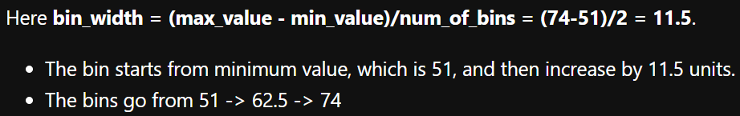
Suppose we create 2 bins of equal size. We would get following:
So the
bin1 : 51 - 62.5
bin2 : 62.5 - 74
We would get following counts for these 2 bins: 36 and 64
51, 55, 55, 55, 56, 56, 57, 57, 57, 57, 58, 58, 59, 59, 59, 59, 59, 60, 60, 60, 61, 61, 61, 61, 61, 61, 62, 62, 62, 62, 62, 62, 62, 62, 62, 62, 63, 63, 63, 63, 63, 63, 63, 63, 63, 63, 63, 63, 64, 64, 64, 64, 64, 64, 65, 65, 65, 65, 65, 65, 65, 65, 66, 66, 66, 66, 66, 66, 66, 66, 66, 66, 66, 66, 66, 67, 67, 67, 68, 68, 68, 68, 69, 69, 69, 69, 69, 69, 69, 70, 70, 70, 71, 72, 72, 72, 72, 72, 72, 74

Slide 4
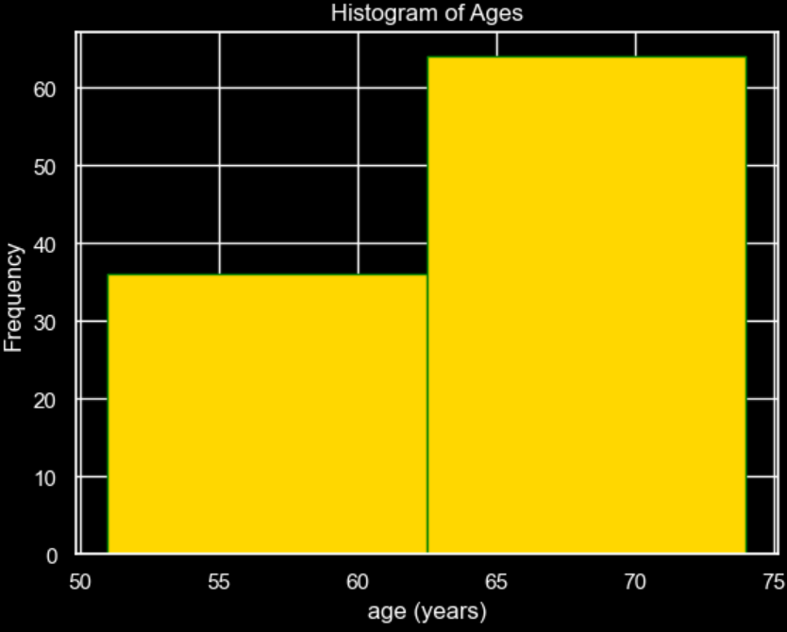
If we create histogram of these 2 bins:
bin1 : 51 - 62.5
bin2 : 62.5 - 74
with counts 36 and 64 we would get ->
51, 55, 55, 55, 56, 56, 57, 57, 57, 57, 58, 58, 59, 59, 59, 59, 59, 60, 60, 60, 61, 61, 61, 61, 61, 61, 62, 62, 62, 62, 62, 62, 62, 62, 62, 62, 63, 63, 63, 63, 63, 63, 63, 63, 63, 63, 63, 63, 64, 64, 64, 64, 64, 64, 65, 65, 65, 65, 65, 65, 65, 65, 66, 66, 66, 66, 66, 66, 66, 66, 66, 66, 66, 66, 66, 67, 67, 67, 68, 68, 68, 68, 69, 69, 69, 69, 69, 69, 69, 70, 70, 70, 71, 72, 72, 72, 72, 72, 72, 74

Slide 5
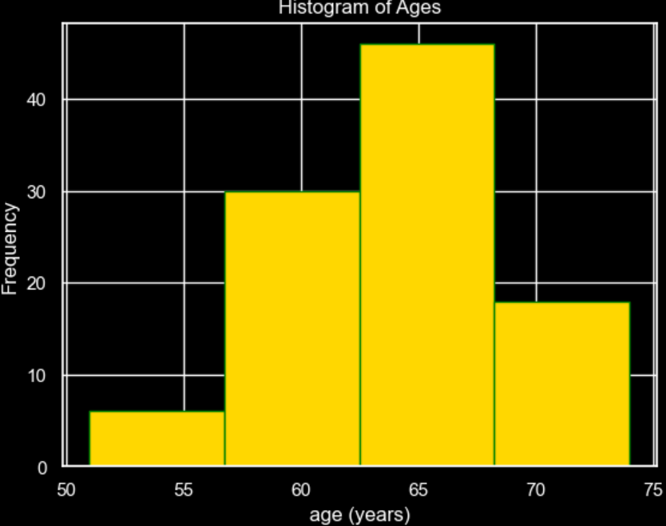
Let’s increase the bin count to 4:
So, the bin width = (74-51)/4 = 5.75
bin1 : 51 - 56.75
bin2 : 56.75 - 62.5
bin3 : 62.5 - 68.25
bin4 : 68.25 - 74
We would get following counts for the 4 bins: 6, 30, 46, and 18
51, 55, 55, 55, 56, 56, 57, 57, 57, 57, 58, 58, 59, 59, 59, 59, 59, 60, 60, 60, 61, 61, 61, 61, 61, 61, 62, 62, 62, 62, 62, 62, 62, 62, 62, 62, 63, 63, 63, 63, 63, 63, 63, 63, 63, 63, 63, 63, 64, 64, 64, 64, 64, 64, 65, 65, 65, 65, 65, 65, 65, 65, 66, 66, 66, 66, 66, 66, 66, 66, 66, 66, 66, 66, 66, 67, 67, 67, 68, 68, 68, 68, 69, 69, 69, 69, 69, 69, 69, 70, 70, 70, 71, 72, 72, 72, 72, 72, 72, 74

Slide 6
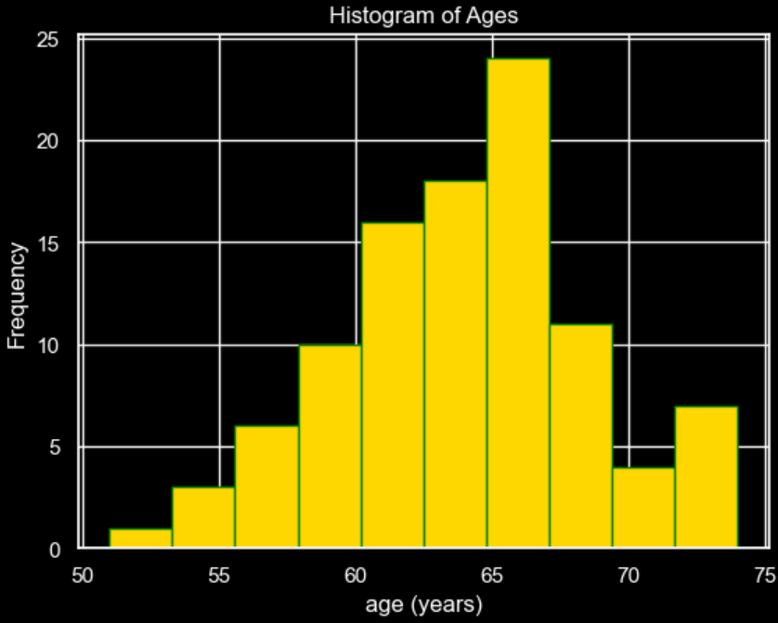
Let’s increase the bin count to 10:
So, the bin width = (74-51)/10 = 2.3
bin1 : 51 - 53.3
bin2 : 53.3 - 55.6
….
bin10: 71.7 - 74
We would get following counts for the 10 bins: 1, 3, 6, 10, 16, 18, 24, 11, 4, 7
51, 55, 55, 55, 56, 56, 57, 57, 57, 57, 58, 58, 59, 59, 59, 59, 59, 60, 60, 60, 61, 61, 61, 61, 61, 61, 62, 62, 62, 62, 62, 62, 62, 62, 62, 62, 63, 63, 63, 63, 63, 63, 63, 63, 63, 63, 63, 63, 64, 64, 64, 64, 64, 64, 65, 65, 65, 65, 65, 65, 65, 65, 66, 66, 66, 66, 66, 66, 66, 66, 66, 66, 66, 66, 66, 67, 67, 67, 68, 68, 68, 68, 69, 69, 69, 69, 69, 69, 69, 70, 70, 70, 71, 72, 72, 72, 72, 72, 72, 74

Slide 7
As bins increases, the histogram becomes bell shaped, that is takes a shape of normal distribution.
51, 55, 55, 55, 56, 56, 57, 57, 57, 57, 58, 58, 59, 59, 59, 59, 59, 60, 60, 60, 61, 61, 61, 61, 61, 61, 62, 62, 62, 62, 62, 62, 62, 62, 62, 62, 63, 63, 63, 63, 63, 63, 63, 63, 63, 63, 63, 63, 64, 64, 64, 64, 64, 64, 65, 65, 65, 65, 65, 65, 65, 65, 66, 66, 66, 66, 66, 66, 66, 66, 66, 66, 66, 66, 66, 67, 67, 67, 68, 68, 68, 68, 69, 69, 69, 69, 69, 69, 69, 70, 70, 70, 71, 72, 72, 72, 72, 72, 72, 74

Slide 8
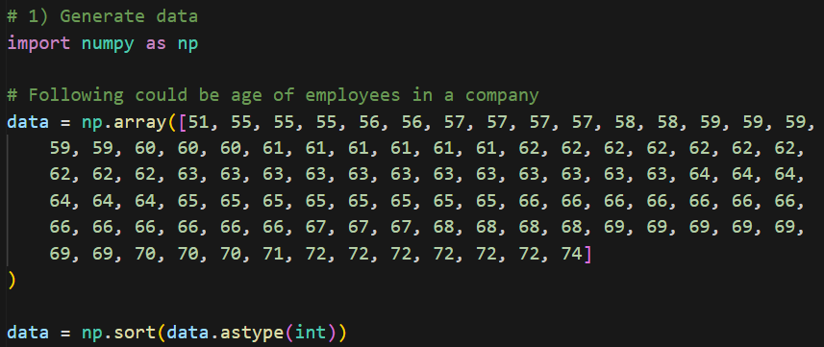
Code

Slide 9
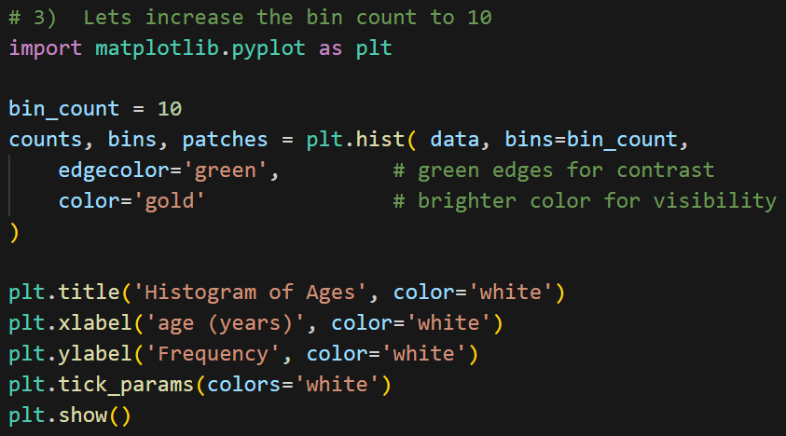
Code

Slide 10
Normal Distribution Functions

