Slide 1
How do big financial companies collect data ?

Slide 2
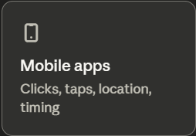
The App That Never Sleeps
Banks and fintechs collect data every time you open, tap, or scroll — even when you don't complete a transaction.
What gets logged:
Time and location of every app open
Which screens you visit and for how long
Abandoned actions (e.g. you started a transfer, then stopped)
Device type, IP address, battery level

Slide 3
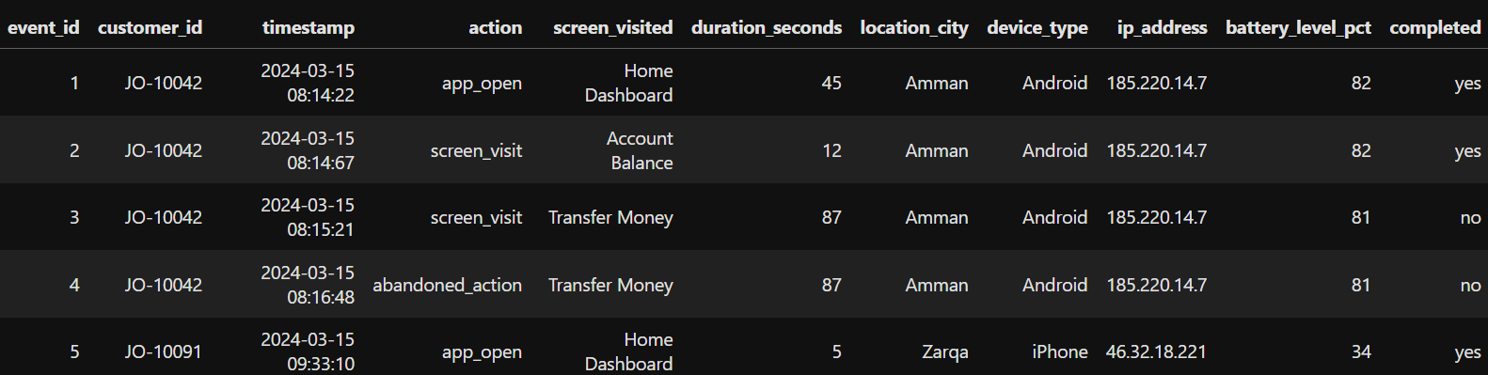
Stories hidden in the data:
Customer JO-10042 started a money transfer and abandoned it — the bank now knows they intended to send money but stopped.
Why? - Financial hesitation? Wrong account details?
This gets flagged for a follow-up push notification.

Slide 4
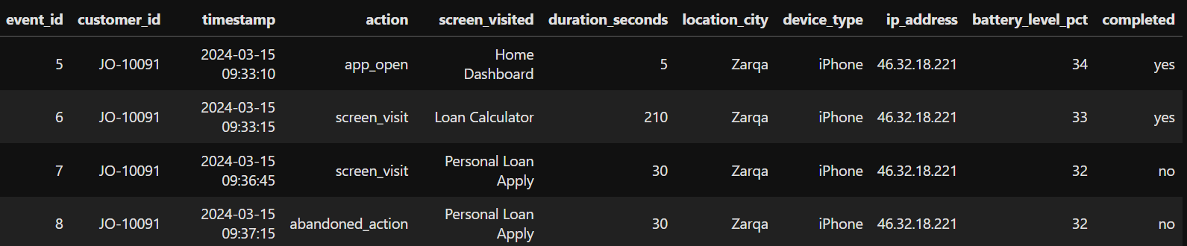
Stories hidden in the data:
2. Customer JO-10091 spent 3.5 minutes on the loan calculator in Zarqa, then opened the application form and abandoned it.
To the bank's model, this person wants a loan but something stopped them.
High-value re-targeting opportunity.

Slide 5
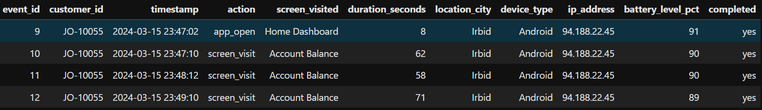
Stories hidden in the data:
3. Customer JO-10055 checked their balance three times in two minutes at midnight in Irbid.
Classic financial stress signal — the bank's model scores this customer as higher risk for the next 30 days.

Slide 6
The real value is behavioral patterns over time.
Check your balance 10x a day → financially stressed signal
Open the app at 2am → unusual behavior flag
Always use the app from the same location → your "home" is profiled
Example:
Jordan Islamic Bank's app logs which features users browse most. Users who repeatedly check the investments section get targeted with sukuk product offers.

Slide 7
The Hidden Sensor
Your phone adds a layer the bank didn't even build itself.
GPS tells the bank where you bank
Accelerometer data can reveal if you're walking, driving, or stationary
Screen recording (with permission) captures how long you stare at a loan offer
Example:
Zain Cash tracks whether payments happen in Amman, Zarqa, or Irbid — location shapes what products you're offered next.

Slide 8
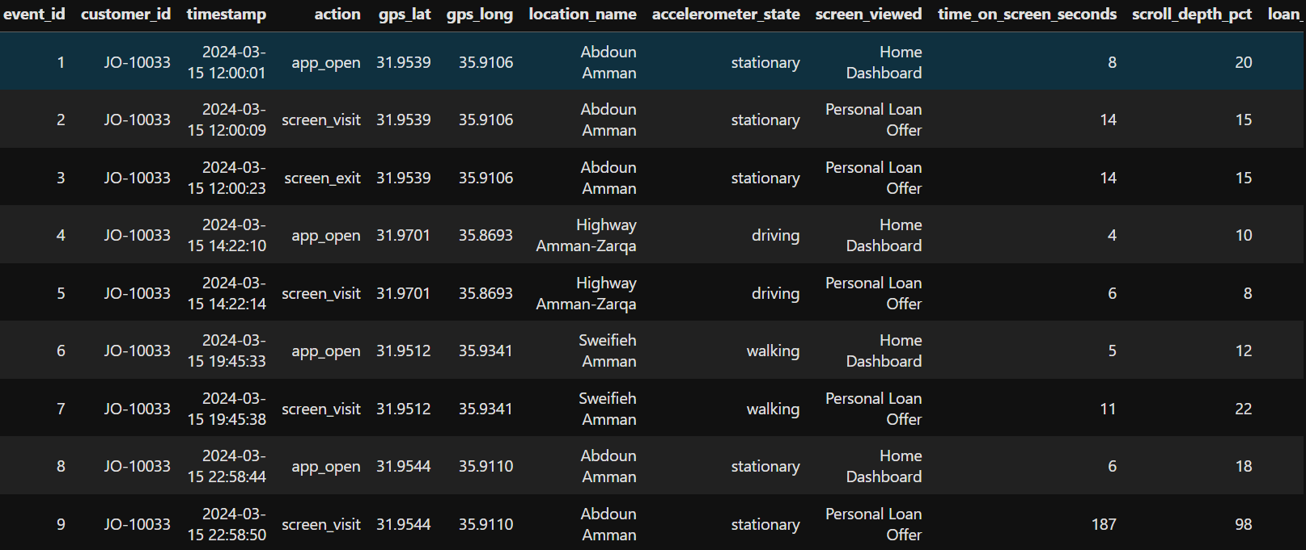
Story from Hidden Sensor: Customer JO-10033 saw the same loan offer four times in one day.
Glanced at it for 14 seconds in the morning, 6 seconds while driving on the Amman-Zarqa highway, 11 seconds while walking in Sweifieh — then at 11pm, sitting stationary at home in Abdoun, stared at it for 187 seconds, scrolled through 98% of it, and came back to it.
The bank's model now knows: this person is seriously considering this loan. The best moment to send a push notification is late evening, when they are home, stationary, and have time to think. The accelerometer made that insight possible.

Slide 9
Question for Discussion?
A bank notices that
a customer opens their app every night between 11pm–1am and
checks their balance repeatedly,
They also abandoned three loan applications halfway.
Should the bank use this behavior to deny them a loan?

Slide 10
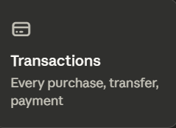
Every Payment Tells a Story
A transaction is not just money moving. It's a data point with 20+ attributes attached.
Every payment logs:
Amount, currency, time, date
Merchant name and category (food, pharmacy, travel...)
Location of the merchant
Payment method (card, CliQ, cash deposit)
Device used to authorize it

Slide 11
Your Spending = Your Life
Over months, transactions reveal things you never consciously shared.
Regular pharmacy spend → possible chronic illness
Wedding vendors in a short window → getting married
Sudden drop in spending → job loss or financial stress
Zakat payment in Ramadan → religious observance
Example: eFawateercom processes electricity, water, and telecom bills for 3M+ Jordanians. Late or missed payments are a direct signal of financial stress — banks can see this.

Slide 12
The Pattern Is Worth More Than the Transaction
One purchase means little. One thousand purchases reveal everything.
Where you shop (malls vs local markets in your neighborhood)
How you manage money (pay bills early vs always late)
What life stage you're in (baby products, school supplies, retirement funds
Example: Cairo Amman Bank can tell from transaction data alone whether a customer is likely
saving for a house,
supporting elderly parents, or
sending remittances abroad
— before the customer says a word.

Slide 13
Discussion Question
A young man in Amman has a stable salary but his transaction history shows he spends heavily at restaurants and never saves.
A microfinance company uses this to charge him a higher interest rate than his colleague with the same income.
Is that fair?
Where should companies draw the line?

Slide 14
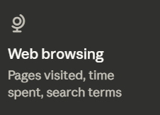
The Bank Knows Before You Ask
Web browsing data captures intent — what you're thinking about before you take any action.
What gets tracked:
Which financial comparison sites you visit
How long you spend on a mortgage or car loan page
Search terms on banking websites
Whether you visited a competitor's site yesterday

Slide 15
How Do They Actually Collect This?
Three main mechanisms — most invisible to the user.
Cookies — tiny files dropped on your browser that follow you across sites
Tracking pixels — invisible 1x1 images embedded in pages that ping a server when loaded
First-party tracking — the bank's own website logs every click, scroll depth, and time spent
Example: When you visit a Jordanian property site like OpenSooq and browse apartments, and then open your Arab Bank app the next day — Arab Bank may already know you're thinking about a mortgage. Both platforms share data through Google's ad network.

Slide 16
Discussion Question
You spend 20 minutes on a website comparing interest rates for personal loans in Jordan. You don't fill in any form. You don't log into anything.
Three days later, every bank app on your phone is showing you loan offers.
Did you consent to this?
Does it matter that you didn't?

Slide 17
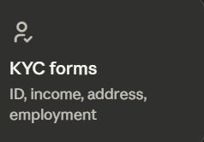
The Form You Have No Choice But to Fill
KYC stands for Know Your Customer. It is not optional.
Every bank, exchange house, and fintech in Jordan must collect it by law before opening any account.
What it includes:
Full name, national ID number, date of birth
Address and proof of residence
Employment status and employer name
Monthly income and source of funds
Purpose of the account

Slide 18
Who Gets Access to Your KYC Data?
Once submitted, it travels further than your branch.
Central Bank of Jordan — receives aggregated compliance reports
Financial Intelligence Unit (FIU) — investigates flagged accounts
Other banks — in cases of fraud investigation, data can be shared
International regulators — Jordan's correspondent banks abroad (e.g. in the US or EU) can request KYC records to comply with their own laws
Example: If a Jordanian sends a wire transfer to a US bank, that American bank can request KYC documentation from the Jordanian bank before releasing the funds — your data crosses borders

Slide 19
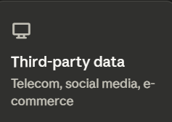
Data You Never Directly Gave the Bank
Third-party data is information collected by other companies and shared or sold to financial institutions.
The bank didn't collect it. You didn't give it to the bank. But the bank is using it.
Common sources:
Telecom companies (Zain, Orange, Umniah)
E-commerce platforms (Noon, Amazon)
Delivery apps (Carriage, Talabat)
Government registries (land, vehicle, business ownership)

Slide 20
Why Do Banks Want Outside Data?
Because their own data has gaps.
A new customer has no transaction history with the bank
A young graduate has no credit record at all
A small business owner gets paid in cash — nothing shows in the system
Third-party data fills those gaps with signals from everyday life.
Example: Microfinance companies like Ahli Microfinancing use Zain and Orange prepaid recharge frequency as a credit signal. Someone who consistently tops up their phone on time is statistically more likely to repay a loan.

Slide 21
What Gets Shared Without You Knowing
Most customers have no idea this is happening.
Your Talabat order frequency signals disposable income
Your Carriage delivery addresses reveal where you actually live vs. your registered address
Your Noon purchase categories reveal lifestyle and spending priorities
Returning a lot of items flags you as a high-maintenance or financially unstable customer in some models
Example: Buy Now Pay Later platforms operating in Jordan like Tamara and Tabby share repayment behavior with credit bureaus — one missed BNPL payment on a JD 30 purchase can affect your CRB score.

Slide 22
Discussion Question
Zain has data showing that a customer in Zarqa recharges their phone every 3 days without fail for 2 years. A bank wants to buy this data to approve them for a JD 500 loan.
The customer never agreed to their telecom data being used this way.
Should this be allowed?
Is it helpful or invasive — or both?

Slide 23
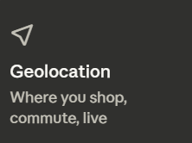
Your Phone Knows Where You Are. So Does Your Bank.
Geolocation data is collected every time your phone's GPS is active and a financial app is open — and sometimes when it isn’t.
What gets recorded:
Exact coordinates when you make a payment
Which city or neighbourhood you are in when you open your app
How often you visit the same locations
Whether your stated home address matches where you actually sleep

Slide 24
Location as a Financial Signal
Where you go reveals what kind of customer you are.
Shop in Abdoun or Sweifieh → higher income bracket assumed
Commute daily from Zarqa to Amman → working class, long hours
Frequent visits to a hospital → possible health condition
Regular stops at a specific mosque → religious profile being built
Example: Insurance companies operating in Jordan use location data from motor apps to verify whether a car registered in Aqaba is actually being driven daily in Amman — a common fraud to get cheaper premiums.

Slide 25
Location Catches Fraud in Real Time
This is where geolocation genuinely protects customers.
Your card is used in Dubai but your phone is in Amman → instant fraud flag
A transaction happens at 3am in an unfamiliar location → step-up verification triggered
Two transactions in two cities within 10 minutes → physically impossible, blocked automatically
Example: Arab Bank and Bank of Jordan both use real-time location mismatch detection. A CliQ transfer initiated from an IP address in Eastern Europe while the customer's phone GPS shows Amman triggers an immediate hold.

Slide 26
Discussion Question
A bank notices that a loan applicant in Amman claims to work in a stable office job. But their phone's location data shows they are in a different part of the city every day, never spending more than 2 hours in one place.
The bank uses this to classify them as "unstable employment" and rejects their loan.
They never consented to location tracking being used this way.
Is this a smart use of data or a serious violation of privacy?

