Slide 1
Google data collection
We tell google “things we might not tell our partners, our friends, our family…even our doctor”.
We are sharing life’s most significant and intense moments.
Source: https://www.bennettinstitute.cam.ac.uk/blog/using-google-data-policy-research/

Slide 2
Type in search bar : “Today I want to l”
and see what auto completion suggests.

Slide 3
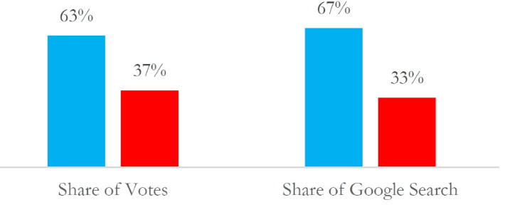
Google search data has been used to
predict the spread of the Mayaro virus,
identify seasonal patterns in domestic violence,
predict who will win.

Slide 4
Detailed breakdown of the types of data Google collects:
Usage data and preferences: This includes information about how you use Google services, such as your search terms, the websites you visit, and the content you interact with.
Location information: Google collects location data when you use services like Maps, search for local businesses, or use devices that provide location data.
Browsing history: When you browse the web using a Google-powered browser like Chrome, Google can track your browsing history, including the websites you visit and the content you interact with.

Slide 5
Detailed breakdown of the types of data Google collects:
Device and browser information: This includes information about your device type, operating system, browser version, and other technical details.
Content: Google-hosted content, such as Gmail messages, photos, videos, and documents, is also analysed by Google.
Activity on third-party sites and apps: If you're logged into your Google account and use third-party apps or websites that integrate with Google services, Google can track your activity on those platforms.
Other data: Google also collects IP addresses, crash reports, and other technical information about your use of its services.

Slide 6
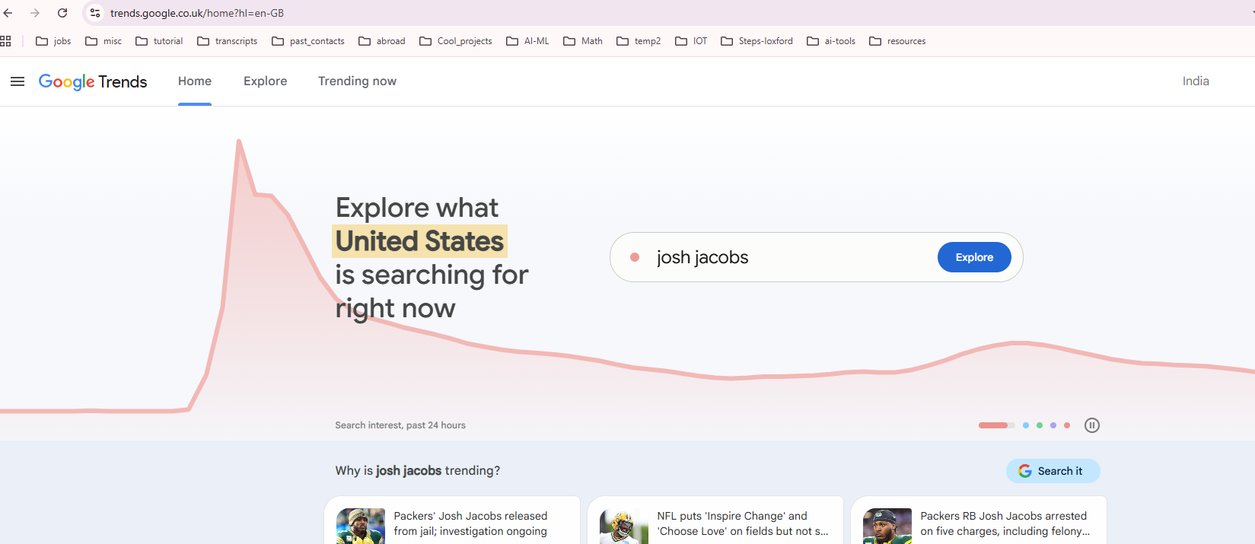
Data sites: https://trends.google.co.uk/

