Slide 1
NewsAPI.org provides a developer-friendly REST API that aggregates
live headlines and
historic articles .
It uses 150,000 global news sources and blogs.
It delivers this data in structured JSON format –
This allows users to
search,
filter, and
Integrate
multilingual news feeds directly into their applications.

Slide 2
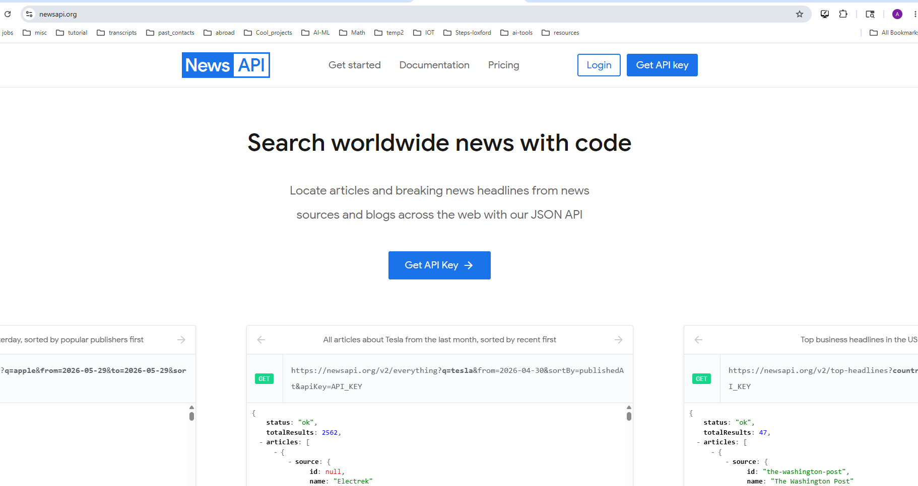



Slide 3
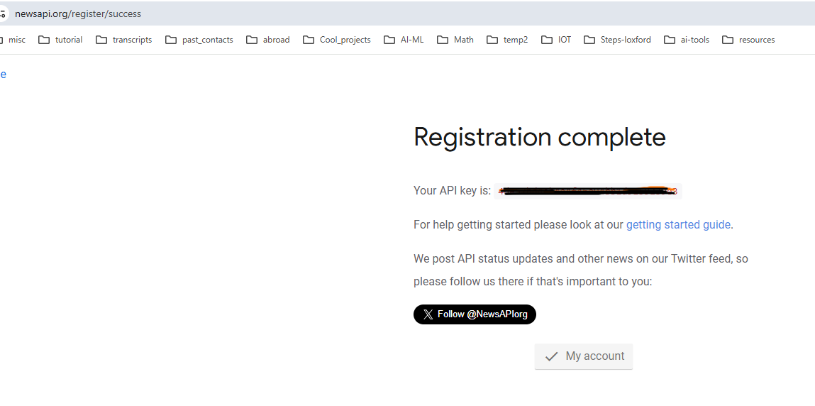
After sign in, you will get your free api key

Slide 4
3 core takeaways:
Structured Data Extraction: NewsAPI simplifies raw web scraping by returning a clean, organized JSON dictionary containing specific fields like title, source, and description.
Alternative Data in Finance: News feeds are considered "alternative data" in finance. Unlike traditional data (like stock charts or balance sheets), natural language tells us how human traders are feeling right now.
From Text to Trading Signals: Mathematical score generated by TextBlob converts qualitative sentences into quantitative data (+1.0 Up to -1.0 Down) that an automated trading algorithm can use to execute institutional buys or sells.

