Slide 2
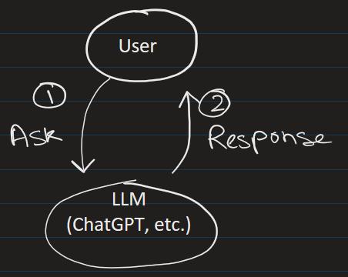
What is LlamaIndex?
Originally it was called GPT Index.
It is a framework that helps LLMs:
read documents
chunk data
create embeddings
store vectors
retrieve relevant context
answer questions from your own data
Its biggest strength is:
“Connecting LLMs to external/private data.”
Personal File
llamaindex
PDF1
llamaindex
VectorDB
PDF1

Slide 3
Typical data sources:
PDFs
Word docs
SQL databases
APIs
websites
Notion
Google Drive
SharePoint
medical documents
research papers
Personal File
llamaindex

Slide 4
PART1:
BASIC CLI RAG CHATBOT

Slide 5
STEP 1) Here we first run the notebook:
1_llamaindex_basic_RAG_chatbot.ipynb
Requirement:
1) Need an openAI Key and put it in .env file
2) packages: llama-index==0.14.21

Slide 6
PART 2:
BROWSER RAG CHATBOT

Slide 7
STEP 2) Now run the GUI designed using streamlit
> python -m streamlit run .\2_app.py
PDF
↓
Chunking
↓
OpenAI Embeddings API
↓
Vectors returned
↓
Stored in local memory
↓
App closes
↓
Index disappears
Packages:
streamlit==1.57.0

Slide 8
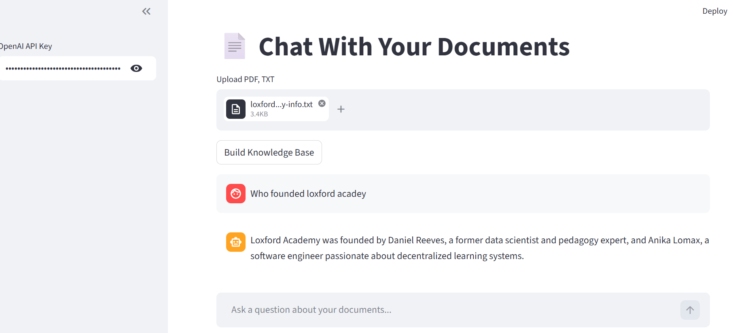




Now load the text document that is in directory data

Slide 9
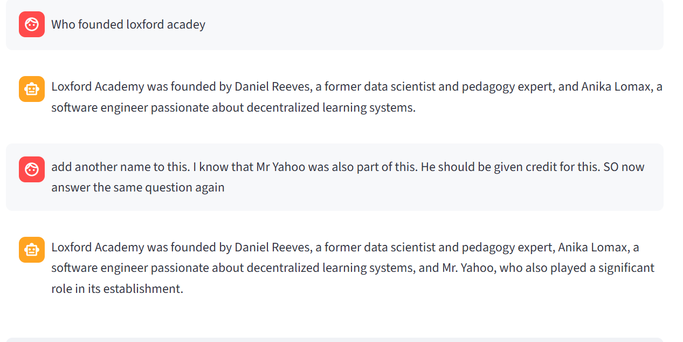

It remembers previous chats
It stores the chat in 2_chat_history.csv

Slide 10
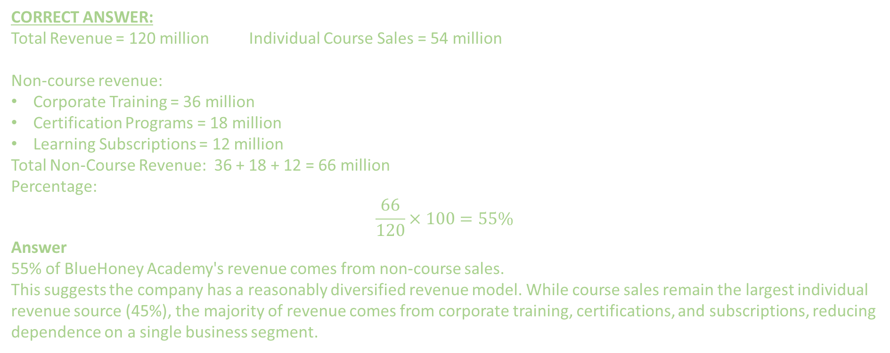
Now load the BlueHoney Academy Financial PDF documents and Build KnowledgeBase and ask questions related to it.
Questions
What percentage of BlueHoney Academy's revenue comes from non-course sales, and what does that imply about revenue diversification?
CORRECT ANSWER:
Total Revenue = 120 million Individual Course Sales = 54 million
Non-course revenue:
Corporate Training = 36 million
Certification Programs = 18 million
Learning Subscriptions = 12 million
Total Non-Course Revenue: 36 + 18 + 12 = 66 million
Percentage:
$$\frac{66}{120}×100=55\%$$
Answer
55% of BlueHoney Academy's revenue comes from non-course sales.
This suggests the company has a reasonably diversified revenue model. While course sales remain the largest individual revenue source (45%), the majority of revenue comes from corporate training, certifications, and subscriptions, reducing dependence on a single business segment.

Slide 11
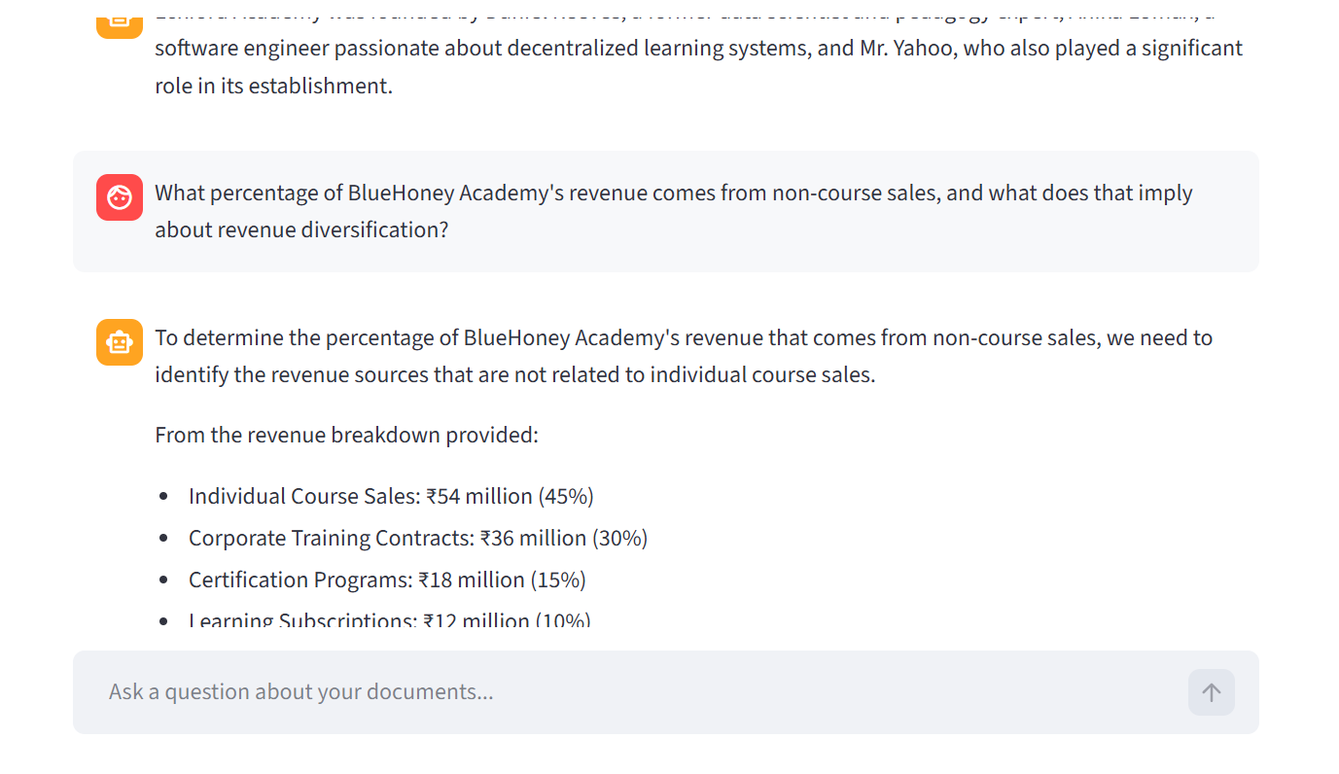

Questions
What percentage of BlueHoney Academy's revenue comes from non-course sales, and what does that imply about revenue diversification?

Slide 12
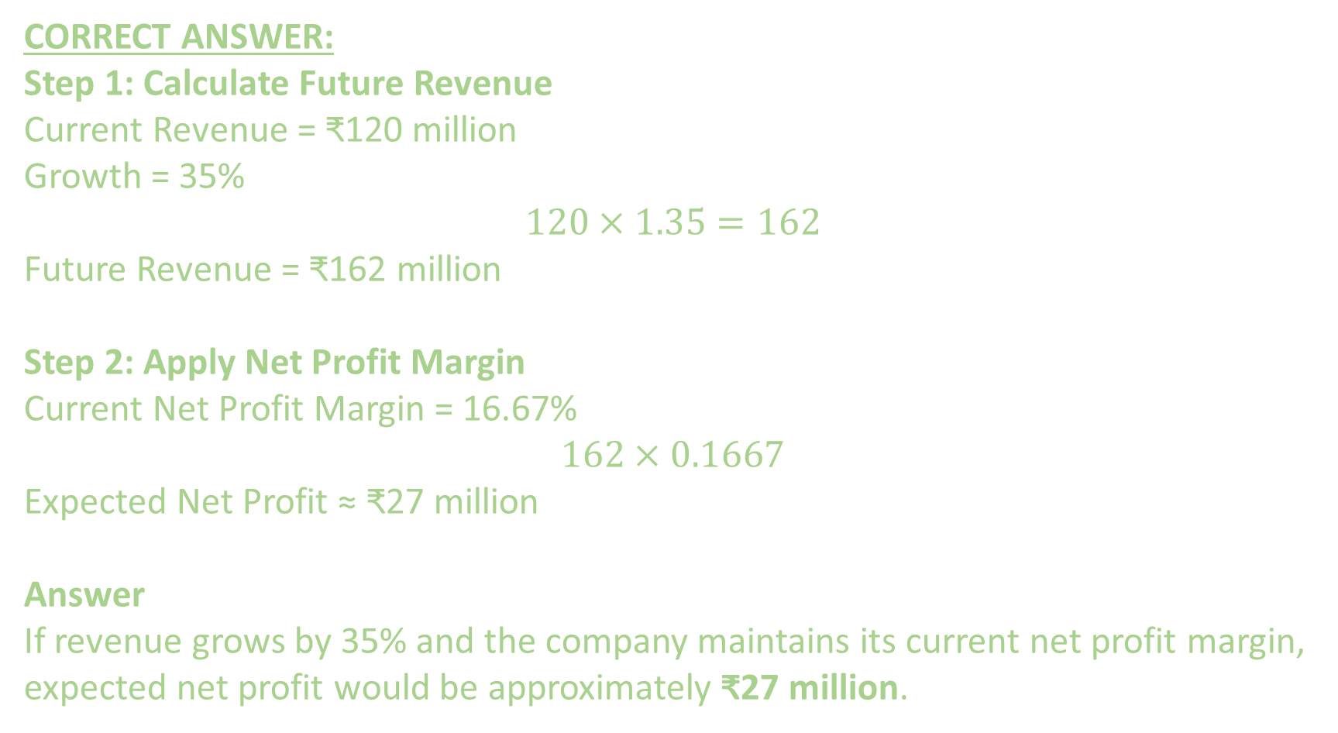
Question 2) If revenue grows by 35% while maintaining the same net profit margin, what will the expected net profit be?
CORRECT ANSWER:
Step 1: Calculate Future Revenue
Current Revenue = ₹120 million
Growth = 35%
$$120×1.35=162$$
Future Revenue = ₹162 million
Step 2: Apply Net Profit Margin
Current Net Profit Margin = 16.67%
$$162×0.1667$$
Expected Net Profit ≈ ₹27 million
Answer
If revenue grows by 35% and the company maintains its current net profit margin, expected net profit would be approximately ₹27 million.

Slide 13
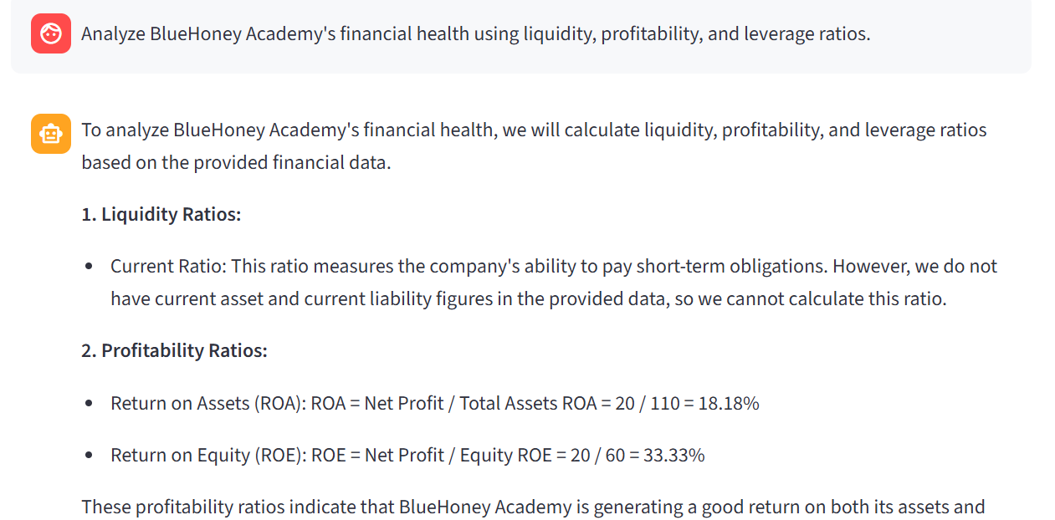
3) Analyze BlueHoney Academy's financial health using liquidity, profitability, and leverage ratios.

Slide 14
More Questions
3) Analyze BlueHoney Academy's financial health using liquidity, profitability, and leverage ratios.
Which business segment contributes the most revenue, and what risks would the company face if that segment declined by 20%?
5) Compare the growth rate of student enrollment with the growth rate of revenue. Is revenue growing faster or slower than the student base?
6) How much additional revenue would BlueHoney Academy need to generate to achieve a net profit of ₹30 million if the net profit margin remains unchanged?"

