Slide 1
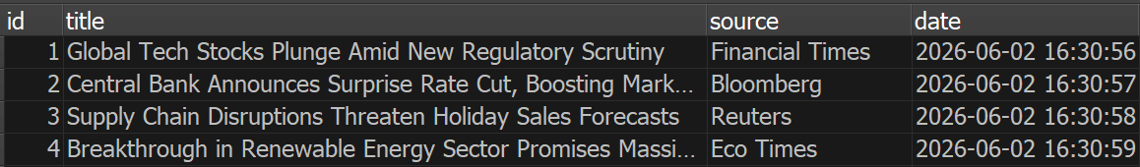
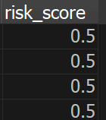
This project is a real-time News Sentiment Risk Tracker that aggregates financial headlines to evaluate portfolio risk levels.
It takes incoming articles, uses open AI to find risk scores and
then stores it within a persistent SQLite3 database
News Articles
OpenAI
(Risk Score)
Database

Slide 2
Install:
Openai, python-dotenv
To run: > python –m find_risk_score
News Articles
OpenAI
(Risk Score)
Database

