Slide 1
Advanced Prompting:
Multi-Step & Iterative Refinement

Slide 2
1. Multi-step prompting
👉 Breaking one task into smaller steps
2. Iterative refinement
👉 Improving output step-by-step using feedback

Slide 3
1. Multi-Step Prompting
❌ Weak Prompt
Write a construction report
👉 Output: Generic, low quality
✅ Multi-Step Prompt (Structured Thinking) – 1 giant prompt
Step 1: Analyze the raw construction data
Step 2: Identify key progress, issues, and resources
Step 3: Generate a structured report with sections:
Summary, Progress, Issues, Next Steps
Step 4: Ensure professional tone
You are forcing AI to:
Think in sequence
Not skip steps

Slide 4
Real Example
Input from construction:
“foundation done, structure 70%, delay due to rain”
Multi-step Prompt:
First extract key information from the input.
Then organize it into categories: progress, issues.
Finally generate a professional construction report.

Slide 5
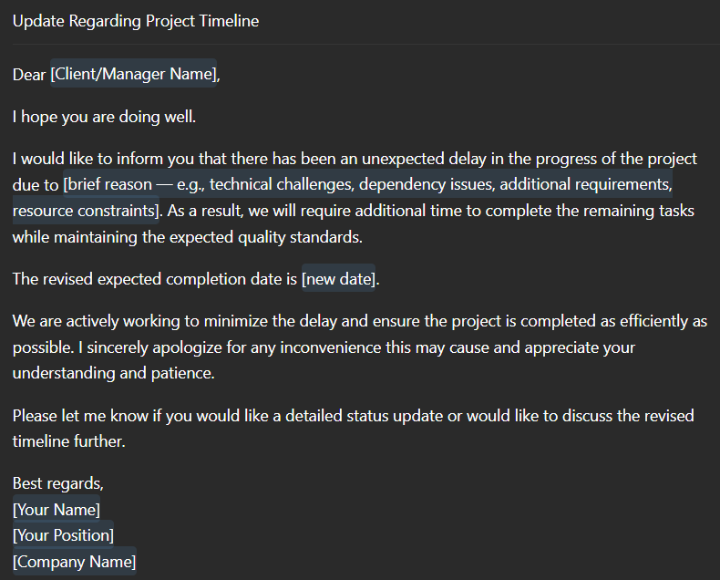
2. Iterative Refinement
Idea:
👉 First output is draft, not final
🧾 Step-by-Step Example
Step 1: Initial Prompt1
Write an email for project delay
👉 Output: Basic

Slide 6
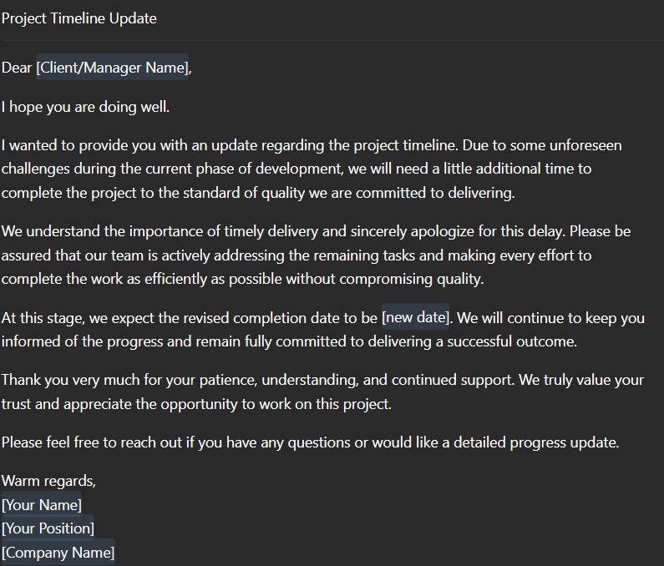
Step 2: Improve Tone – Prompt2
Make the email more polite and reassuring

Slide 7
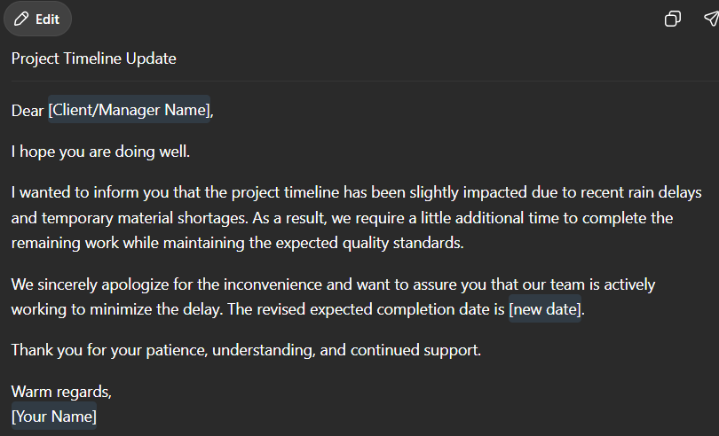
Step 3: Add Business Detail – Prompt3
Add reason: rain delay and material shortage
Keep it concise

Slide 8
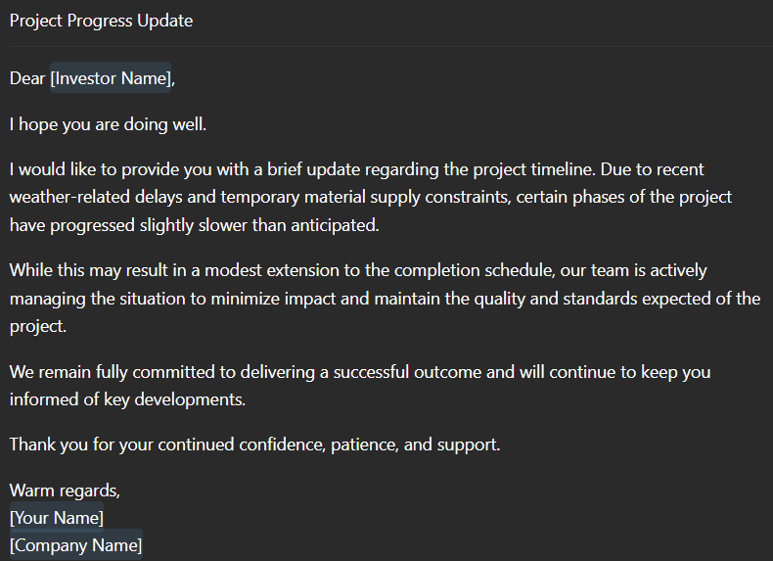
Step 4: Final Polish – Prompt4
Make it suitable for high-value investors
What’s happening?
👉 You are:
Guiding AI
Refining output
Moving toward business quality

Slide 9
3. Combined Example
Show this:
Step 1: Write an email for project delay
Step 2: Make the email more polite and reassuring
Step 3: Add reason: rain delay and material shortage
Keep it concise
Step 4: Make it suitable for high-value investors
👉 This combines BOTH techniques

